Slide 1
Conference at the APEQ meeting in Porto, September 20, 2019
Evidence-based Sea Level Changes
versus
Scaremongering violating Science and Ethics
By
Nils-Axel Mörner
Paleogeophysics & Geodynamics, Stockholm, Sweden
morner@pog.nu

Slide 2
“Give me a stable point and I will lift the Earth”,
Atlas, the Titan of strength, is supposed to have said.
In sea level research we don’t have any stable point – but we have observational records in time and space, documenting the effects of different processes involved, their amplitudes and rates.
“res tenit, verba venit”
The problem is that Sea Level Science has become vulgarized by modelists and lobbyists in recent time.

Slide 3
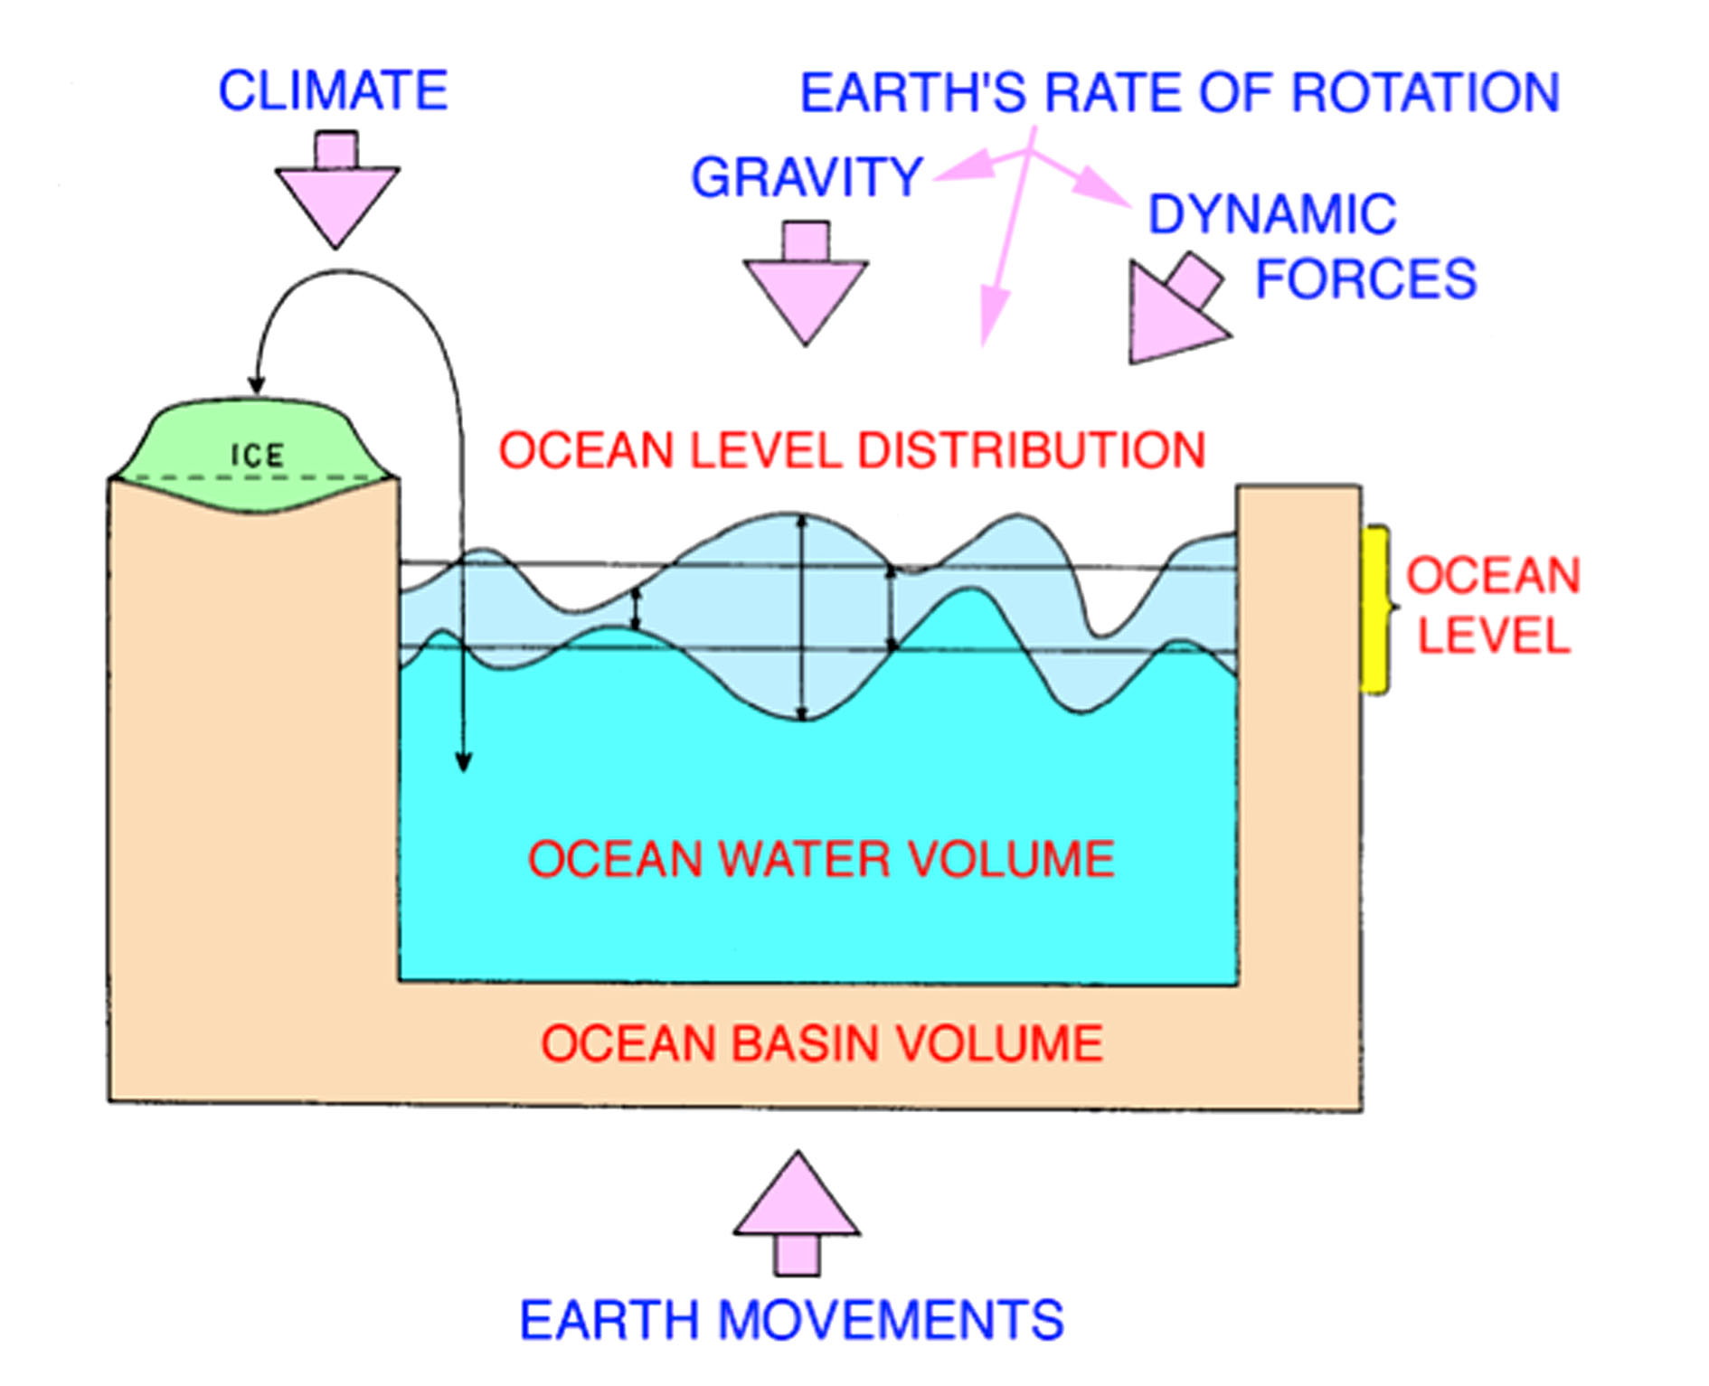

Slide 4
Many factors affect sea level but
3 main variables will affect & control
Future Sea Level
Changes in the ocean water volume (glacial eustasy)
Ultimate frame: 10 mm/year ≈ maximum postglacial rates
Thermal expansion (steric eustasy)
Ultimate frame: <5 mm/year ≈ short-term heating
At shore: always zero (±0.0 mm/yr) – no water to expand
Redistribution of water masses over the globe
important but regional to local
and compensated on a global scale

Slide 5
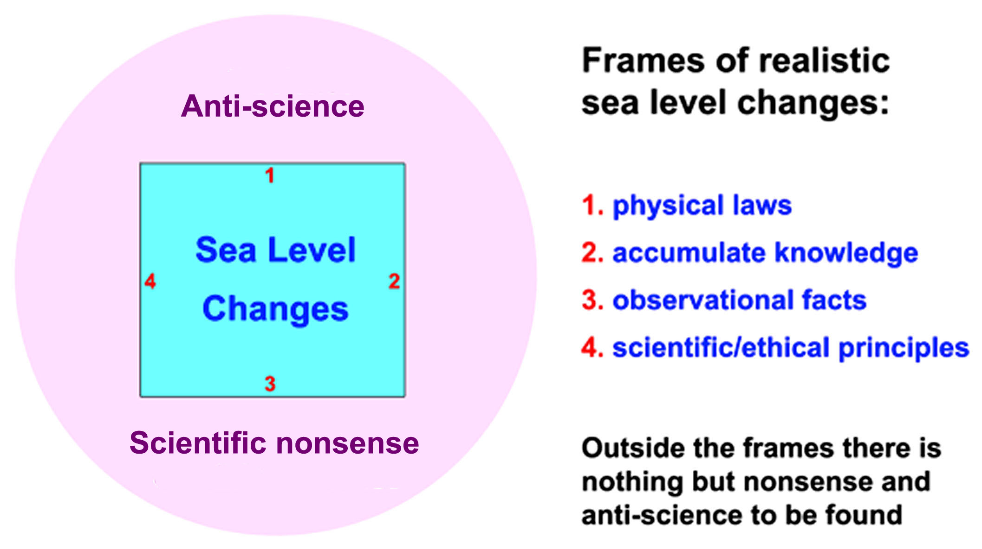

Slide 6
Part 1
Frame 1: Physical Laws

Slide 7
it takes time to melt ice: maximum rate of sea level rise 10-15 mm/yr
principle of Archimedes and global isostatic loading
gravity and ocean geoid relief of 180 m with respect to Earth’s centre
ocean basin volume changes: a slow process < 0.06 mm/yr
no thermal expansion at shore

Slide 8
1a - ice melting – takes time
The obelisks of ice on the Nobel Banquet 2017 lasted for at least 6 hours

Slide 9
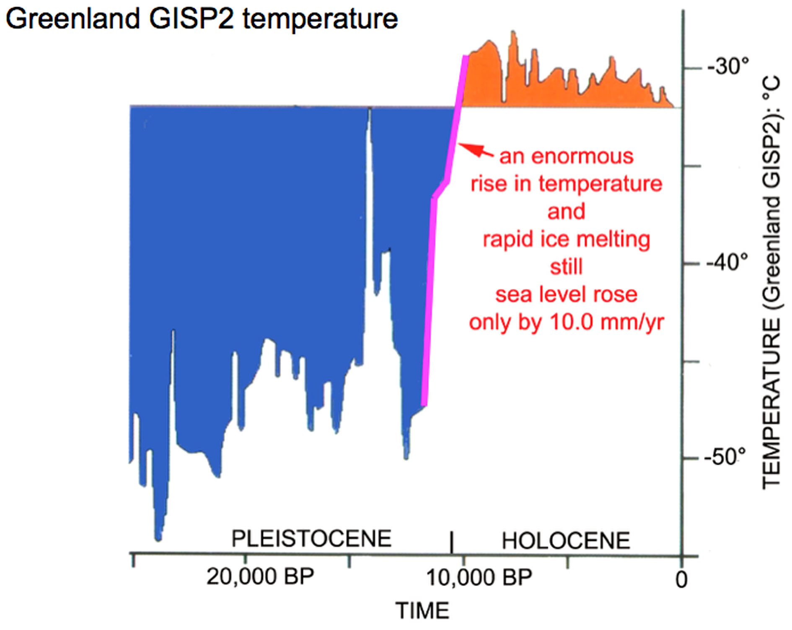

Slide 10
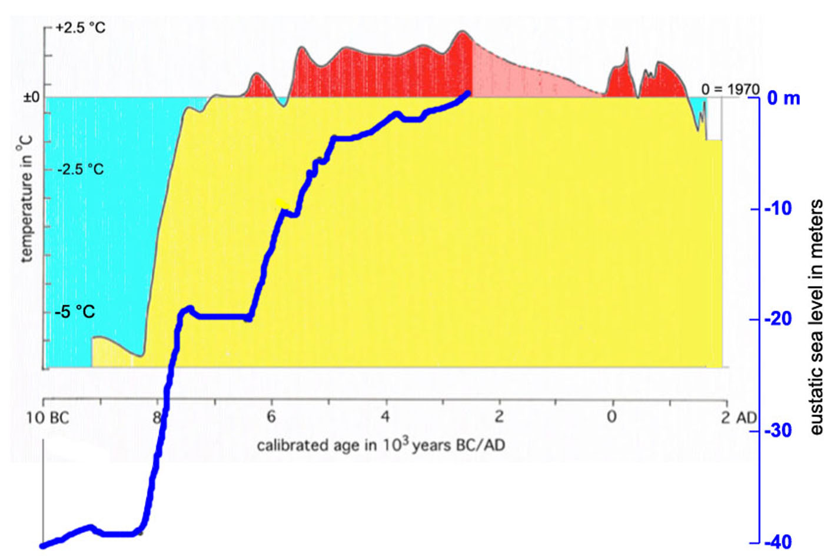
1. By 9000 years ago, temperature was at about the same level as today, 2. but global mean sea level was at -20 m 3. and it took up to about 4600 BP, before sea level reached present level 4. implying a delayed melting by about 4000-5000 years

Slide 11
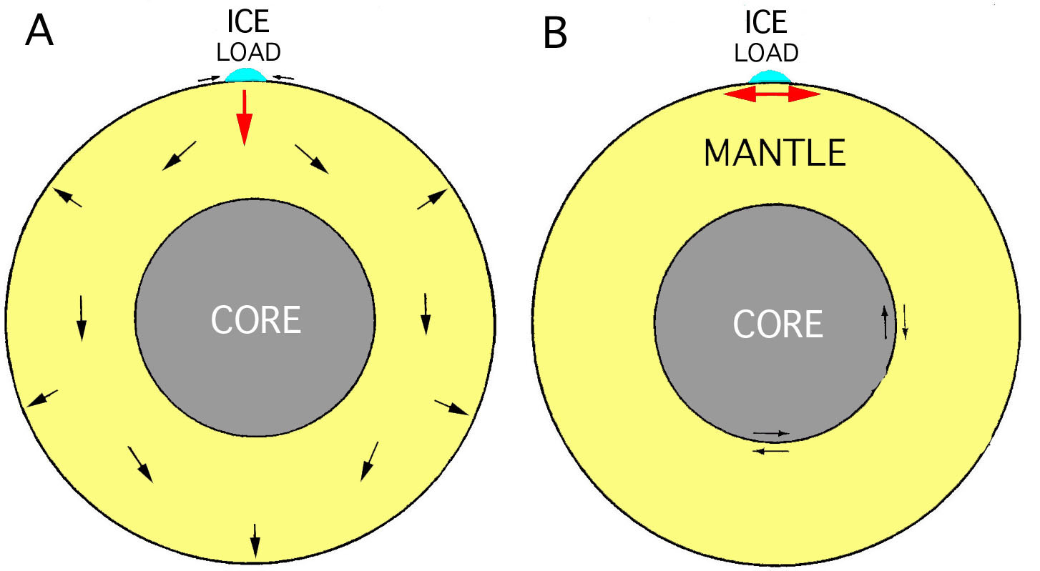
1b – the principle of Archimedes
Glacial isostasy is adjusted regionally (B), not globally (A) nor super-regionally (Scandinavia–Mediterranean)

Slide 12
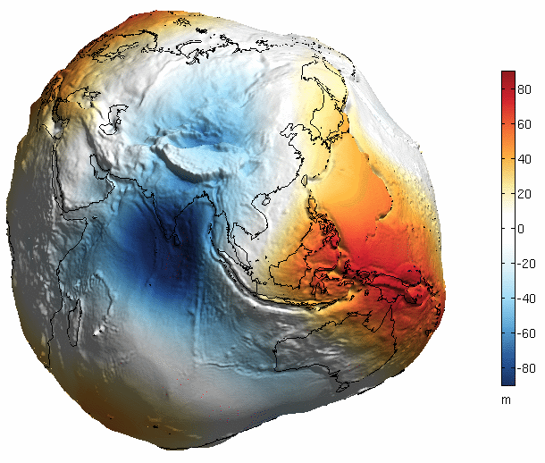
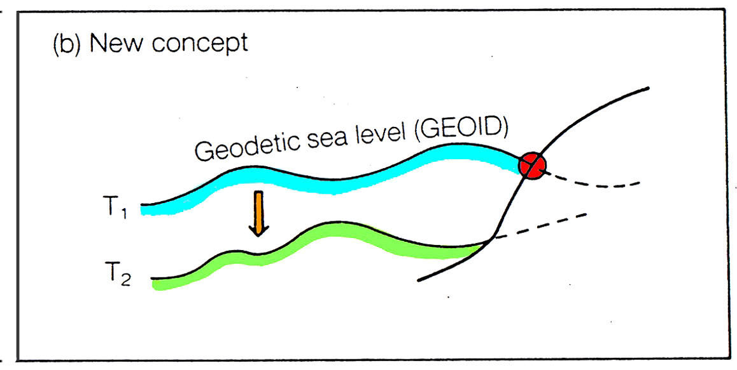
1c – Gravity
x
-104 m
x
-104 m
+86 m
x
+86 m
x
The sea level is irregular due to gravity
with 180 m between New Guinea and the Maldives
It is also wrinkled due to dynamic factors
with up to 2 m relief
Sea level does not change equally over the globe;
water masses are also dislocated horizontally

Slide 13
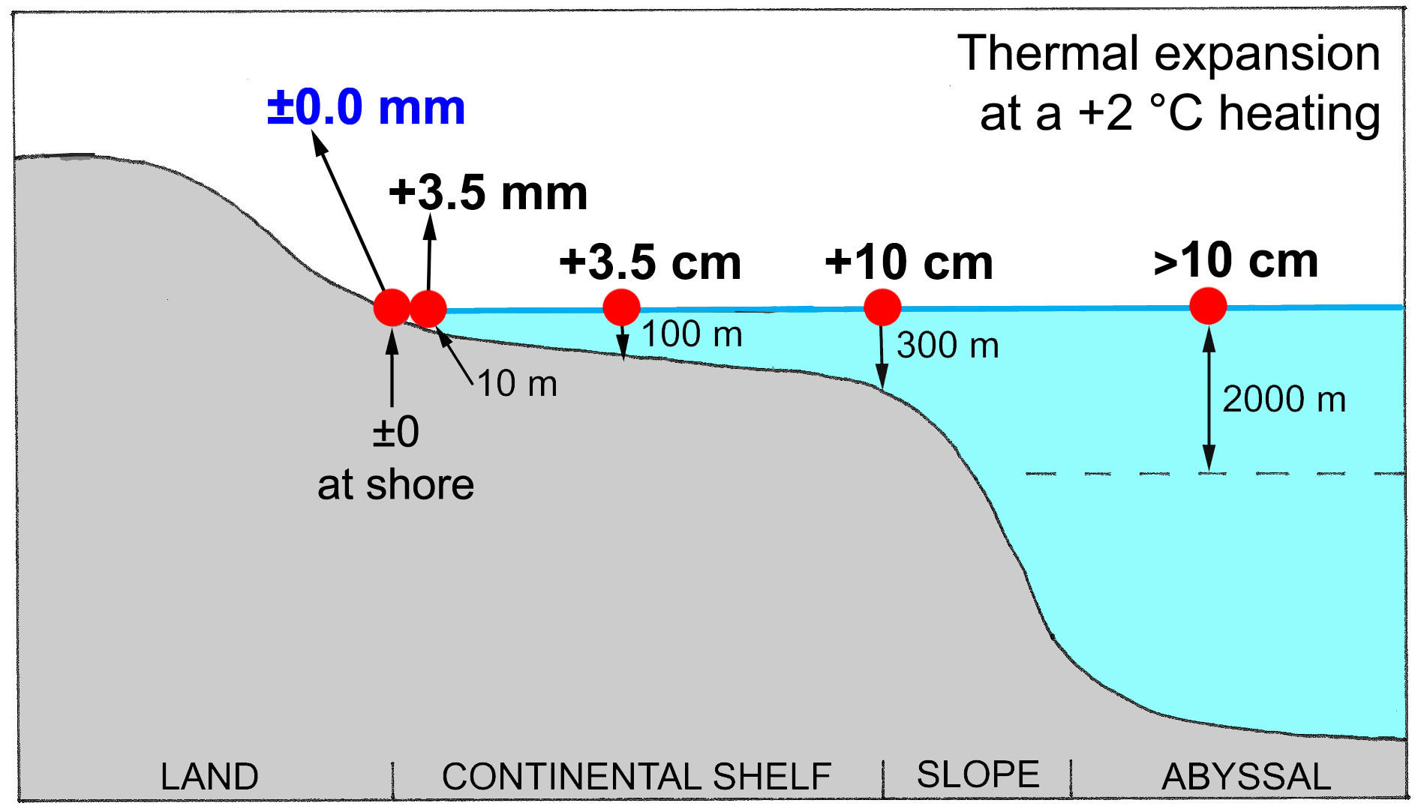
1d – thermal expansion
Thermal expansion is always zero at the shore

Slide 14
Part 2
Frame 2: Accumulated knowledge

Slide 15
Sea level changes with time
Pacific sea floor subsidence
Ice Age low
Several Ice Ages
Post-LGM rise with oscillations
Smooth Holocene rise
Moderate oscillation amplitudes
Irregular changes over the globe
Global isostatic adjustment
Ocean circulation beat
Planetary beat on Sun and Earth
Rotational eustasy
Ovidius around ±0 BC/AD
Darwin 1842, Dana 1849, Suess 1888
McLaren 1841
Schackleton, Kukla, etc.
Fairbridge, 1961
Schepard 1963, IGCP-61
Mörner 1969, Tooley 1974
Mörner 1976, IGCP-200
Clark, Peltier, Lambeck, etc.
Mörner 1984, 1988
Mörner 2010, 2015
Mörner 2019

Slide 16
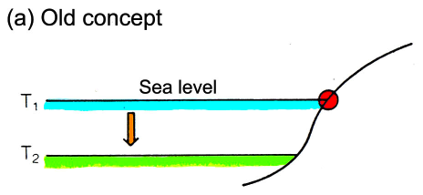
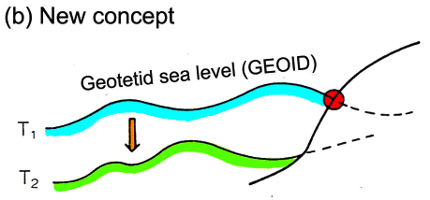
Sea level changes with time
Pacific sea floor subsidence
Ice Age low
Several Ice Ages
Post-LGM rise with oscillations
Smooth Holocene rise
Moderate oscillation amplitudes
–––––––––––––––––––––––––––––––––––––––––––––––––––––––––––––
Irregular changes over the globe
Global isostatic adjustment
Ocean circulation beat
Planetary beat on Sun and Earth
Rotational eustasy

Slide 17
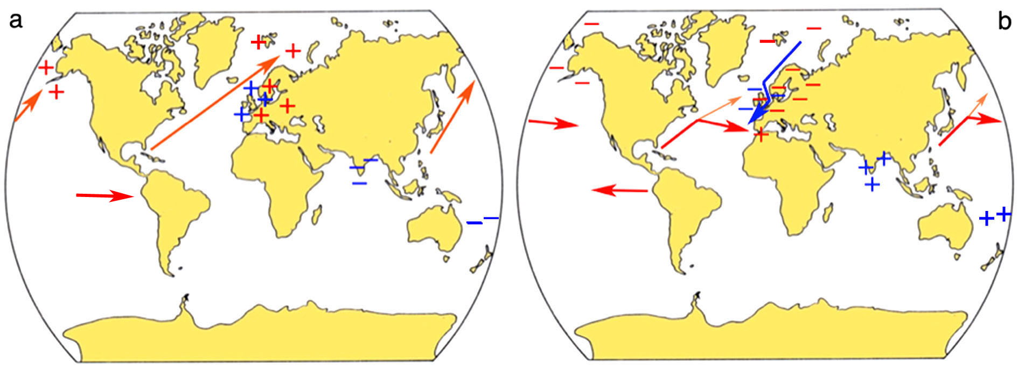
2a – Rotational eustasy
Grand Solar Maxima - rotation slows down - warm phase and higher sea level in the north but low sea level in the equatorial region
Grand Solar Minima - rotation speeds up - cold phase and lower sea level in the north but high sea level in the equatorial region

Slide 18
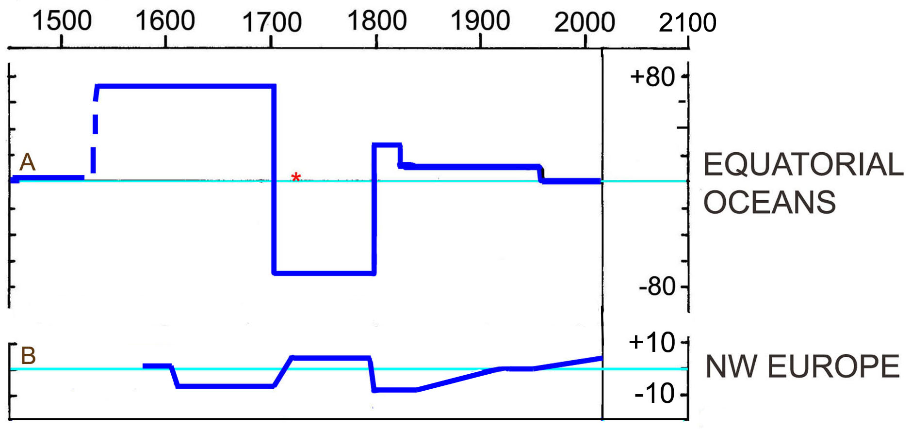
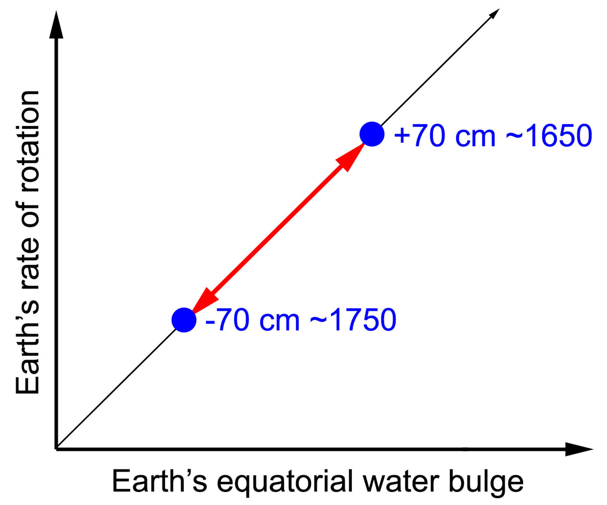
2a2 – Rotational eustasy
International Journal of Geoscience, 10, 745-757, 709-723 (2019)

Slide 19
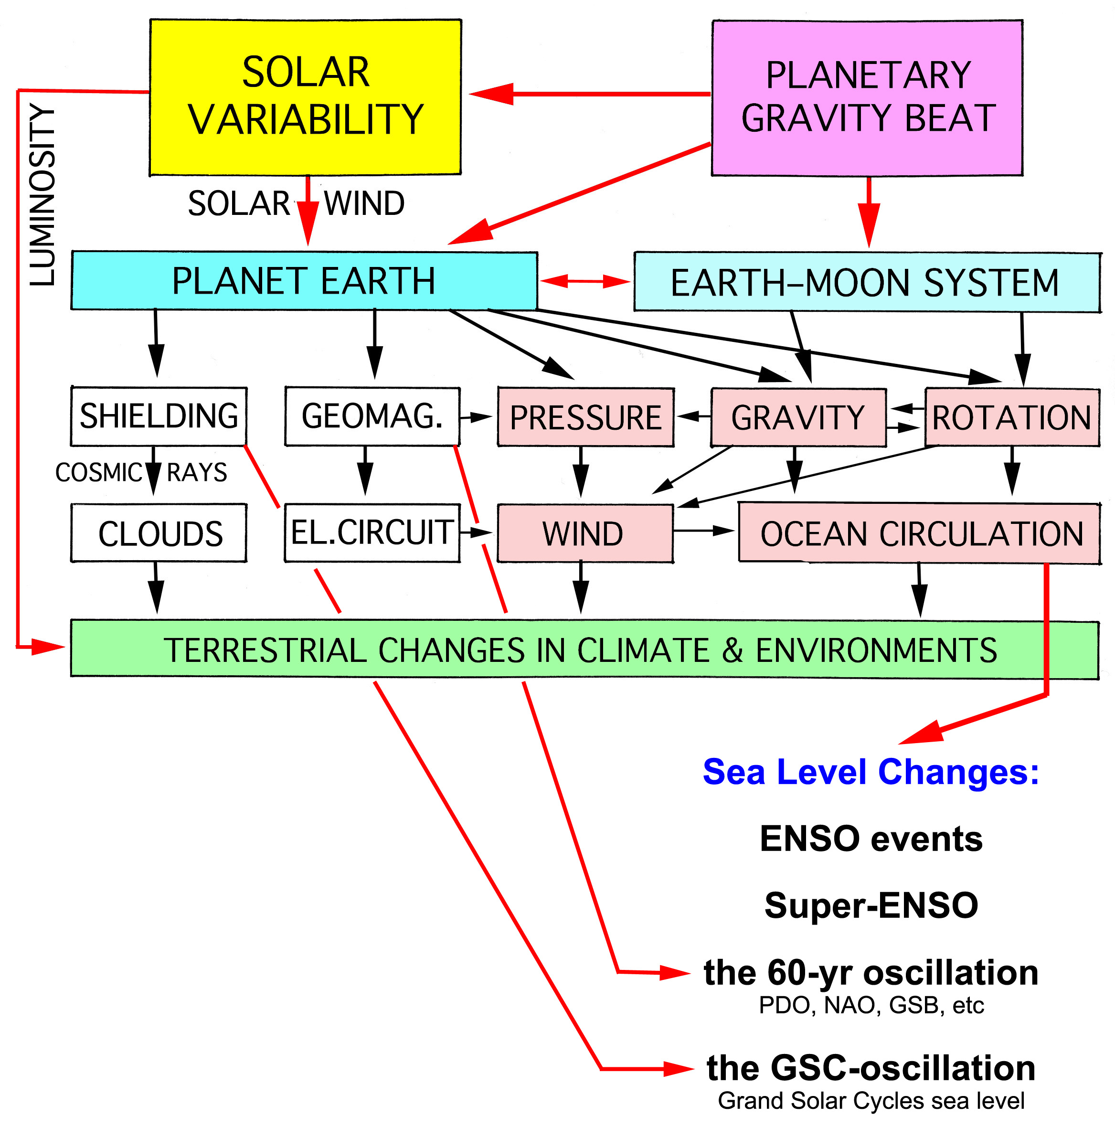

Slide 20
Part 3
Frame 3: Observational Facts

Slide 21
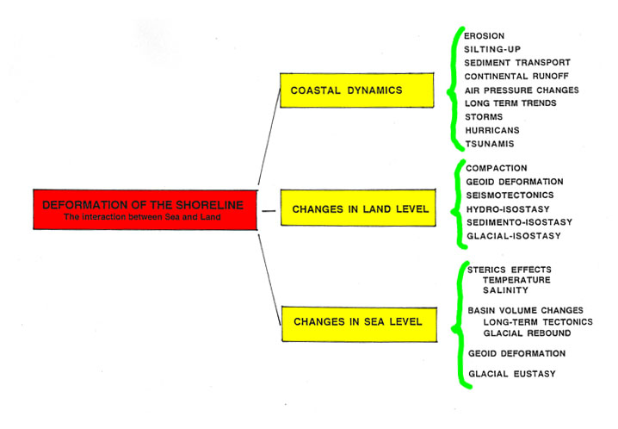
Numerous interacting factors control the stability of the shoreline

Slide 22
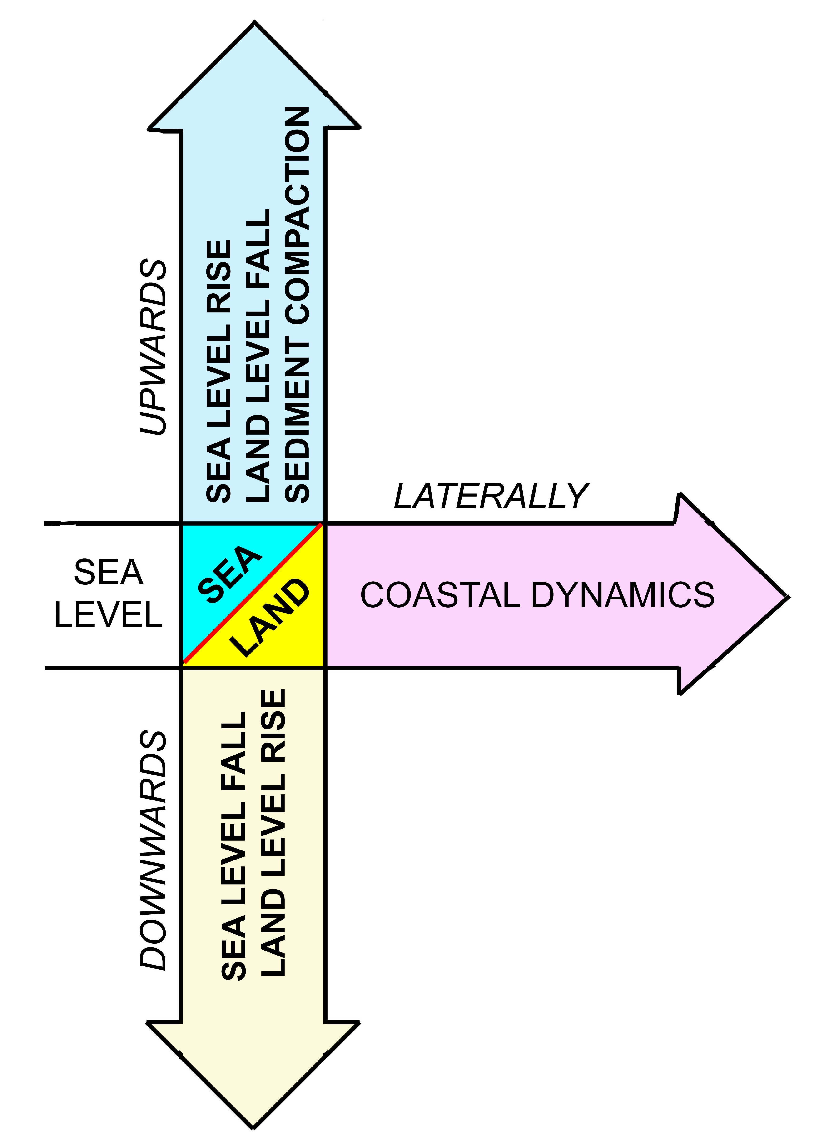
Relative Sea Level rises
Relative Sea level stable
but shore displaced laterally
Relative Sea Level falls
from Mörner, 2017, in: Encyclopedia of Coastal Science

Slide 23
Human observations
Water marks
Tide gauges
Satellite altimetry
Gravity
Shore morphology & stratigraphy

Slide 24
3a – Human observations
I have myself seen
what was once was solid ground
disappear into the sea
And I have heard of
land risen out of the sea
Ovidius 2000 years ago

Slide 25
3a – Human observations 2
Old paintings
can sometimes be very useful
In pinpointing former sea levels
Photographs of the same shore
at different times
often offer excellent records
of sea level changes

Slide 26
3b – Old water marks
In 1704
a water mark was cut into the bedrock
just east of Stockholm
at a level 356 cm above mean sea level
Today
(levelled in 1994)
the water mark lies 5.0 m
above present mean sea level
The uplifts rate is 4.9 mm/yr
in 290 year giving an uplift of 142 cm
This implies that eustatic sea level in 1704
was almost exactly where it is today
at about ±0.0 cm

Slide 27
3c – Tide gauges
The quality of tide gauges differs significantly
Gaps and relocation occur
Stations in delta areas and river-mouths are
often affected by local subsidence
Stations near big cities are often affected by
compaction due to groundwater use
Stations attached to heavy harbour constructions
are often affected by site-specific subsidence
Records need to be long enough in order to cover
cyclic changes
There are a few test sites, however, where the isostatic, tectonic (or compaction) factor is known in details so that the crustal and oceanic components can be separated and the eustatic factor quantified (the Kattegatt Sea, Amsterdam, Stockholm, Venice)

Slide 28
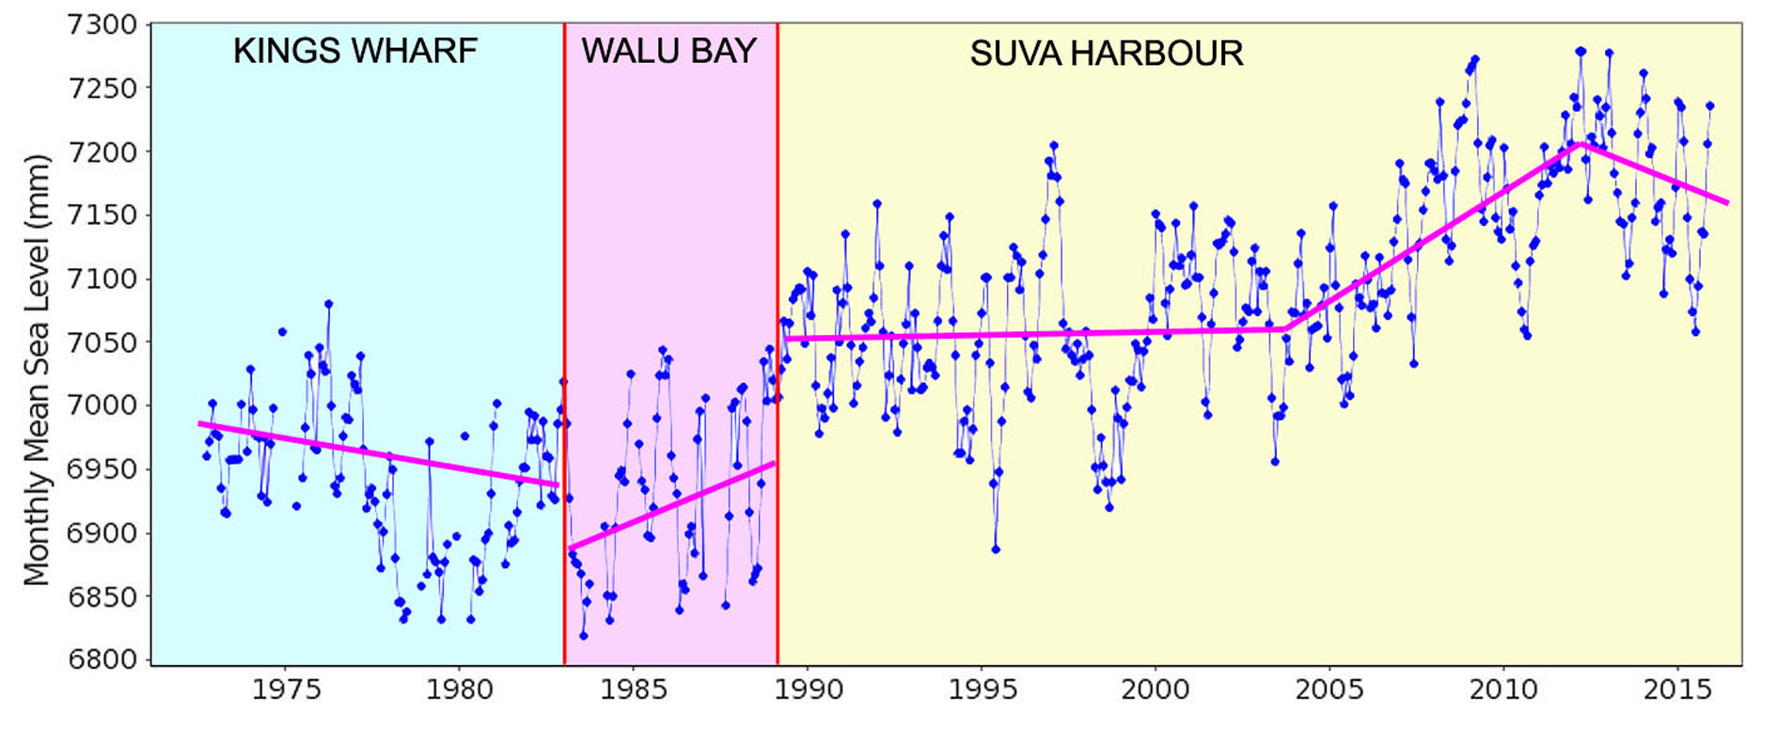
3c – Tide gauges 2

Slide 29
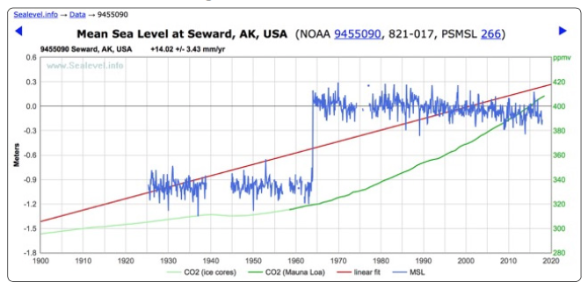
3c – Tide gauges 3 – earthquake tectonics
The Seward, Alaska, tide gauge record as presented by NOAA and PSMSL where they claim that sea level has been rising by 14.02 ±3.43 mm/yr during the last 90 yrs
The truth is totally different, however: next slide
Wyssmuller, 2019

Slide 30
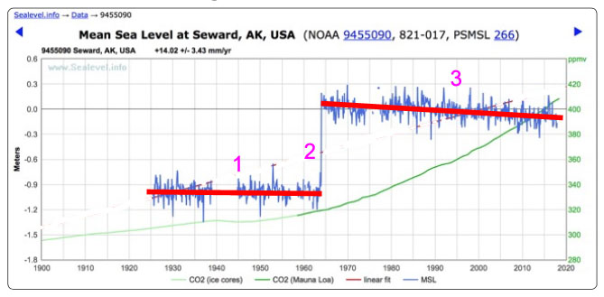
3c – Tide gauges 3b – earthquake tectonics
Falling sea – not rising sea level
Stable sea level for 40 years
Seismotectonic subsidence by 90 cm at the Alaska 1964 M 9.3 earthquake
Falling sea level by about 3.0 mm/yr for 50 years due to crustal uplift

Slide 31
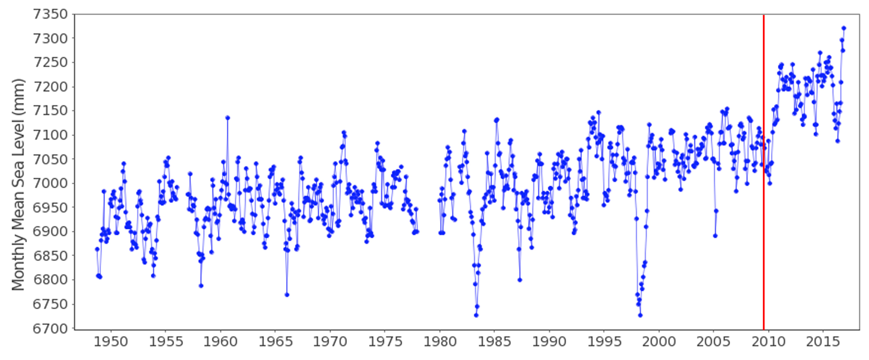
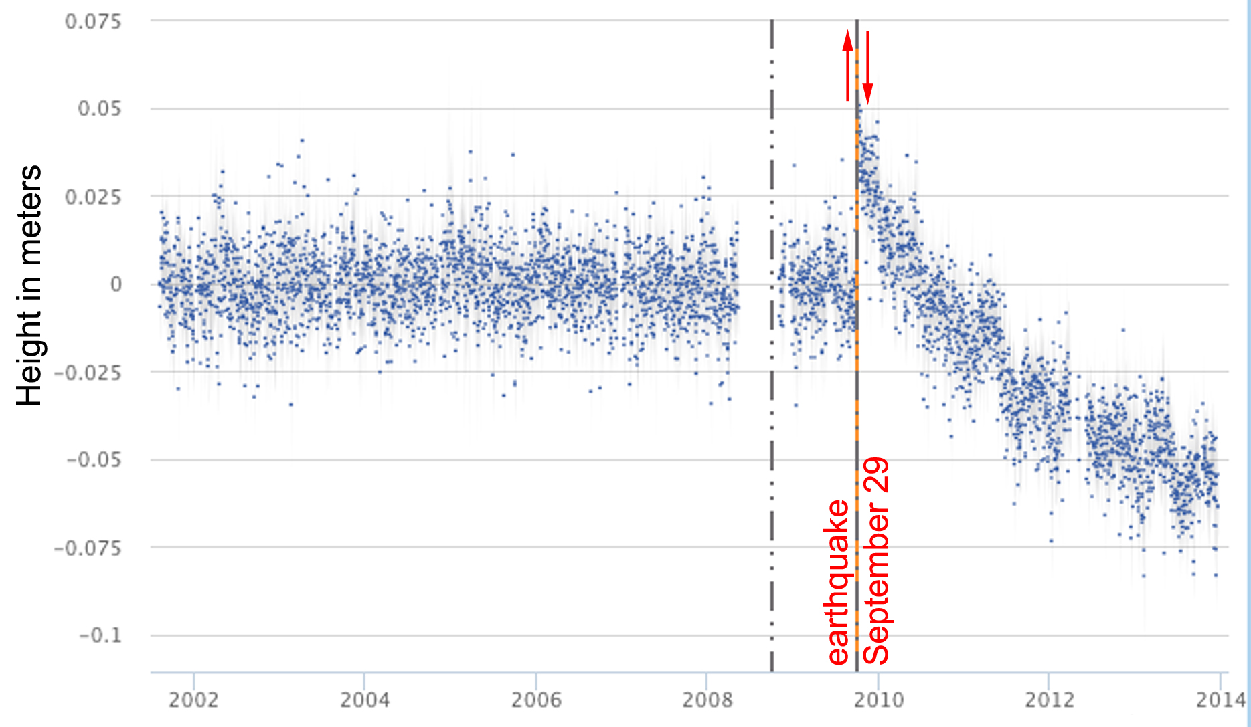
3c – Tide gauges 4
Samoa Islands,
Pago Pago stations:
Tide gauge & GPS
Mörner et al., 2018, IJG, 9, 579-592

Slide 32
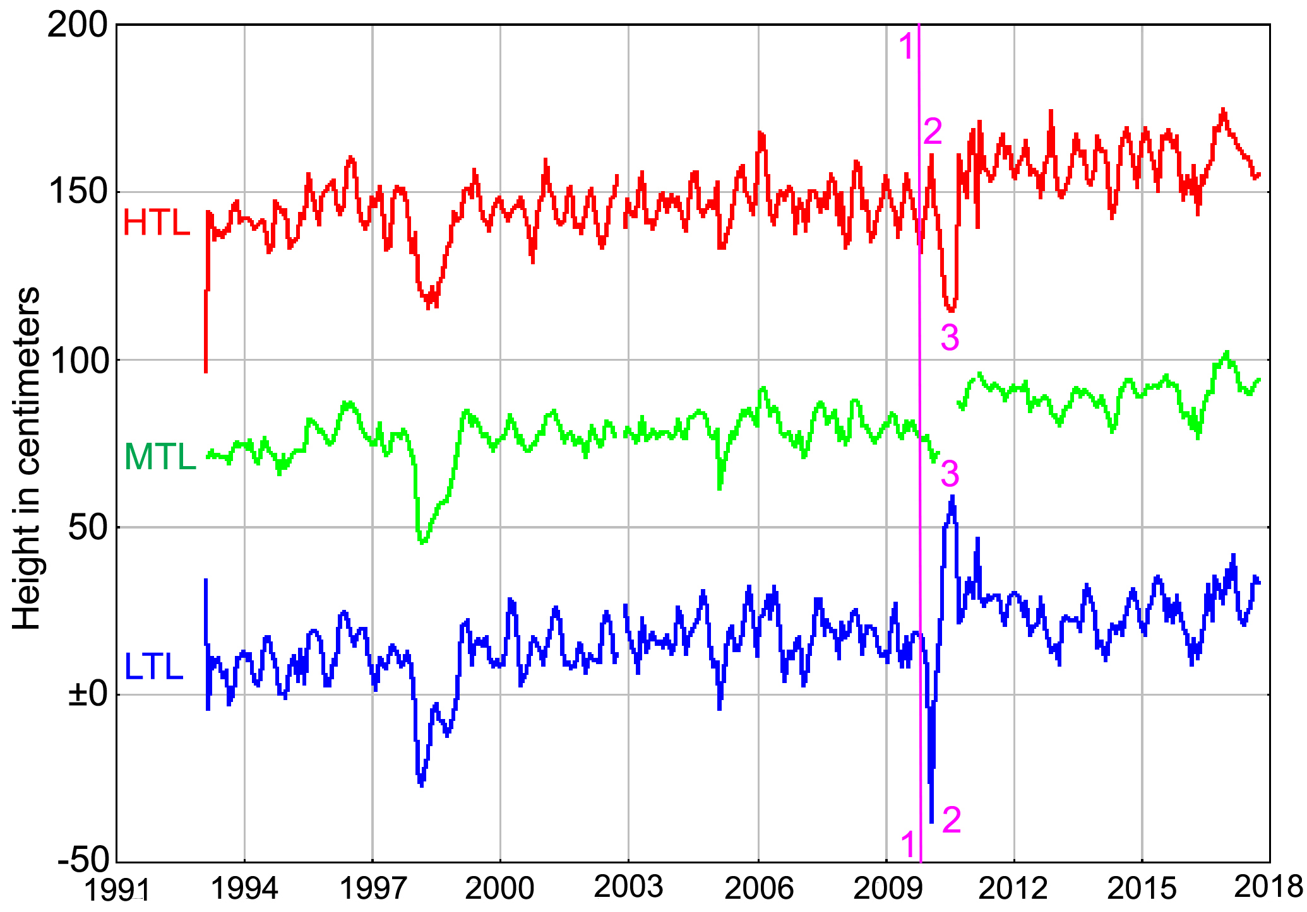
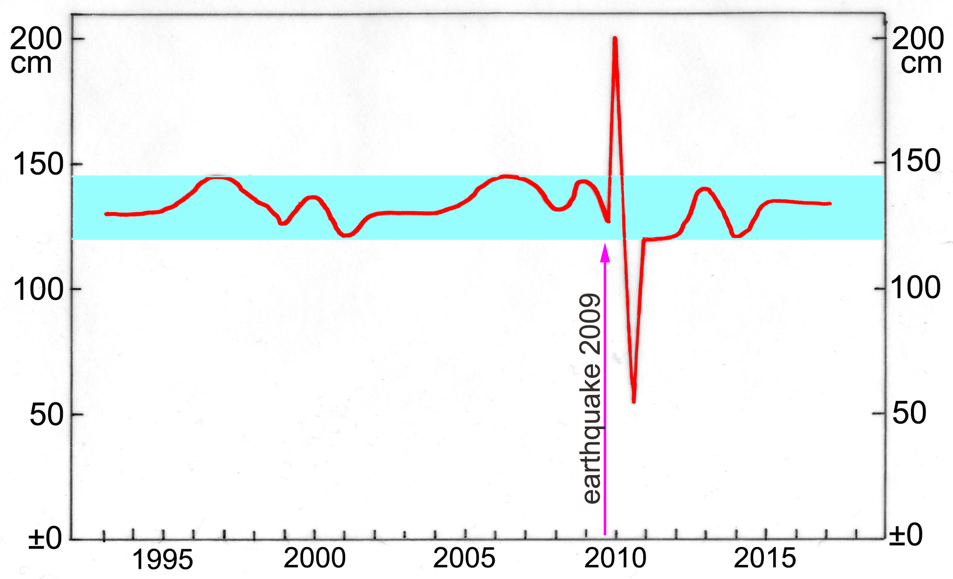
Changes in tidal range
at the Apia station in Samoa
provide evidence of
geoidal eustasy
(post-earthquake gravity changes)
No traces of acceleration left
International Journal of Geosciences, 2018, 9, 579-592

Slide 33
±0.0 or +3.0 mm/yr
Sea level record from French Guiana-Surinam
Showing a clear dominance of the 18.6 years tidal cycle around a stabile zero-level (±0.0 mm/yr)
Satellite altimetry gives a rise of ~3.0 mm/yr
There is a clear message in the difference!
One value must be wrong – and it cannot be the observational one.

Slide 34
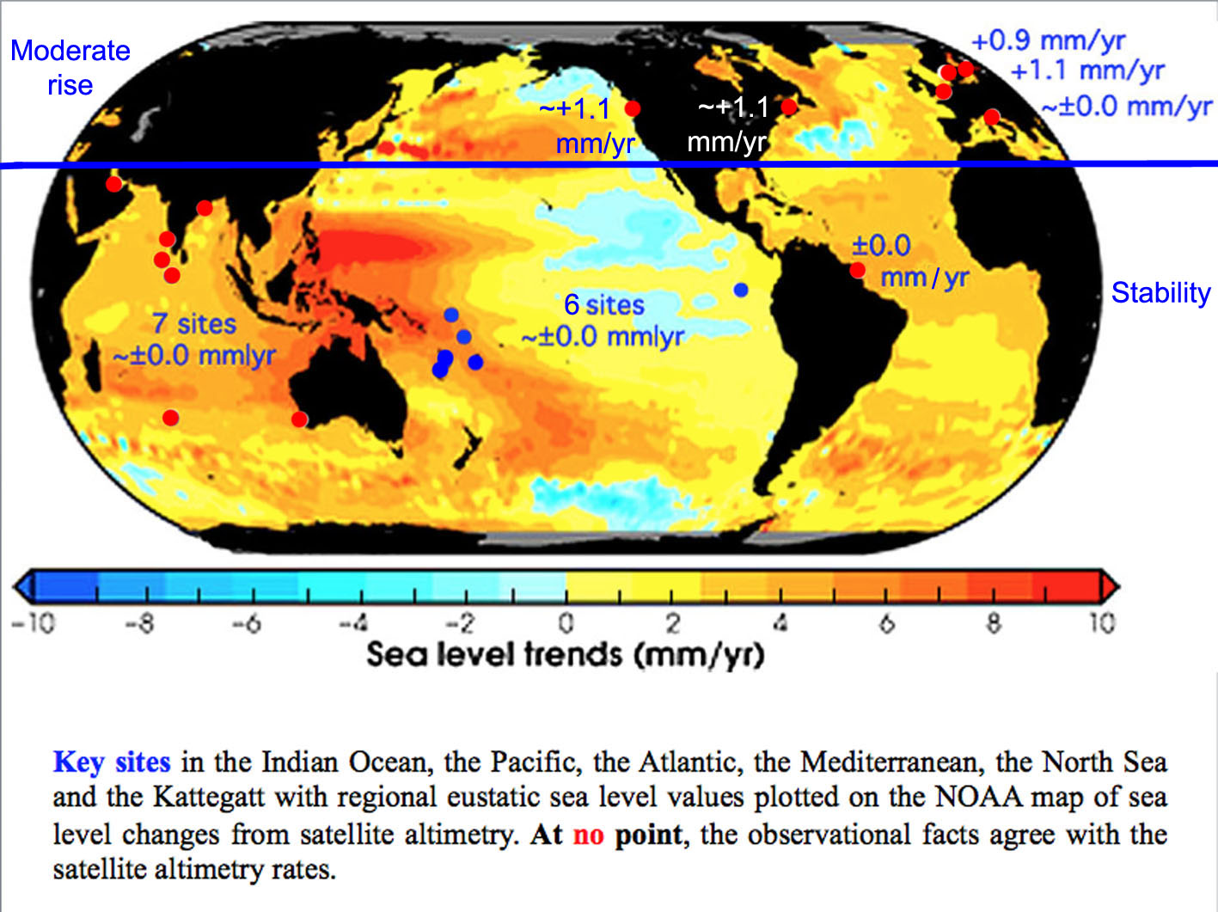

Slide 35
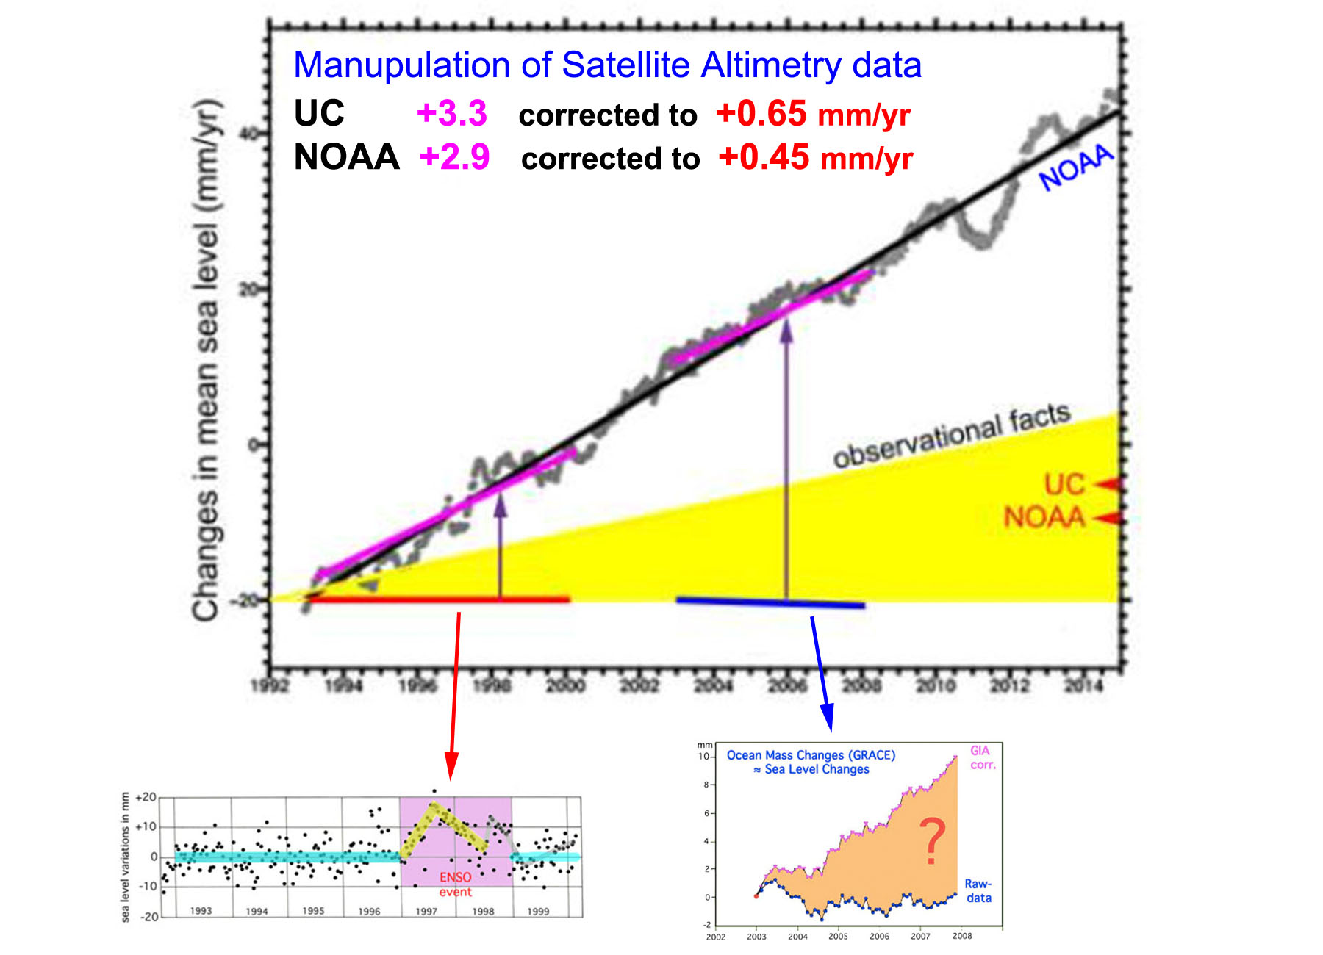

Slide 36
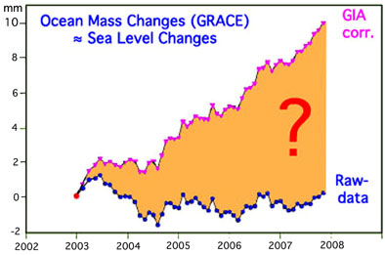
3e – Gravity

Slide 37
Frame 3e:
Shore Morphology & Stratigraphy

Slide 38
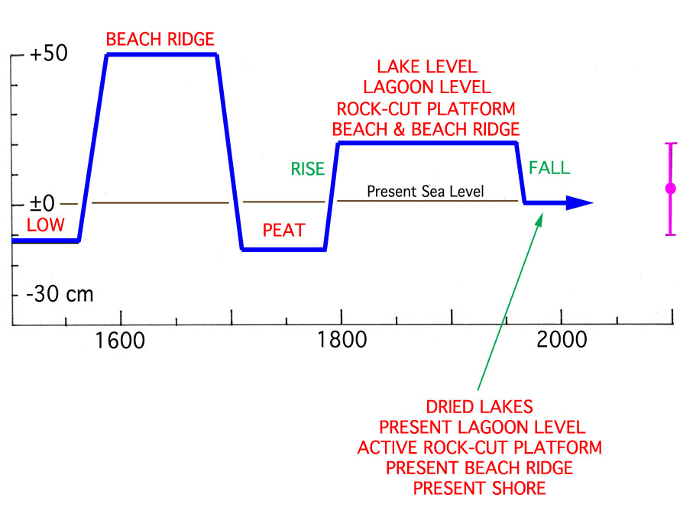
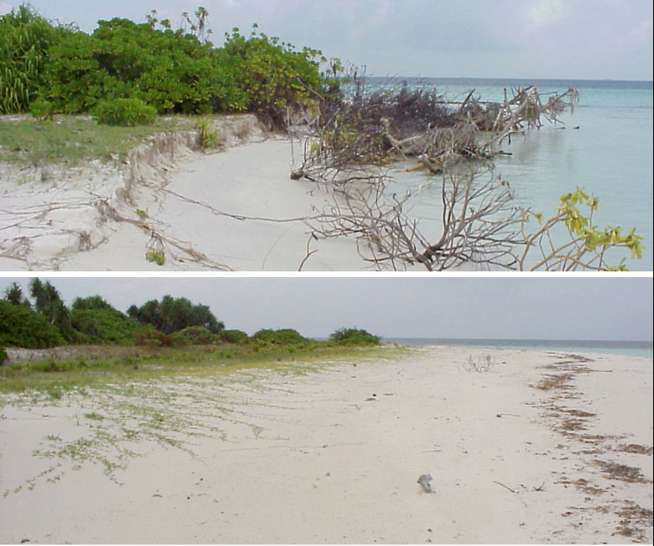
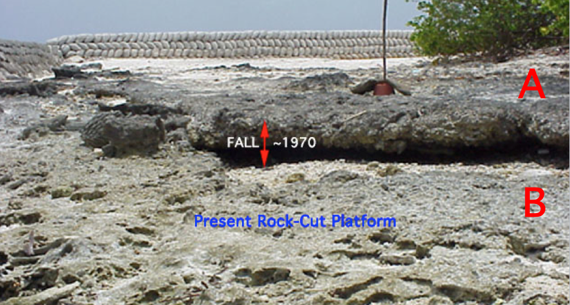
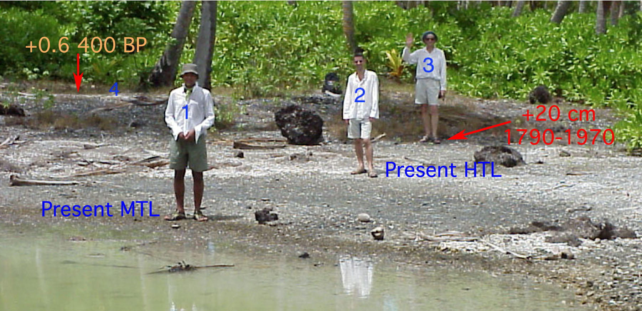
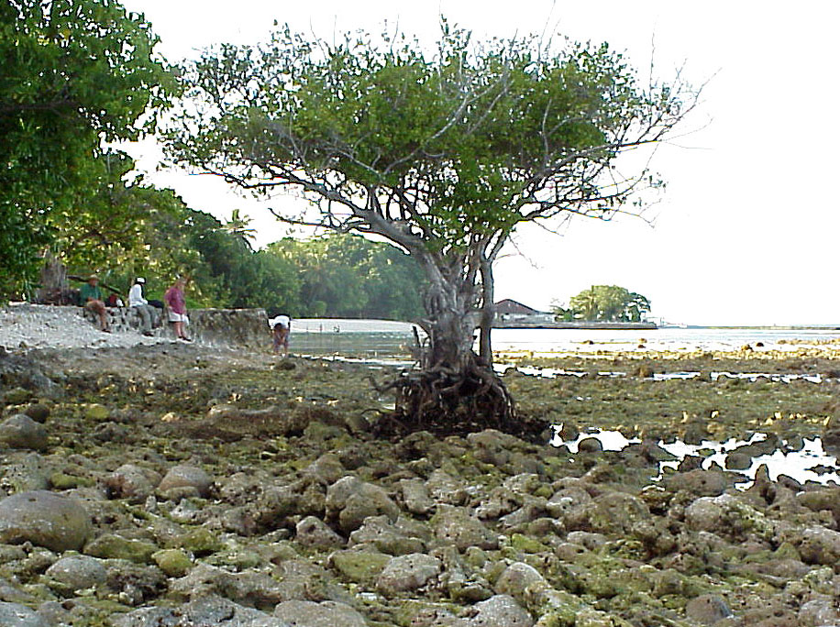
Coastal
morphology
in the
Maldives

Slide 39
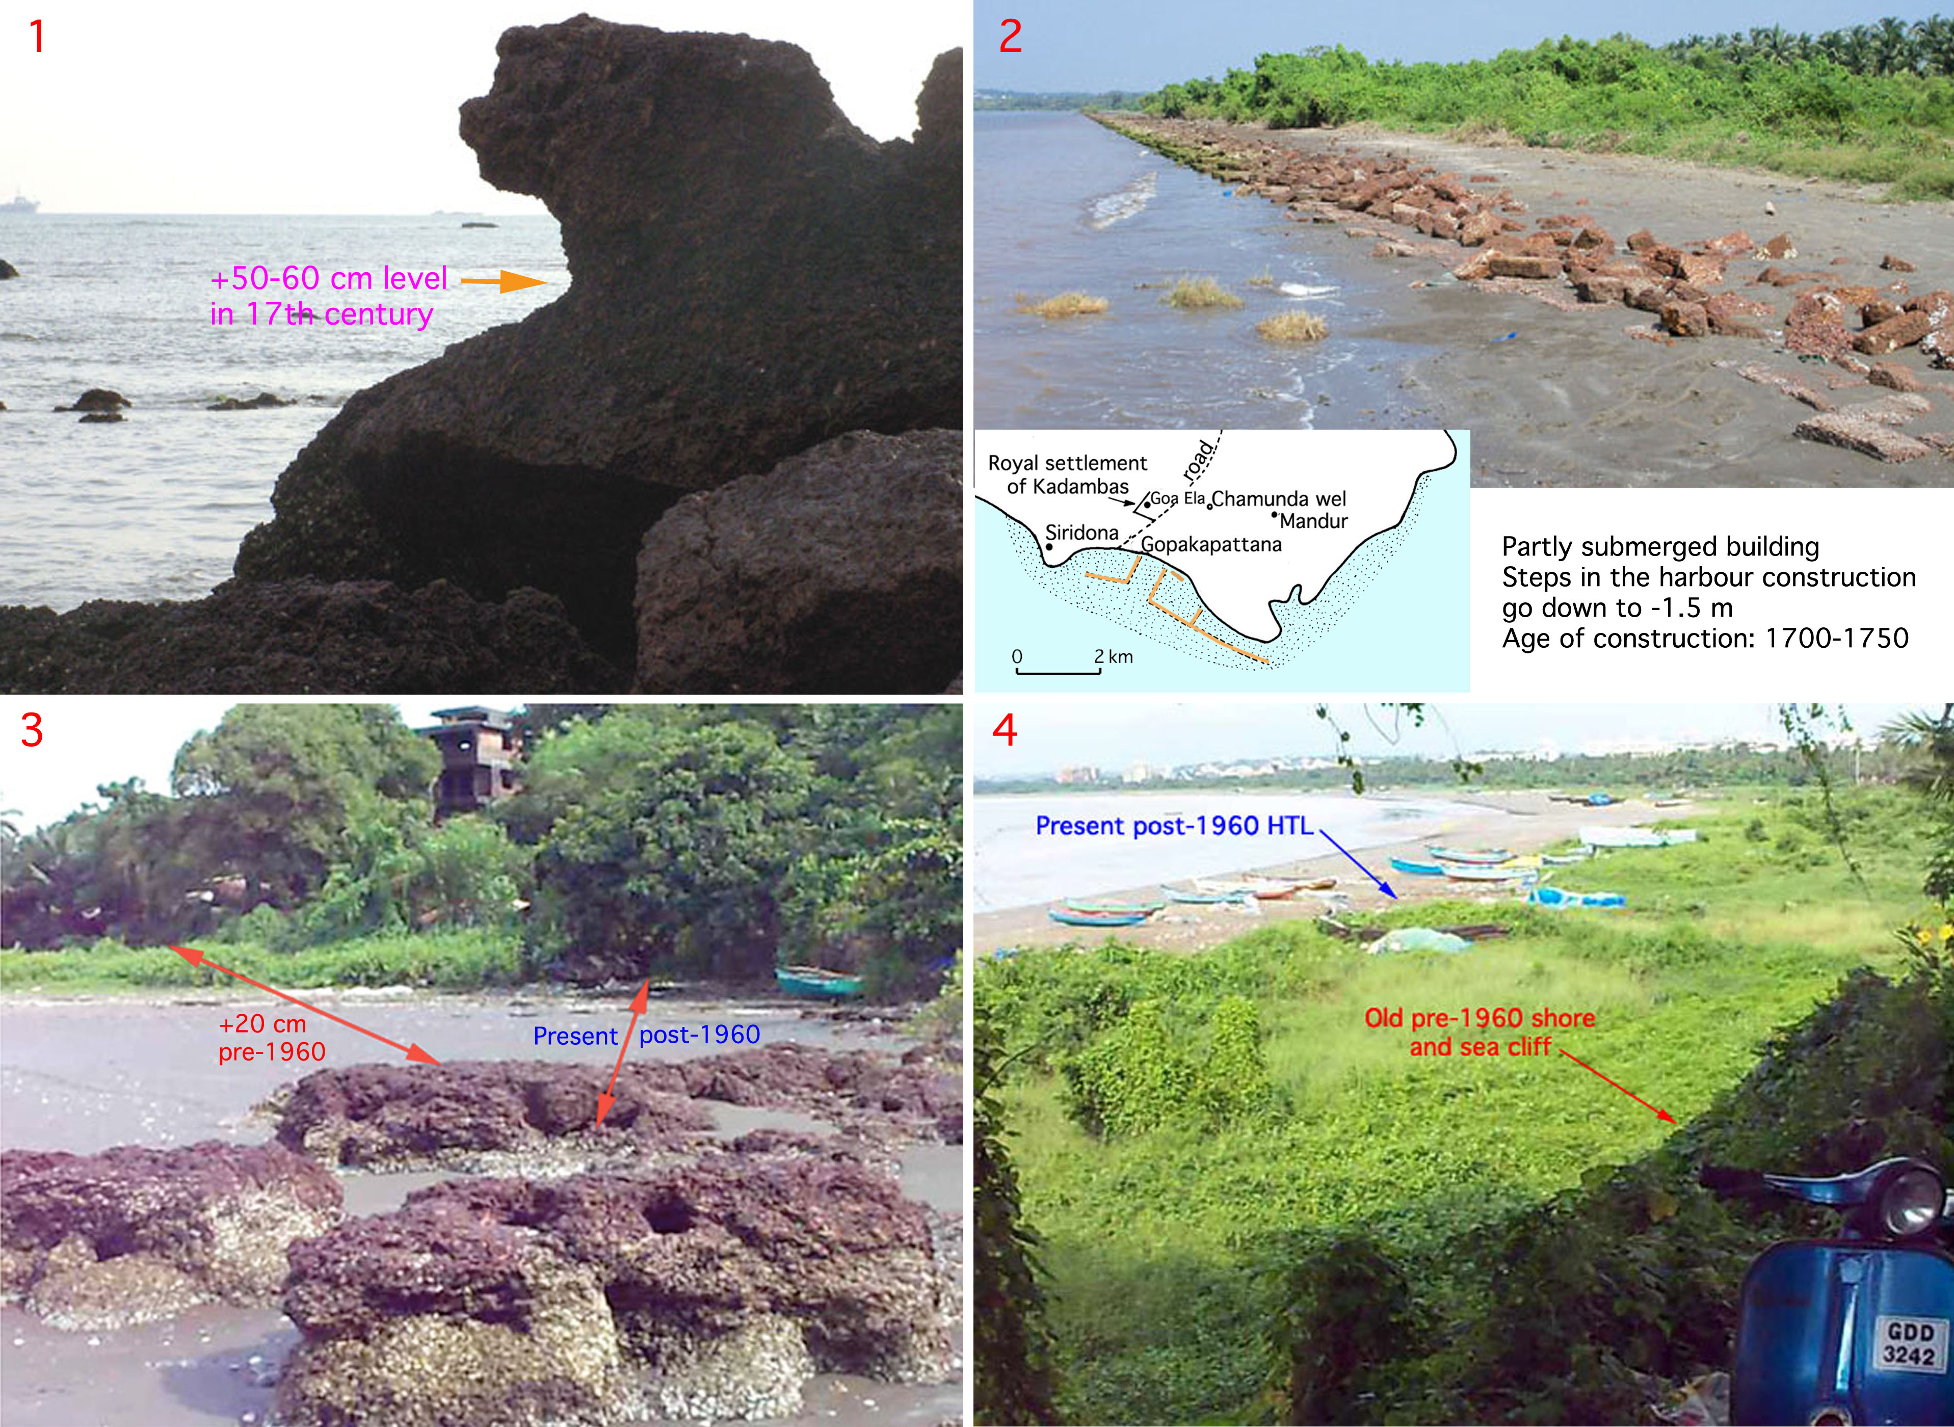

Slide 40
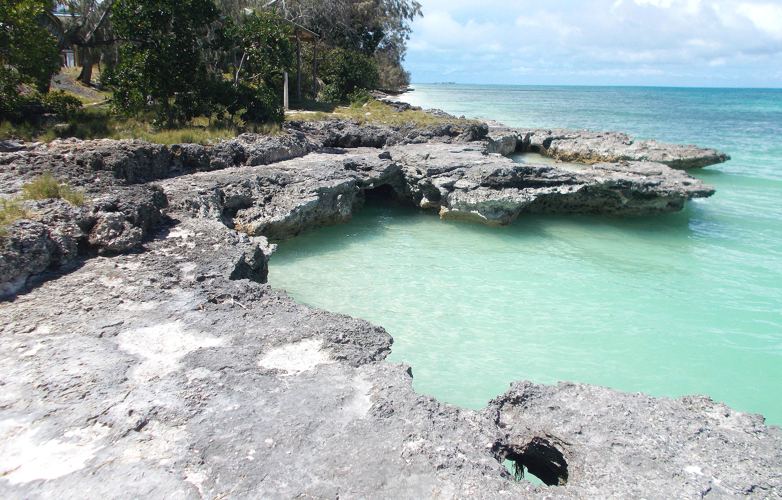
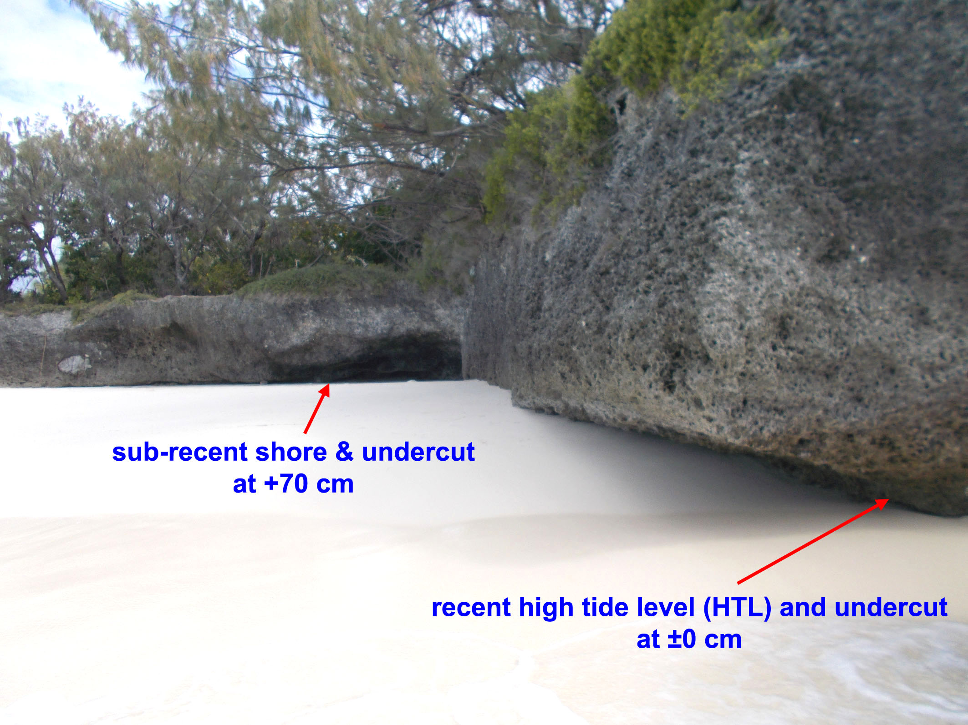
Ouvéa Island
+70 cm shore
of high sea level
around ~1650 AD
(Maunder Minimum)
The +70 cm shore
is a part of the present beach

Slide 41
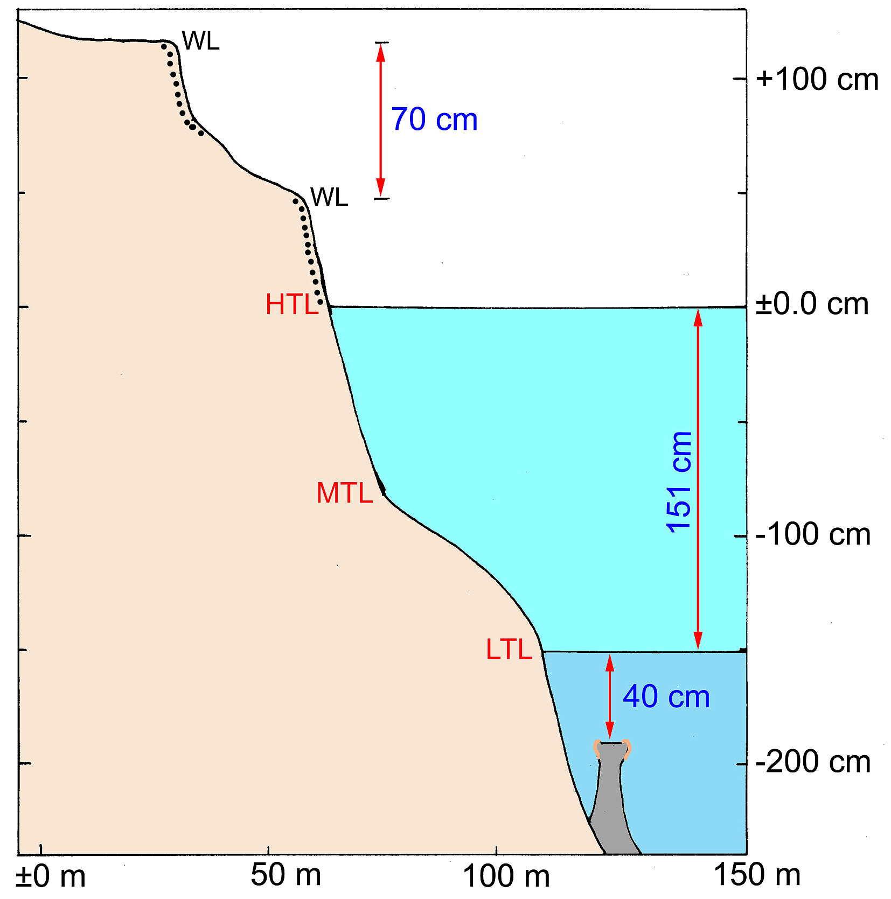
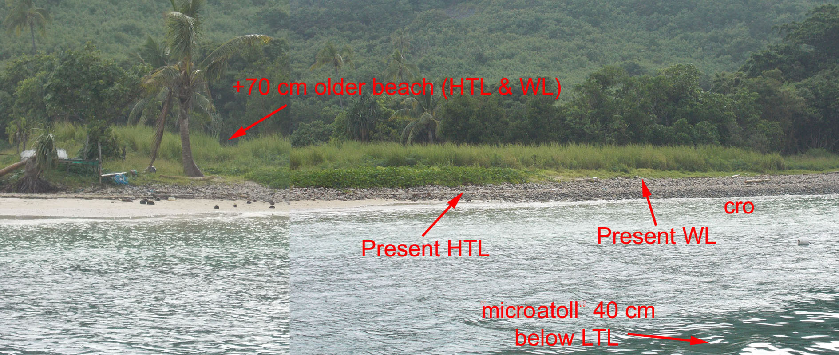
*
* Corals from the +70 cm shore were C14-dated at AD 1601 ± 143 (≈ 1550-1700 high SL

Slide 42
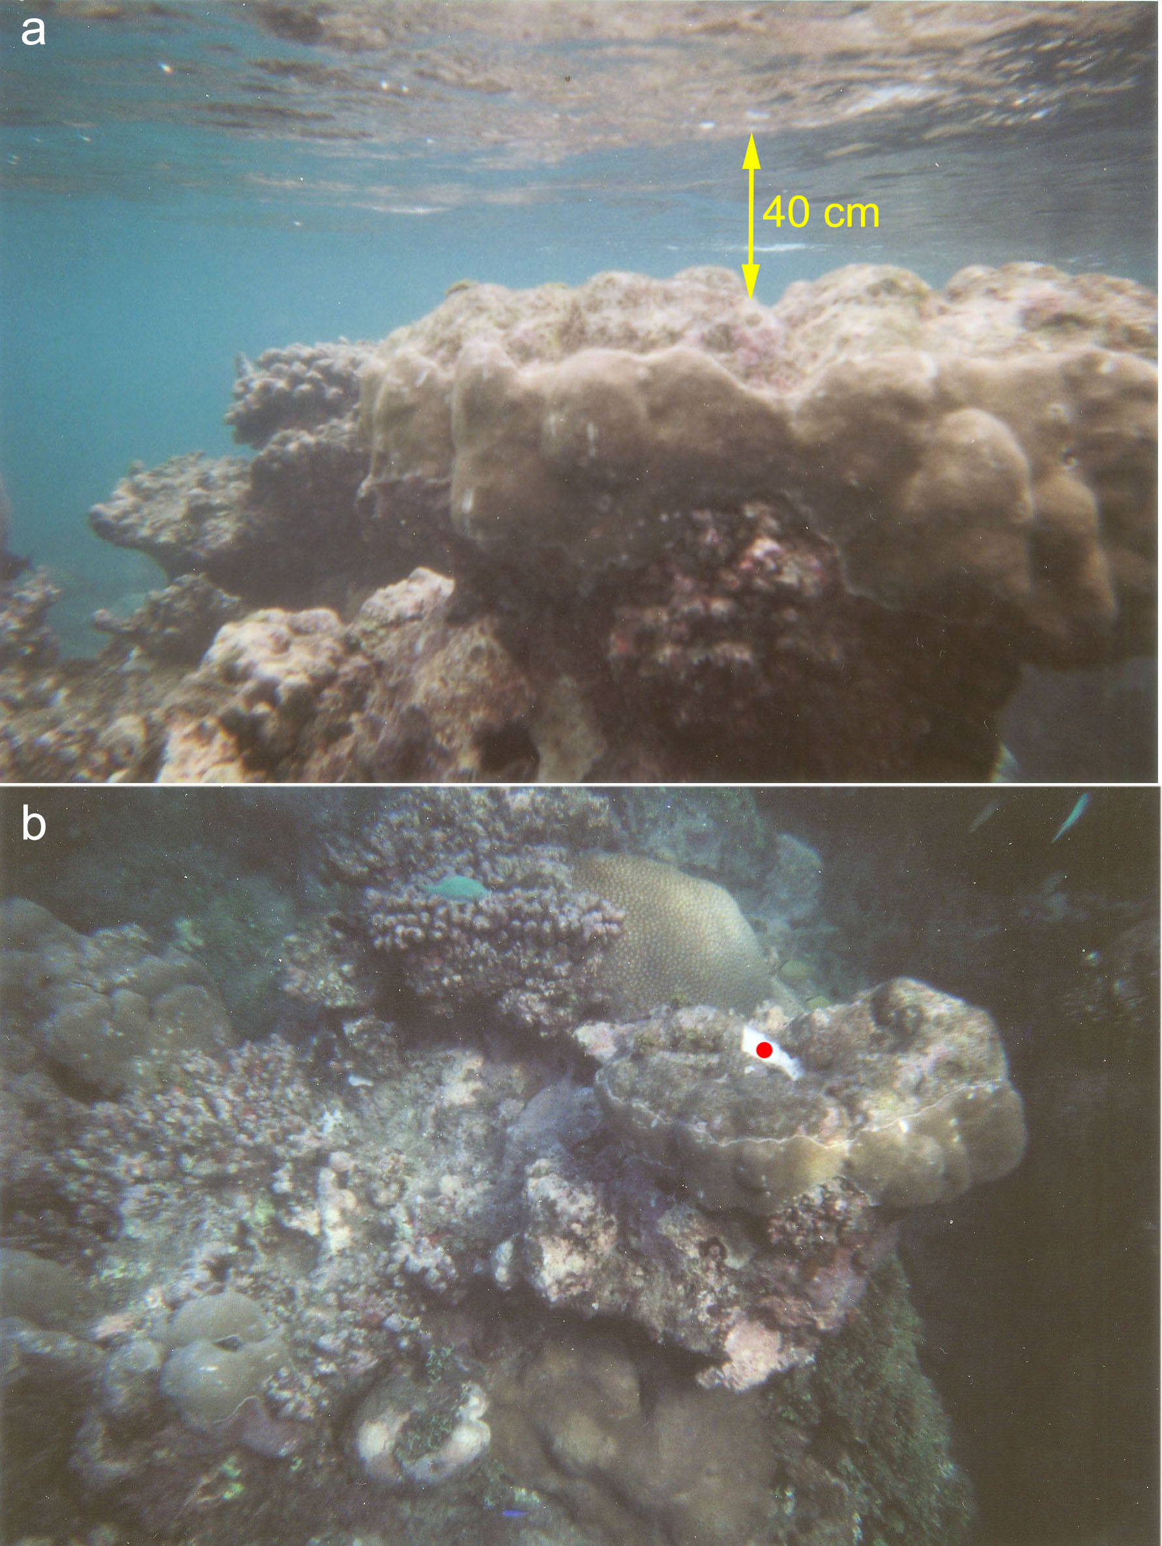
Microatoll
at a 40 cm below LTL
implying coral growth
at constant sea level
and corals
do not lie
C14-date of dead centre
= younger than 1950
indicating a sea level lowering
after 1950
and stable sea level conditions
after that

Slide 43
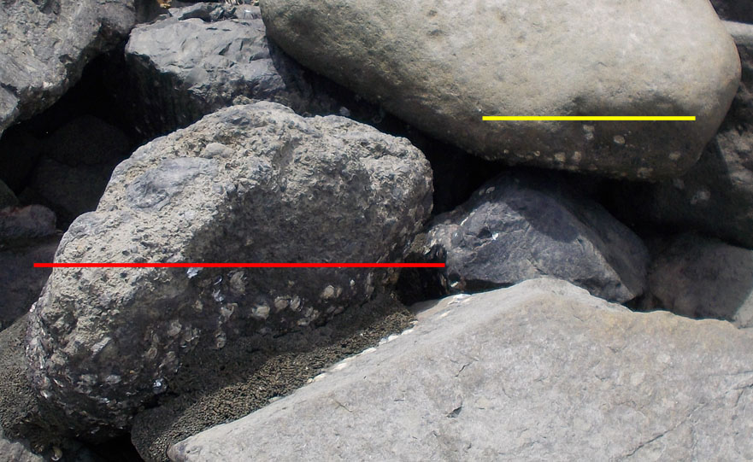
Record of a probable sea level lowering of about 10-20 cm
Yellow line = limit of dead shells
Red line = limit of living shells

Slide 44
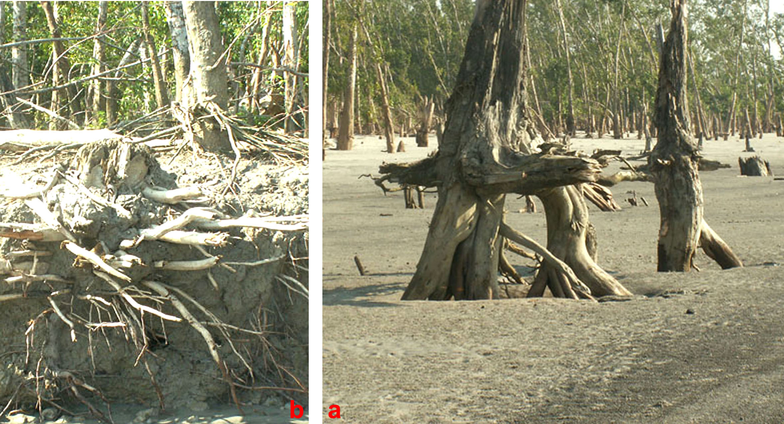
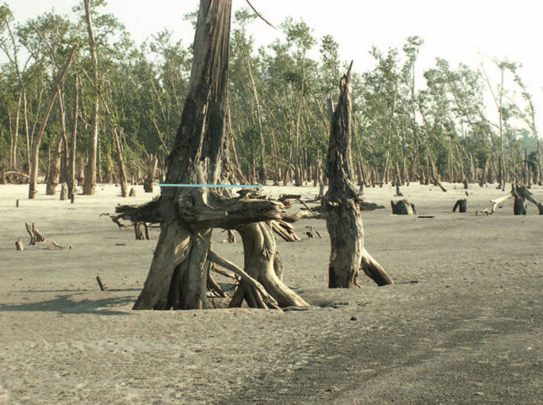
Bangladesh
At the base here: littoral sand
(low SL)
Close-by: salt kilns below sea level (low sea level) dated at the 18th century
No sea level change
Erosion by Sidar Cyclone in 2007

Slide 45
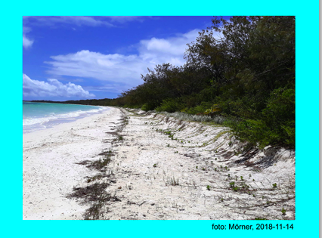
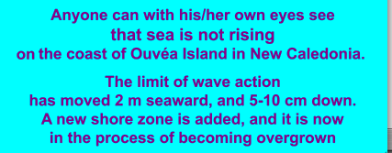
Ouvéa Island
(New Caledonia)

Slide 46
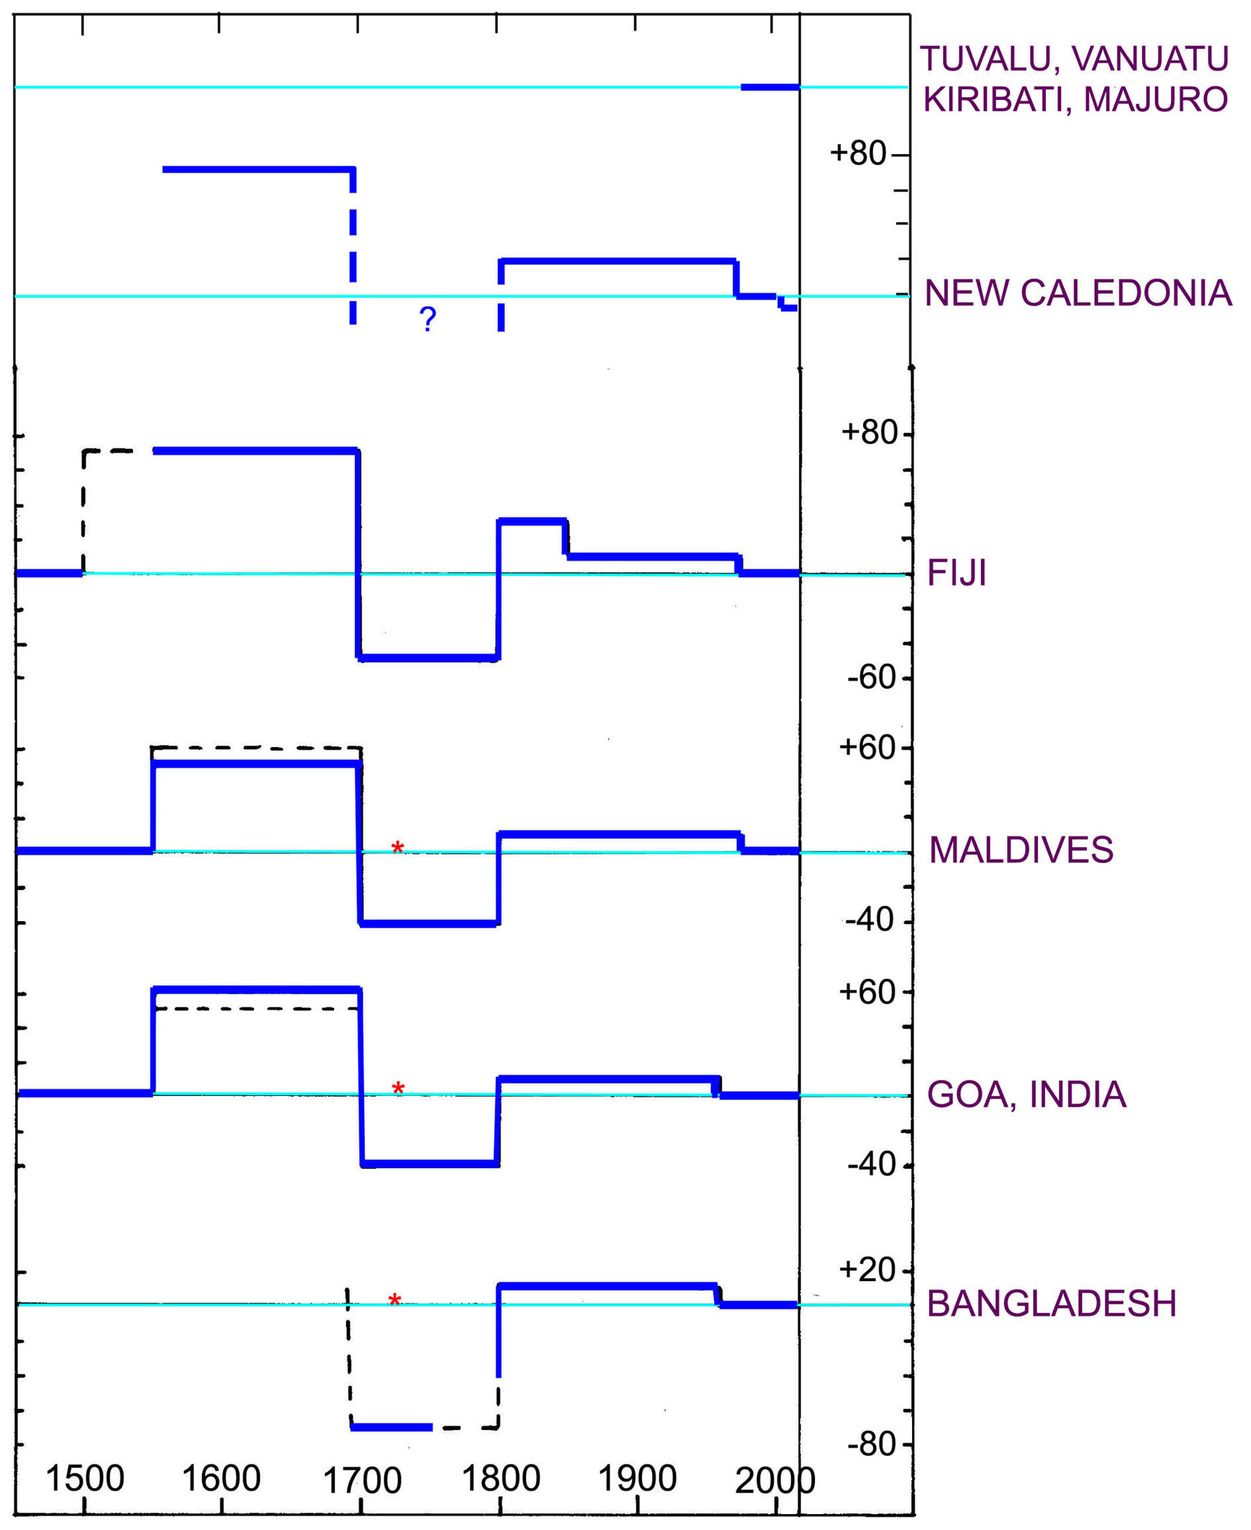
Observed sea level changes
in the Indian Ocean and the
Pacific
High in the 17th century
Low in the 18th century
Stable last 50-70 years
This can only be understood in terms of rotational eustasy

Slide 47
The Pacific
four key sites, all notorious for proposed on-going flooding
Majuro
Kiribati
Tuvalu
Vanuatu

Slide 48
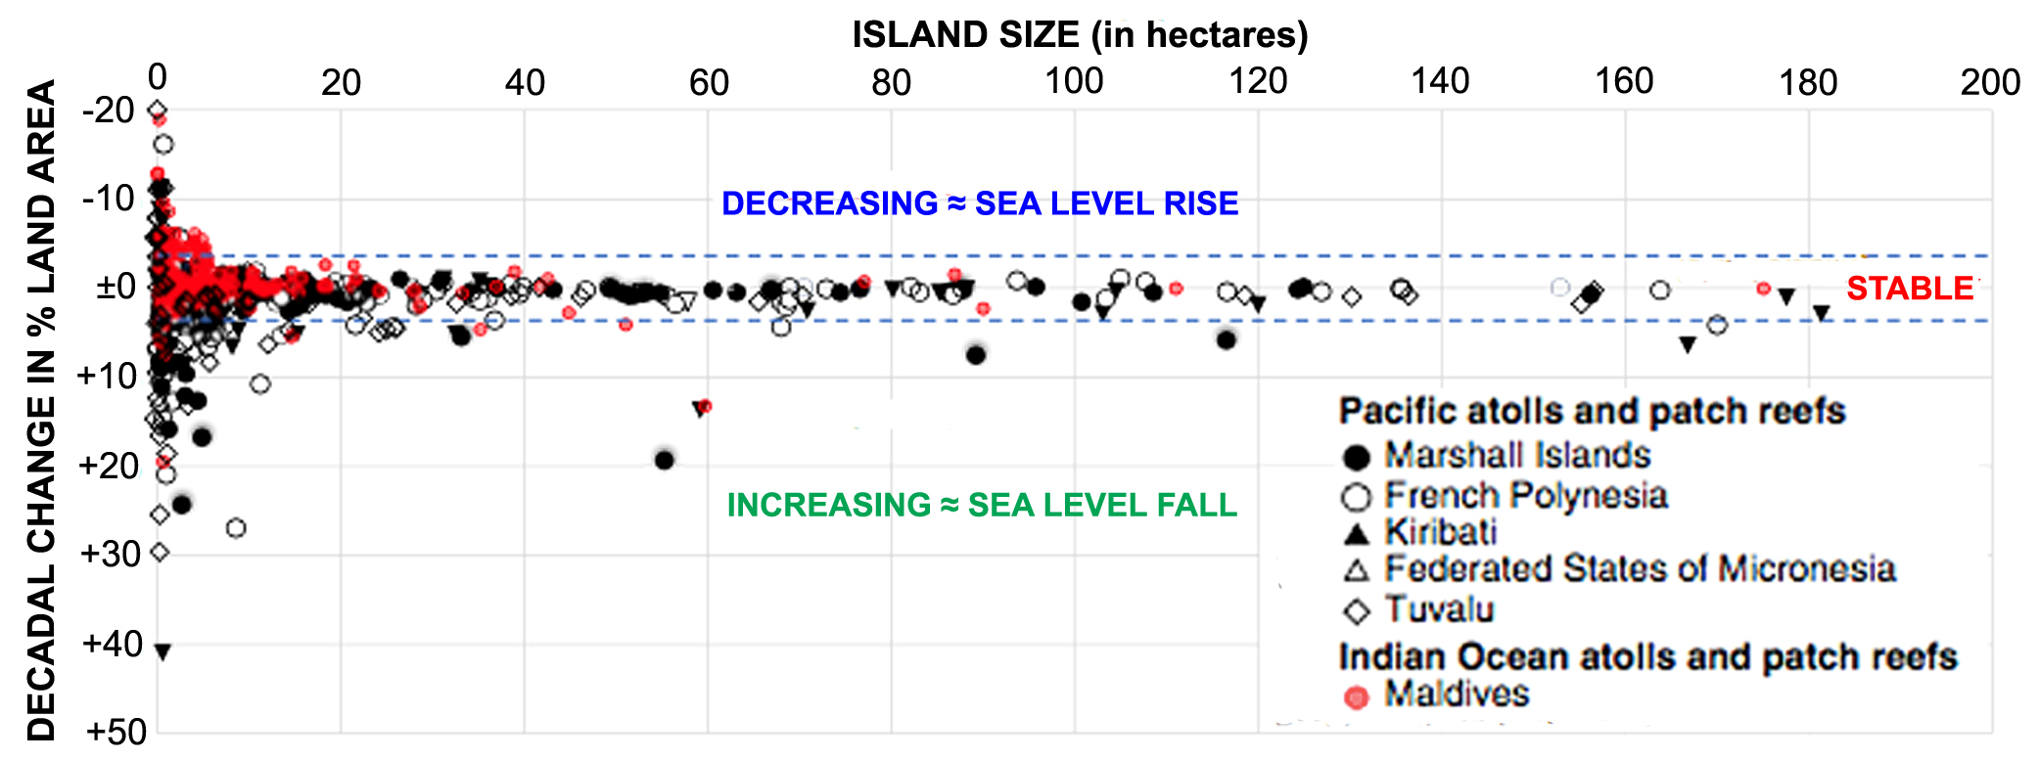

Slide 49
Part 4
Frame 4: Scientific & Ethical Principles

Slide 50
When observations (or experiments) do not fit with models, it is the models that need revision and improvements, and it is not the observations that should be ignored & neglected
Observational facts always beat models
Don’t hide facts that do not concur with your hypothesis
In good science, all facts are considered and discussed, not just a selection of data fitting your own views
Of course, this goes for the references, too.

Slide 51
Part 5
Test areas of eustasy
Test comparisons

Slide 52
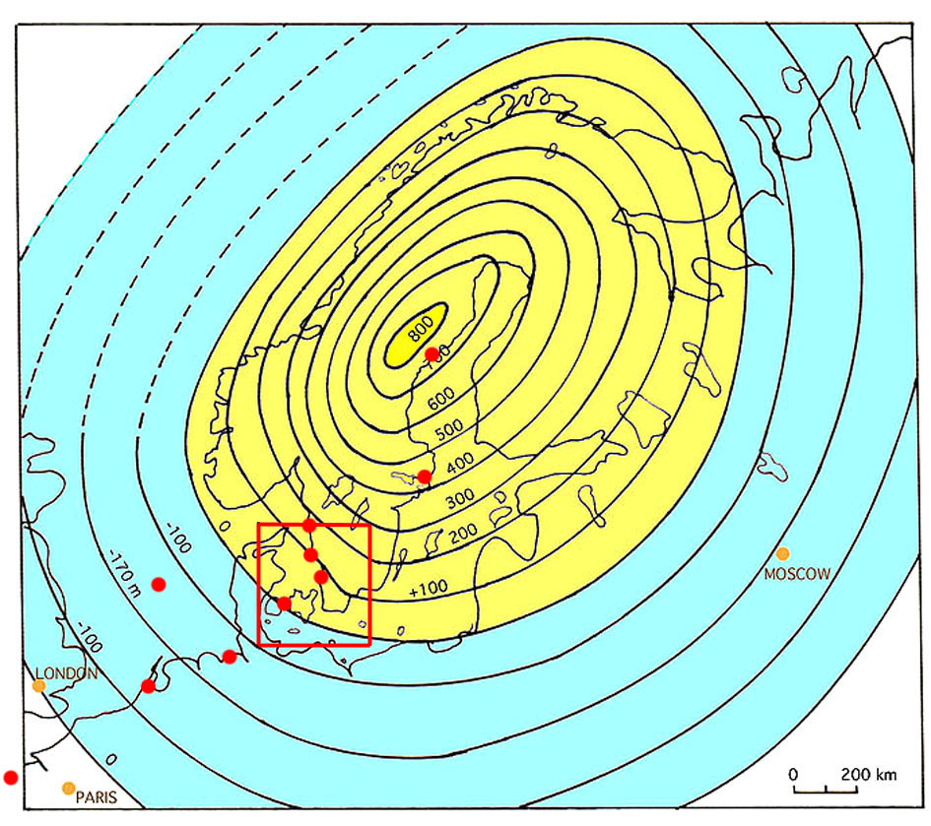
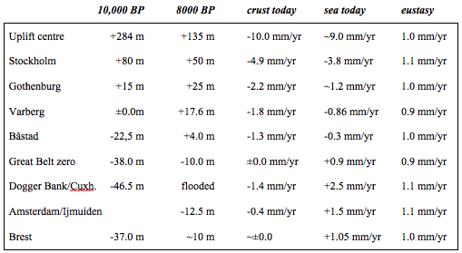
The Fennoscandian Uplift (yellow)
and surrounding subsidence (blue)
The 10,000 BP shore tilt from +284 m in the centre
to -46.5 m at Dogger Bank
The 8000 BP shore tilt from +134 m in the centre
to -12.5 m in the North Sea
The present relative sea level changes give evidence of a regional eustatic rise in sea level of +1.0 ±0.1 mm|yr, which can be regarded as an excellent test of true rise in sea level
over the last 100-150 years.
Already at this point,
we must invalidate
all talk about rapid,
even accelerating,
sea level rise

Slide 53
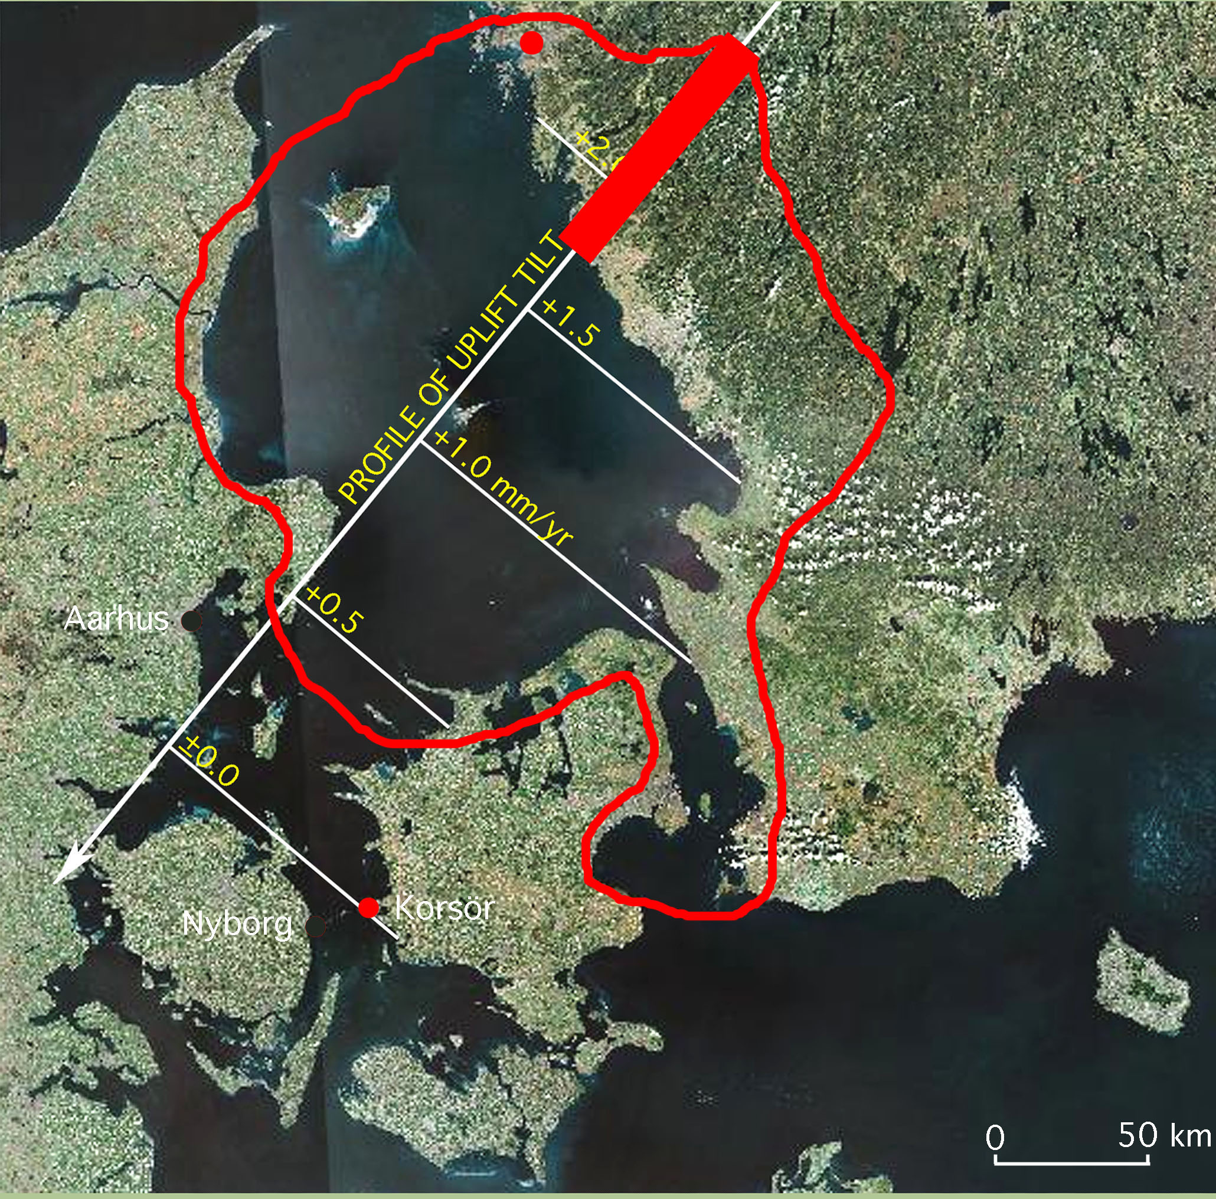
The
investigation area
covering the transition between uplift and subsidence
Where 40 shorelines were identified and dated over 250 km
in tilt direction
and
The istostatic and eustatic components were separated
and
Present sea level tested

Slide 54
Part 6
Comparisons & Conclusions

Slide 55
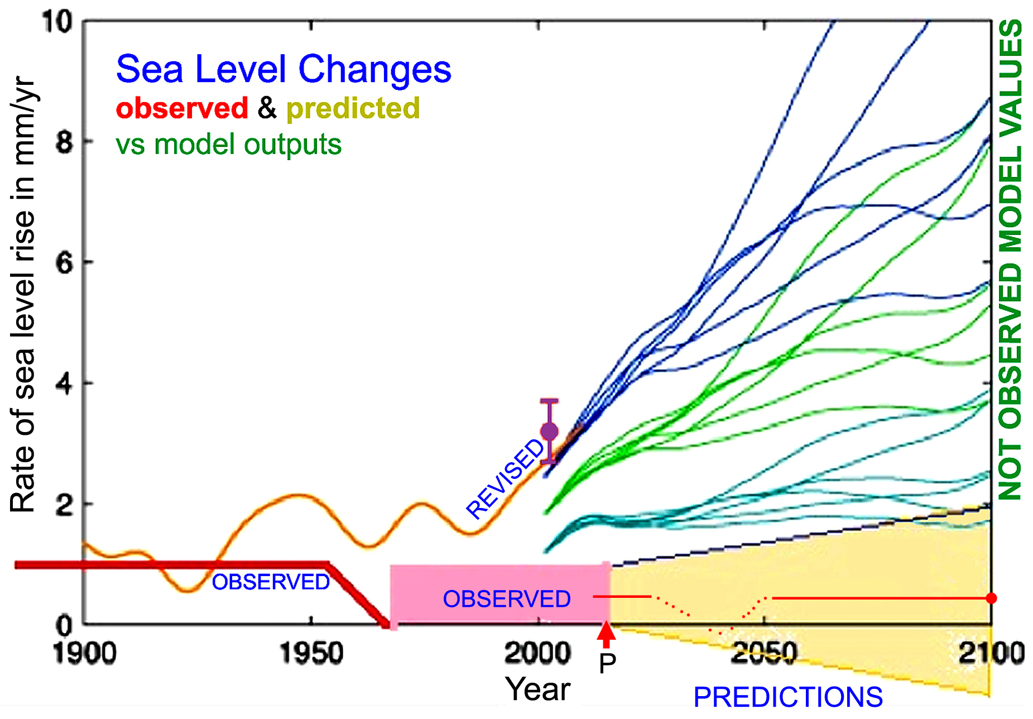

Slide 56
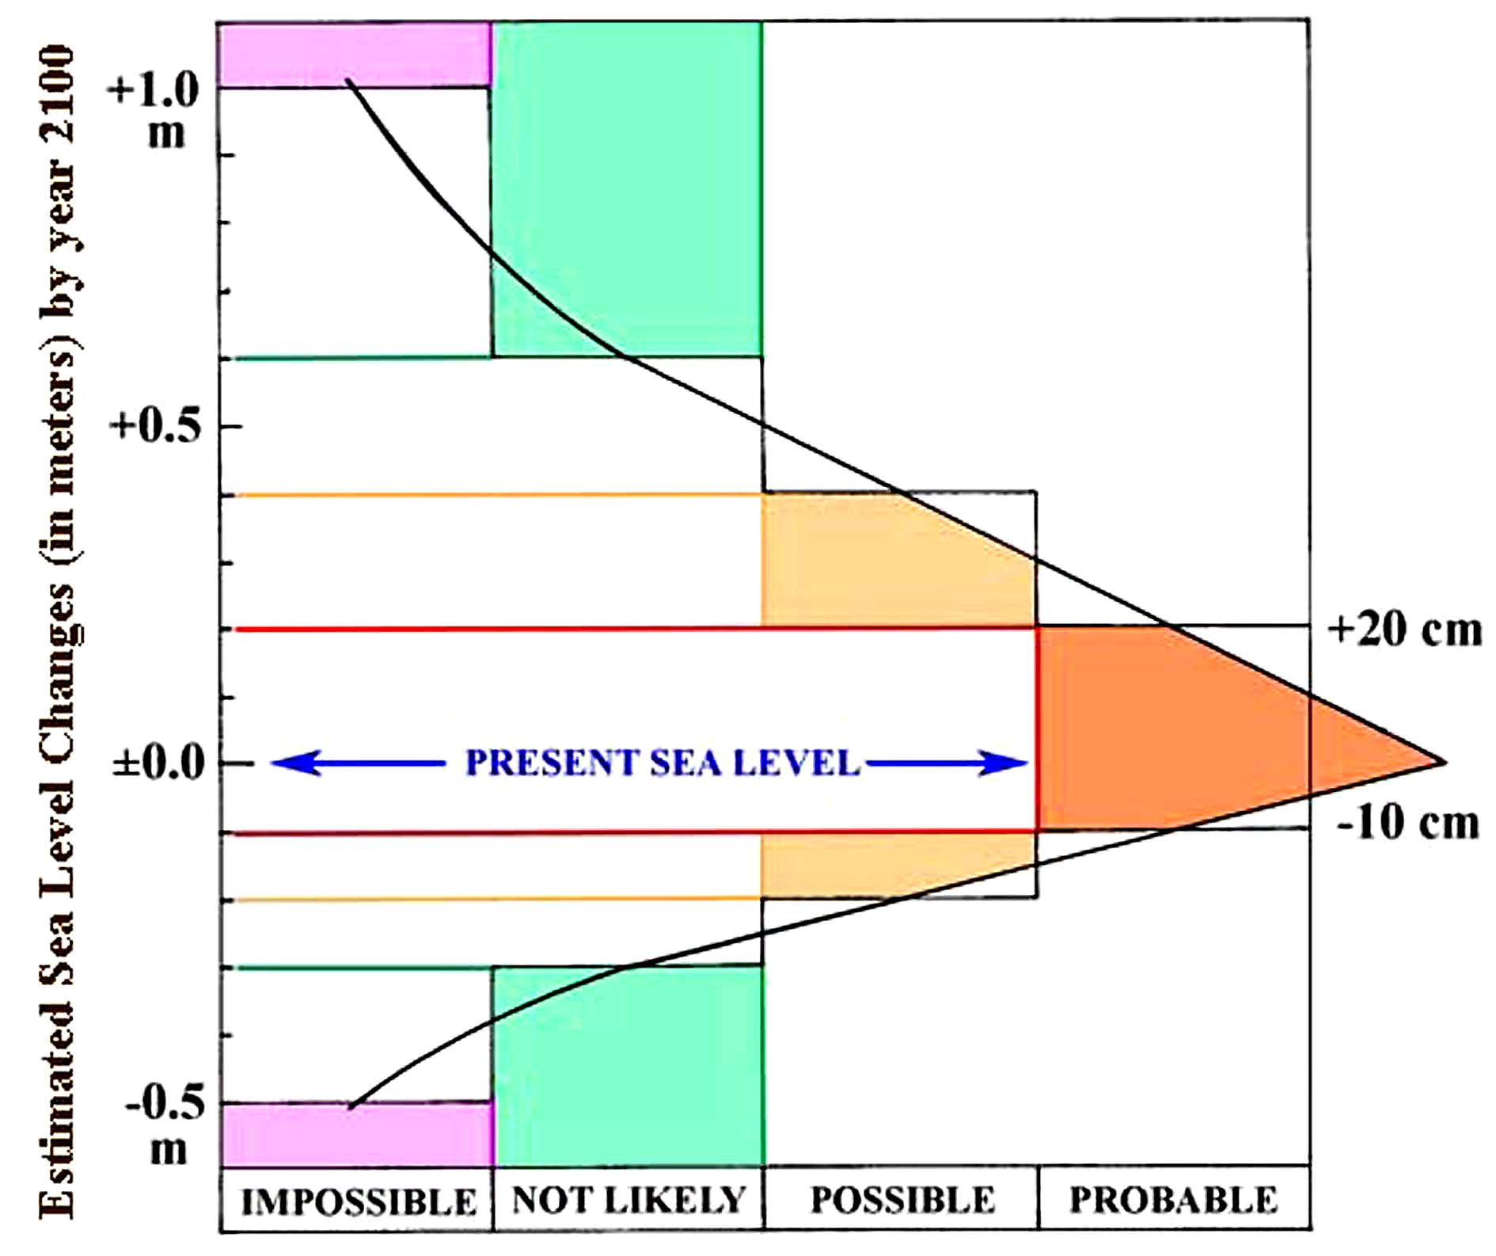

Slide 57
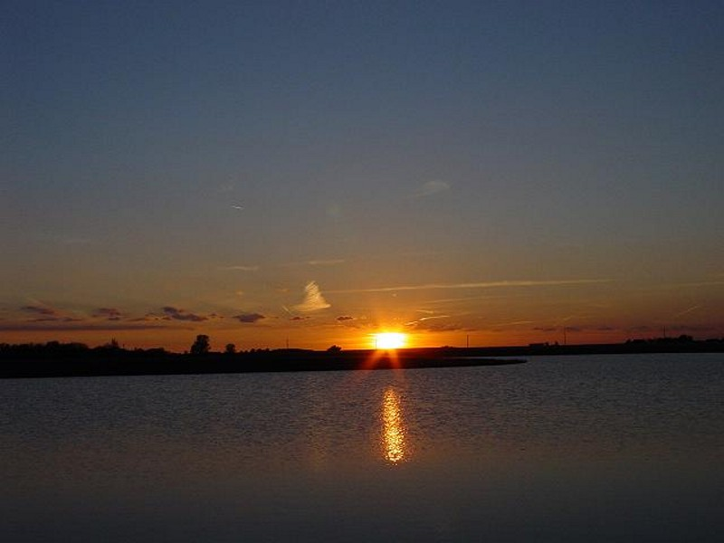
Sea Level year
2100
estimated to be
only
+5 ±15 cm

Slide 58
from IJOER 2015, 1 (9), 42-46

Slide 59
The sea level view presented implies:
Liberation of fear of a disastrous sea level rise in the near future
and a collapse of the IPCC sea level scenarios
(all based on models)

Slide 60
In conclusion
Evidence-bases sea level observations
are the only facts worth building a trustworthy story on
Scaremongering based on model scenarios
violates science and ethics
and must be avoided
(not to say ignored)

Slide 61
MANY THANKS

Slide 62
Part 7
Reserve pictures for discussion

Slide 63
Why?
Endorsed by Lobbyists
Contradicted by true Science

Slide 66
Part 8
The IPCC Sixth Assessment report

Slide 67
I have been expert reviewer 1999, 2003, 2013 (when I withdraw due to the exceptionally low quality of the sea level chapter), and also for the 6th Assessment Report of 2019, which violates all the 4 frames separating realistic sea level changes (blue field) form the pink field of nonsense and anti-science.

Slide 68
The 5th IPCC Assessment Report 2019
It just consider literature favourable in view of the rapidly rising and acceleration sea level scenario of the IPCC. In this matter, the chapter implies a total failure, and must be rebuffed.
Several of the authors engaged in the writing of Chapter 9, have a background firmly fixed in the idea of a sea level acceleration soon to come. Those ideas form the base of the message of Chapter 9.
This is a new lobbying product set to glorify the IPCC concept: i.e. the scaremongering of climate change with a global sea level flooding in the centre.
This paper is nothing but a document meant to provide confirmation of the old IPCC idea of a sea level in rapidly rising mode where acceleration has been claimed but never documented by observations.
The chapter is a remarkable product in terms of lobbying for the sea level rise concept. But this is not what it portends to be: it is claimed to be a scientific product, which it fails to be.
So, in short: A remarkable lobbying product for the IPCC
But a document failing to fulfil scientific standards

Slide 69
The science of sea level changes is clear and straight forward

Slide 71
2c – Tide gauges 6
Several equatorial global test sites, (2) mean of 170 long tide gauge records (> 60 yr), (3) revised satellite altimetry data =.0.55 ±0.10 mm/yr), (4) eustatic component of the North Sea, Kattegatt & Baltic (1.0 ±0.1 mm/yr), mean of 184 tide gauge stations from all over the globe (1.14 mm/yr) most of which include a subsidence component
Journal of International Geosciences, 2016, 7, 1318-1322

Slide 72
Present sea level trends
About ±1.1 ±0.2 mm/yr for the region north of Latitude 30° N
About ±0.0 mm/yr for the equatorial region south of Lat. 30° N

