Slide 1
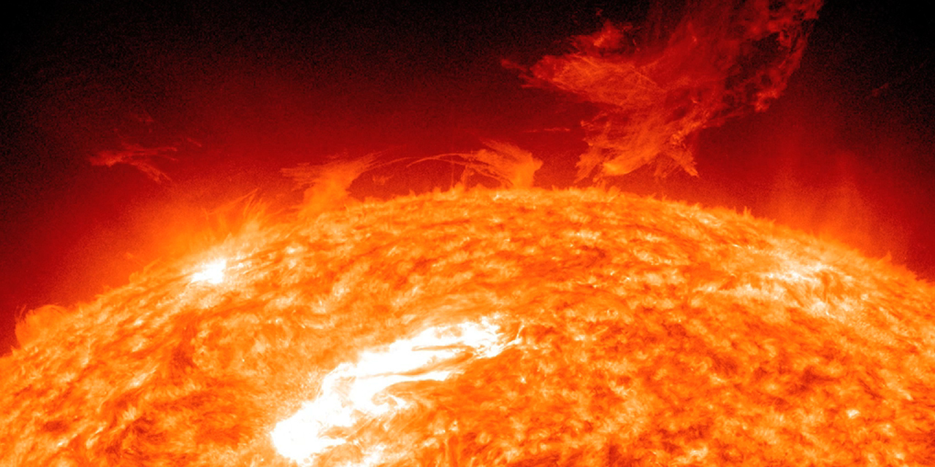

Slide 2
Feedback
misdefined
How models forgot the Sun
Christopher Monckton of Brenchley
monckton@mail.com
Porto, 7 September 2018

Slide 3
Matt Briggs
Alex Henney
Tom Sheahen
David Legates
Michael Limburg
Willie Soon
William Rostron
James Morrison
John Whitfield
Dietrich Jeschke

Slide 4
Ad argumentum, we adopt all of climatology except what we disprove

Slide 5
IT’S THE SUN: changes in solar radiance striking the ground
explain recent temperature changes
monckton@mail.com
Large feedback: the chief
pretext for large warming

Slide 6
Feedback response currently represents
$$>67\%$$
of mid-range predicted global warming and
$$>90\%$$
of the uncertainty in predicted warming

Slide 7
1 2 3 4 5 6 7 8 9C
Extreme papers
CMIP5
M of B
Reference sensitivity
IPCC
Feedback response

Slide 8
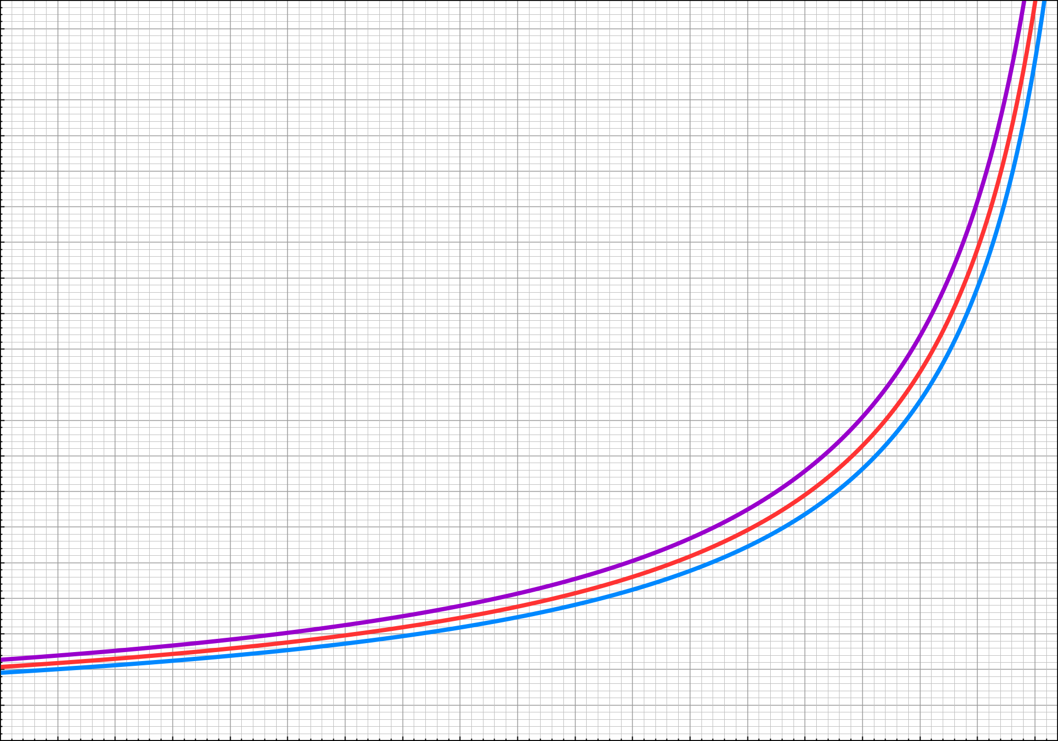
10 K
9 K
8 K
7 K
6 K
5 K
4 K
3 K
2 K
1 K
0
Murphy 2009
Andronova 2001
Hyperbole
Forest 2006
Johansson 2015
hyperbola
Friedrich 2016
Armour 2017
Charney sensitivity ${∆E}_{2}$
$${∆E}_{2} =\frac{{∆R}_{2}}{1−f}$$
IPCC
CMIP5
Feedback response
Reference sensitivity $∆R_{2}$ on 1.05 [0.95, 1.15] K
0.0 0.1 0.2 0.3 0.4 0.5 0.6 0.7 0.8 0.9
Feedback factor f

Slide 9
A perturbing error of definition
“Climate feedback: … a perturbation in one climate quantity causes a change … negative feedback … the initial perturbation is weakened … positive feedback … the initial perturbation is enhanced ... a somewhat narrower definition … the … quantity … perturbed is the global mean surface temperature … the initial perturbation ...” – IPCC (2013, p. 1450)

Slide 10
The corrected definition
Where absolute surface reference temperature $R$ (before feedback acts) is input to a feedback loop,
absolute surface equilibrium temperature $E$
(after feedback has acted) is the output signal.
The feedback factor $f$ $(=1−R/E$) is the ratio
of the feedback response $fE (=E−R)$ to $E$.
Then $E=R+fE=R{(1−f)}^{−1} ≔RA$, where
the transfer function $A={(1−f)}^{−1} =E/R$.

Slide 11
Perturbation transfer-function equation
$$∆E=∆RA$$
Valid but not very useful
$$E=RA$$
Valid and very useful
Absolute transfer-function equation

Slide 12
$$A=∆E/∆R$$
Small absolute uncertainties in $∆E$, $∆R$
$⇒$ large fractional uncertainties in $A$
Large absolute uncertainties in $E$, $R$
$⇒$ small fractional uncertainties in $A$
$$A=E/R$$

Slide 13
The difference of 2 absolute equations
$$E_{t+1}=(R_{t}+ ∆R_{t})A$$
$$E_{t }=(R_{t}$$
$$)A$$
$${∆E}_{t}$$
$$=$$
$${∆R}_{t} A$$
… is the perturbation equation

Slide 14
IT’S THE SUN: changes in solar radiance striking the ground
explain recent temperature changes
monckton@mail.com
Some linear network analysis
to simplify the argument

Slide 15
Gain block
$$+$$
Absolute
reference
temperature
Absolute
equilibrium
temperature
G
$$R$$
$$E$$
$$+$$
Summative
input node
Output
node
Input signal
Output signal
$$+$$
Based on Bode
H
(1945, fig. 3.1)
Feedback block

Slide 16
Emission
temperature
$$+$$
Absolute
reference
temper-
ature
Absolute
equilibrium
temperature
{
$$+$$
$$R_{0}$$
$${∆R}_{0}$$
$$E_{1}$$
Change
in emission
temperature
$$R_{1}$$
$$=$$
$$=$$
$$f$$
reference
temperature
Feedback
response
feedback factor
X equilib. temp.
$$E_{1}$$
$$+$$
$$R_{1}$$
$${fE}_{1}$$
$$+$$
feedback
response
feedback
factor
$$f$$
$${fE}_{1}$$

Slide 17
$$R$$
$$E$$
$$+$$
$$=R+fE$$
$$fE$$
$$=$$
$$E−R$$
$$=R{(1−f)}^{−1}$$
$$f$$
$$RA$$
$$≔$$
$$+$$

Slide 18
Convergence criterion: $\left| f \right|<1$
$$\sum_{i=0}^{∞}{f^{i}}$$
$$A$$
$$=\frac{1}{1−f}$$
$$=$$

Slide 19
Absolute
reference
temperature
Absolute
equilibrium
temperature
Transfer
$$A$$
$$R$$
$$+$$
function
$$E$$
$$≔\frac{E}{R}$$
Input signal
Output signal
$$={(1−f)}^{−1}$$
BLACK BOX

Slide 20
Argumentum ex definitione
Reference temperature is before feedback acts
Equilibrium temperature is after feedback acts
The transfer function is the ratio of
equilibriium to reference temperature:
$$A=E/R$$

Slide 21
Two temperature equilibria
1: 1850 $E_{1}=\text{287 }\text{K}$
2: 2011 $E_{2}=$ 288 K
will be studied to derive
Charney sensitivity ${∆E}_{2}$

Slide 22
8 key quantities determine
Charney sensitivity
$${ S}_{0}$$ | Industrial-era insolation | 1365 W m^{–2}
$$α$$ | Industrial-era albedo | 0.3
$${ λ}_{P}$$ | Planck sensitivity parameter | 0.3 K W^{–1} m²
$${∆R}_{0}$$ | Non-con. GHG warming to 1850 | 11 K
$${ E}_{1}$$ | Equilibrium temperature in 1850 | 287 K
$${∆Q}_{1}$$ | Anthropogenic forcing to 2011 | 2.3 W m^{–2}
$${∆Q}_{im}$$ | Net radiative imbalance to 2011 | 0.6 W m^{–2}
$${ ∆Q}_{C}$$ | Radiative forcing, 2011 to 2xCO₂ | 3.5 W m^{–2}

Slide 23
IT’S THE SUN: changes in solar radiance striking the ground
explain recent temperature changes
monckton@mail.com
First equilibrium: 1850

Slide 24
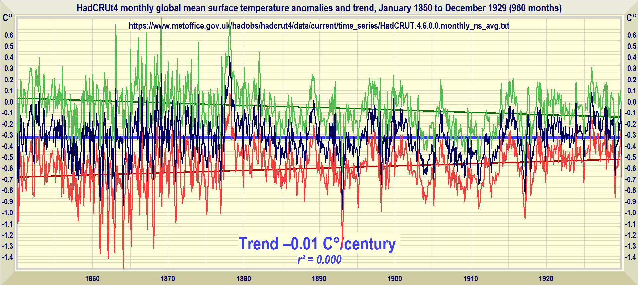
Equilibrium temperature in 1850
No trend for 80 years 1850-1929
$$E_{1}$$
$=$ 287 K

Slide 25
Emission temperature
$$R_{0}$$
Sunshine
term
$=$ 255 K
$$={ [{(S}_{0}/4)\left(1−α\right)/σ]}^{¼}$$
1365 W m ^{– 2} insolation $S_{0}$ (DeWitte & Nevens 2016)
0.3 albedo $α$ (Loeb 2009) :: $σ$ = 5.67 x 10^{–8}

Slide 26
The transfer function in 1850
Sunshine term: Emission temperature | 255 Kelvin
Plus non-condens. GHG warming to 1850 | 11 Kelvin
Equals reference temperature in 1850 | 266 Kelvin
Minus equilibrium temperature in 1850 | 287 Kelvin
Feedback response $E−R$ | 21 Kelvin
Transfer function in 1850: 287 / 266 | $$=1.1$$
” ” ” ” (feedback response 63 K) | $$=1.3$$

Slide 27
IT’S THE SUN: changes in solar radiance striking the ground
explain recent temperature changes
monckton@mail.com
Second equilibrium: 2011

Slide 28
Reference sensitivity, 1850-2011
$∆R_{1}=$ 0.3 x 2.3
$=0.7 K$
0.3 K W^{–1} m² Planck parameter (Schlesinger 1985)
2.3 W m^{–2} net anthro. forcing, 1850-2011 (IPCC 2013)

Slide 29
$$\text{Equilibrium} \text{sensitivity}\text{, 1850−2011}$$
$∆E_{2}=$ 0.75 [2.3 / (2.3 – 0.6)]
$=1.0 K$
0.75 K observed warming, 1850-2011 (HadCRUT4)
2.3 W m^{–2} net anthro. forcing, 1850-2011 (IPCC 2013)
0.6 W m^{–2} net radiative imbalance to 2009 (Smith 2015)

Slide 30
The transfer function in 2011
Reference temperature in 1850 | 266.0 Kelvin
Plus reference sensitivity, 1850-2011 | 0.7 Kelvin
Equals reference temperature in 2011 | 266.7 Kelvin
Equilibrium temperature in 1850 | 287.0 Kelvin
Plus equilibrium sensitivity, 1950-2011 | 1.0 Kelvin
Equals equilibrium temperature in 1850 | 288.0 Kelvin
Transfer function in 2011: 288 / 266.7 | $=1.1$.

Slide 31
IT’S THE SUN: changes in solar radiance striking the ground
explain recent temperature changes
monckton@mail.com
Charney sensitivity: 2xCO₂

Slide 32
Equilibrium sensitivity to 2xCO₂
(Charney sensitivity)
Reference sensitivity to doubled CO₂ | 1.1 K
Times transfer function in 1850 & 2011 | 1.1
Equals Charney sensitivity: 1.1 x 1.1 | $=$ 1.2 K
For comparison: IPCC (2013) | 1.5 - 4.5 K
CMIP5 general-circulation models | 2.1 - 4.7 K
Extremist papers in climate journals | up to 10 K

Slide 33
IT’S THE SUN: changes in solar radiance striking the ground
explain recent temperature changes
monckton@mail.com
Models’ chief physical error

Slide 34
0.32
Specific humidity (g kg^{–1}) at 300 mb (9 km a.g.l.)
NOAA ESRL: Kalnay et al. (1996 updated)
April 2018
0.28
0.24
2.5
Specific humidity (g kg^{–1}) at 600 mb (4.2 km a.g.l.)
2.3
2.1
1.9
12
Specific humidity (g kg^{–1}) at 1000 mb (near surface)
11
10
Prof. Ole Humlum: climate4you.com
9
1950 1954 1958 1962 1966 1970 1974 1978 1982 1986 1990 1994 1998 2002 2006 2010 2014 2018

Slide 35
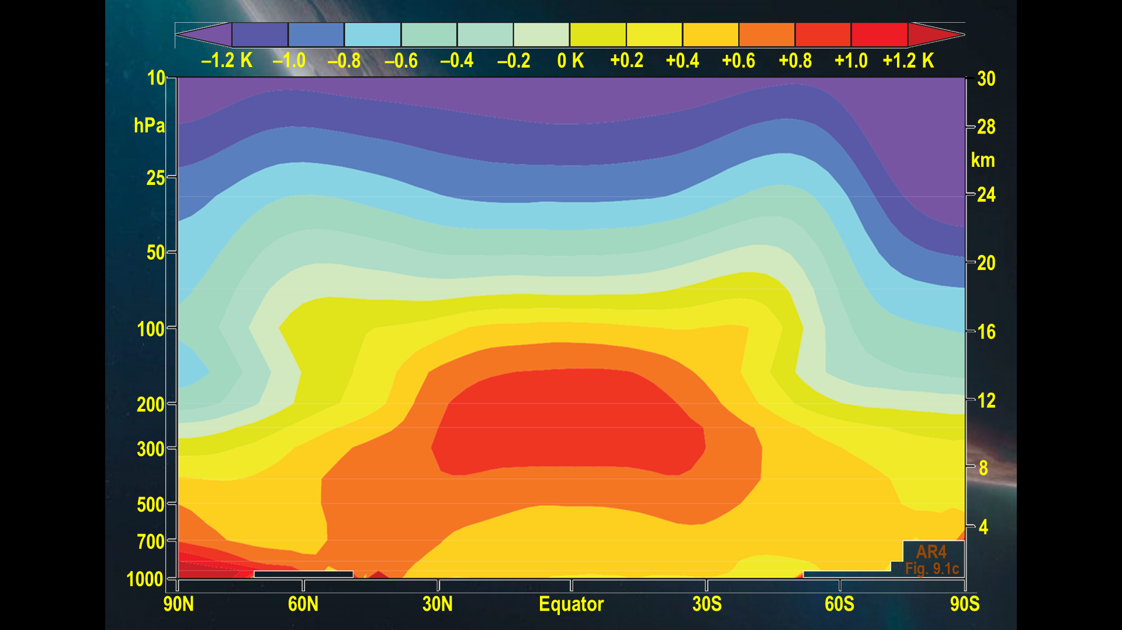
PREDICTED
AR4
fig. 9.1c

Slide 36
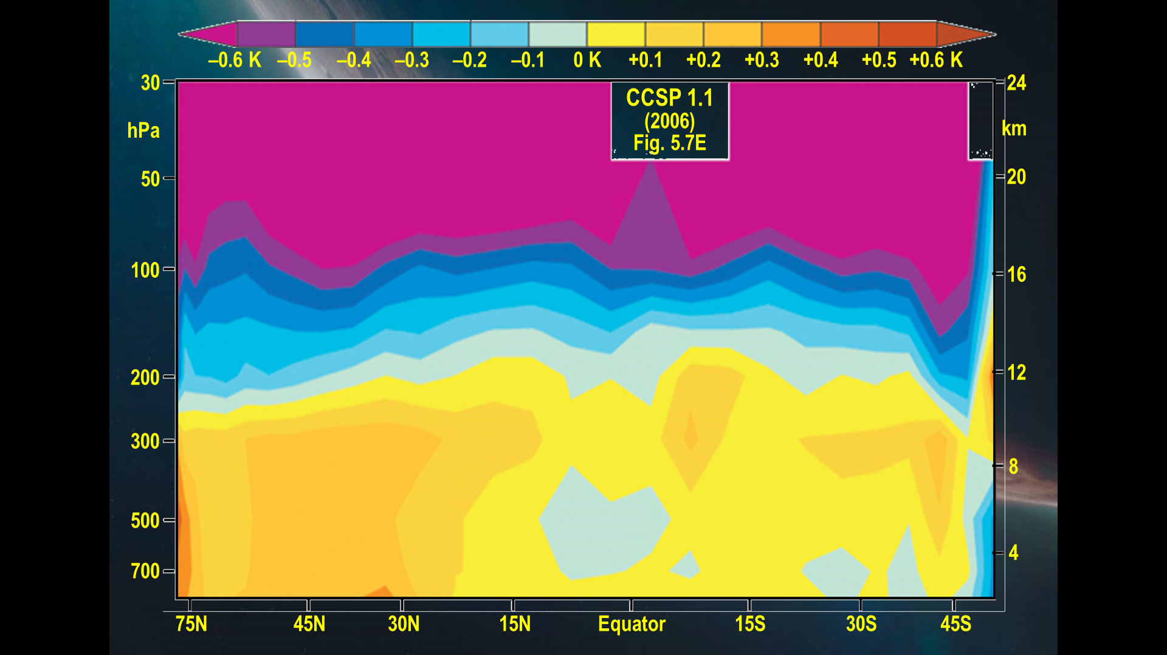
OBSERVED

Slide 37
IT’S THE SUN: changes in solar radiance striking the ground
explain recent temperature changes
monckton@mail.com
Don’t trust – verify

Slide 40
IPCC business-as-usual 1990-2030 3.30 K
IPCC biz-as-usual 1990-2025 2.78 K
RSS 2.10 K
Predicted
and observed
centennial-
equivalent
warming (K cent^{–1})
from 1990-2018
GISS 1.93 K
NCEI 1.82 K
HadCRUT4 1.72 K
UAH 1.28 K
MofB 1.17 K

Slide 41
IT’S THE SUN: changes in solar radiance striking the ground
explain recent temperature changes
monckton@mail.com
$2 σ$ confidence interval
of Charney sensitivities

Slide 42
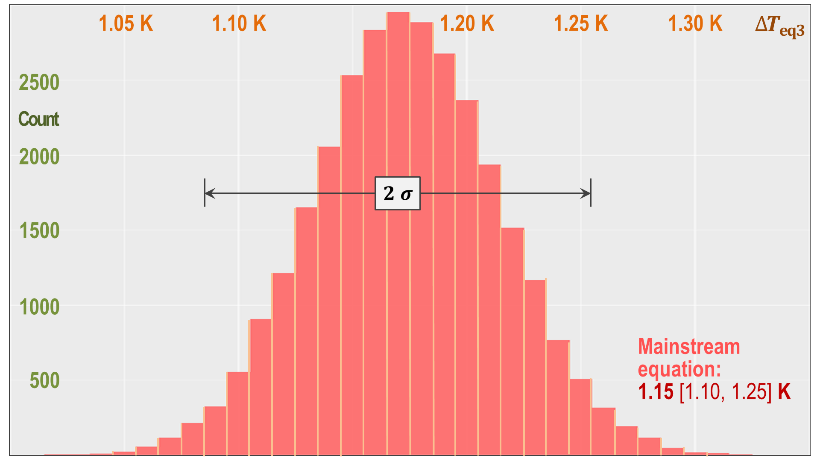
Monte Carlo
simulation:
30,000 trials
$2 σ$ uncertainties
$$1.17 [1.09, 1.25] K$$
{ }

Slide 43
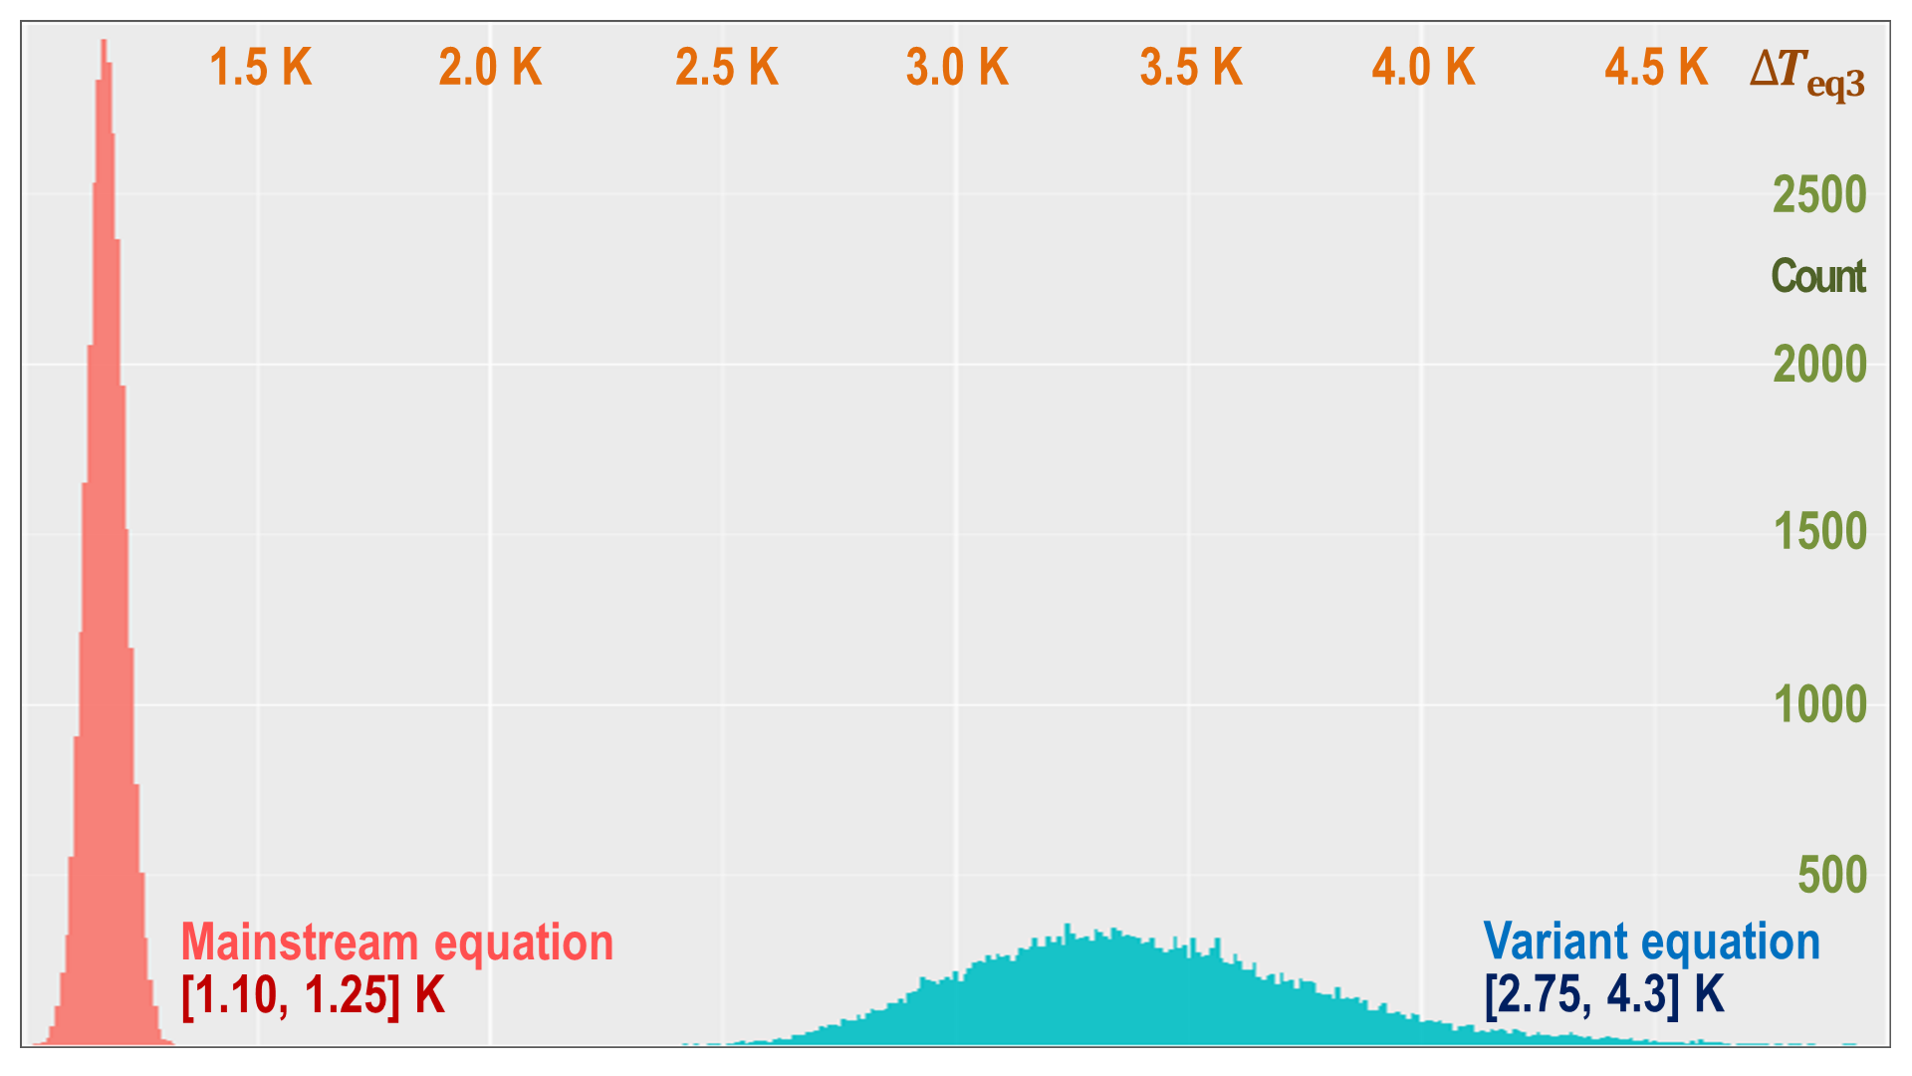
$1.17 [1.09, 1.25] K$: M of B
CMIP5: $3.37 [2.75, 4.30] K$

Slide 44
IT’S THE SUN: changes in solar radiance striking the ground
explain recent temperature changes
monckton@mail.com
THE BOTTOM LINE

Slide 45
10 K
9 K
8 K
7 K
6 K
5 K
4 K
3 K
2 K
1 K
0
Murphy 2009
CORRECTED SENSITIVITY
$f$ on 0.12 [ 0.08, 0.15 ]
${∆E}_{2}$ on 1.17 [ 1.09, 1.25 ] K
Andronova 2001
Forest 2006
Johansson 2015
Friedrich 2016
Armour 2017
$${∆E}_{2} =\frac{{∆R}_{2}}{1−f}$$
Charney sensitivity ${∆E}_{2}$
IPCC
CMIP5
Feedback response
Reference sensitivity $∆R_{2}$ on 1.1 [1.0, 1.2] K
0.0 0.1 0.2 0.3 0.4 0.5 0.6 0.7 0.8 0.9
Feedback factor f

Slide 46
Charney sensitivities compared
4.7 C°
CMIP5
3.35 C°
2.1 C°
4.5 C°
IPCC
(3.0 C°)
1.5 C°
1.25 C°
Too little to
cause harm
1.17 C°
1.09 C°

Slide 47
IT’S THE SUN: changes in solar radiance striking the ground
explain recent temperature changes
monckton@mail.com
End of the global warming
crisis in a single slide

Slide 48
1850: Reference temperature | 266 K
Equilibrium temperature | 287 K
Transfer function | 287 / 266 | 1.1
2011: Reference temperature | 266 K + 0.7 K | 266.7 K
Equilibrium temperature | 287 K + 1.0 K | 288 K
Transfer function | 288 / 266.7 | 1.1
2xCO₂: Planck parameter | 0.3 K W^{–1} m²
CO₂ radiative forcing | 3.5 W m^{–2}
Charney sensitivity | 0.3 x 3.5 x 1.1
1.2 K

Slide 49
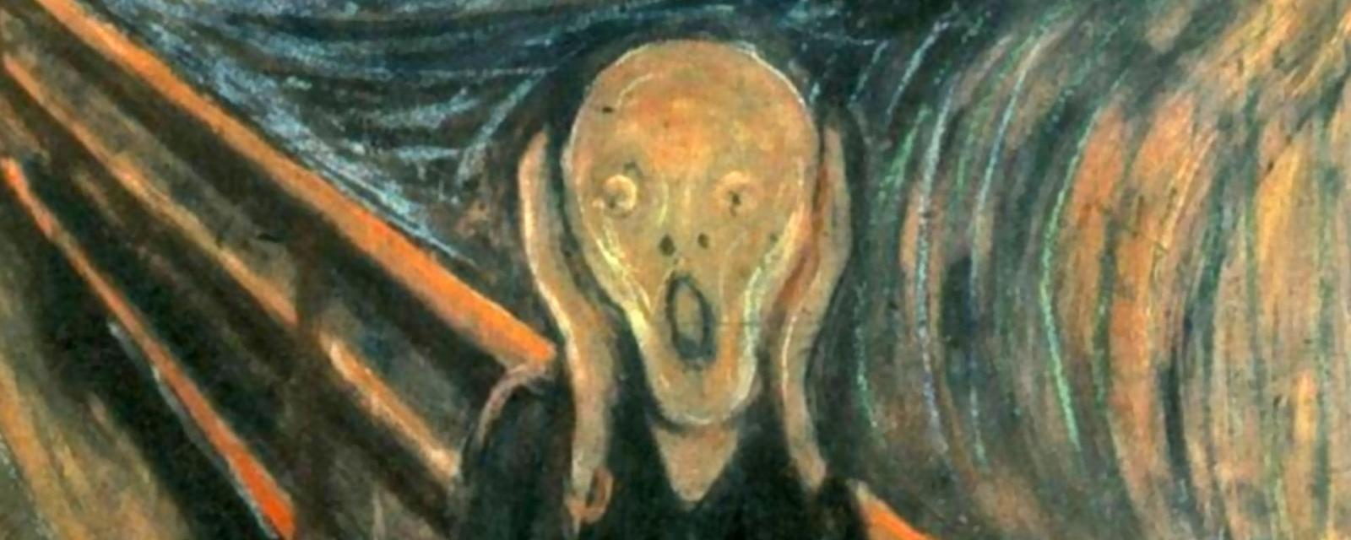
UEA,
IPCC,
UN, IMF,
UNFCCC
et hoc genus omne

