Slide 1
Cooling of Climate sensitivity François Gervais Emeritus Professor of Physics at the University of Tours (France) Expert reviewer of Intergovernmental Panel on Climate Change (IPCC) AR5 The author acknowledges support of Association des climato-réalistes
Basic Science of a changing climate – Porto – September 7-8 2018

Slide 2
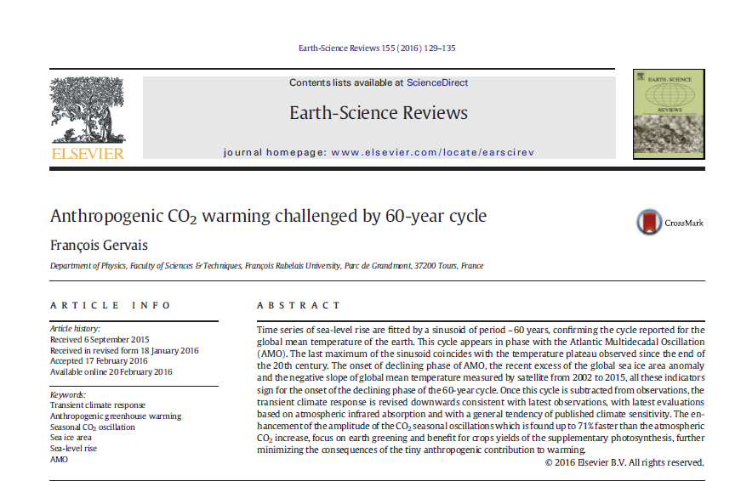

Slide 3
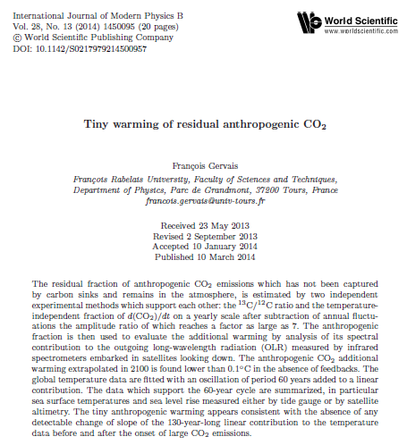

Slide 4
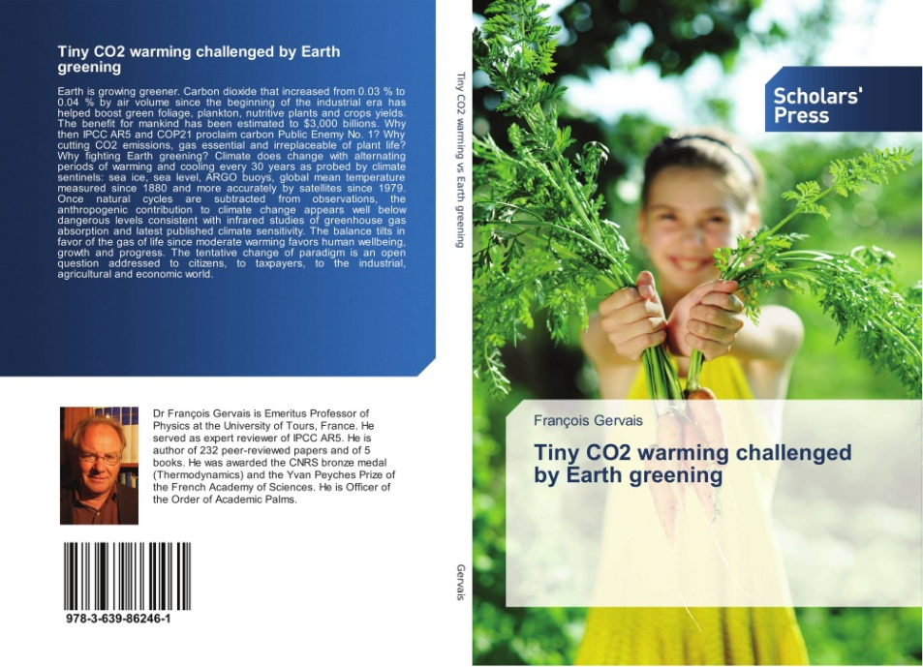

Slide 5
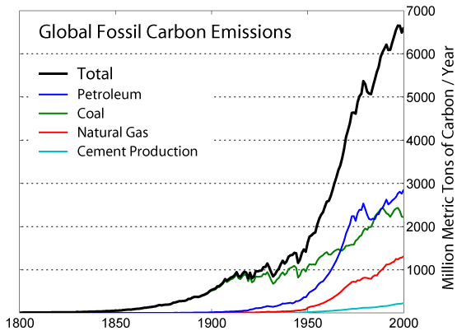
Correlation of Earth temperature and CO2 emissions?
Oil
Coal
Gas
Cement

Slide 6
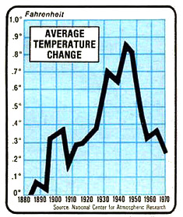
30-year cooling contradicted by CO2 acceleration Two 30-year temperature increases with the same amplitude unrelated to x4 CO2 increase in the meantime
Oil
Coal
Gas
Cement

Slide 7
Good fit with a ~ 60-year cycle
Oil
Coal
Gas
Cement

Slide 8
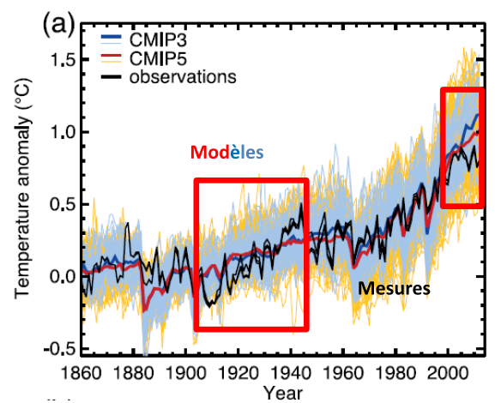
Good fit with a ~ 60-year cycle Agreement better than IPCC CMIP5 models (Fig. TS.9a of AR5)
Oil
Coal
Gas
Cement

Slide 9
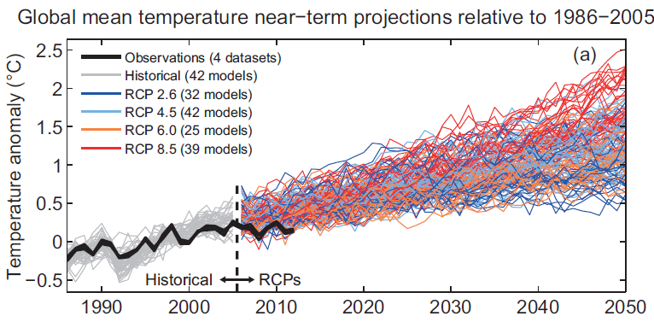
Ignoring natural variability, IPCC CMIP5 models diverge (i) from measurements (ii) from each others
Models
Measurements
Figure TS.14(a) of IPCC AR5

Slide 10
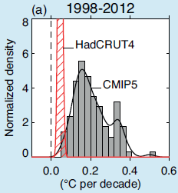
The « pause » in warming is shown by IPCC AR5 itself No significant warming in a period corresponding to almost 1/3 of total emissions since the beginning of the industrial era Models run 2 to 10 times too hot Climate alarmism is not validated
Measurements
Models
Figure 1(a) of Box TS3 of IPCC AR5

Slide 11
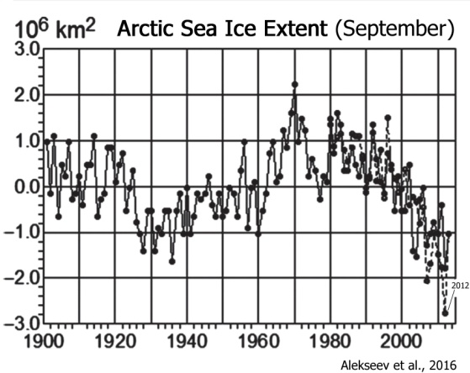
The ~ 60-year cycle fits other climate sentinels
Data: Fig. 3.14 of IPCC AR5

Slide 12
60-year cycle reported in many peer-reviewed papers
Schlesinger and Ramankutty 1994, Atlantic Multidecadal Oscillation
Ogurtsov et al 2002
Klyashtorin and Lyubushin 2003
Loehle 2004
Zhen-Shan and Xian 2007,
Carvalo et al 2007
Swanson and Tsonis 2009,
Scafetta 2009, 2016, tide effect of largest planets of the solar system
Akasofu 2010
D’Aleo and Easterbrook 2010
Loehle and Scafetta 2011
Humlum et al 2011
Chambers et al 2012
Lüdecke et al 2013
Courtillot et al 2013
Akasofu 2013
Macias et al 2014
Ogurtsov et al 2015
Ollila 2017
Largest amplitude
of 60 year cycle
Temperature
Velocity of sun with respect to the
center of mass of the solar system

Slide 13
In peer-reviewed literature, tendency: cooling of climate sensitivity (warming in case of CO2 doubling) published in peer-reviewed journals TCR : Transient climate response ECS : Equilibrium climate sensitivity Uncertainty larger than in IPCC AR5: 1.5-4.5°C (ECS) Is it the alternative or post-modern definition of « consensus »?
A: Andronova & Schlesinger 2001, B: Forest et al 2002, C: Knutti et al 2002, D: Gregory et al 2002, E: Frame et al 2005, F: Forest et al 2006, G: Tomassini et al 2007, H: Allen et al 2009, I: Lin et al 2010, J: Spencer & Braswell 2010, K: Lindzen & Choi 2011, L,e: Libardoni & Forest 2011, M: Olsen et al 2012, N,i: Schwartz 2012, O,g: Aldrin et al 2012, P: Ring et al 2012, Q,h: Rojelj et al 2012, R: Aspen 2012, S,k: Otto et al 2013, T,l: Lewis 2013, U: Skeie et al 2014, V: Lewis & Curry 2014, W: Ollila 2014, X,p: Loehle 2015, Y: Soon et al 2015, Z: Monckton et al 2015, α: Kissin 2015, β: Tan et al 2016, γ: Bates 2016, δ: Abbott & Marohasy 2017, ε: Harde 2017, ζ: Holmes 2017, η: Lewis & Curry 2018, θ: Dessler et al 2018, λ: Smirnov 2018, μ: Skeie et al, a: Stott & Forest 2007, b: Knutti & Tomassini 2008, c: Gregory & Foster 2008, d: Meinshausen et al 2009, f: Padilla et al 2011, g: Gillett et al 2012, j: Harris et al 2013, m: Skeie et al 2014, n: Lewis & Curry 2014, o: Harde 2014, p: Gervais 2016, q: Ollila 2017, r: Lewis & Curry 2018, s: Booth 2018
IPCC AR5

Slide 14
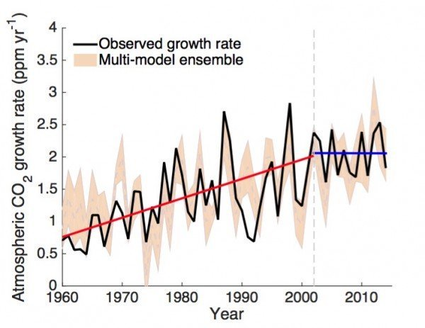
Average increase of CO2 in air : 2 ppm/yr since 2002
+100 ppm
till 2068
2068 : possible end of known reserves
of oil and gas
at the present rate
of consumption (BP)
(Ollila 2018)
Keenan, T.F. et al, 2016. Nature Communications

Slide 15
Both atomic vibrations of the CO2 molecule absorb at 20 et 70 THz the thermal radiation emitted by the Earth at both these frequencies 1 THz = 1000 billions of oscillations per second
CO2 greenhouse effect is so efficient that it is (almost) saturated
Saturation
Continuation of rainbow beyond red in the infrared wavelengths (Farmer 1974)

Slide 16
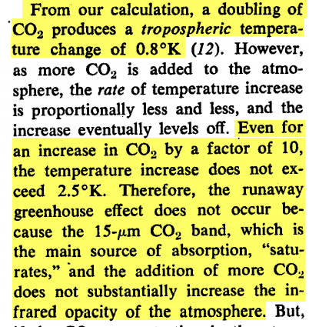
CO2 greenhouse effect (almost)« saturates »
Harde (2014), Kissin (2015), Abbott & Marohasy (2017), Ollila (2017):
climate sensitivity: 0.6°C
By differenciating the Stefan Boltzmann equation σT⁴ = F_{OLR}
4 ΔT/T = ΔF/F
ΔT = T/4 x ΔF/F
Radiative forcing ΔF = 3.12 ln(2) = 2.2 W/m²
288/4 x 3.12 x ln(2)/238.5 = 0.6°C
ΔT = 0.9 ln(C/C0)
+ 2 ppm CO2/yr
ΔT = 0.9 ln(508/408)
= +0.2°C in 2068
(ΔT = +0.3°C with TCR = 1°C)
Rasool and Schneider, Science 1971

Slide 17
~ 40 % of all CO₂ emitted since 1900 had NO IMPACT on temperature measured independently by satellites in the low stratosphere ( ~ 17 km) Remote Sensing System (o) and UAH (l)
« Hiatus » since a quarter of century strongly constrains climate sensitivity confirming ≤ 0.6°C

Slide 18
~ 40 % of all CO₂ emitted since 1900 had NO IMPACT on temperature measured independently by satellites in the low stratosphere ( ~ 17 km) Remote Sensing System (o) and UAH (l)
« Hiatus » since a quarter of century strongly constrains climate sensitivity confirming ≤ 0.6°C
-2.4°C expected from Sloan and Wolfendale (2013)

Slide 19
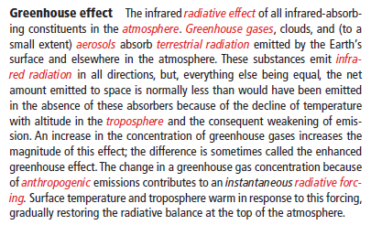
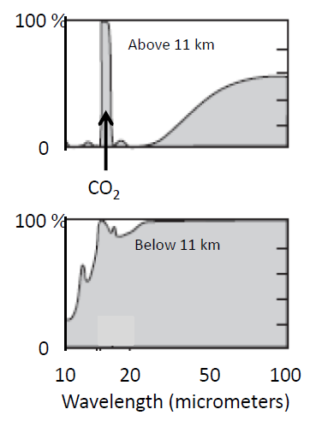
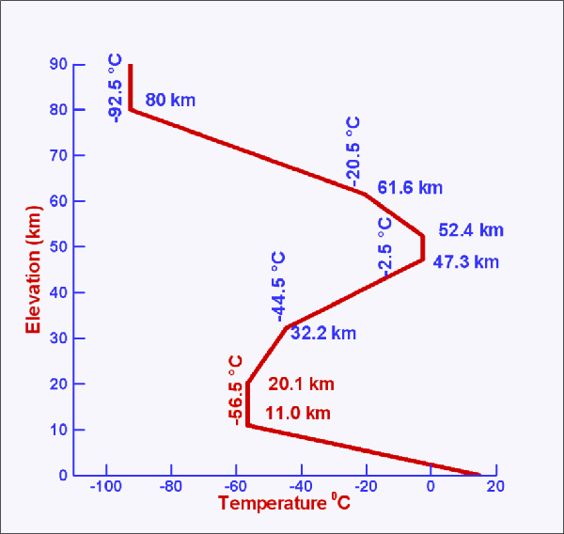
Theory of Greenhouse effect in the Glossary of IPCC AR5
Adapted from Fig. 8.1 of Salby (2012)

Slide 20
Above 11 km, where CO2 absorption is still 100 %, there is no decrease of temperature and, therefore, no weakening of emission: confirms low climate sensitivity
Might balance
warming due
to emission
in the wings
of CO2 band
in the
troposphere
Maximum of
black body
spectral emission at 255 K
“Saturation” depends on atmospheric pressure: absorbed heat dissipated by collisions at low altitude, by emission at high altitude
Infrared absorption of atmosphere
Goody & Young (1995)

Slide 21
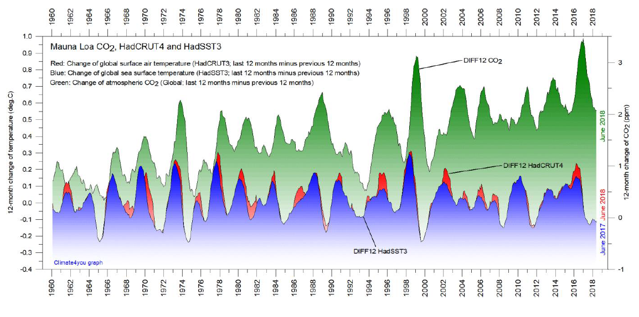
Is the CO2 so dangerous that it warms Earth before it has been emitted?! Humlum, O., Stordahl, K., Solheim, J.E., 2013. Global & Planetary Change 100, 51 If the fluctuating contribution is released from the oceans, then the anthropogenic contribution might be only 0.9ln(1.06) = 0.05°C in 2068
www.climate4you.com

Slide 22
No correlation CO2/temperature, consistent with TCR = 0.6°C AGW contribution of 0.9 ln(408/285) = 0.3°C since 1880 is LOWER than natural variability

Slide 23
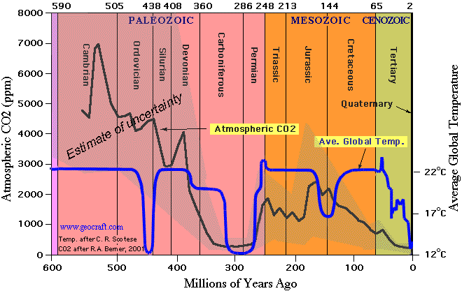
No correlation CO2/temperature consistent with TCR = 0.6°C
CO2 doubling or dividing by 2 is negligible
with respect to actual temperature variations
Fleming Env. Earth Sci. 2018

Slide 24
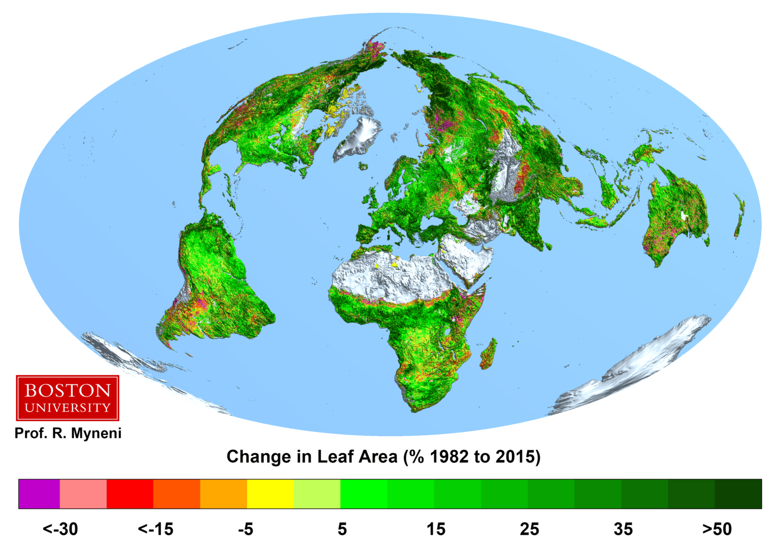
Earth greening equivalent of a 6th green continent of 18 millions km²
Zhu et al Nature Climate Change (2016)
« Equivalent of a 6th green continent of 18 millions km² »
Zhu et al Nature Climate Change (2016)

Slide 25
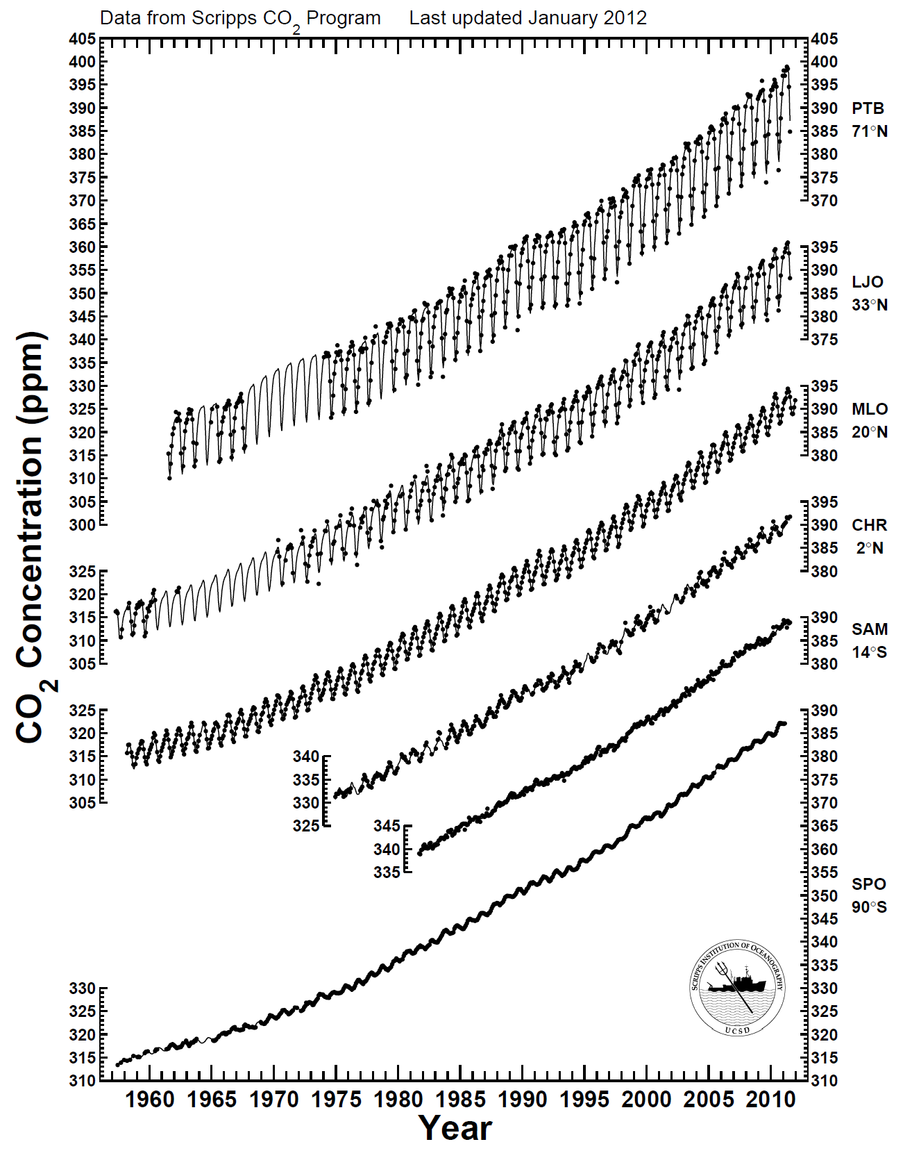
In the absence of proof of CAGW, consider the benefit of CO2
Seasonal oscillation of atmospheric CO2 as a function of latitude
The increase is maximum where there is growing vegetation around like at La Jolla (California)
La Jolla
Mauna Loa
6 ppm
en 2013
5 ppm
en 1959
Antarctica

Slide 26
3 000 milliards d’euros.^{[1]}
Seasonal drop at La Jola increased 71 % more rapidly than CO2!
Till 2068: benefit of 2.6/450 x 50 yrs = 29 % of additional plant biomass
2.6 GtC = estimate of yearly increase of biomass due to anthropogenic emissions
450 GtC = total Earth plants
Recovery of CO2
during drop
of leaves in the
Northern
hemisphere

Slide 27
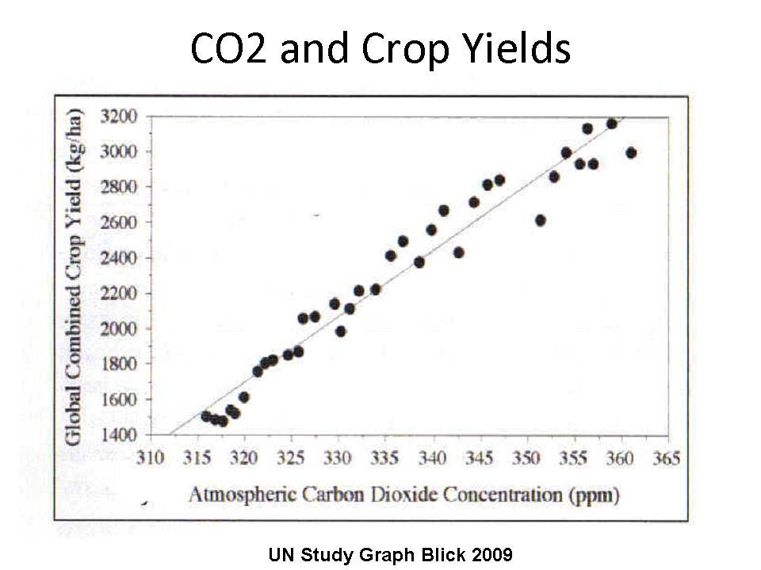
3 000 milliards d’euros.^{[1]}
An increased concentration of CO₂ – essential and irreplaceable for plant feeding – favors crop yield:
1961-2011: benefit of € 3000 billions (Idso)
^{[1]}
Blick 2009

Slide 28
Climate does change in particular with alternating periods of warming and cooling every 30 years
Is the anthropogenic contributions of 0.2°C till 2068 (0.3°C with climate sensitivity of 1°C) a threat?
Future benefit of 29 % of additional plants biomass
Past benefit of € 3000 billions of increase of crop yields
francois.gervais@univ-tours.fr

