Slide 1
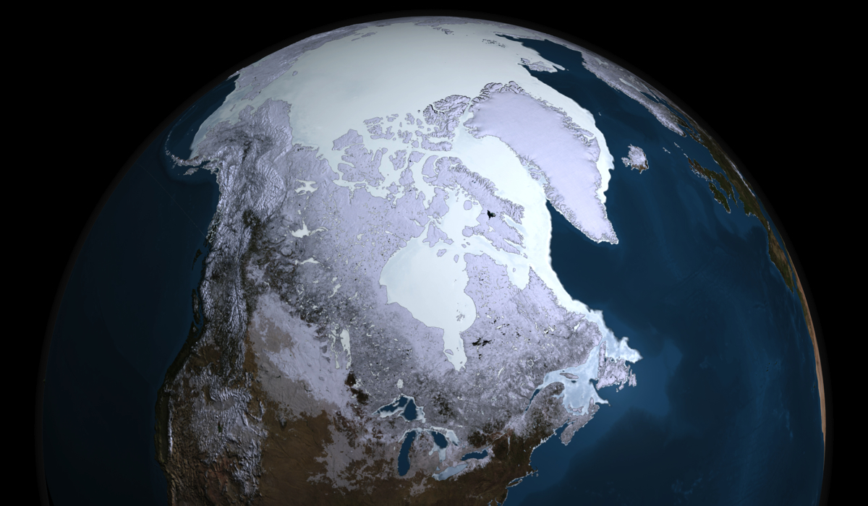
New Planetary Temperature Model and Its
Implications for Understanding of Earth’s Climate History
Ned Nikolov, Ph.D. and Karl Zeller, Ph.D.
Independent Researchers
Fort Collins CO, USA

Slide 2

Purpose of this Talk:
Present an extension to the NZ semi-empirical model (Nikolov & Zeller 2017) that accurately describes latitudinal surface temperature gradients on rocky planets & moons in addition to the average global temperature.
Discuss implications of the extended NZ model for a qualitatively new understanding about drivers of Earth’s paleoclimate.
Early Eocene
51,000,000 Years Ago
Global Temp. = 31.6 ºC
Last Glacial Maximum
22,000 Years Ago
Global Temp. = 7.2 ºC

Slide 3
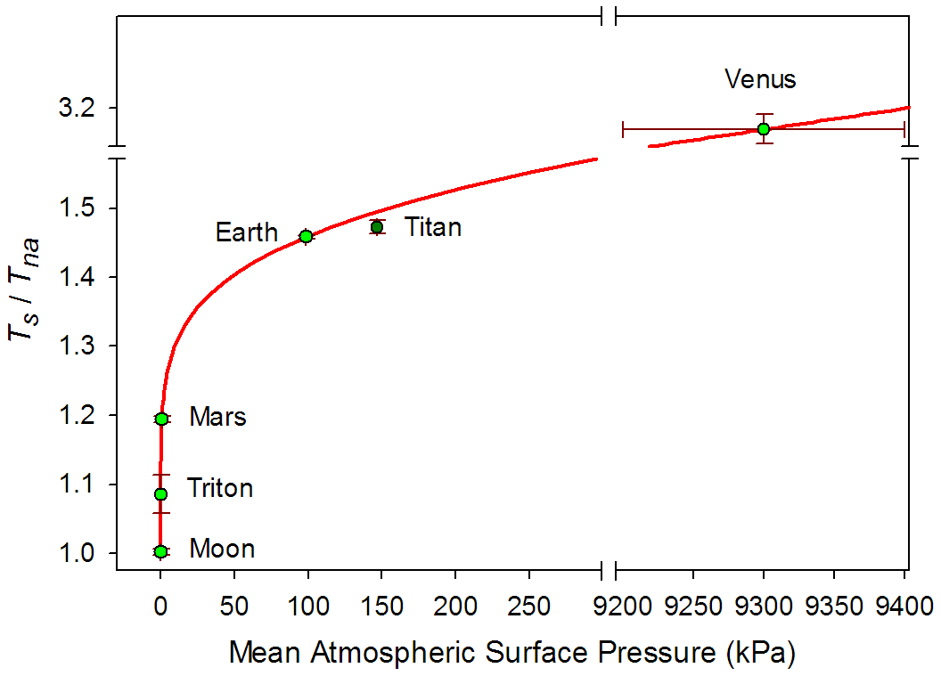
Empirical Model Based on NASA Data:
Atmospheric Thermal Effect (T_{s}/T_{na}) vs. Total Surface Pressure
Nikolov N, Zeller K (2017) New insights on the physical nature of the atmospheric greenhouse effect deduced from an empirical planetary temperature model. Environ Pollut Climate Change 1:112, doi: 10.4172/2573-458X.1000112

Slide 4
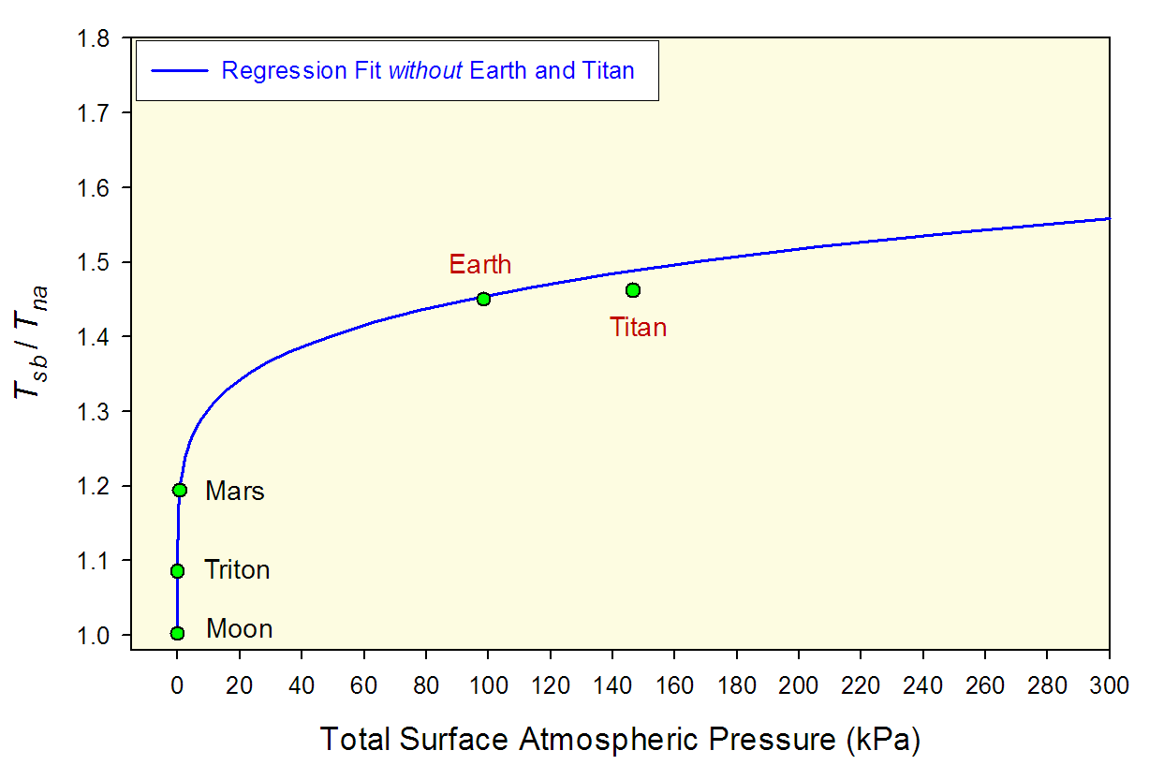
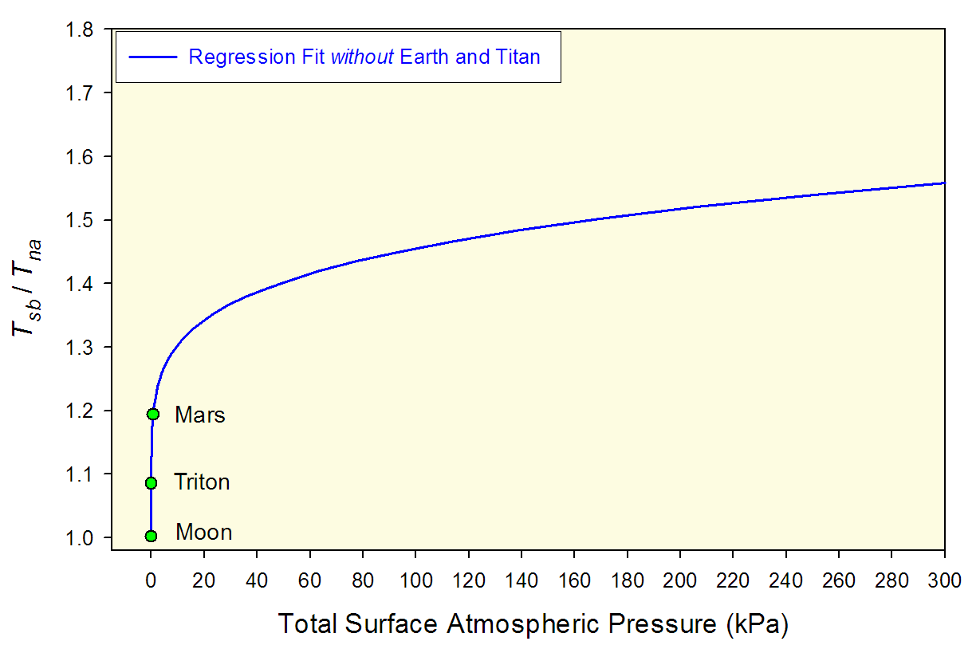
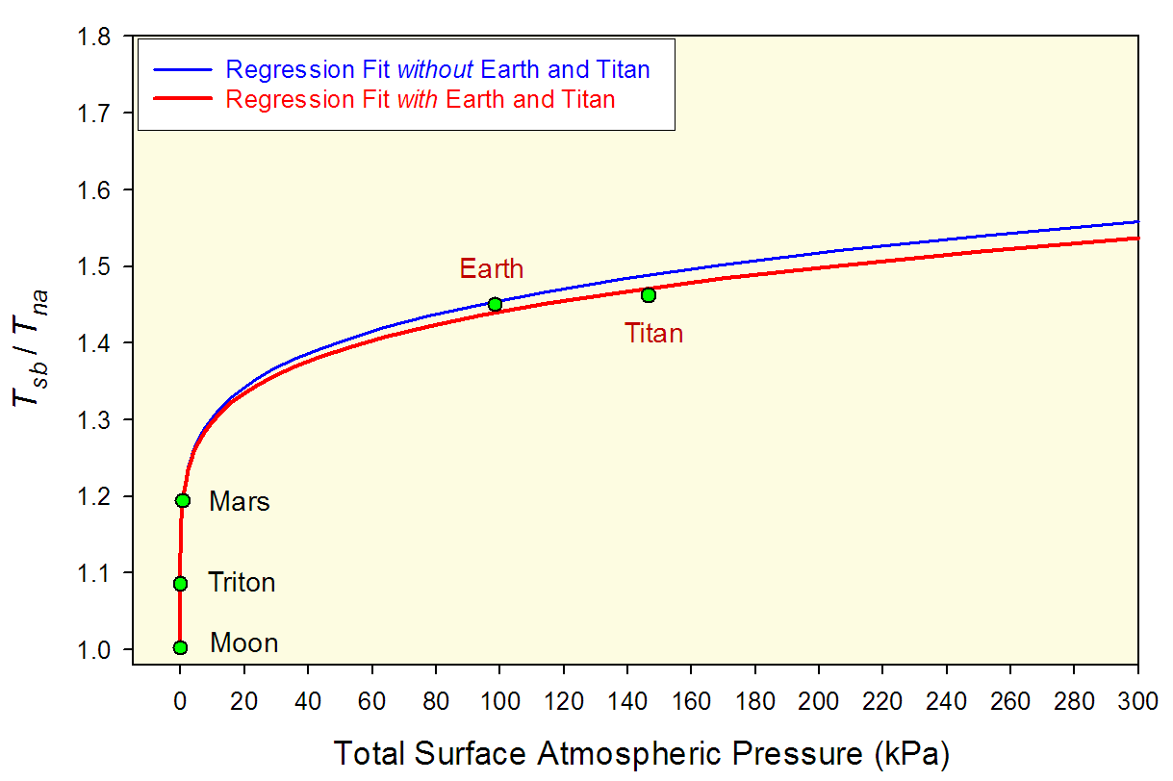
NZ Model Robustness

Slide 5
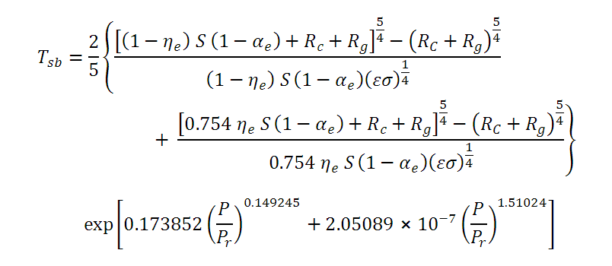
Baseline Global Surface Temperature (T_{sb}) as a Function of
TOA Solar Irradiance (S) and Total Atmospheric Pressure (P)
Relative Atmospheric Thermal Enhancement, E_{a} (-)
Airless Spherical Average Global Temperature, T_{na} (K)
© Ned Nikolov
August 2018

Slide 6
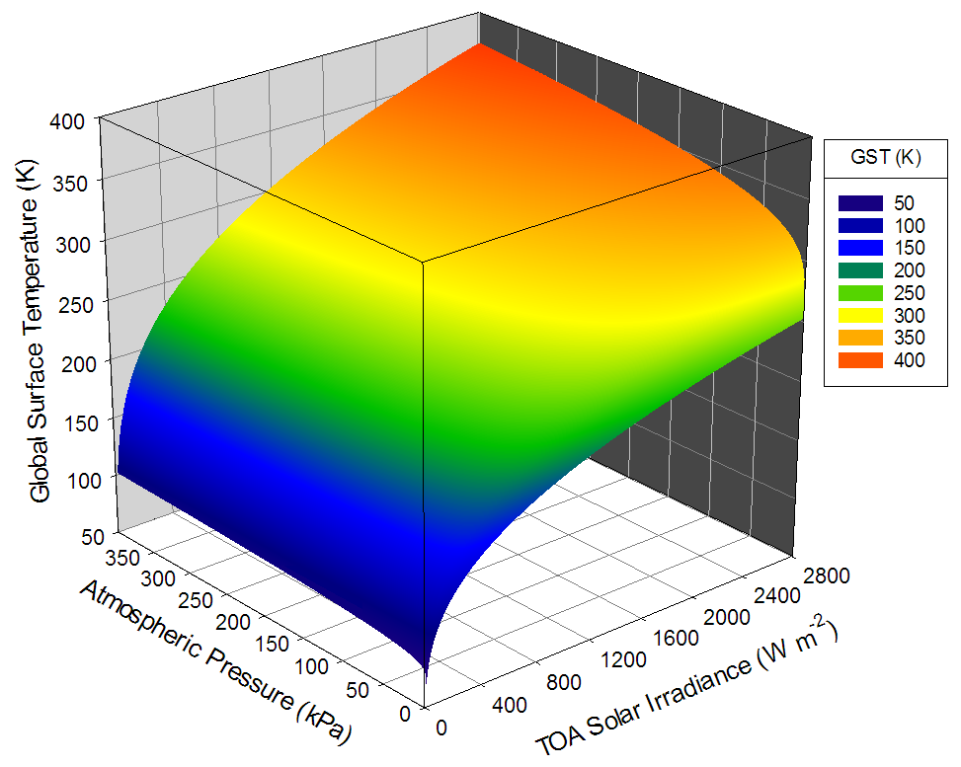
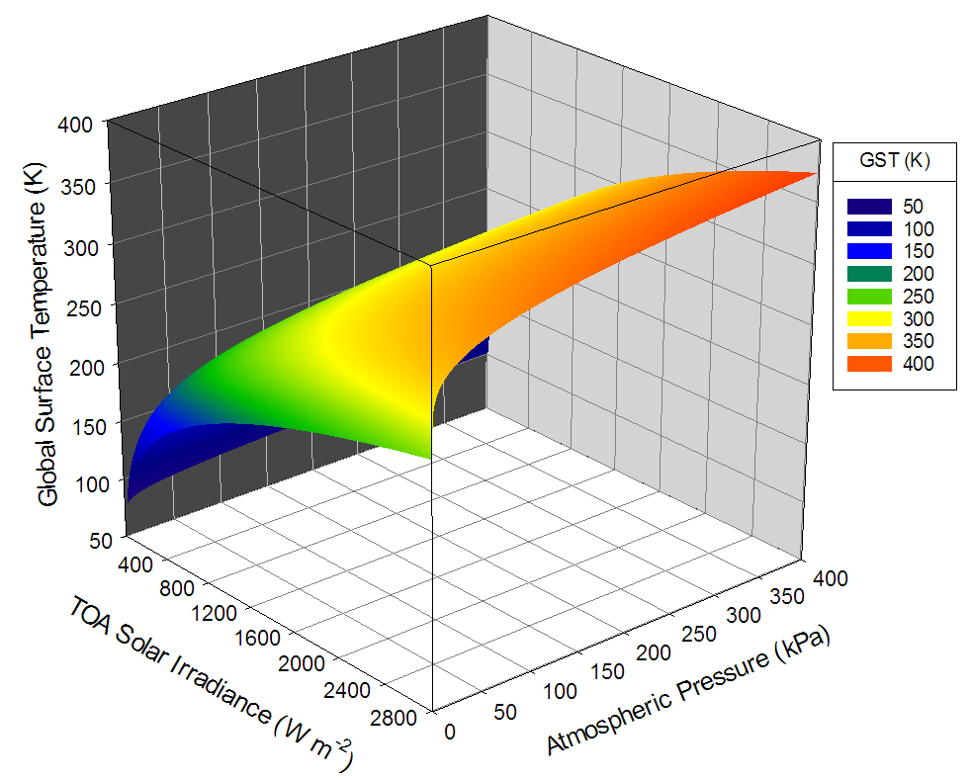
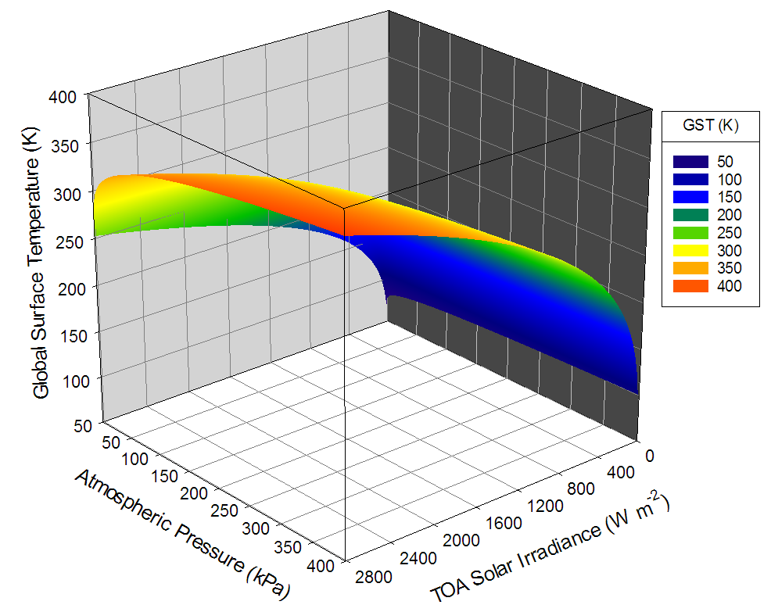
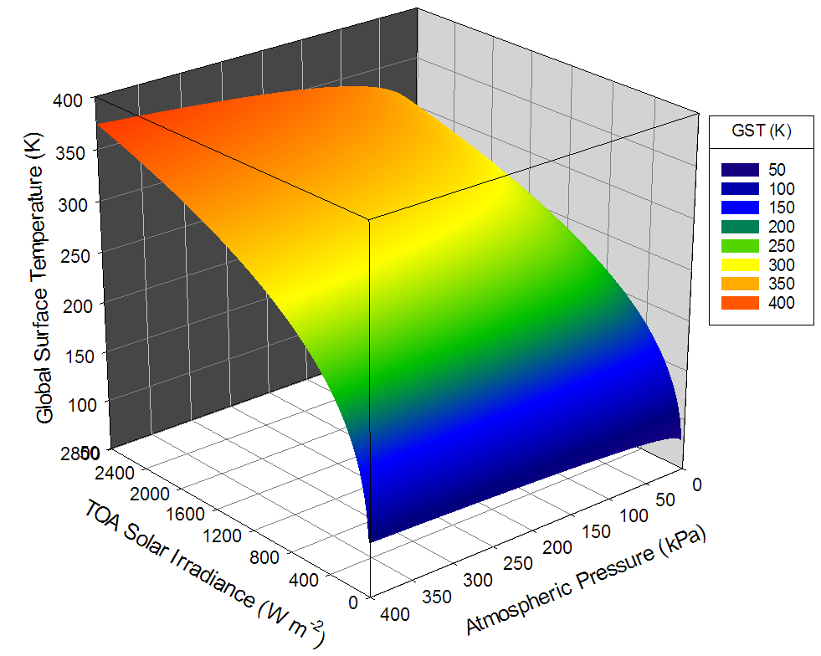
Baseline Global Surface Temperature (GST) as a Function of
TOA Solar Irradiance and Total Atmospheric Pressure

Slide 7
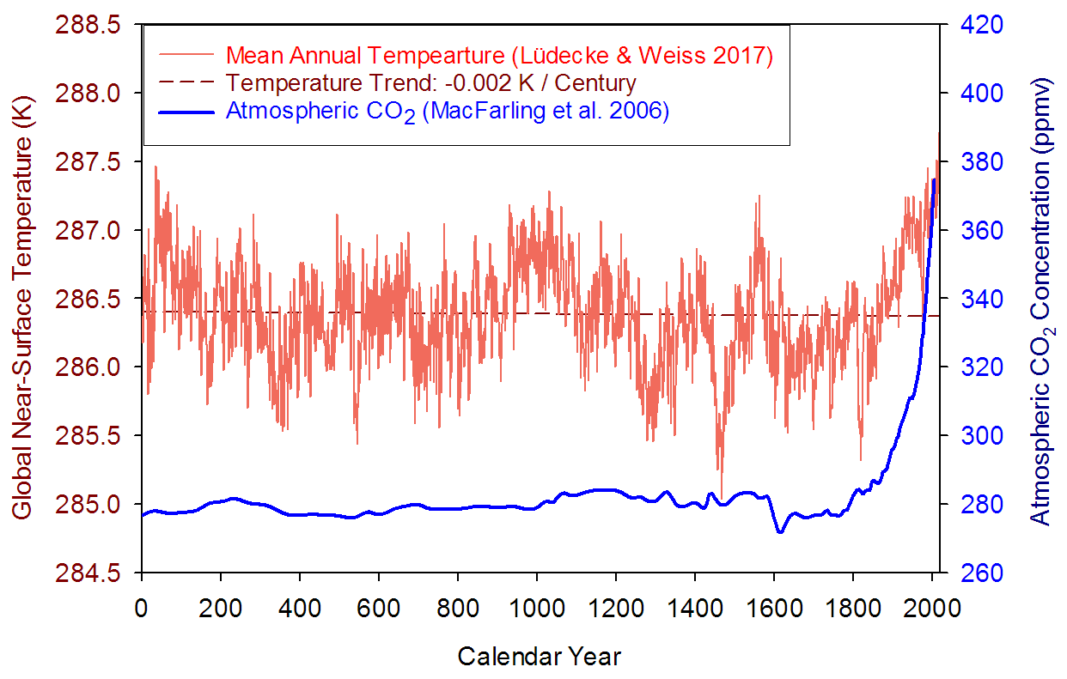
Earth’s Baseline Global Surface Temperature for the Past 2000 years: 286.4 K (+13.2 ºC)
Baseline
Temperature
© Ned Nikolov
August 2018

Slide 8
If the baseline Global Surface Temperature of a planet is predictable from Solar Irradiance and Total Atmospheric Pressure, what about the average temperatures at other latitudes?
Can we predict the average surface temperature at the Equator (T_{eq}),
60-degree absolute latitude (T₆₀), and the Polar Region (T_{p})?
Method: Model Temperature Gradients via Dimensional Analysis
If
T_{bs} = Baseline Global Surface Temperature
ΔT_{lat} = Meridional Temperature Gradient (T_{eq} – T_{p})
Then find:
ΔT_{lat} = ƒ₁(x), T_{eq} – T_{bs} = ƒ₂(x), T_{bs} – T₆₀ = ƒ₃(x),
where x is an unknown driver of the latitudinal temperature gradients.
Once the above gradients are defined, then T_{p} = T_{eq} – ΔT_{lat}
What is the nature of x ?
We found: Across planetary bodies of the Solar System, latitudinal temperature gradients can accurately be predicted from near-surface atmospheric molar density ρ_{m} (mol m⁻³), i.e. x = ρ_{m.}

Slide 9
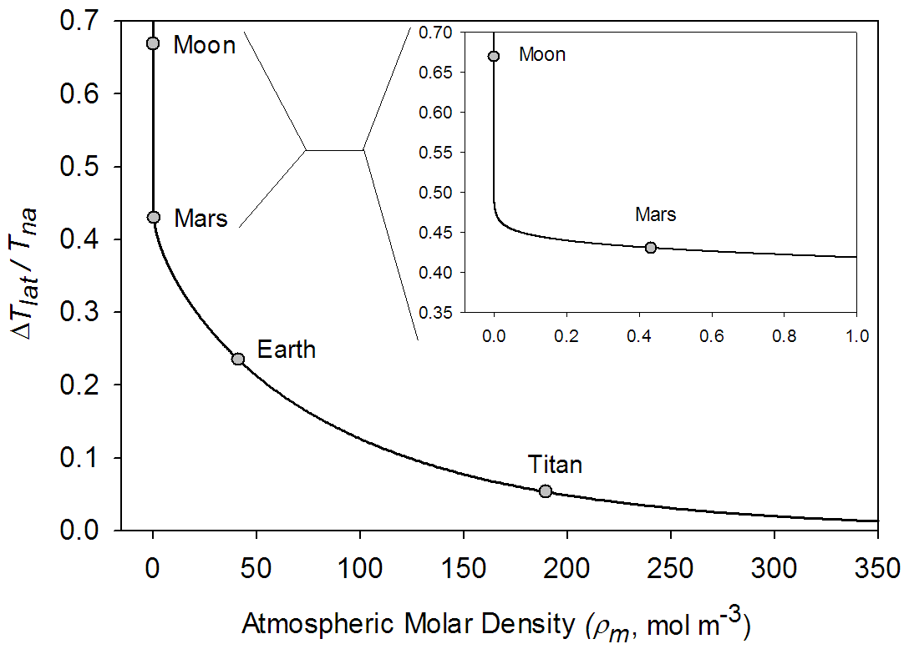
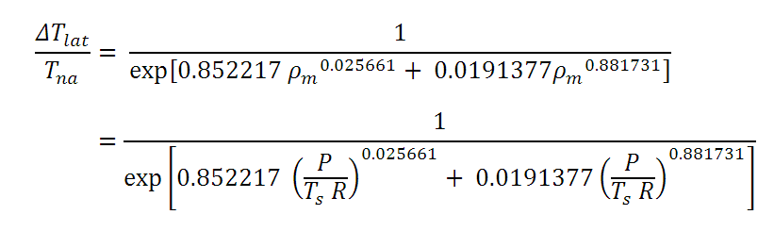
Empirical Model Based on NASA Data:
Meridional Temperature Gradient vs. Atmospheric Density
ΔT_{lat} = Equator-to-Pole (Meridional) Temperature Gradient (K)
T_{na} = Spherical Average Global Airless Surface Temperature (K)

Slide 10
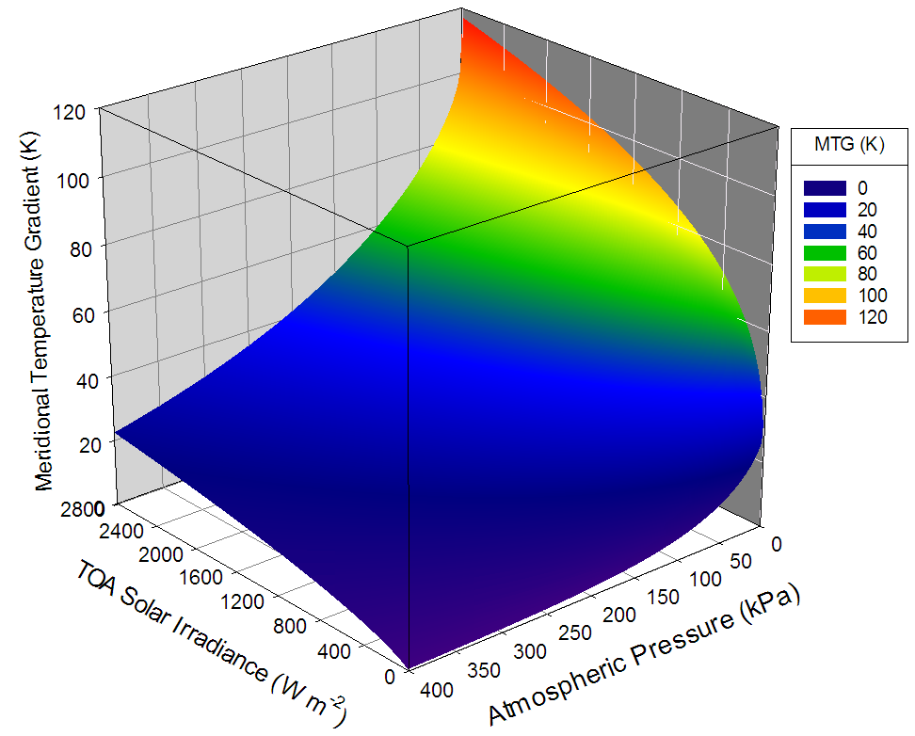
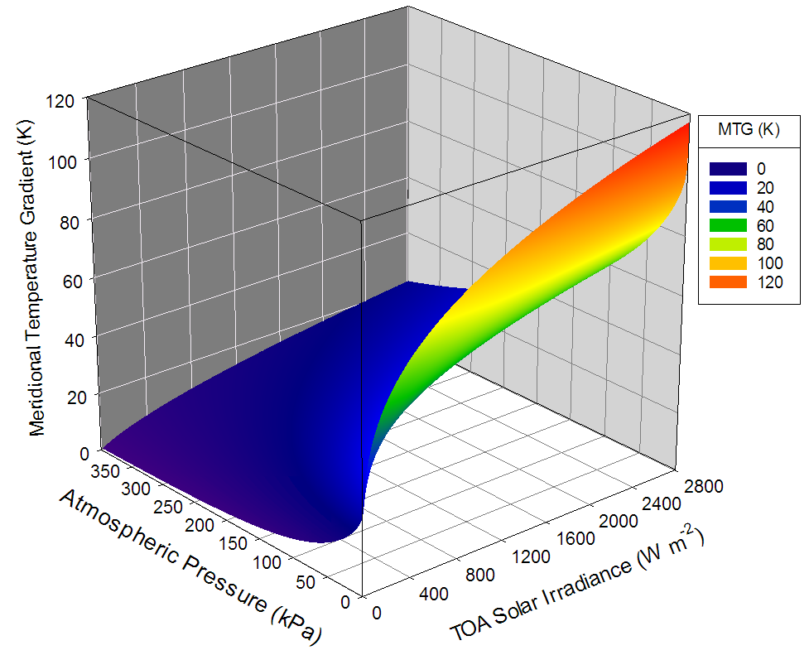
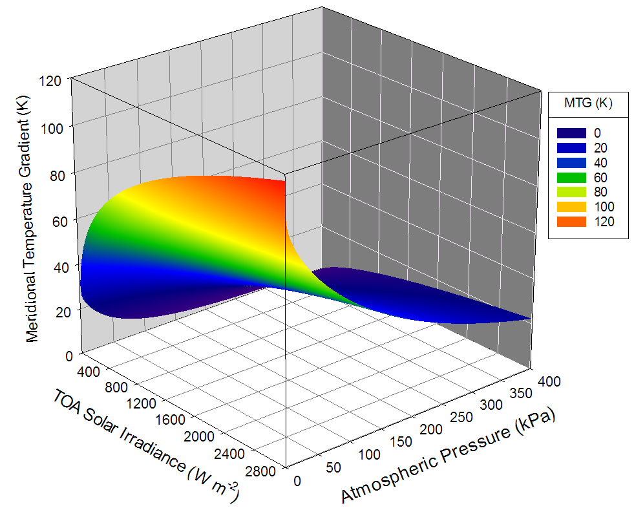
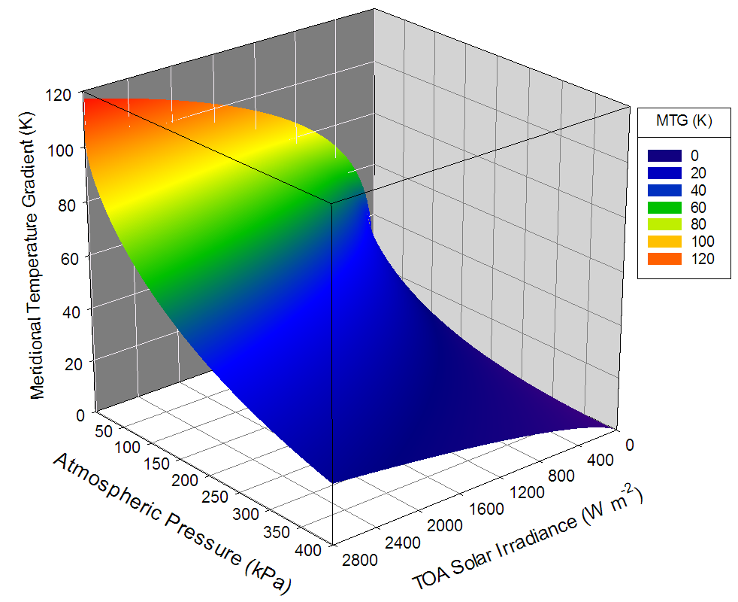
Meridional Temperature Gradient (MTG) as a Function of
TOA Solar Irradiance and Total Atmospheric Pressure

Slide 11
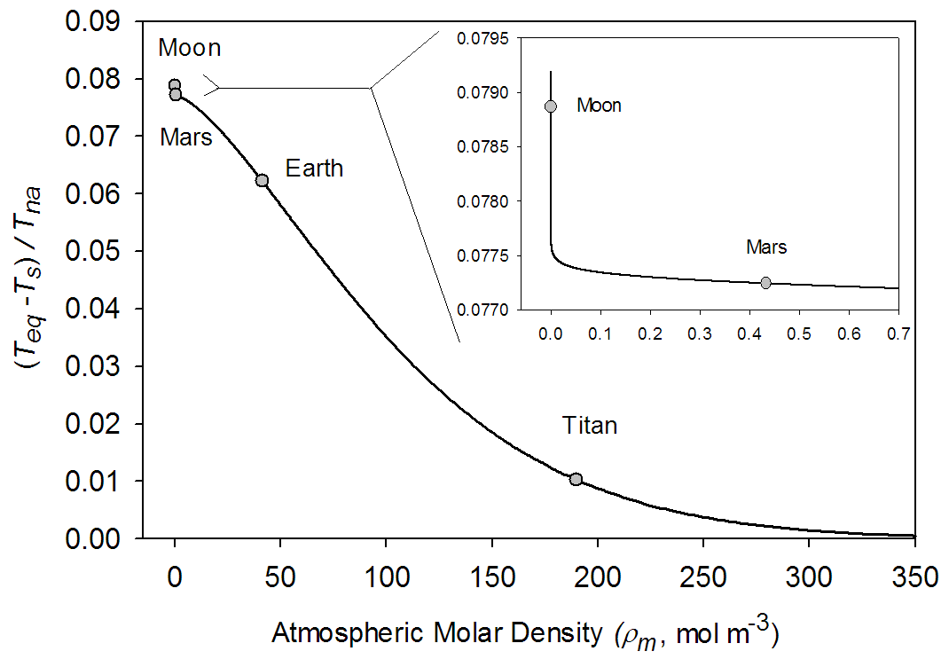
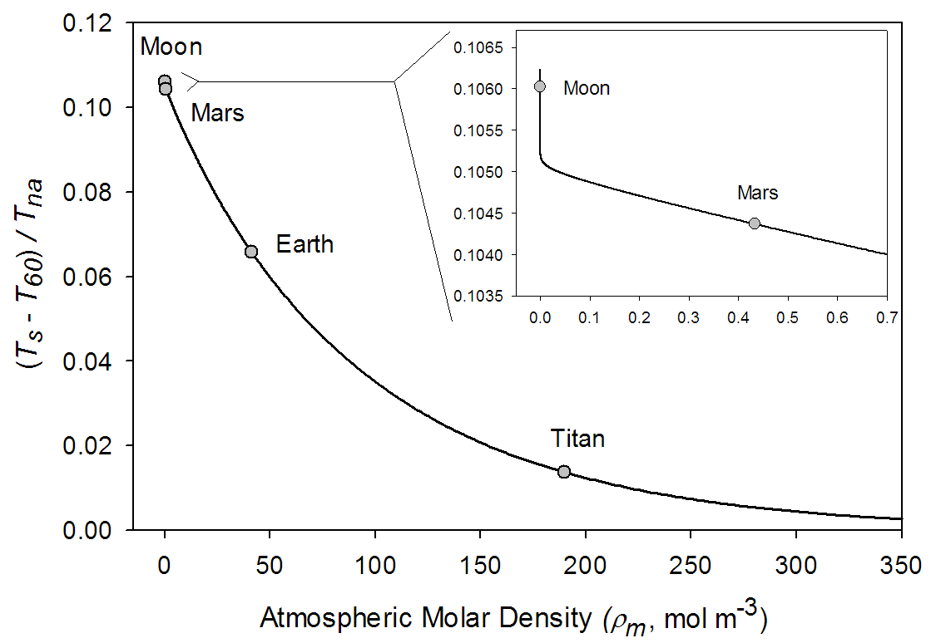
Empirical Model Based on NASA Data:
Temperature Gradients vs. Atmospheric Density
T_{eq} = Equatorial Mean Annual Surface Temperature (K)
T_{s} = Spherically Averaged Global Mean Annual Surface Temperature (K)
T₆₀ = Mean Annual Surface Temperature at 60 degree Absolute Latitude (K)
T_{na} = Spherical Average Global Airless Surface Temperature (K)

Slide 12
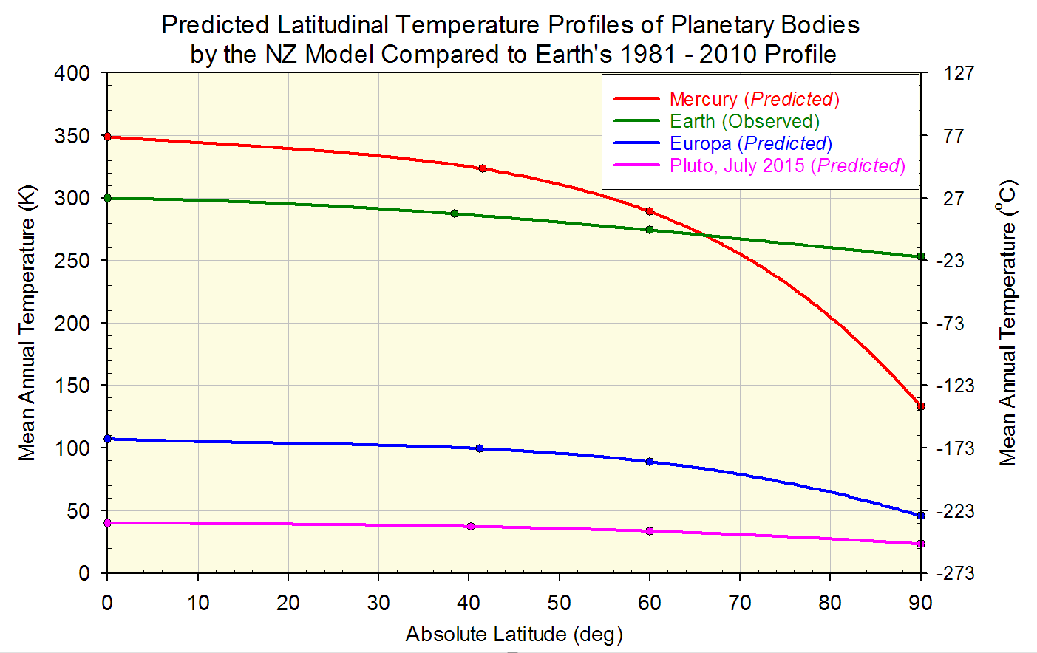
NZ Model Predictions for Mercury, Europa, and Pluto

Slide 13
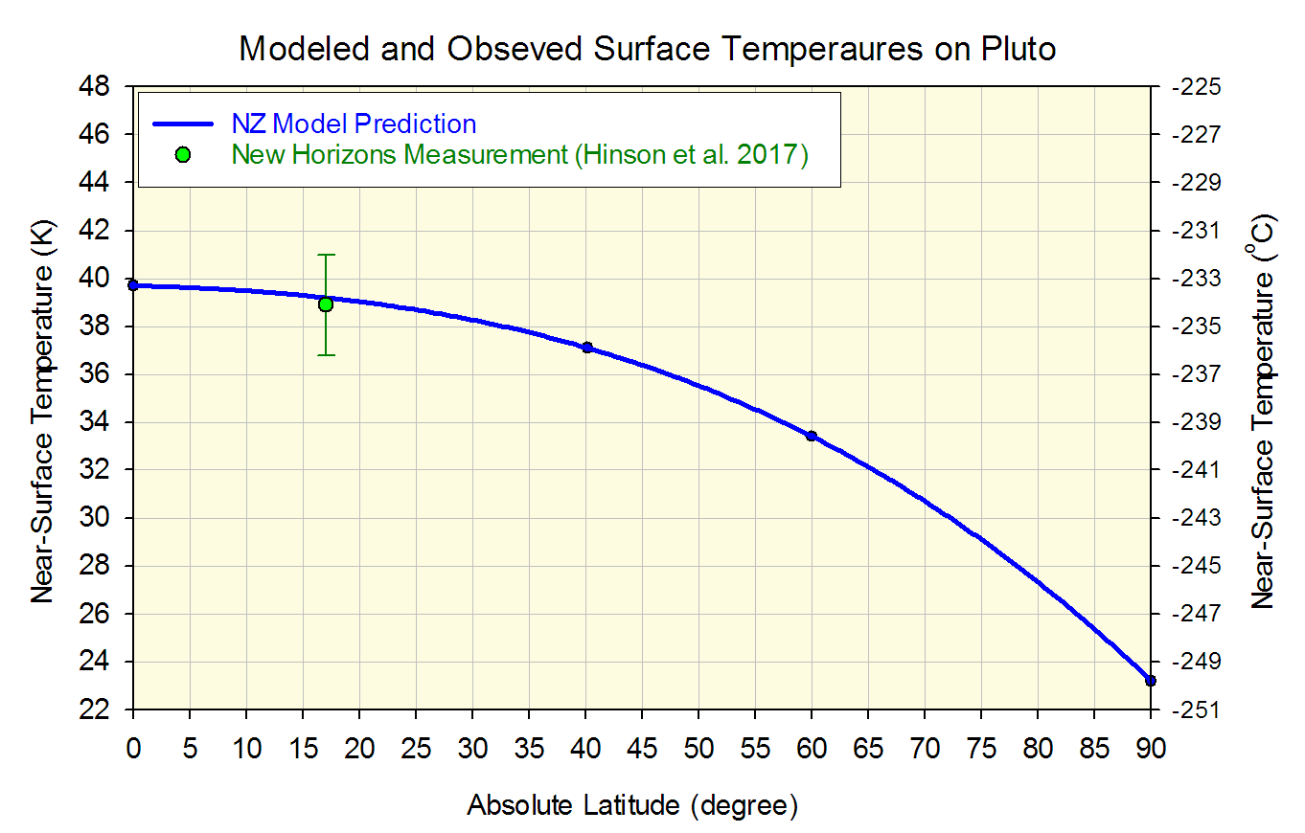
Pluto’s Near-Surface Temperatures
Data Reference: Hinson et al. (2017) Radio occultation measurements of Pluto’s neutral atmosphere with New Horizons. Icarus, 290:96-111.

Slide 14
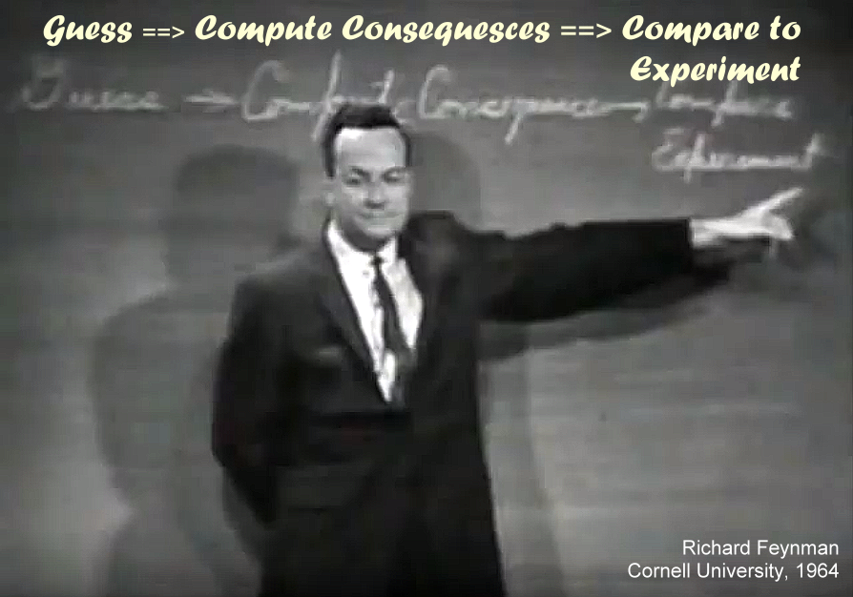
Application of the New Planetary Temperature Model
to Investigate Drivers of Earth’s Paleoclimate
Employing Method of Richard Feynman

Slide 15
Application of the New Planetary Temperature Model
to Study Drivers of Earth’s Paleoclimatic Changes
Employing Method of Richard Feynman
Make a Guess (Formulate a Hypothesis):
Changes in Earth’s Global Surface Air Temperature (GSAT) observed in the geological record on time scales of thousands to millions of years are caused by variations in total atmospheric pressure and do not depend on greenhouse-gas concentrations.
Compute Consequence of the Guess (Hypothesis Test):
A model assuming that variations in total atmospheric pressure were the main driver of Earth’s past climatic changes should correctly reproduce the observed Polar Temperature Amplifications in the geological record.
Compare Model Computations to Observations (Hypothesis Verification):
If the model correctly reproduces independent reconstructions of Equatorial and Polar paleo-temperature dynamics (i.e. past Polar Amplifications), then the Hypothesis is considered verified.

Slide 16
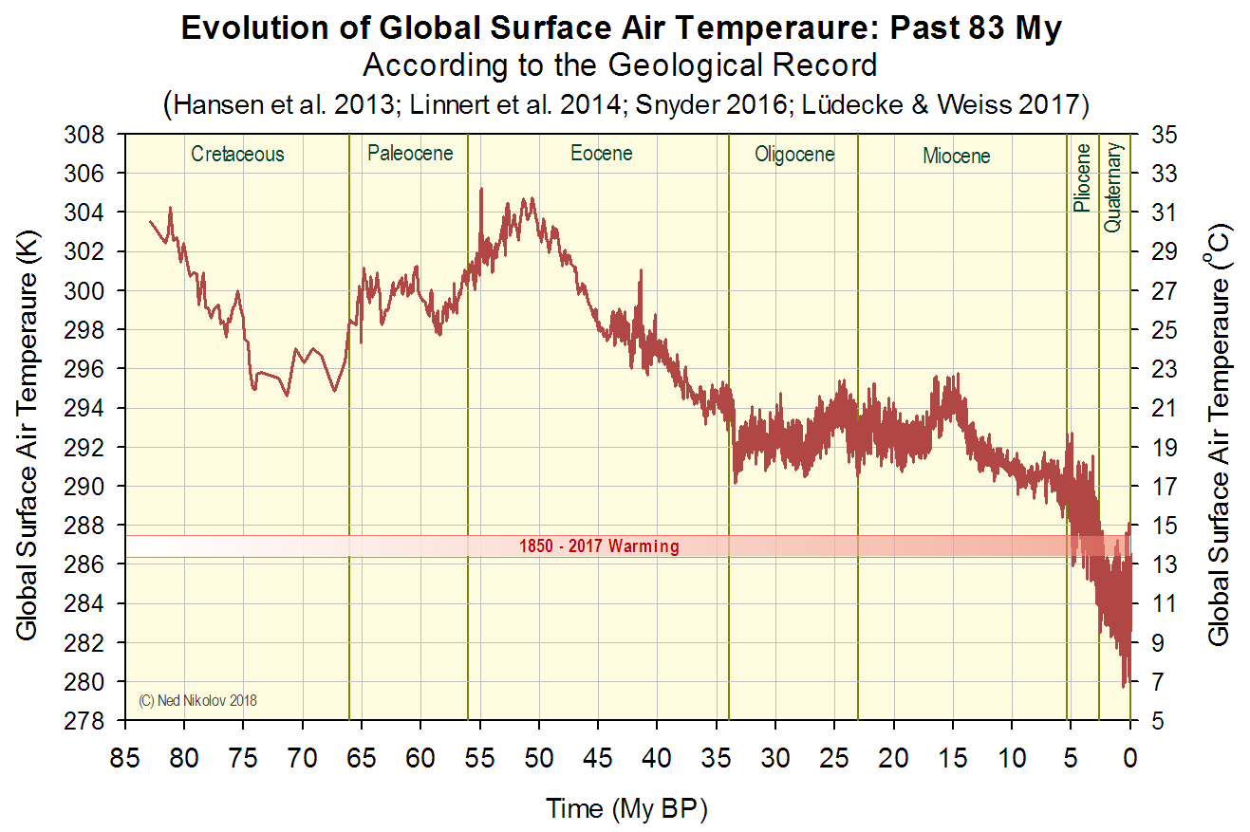
What Has Caused these Paleoclimatic Changes?

Slide 17
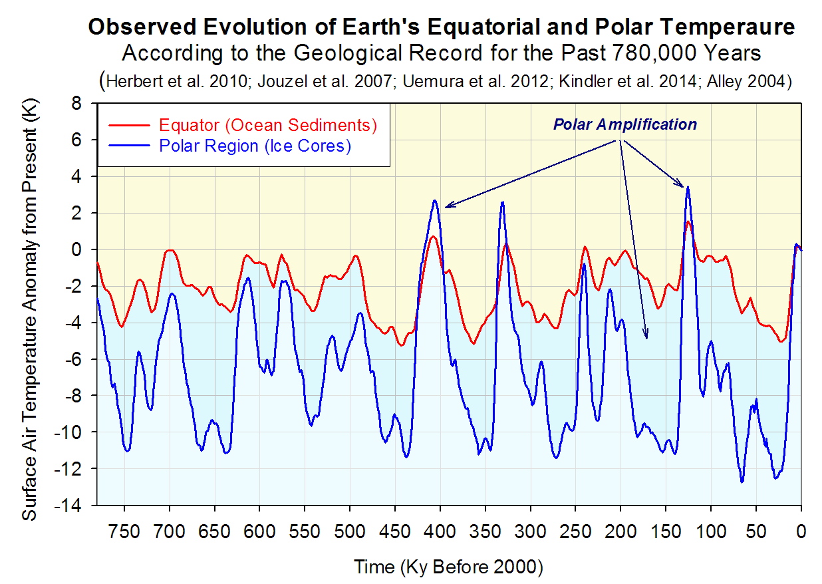
Quaternary Climate Change & Polar Amplification

Slide 18
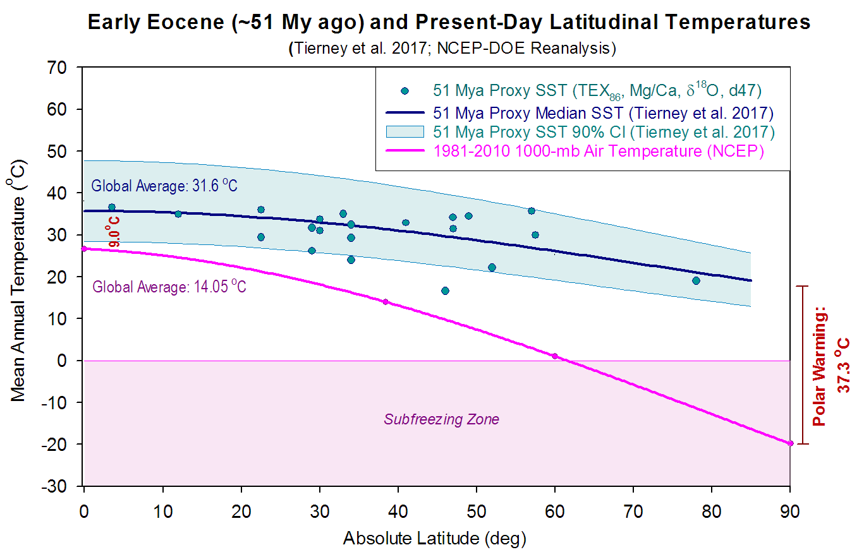
Early Eocene Temperatures & Polar Amplification
Data Reference: Tierney et al. (2017) Eocene temperature gradients. Nature Geoscience, 10:538-539

Slide 19
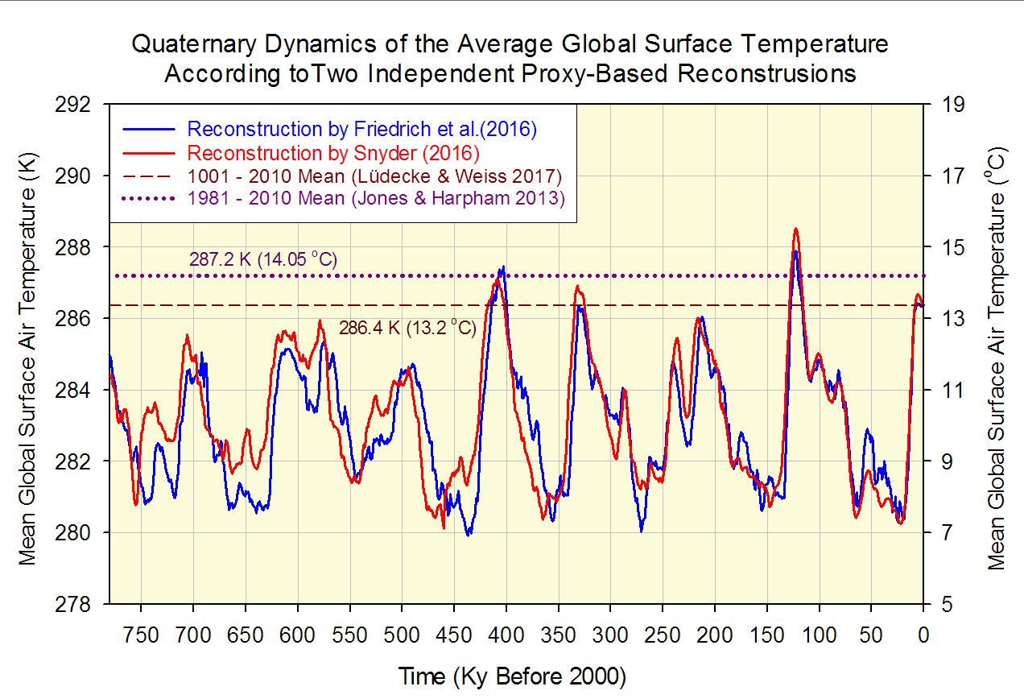
Global Climate Dynamics during the Quaternary

Slide 20
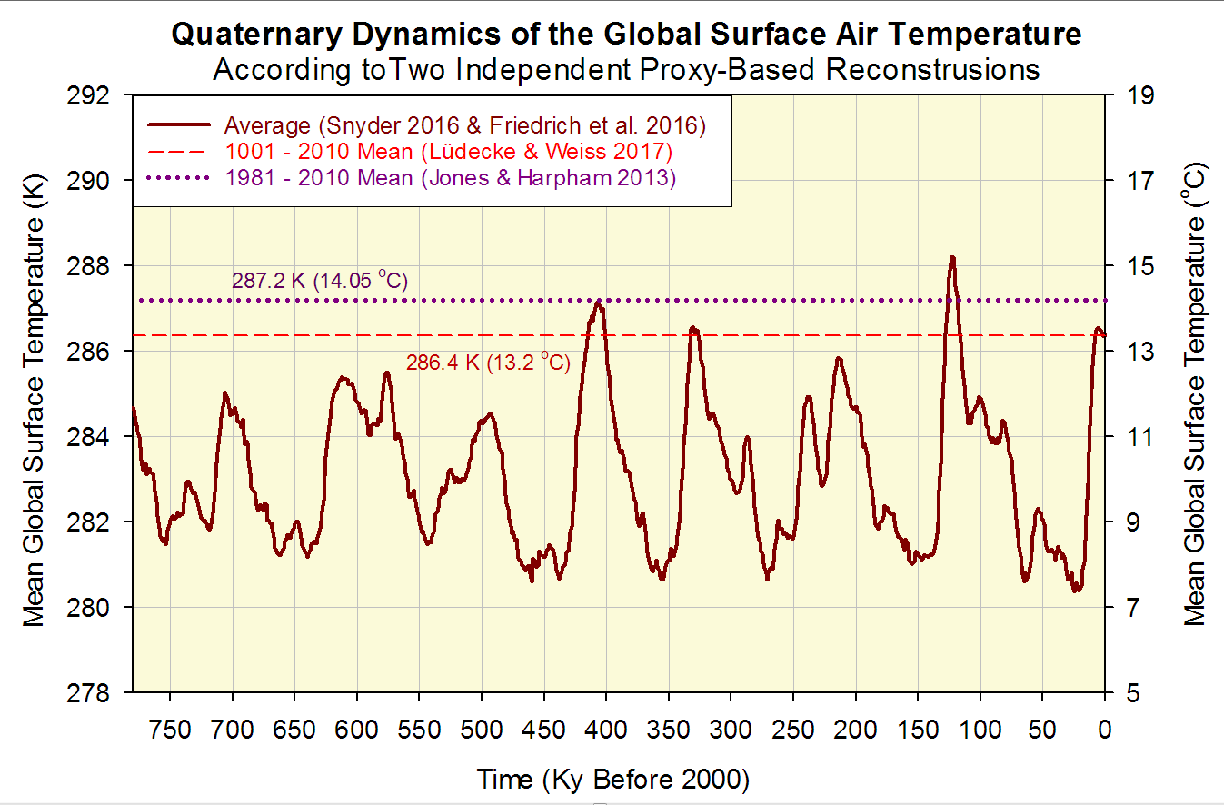
Model Input:
Observed Global Temperature Time Series for the Quaternary

Slide 21
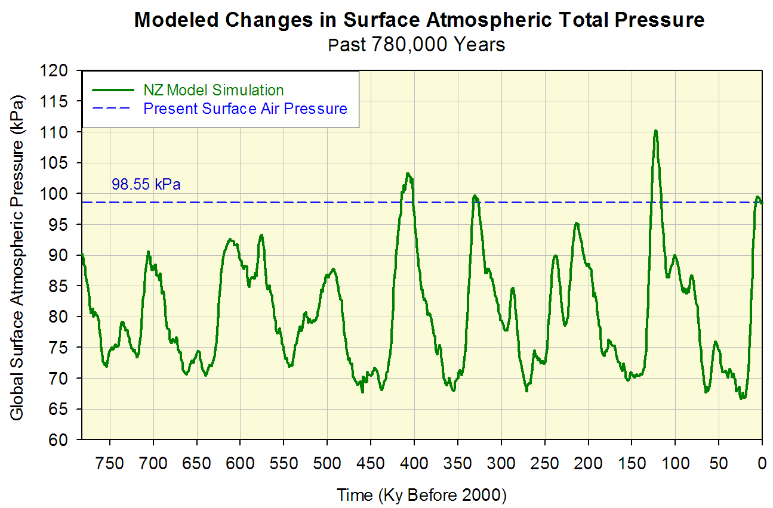
Intermediate Model Prediction/Output:
Total Atmospheric Pressure Dynamics during the Quaternary

Slide 22
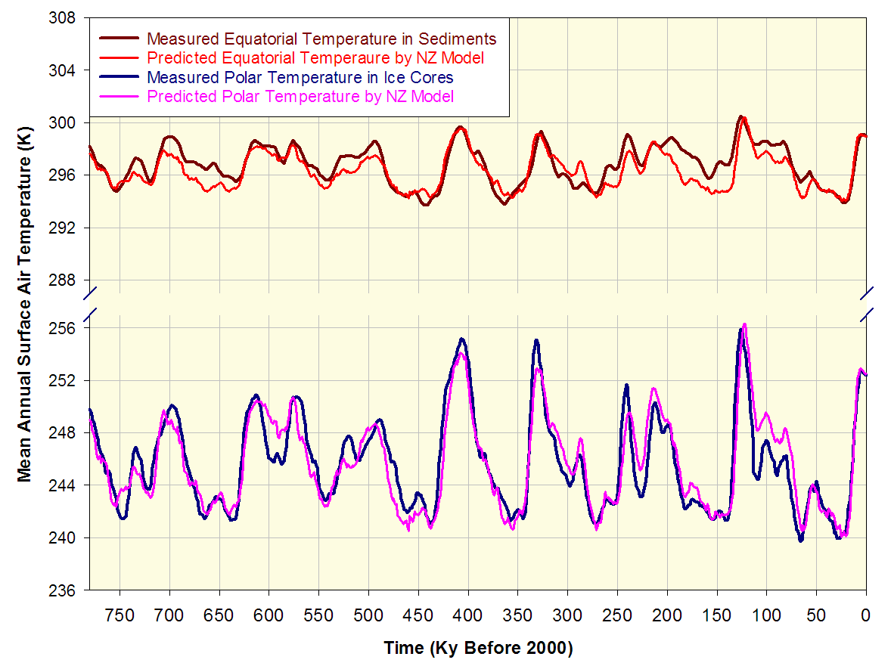
Model - Data Comparison for the Quaternary :
Absolute Surface Air Temperatures

Slide 23
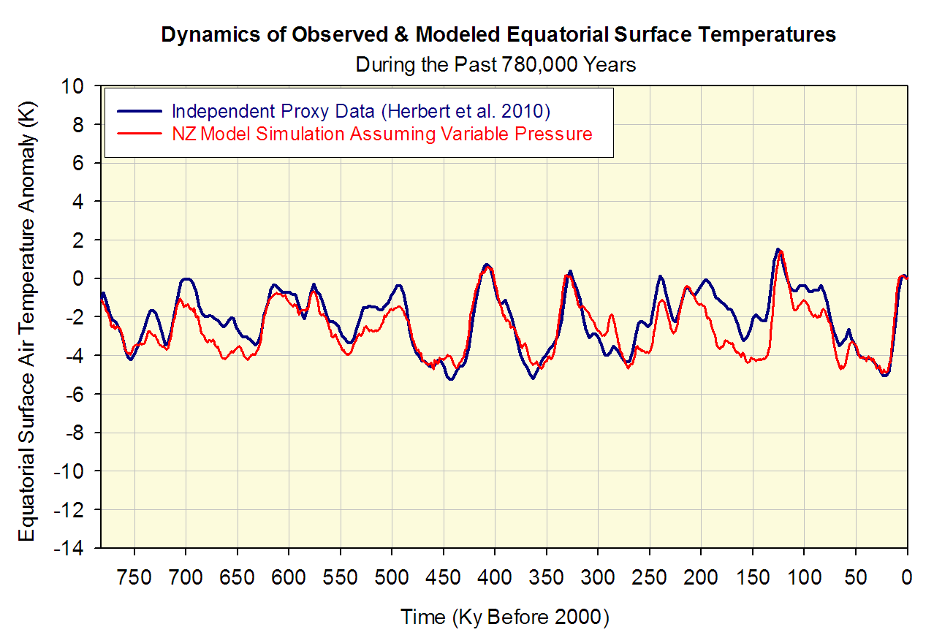
Model - Data Comparison for the Quaternary :
Equatorial Surface Air Temperature Anomalies

Slide 24
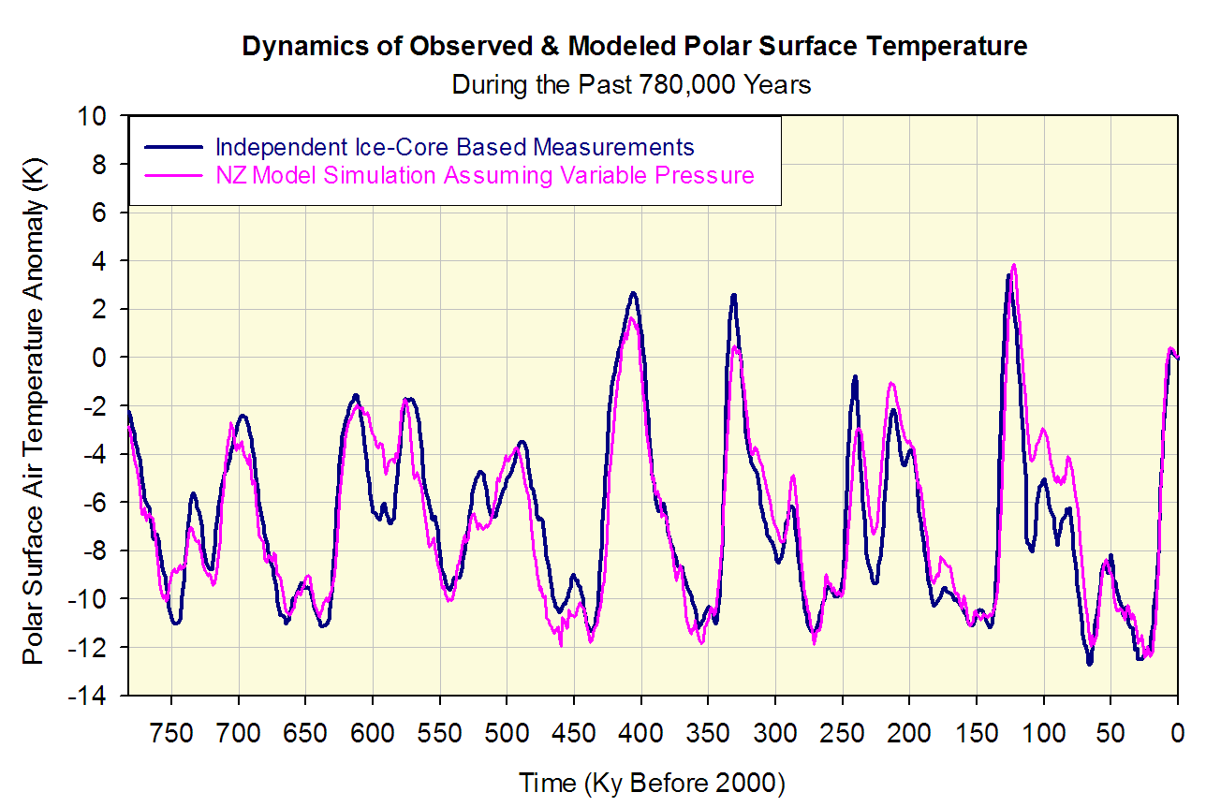
Model - Data Comparison for the Quaternary :
Polar Surface Air Temperature Anomalies

Slide 25
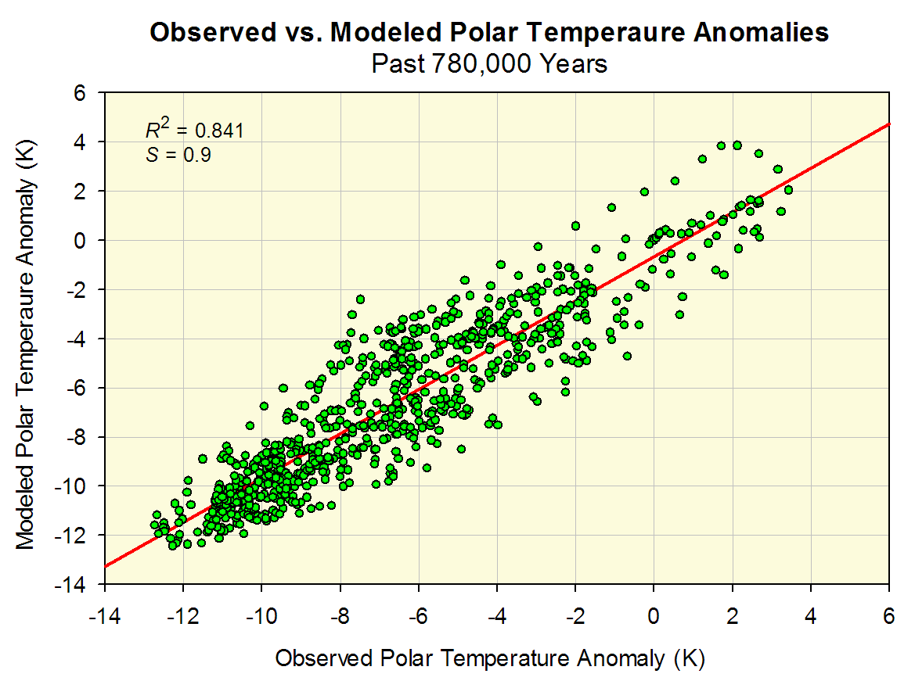
Model - Data Comparison for the Quaternary:
Comparison of Polar Surface Air Temperatures

Slide 26
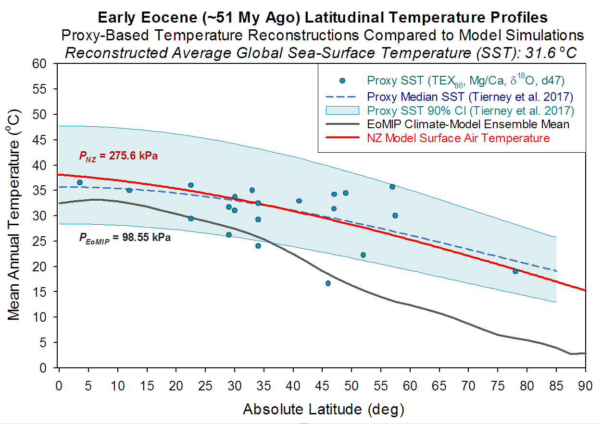
Model - Data Comparison for the Early Eocene :
Latitudinal Temperatures

Slide 27
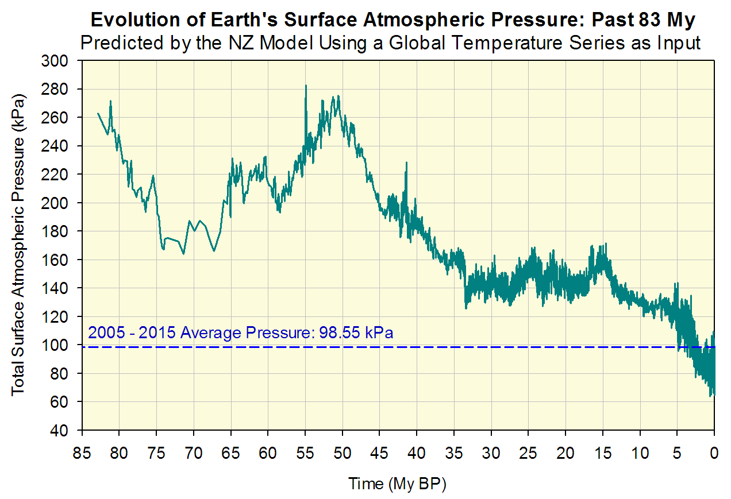
Model Prediction for the past 83 My:
Dynamics of Total Surface Atmospheric Pressure
The only input to the NZ Model is a time series of proxy-measured average global surface air temperature (GSAT) shown above, and the assumption that pressure variations have been driving past climatic changes.

Slide 28
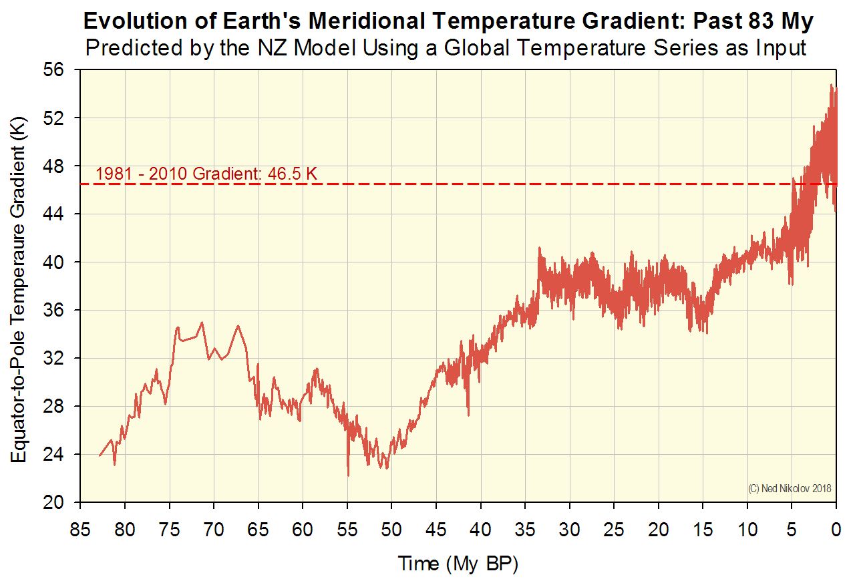
Model Prediction for the past 83 My:
Dynamics of Meridional Temperature Gradient
The only input to the NZ Model is a time series of proxy-measured average global surface air temperature (GSAT) shown above, and the assumption that pressure variations have been driving past climatic changes.

Slide 29
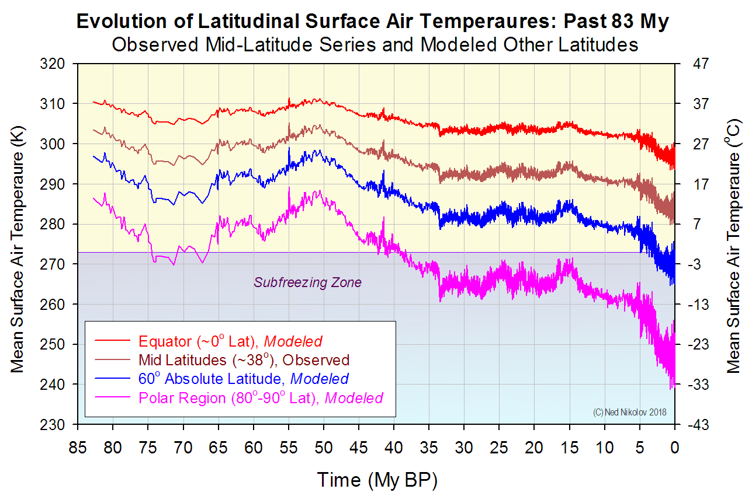
Model Prediction for the past 83 My:
Dynamics of Annual Latitudinal Temperatures
Initial Polar
Glaciation
© Ned Nikolov
August 2018

Slide 30
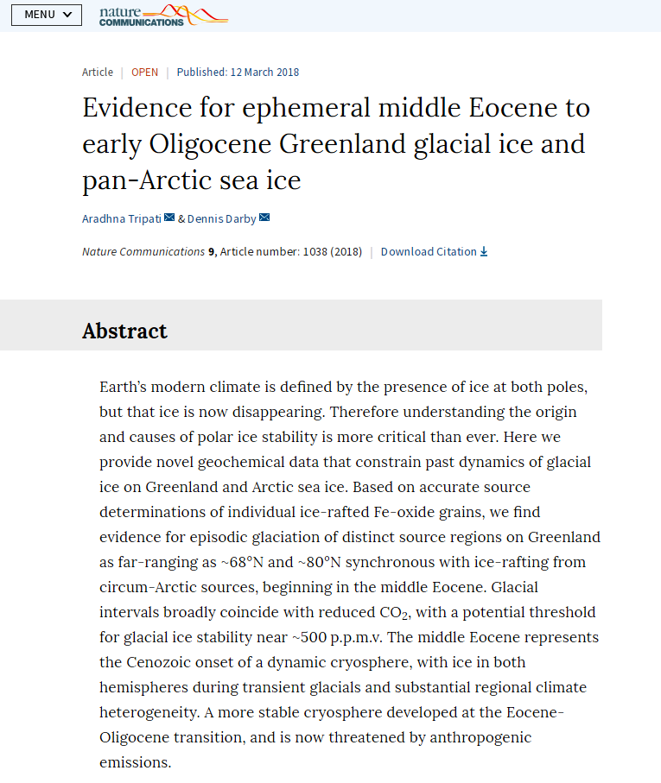
Geological Evidence Confirms the Beginning of
Arctic Glaciation in Middle Eocene: 42-39 My ago

Slide 31
CONCLUSIONS:
TOA solar irradiance and total atmospheric pressure completely & accurately explain the distribution of latitudinal temperatures on planets across a broad range of physical environments in the Solar System. This confirms the finding by Nikolov & Zeller (2017) that long-term average planetary temperatures are controlled by solar radiation & pressure while being independent of atmospheric composition.
The NZ planetary temperature model derived from recent NASA observations provides a new, simpler, and far more accurate explanation of the observed global & latitudinal dynamics of surface air temperature throughout Earth’s geological history.
On the time scale of thousands to millions of years, Earth’s climate appears to be controlled by variations in total atmospheric mass and surface air pressure, a mechanism unbeknown to and not considered by modern science. This opens a new paradigm for understanding of the dynamics of Earth’s climate system!
The ability of the NZ model to accurately reproduce independent measurements of past Equatorial & Polar temperatures further confirms the physical reality of the empirical pressure-temperature relationships inferred from NASA planetary data.

Slide 32
Thank you!

Slide 33
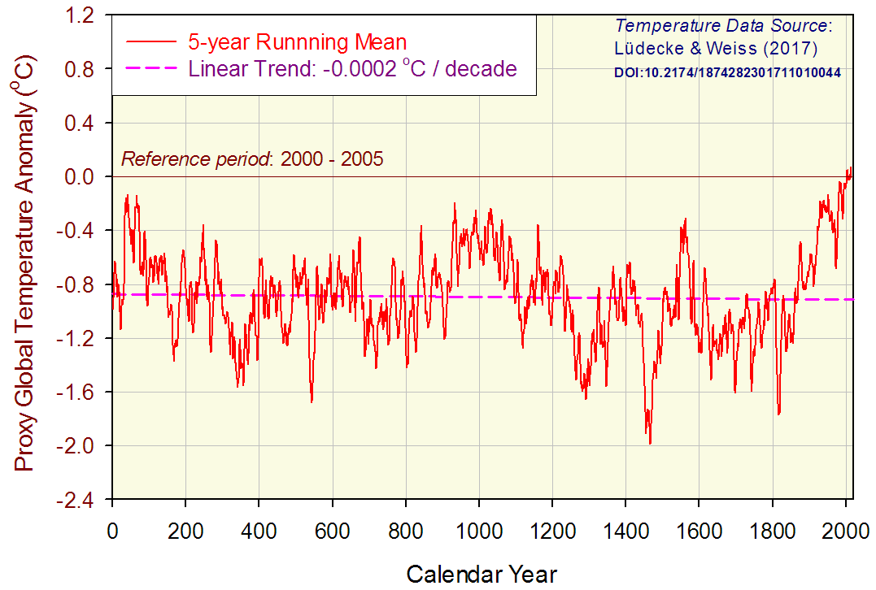
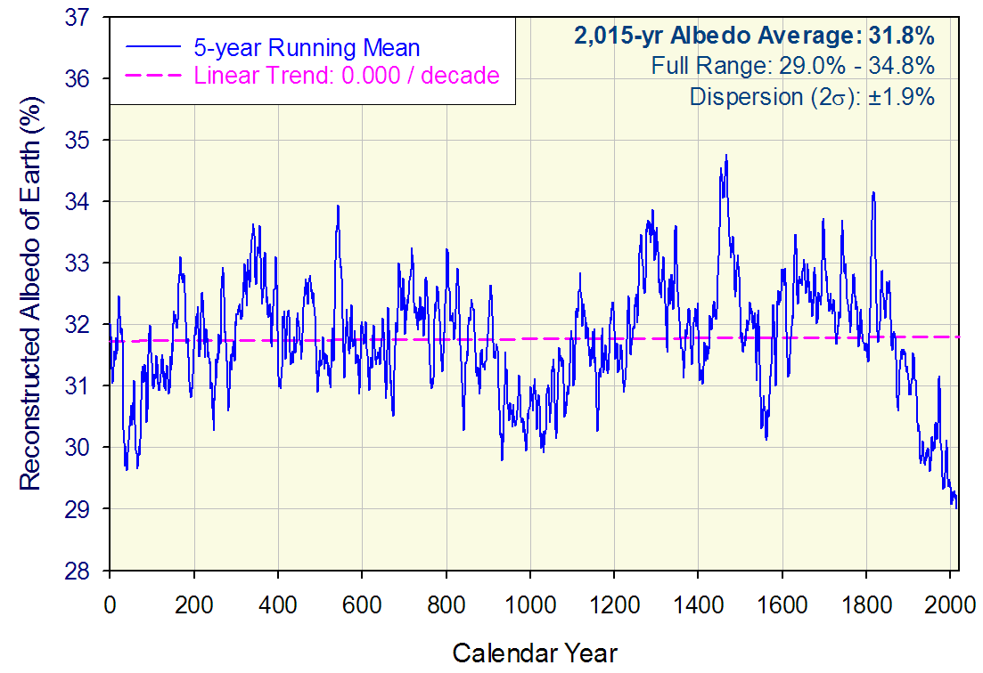
Reconstruction of Earth’s Albedo from Global Proxy Temperature Records for the past 2,015 Years
Upper Panel:
Global temperature reconstruction using a variety of proxies.
Reference: Lüdecke H-J & Weiss C-O (2017) Harmonic analysis of worldwide temperature proxies for 2000 years. Open Atmos. Sci. J. 11:44-53, doi: 10.2174/1874282301711010044
Lower Panel:
Dynamics of Earth’s global albedo reconstructed from the temperature record of Lüdecke & Weiss (2017) assuming that temperature variations have been caused by changes in cloud albedo. Albedo calculations done by an analytical model by Nikolov & Zeller (paper in preparation) parameterized with satellite-aided observations of Loeb et al (2009) and Herman et al. (2013).

