Slide 1
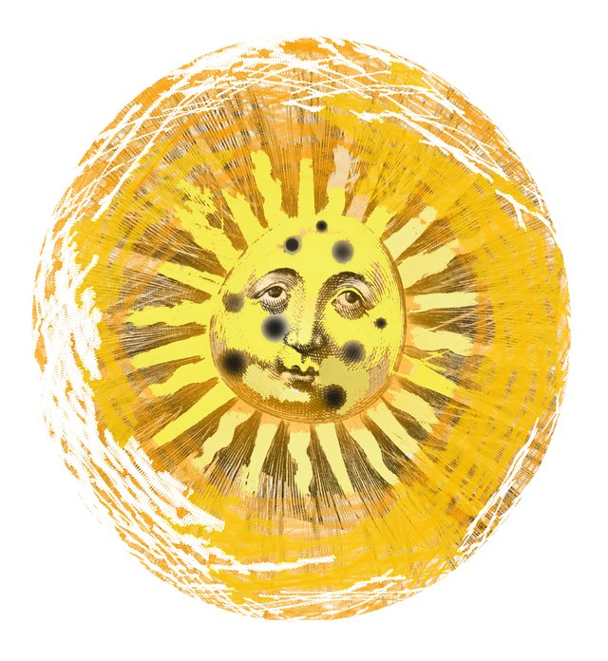
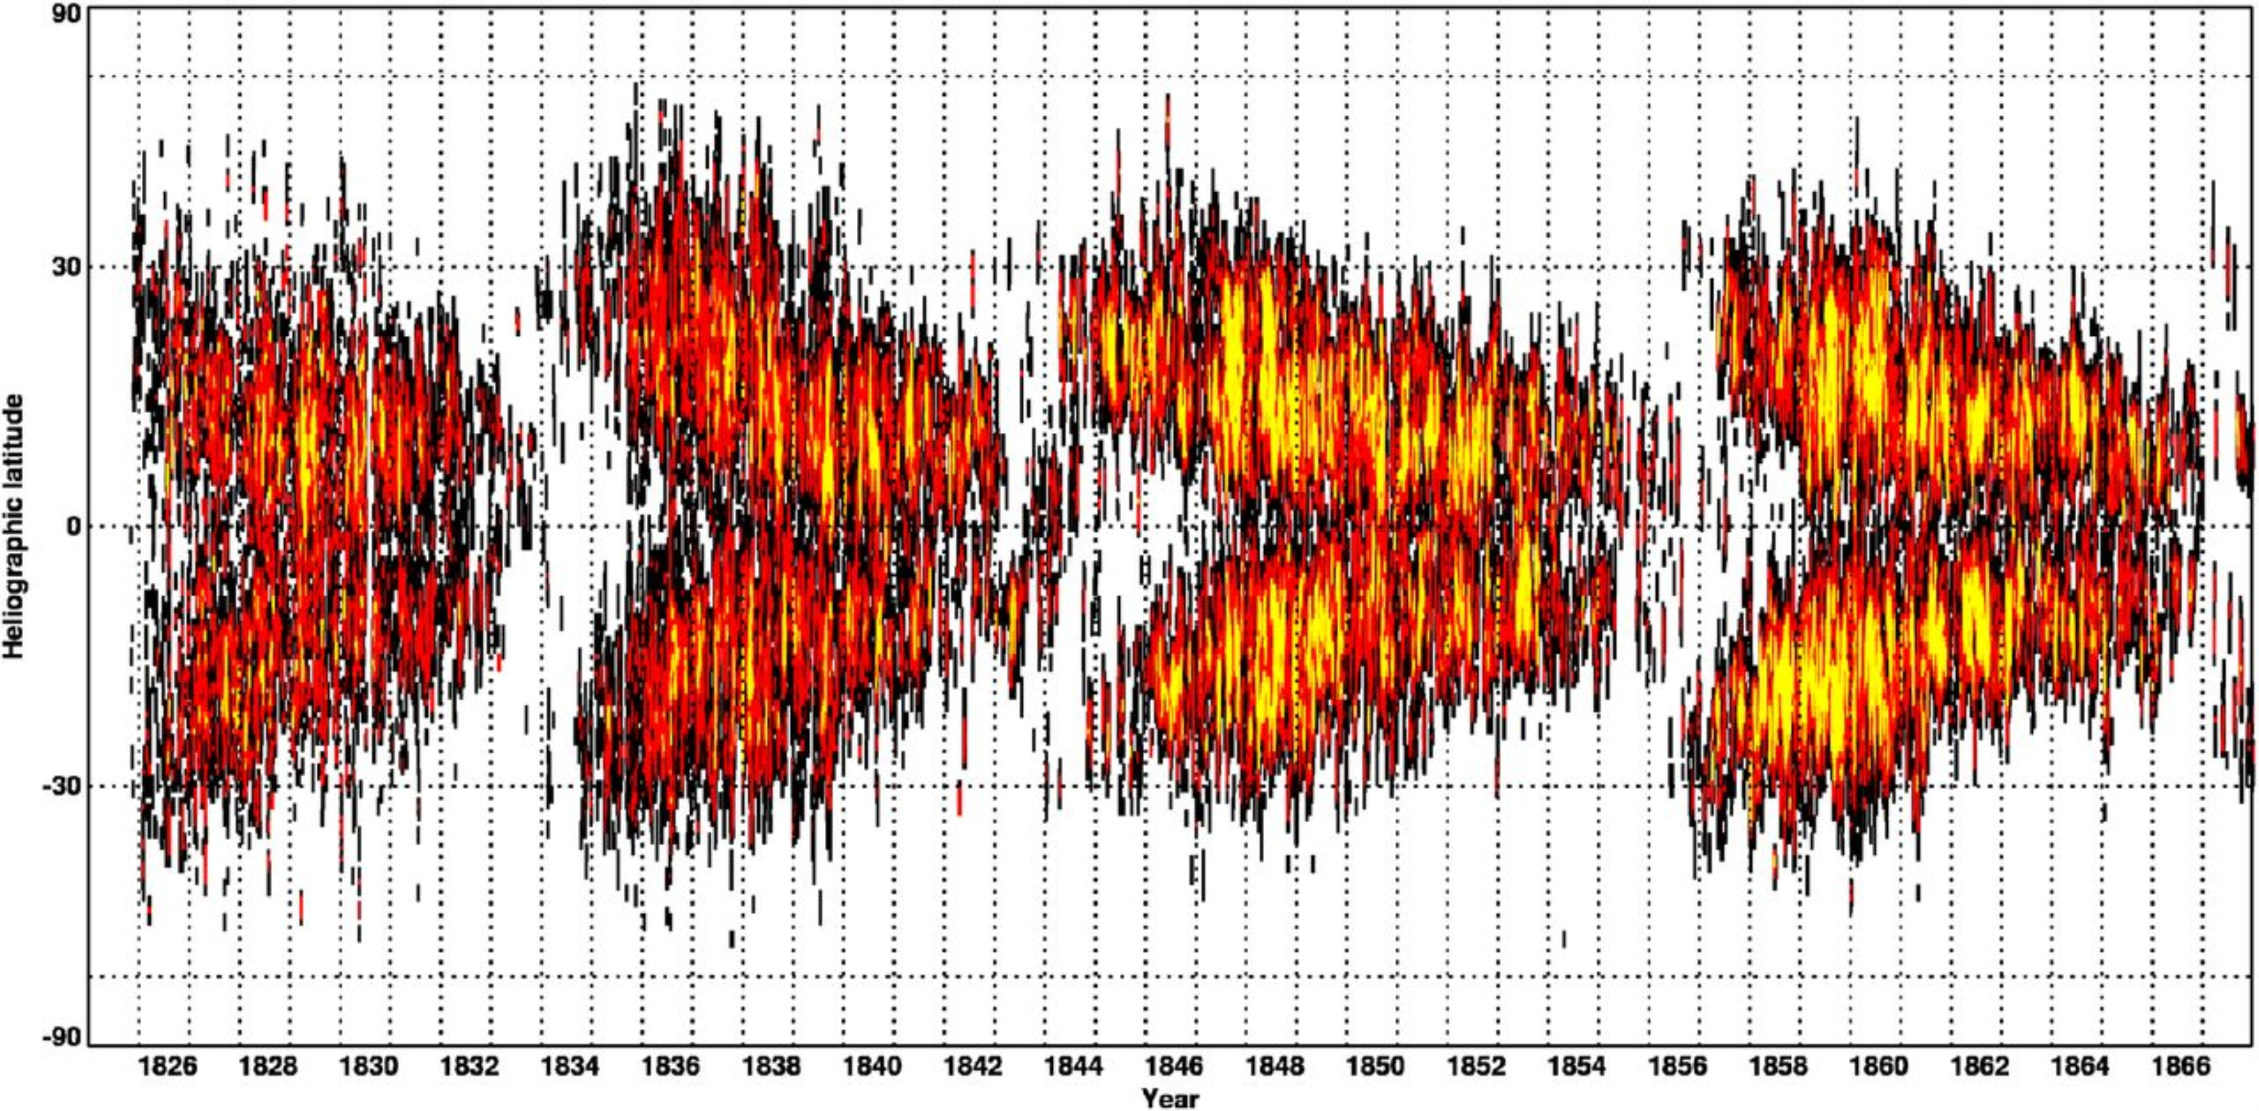
The length of the Solar Cycle as a predictor for local climate?
J.-E. Solheim
Norwegian Climate Realists

Slide 2
Read me
This talk was presented at the Porto Conference on Saturday Sept 09, 2018
A few comments have been added after the Conference

Slide 3
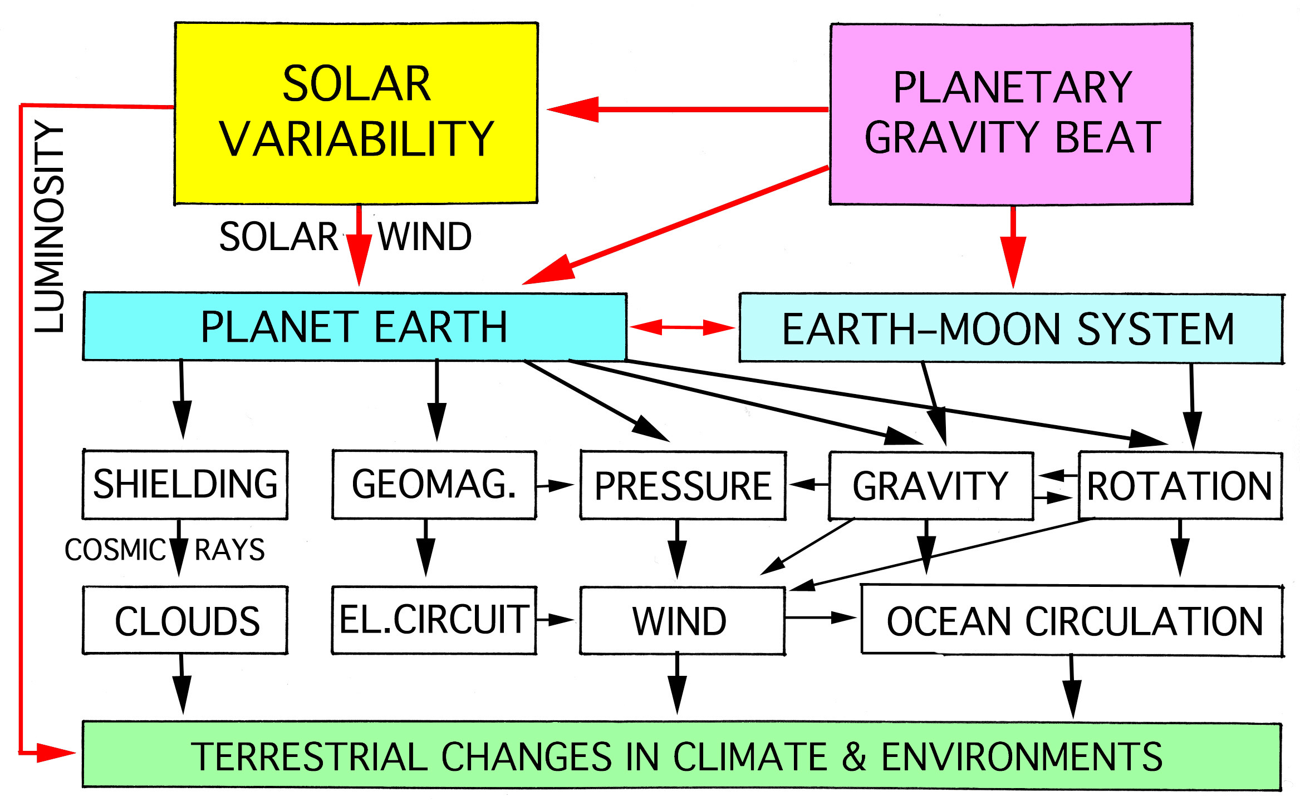
N.-A. Mörner, 2013
Notes:
This is explained in N. Mörners talk at 12:20

Slide 4
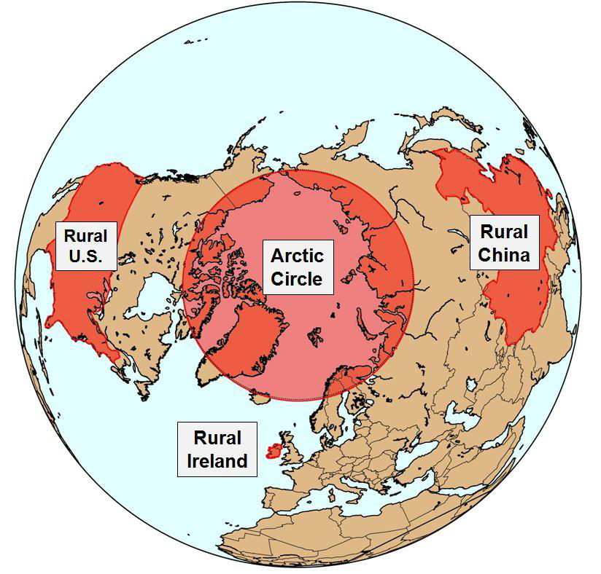
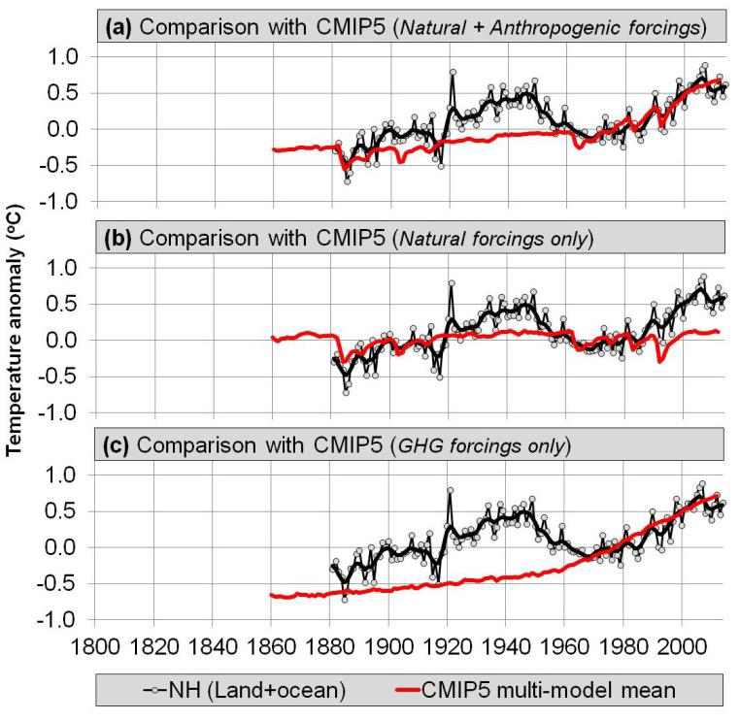
Rural temperatures and Climate models
Rural Temperatures and TOTAL SOLAR IRRADIANCE
Soon, Conolly and Connolly, 2015
Notes:
In the same paper they also discuss various estimates of TSI - this is the one that matches NH-temperature best

Slide 5
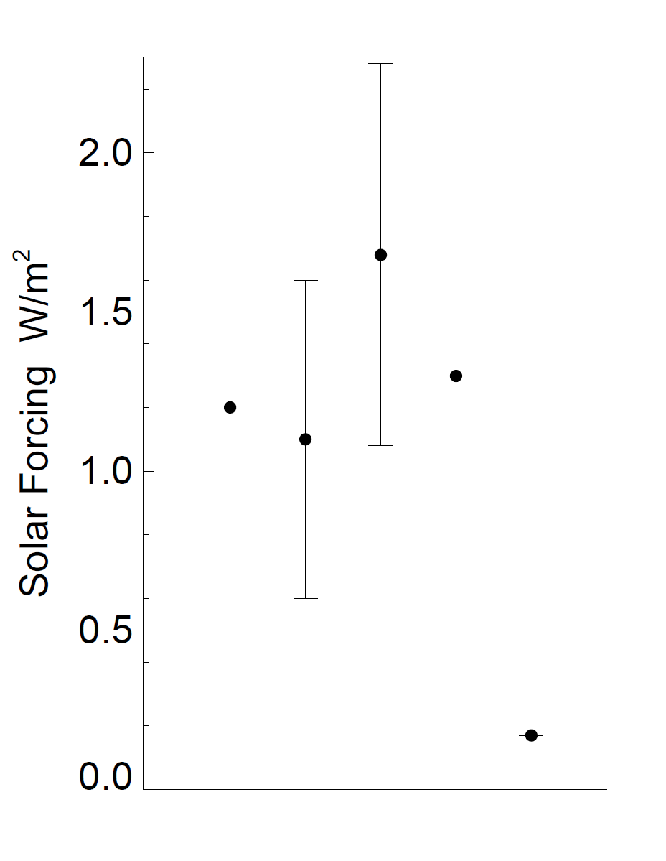
Quantifying Solar Forcing
over 11 years
Sea Level Change
Sea Surface Temperature
Ocean Heat Content
Altimetry Data
Require an amplification
mechanism
Total Solar Irradiance
Shaviv, 2008
Notes:
Based on the needed amplification a search has started for possible mechanism. They are shown in slide 3 (Mörner) -

Slide 6
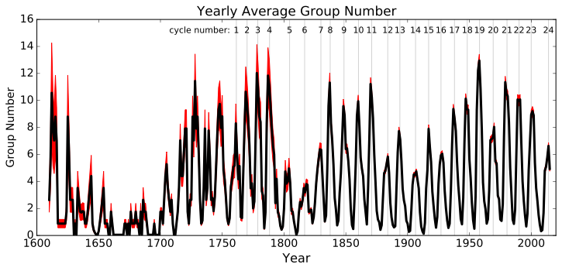
Dalton Minimum
Maunder
Minimum
(WDC-SILSO “backbone”; Svalgaard & Schatten. 2015)
Notes:
It has long been noted that the periods of low solar activity as the Maunder and Dalton minima, were cold periods on Earth. The curve shows the number of sunspot groups - the red are corrections/additions done recently

Slide 7
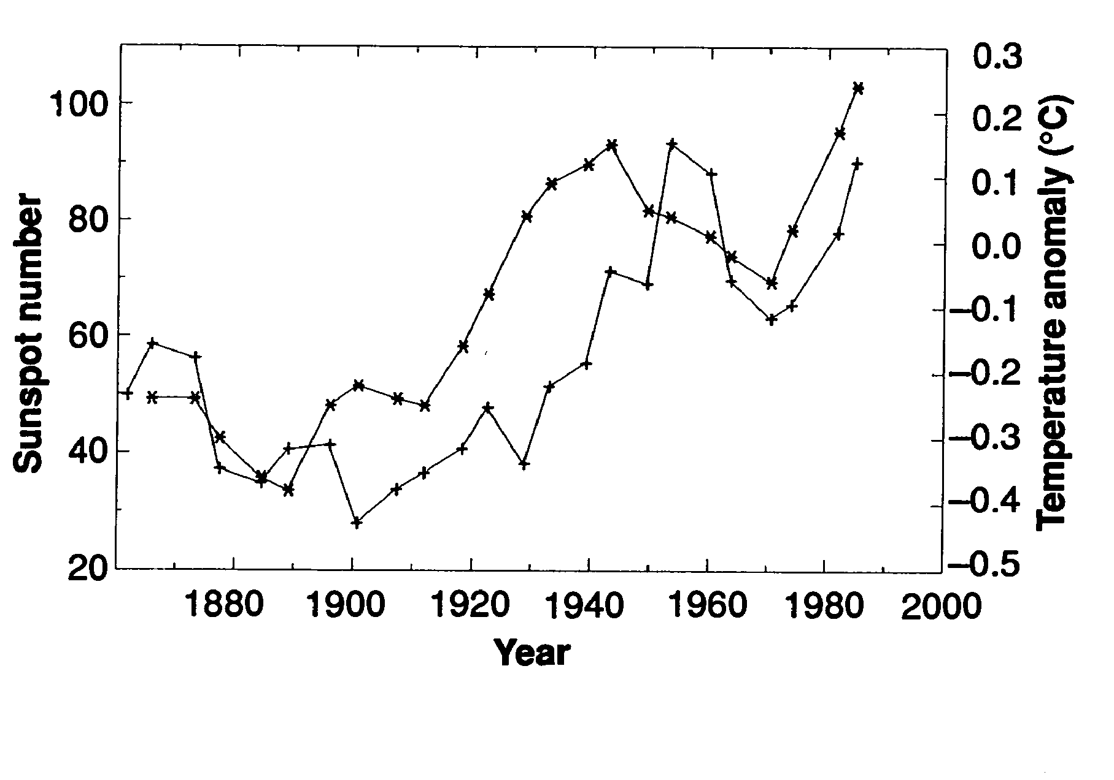
Northern Hemisphere Land Temperature and Sunspot Numbers
T
SN
E. Friis-Christensen and K. Lassen, 1991, Length of the Solar Cycle: An indicator of Solar Activity Closely Associated with Climate, Science, 254, 698-700, fig 1

Slide 8
Dalton Minimum
Maunder
Minimum
(WDC-SILSO “backbone”; Svalgaard & Schatten, 2015)

Slide 9
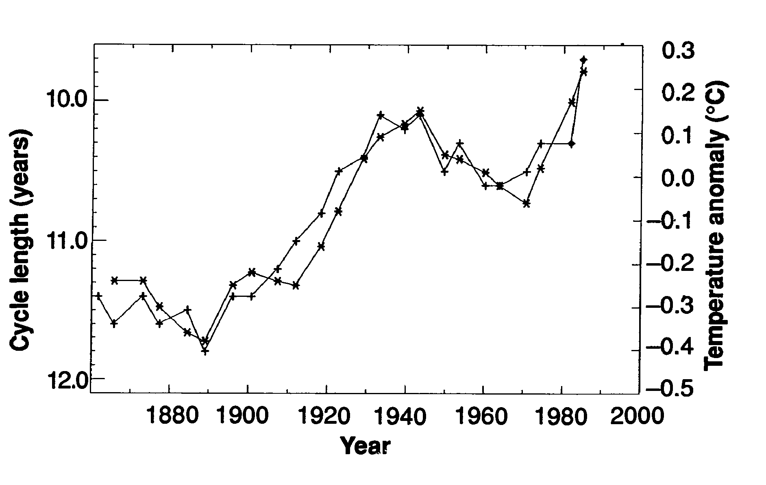
Sunspot Cycle Length (1-2-2-2-1) and NH-temp
SCL
T
Friis-Christensen & Lassen, 1991, fig2
Notes:
The 1-2-2-2-1 means that the length of the solar cycle has been smoothed by 5 cycles with weight 1-2-2-2-1, i.e. a low pass filter.

Slide 10
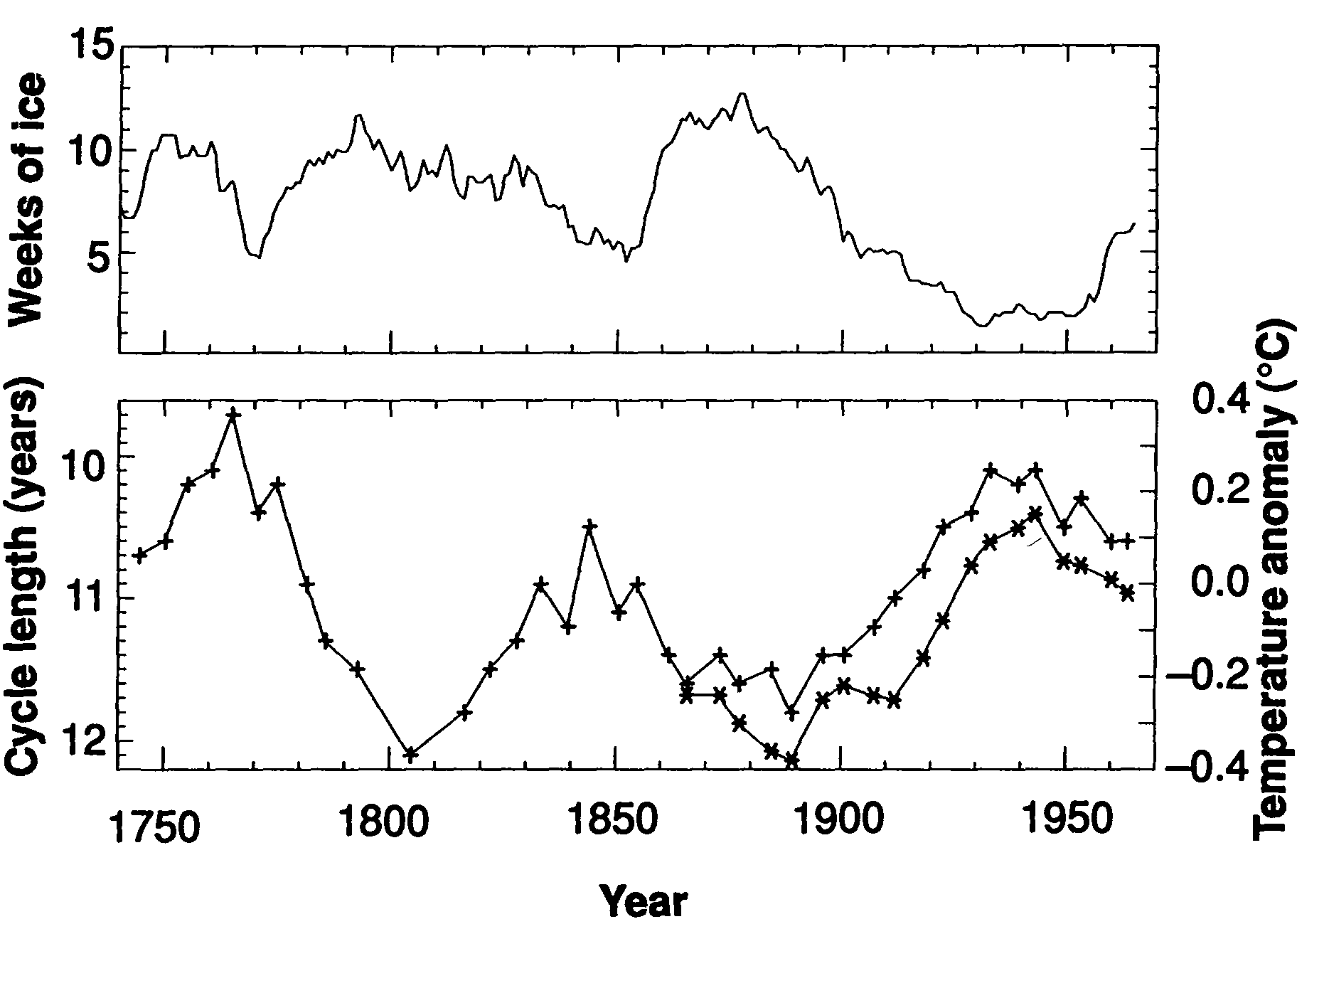
SCL₁₂₂₁ and Iceland Sea Ice
Friis-Christensen & Lassen, 1991, fig3
Notes:
The top panel show weeks with ice around Iceland, and the lower the smoothed sunspot number together with NH-temperature

Slide 11
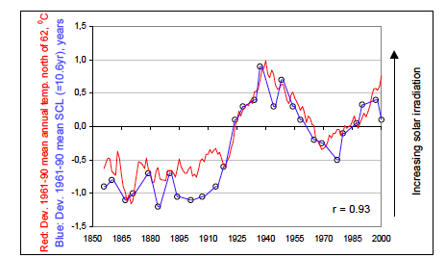
SCL₁₂₁ and T_{62N}
Vinje & Grosse, 2003
Notes:
Arctic temperature (red) compared with the sunspot number (blue) smoothed (1-2-1)

Slide 12
Quantifying Solar Forcing
over 11 years
Sea Level Change
Sea Surface Temperature
Ocean Heat Content
Altimetry Data
CLOUDS
Require an amplification
mechanism
Total Solar Irradiance
Shaviv, 2008
Notes:
The needed amplification of Solar Forcing is proposed in cosmic rays modulated by the solar wind, creating clouds that rapidly change the Earth’s albedo

Slide 13
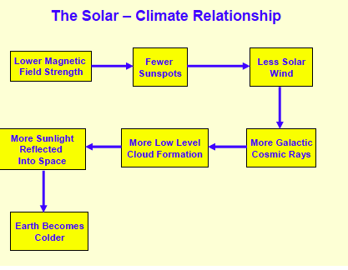
D. Archibald, 2008
Notes:
The possible relation between cosmic rays and clouds have been investigated experimentally by Svensmark et. al, (SKY-project) and Kirkby et al. in CERN (the CLOUD project). This is explained in more detail in Easterbrook’s talk 10:30

Slide 14
Position of sunspots 1825-1867
From: Sunspot positions and sizes for 1825–1867 from the observations by Samuel Heinrich Schwabe
Mon Not R Astron Soc. 2013;433(4):3165-3172. doi:10.1093/mnras/stt961
Mon Not R Astron Soc | © 2013 The Authors Published by Oxford University Press on behalf of the Royal Astronomical Society
Notes:
Figure 4. Butterfly diagram based on about 135 000 sunspot positions derived from Schwabe's observations of 1825–1867. A similar plotting style as used by Hathaway (http://solarscience.msfc.nasa.gov/SunspotCycle.shtml) is employed here. The first spots of a new cycle are observe at high latitude N or S and with opposite polarity than in the previous cycle.
14

Slide 15
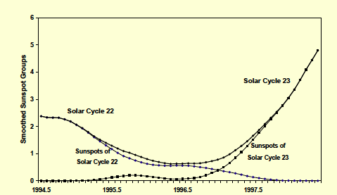
Determination of solar minimum
Archibald, 2008
Notes:
The transition between two cycles: Spots from both cycles may exist simultaneously - when there are equal no of spots from both cycles, it is officially a minimum. Other parameters may also be used in the final definition of a minimum.

Slide 16
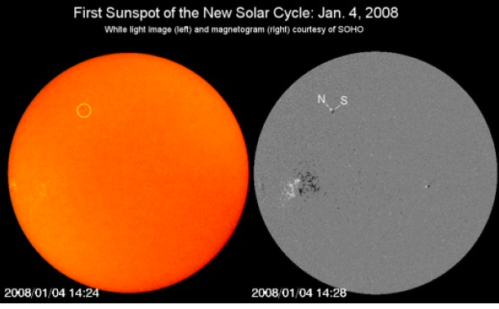
The first sunspot of cycle 24
Notes:
The picture to the left and the magnetogram to the right are both taken with the SOHO space observatory. Since we have much better telescopes and satellites to follow the Sun today. it is important to count sunspots with the same small telescopes as done from 1850. The smallest spots (or nudges) seen in the pictures may therefore not be counted.

Slide 17
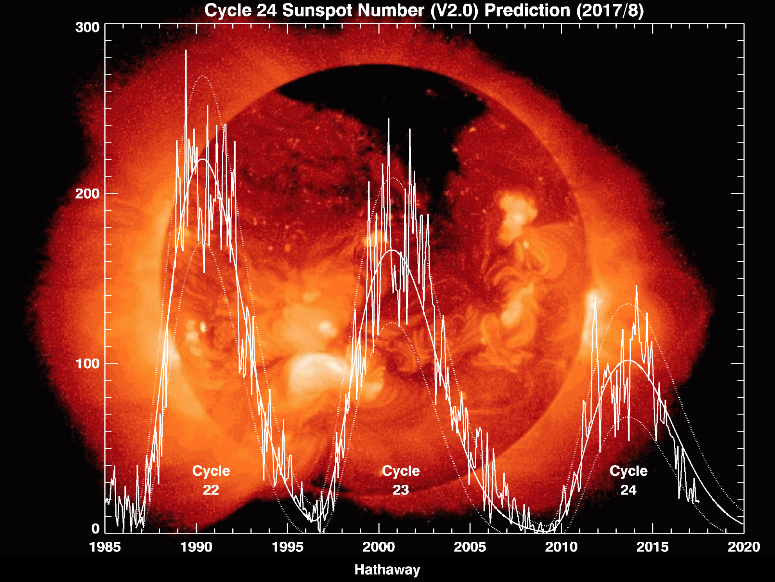
10.0y
12.2y
?
Notes:
The three last cycles show diminishing activity. Cycle 23 became 2.2 yrs longer than cycle 22.

Slide 18
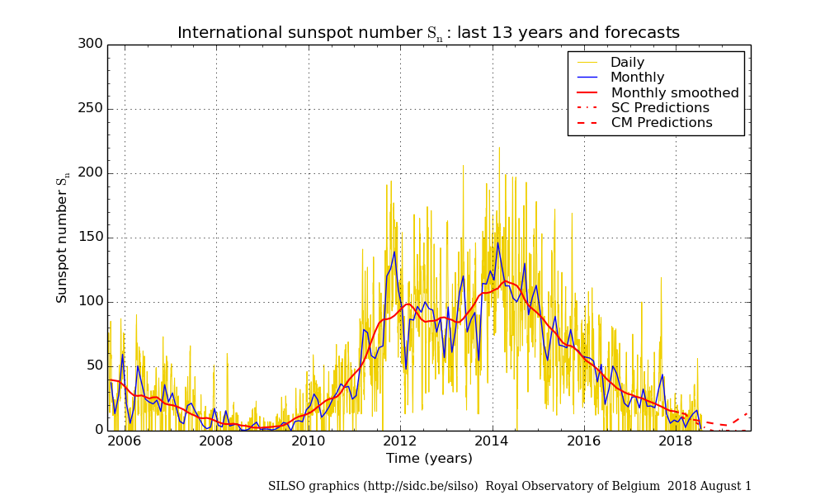
2008.9
Notes:
We are close to the end of cycle 24 which started in September 2008. It has now lasted in 10 years, and may last one or two years longer. We may also note that cycle 24 apparently has two maxima.

Slide 19
Note: period length inverted
Solheim, Pattern Reg. Phys.,2013
Notes:
From 1850 the sunspot cycle length has been successively shorter - until Cycle 23, which jumped to 12.2 yrs

Slide 20
Solheim, 2013
Notes:
This diagram shows the timing of sunspot minimum related to when the minimum is expected to arrive if the length is determined by a stationary clock. It apparently is not. From Cyle 3 to Cycle 14 the arrival time was changed from 4 years to early to about 3 years too late. Then from Cycle 15 through 22 the delay was corrected and the Sun was finaly two years too early. My opinion is that such a systematic change cannot be random, it is either an internal clock or external that sends the correction signal. The planets in our solar system may be the correcting clock.

Slide 21
Notes:
To the upper right a Fourier Transform of the time deviation from a constant clock with P=11.06 yrs signal. Upper panel: simulation with 2 periods (P=440 and 190 yrs). In the lower panel 6 periods are included:192, 437, 86, 43,46, 27

Slide 22
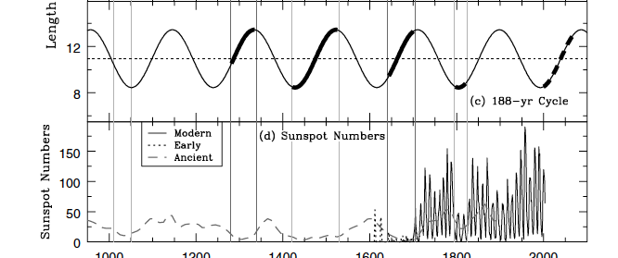
Oort Wolf Spörer Maun Dalt Future
M.T. Richards et al. 2009
Notes:
A deep solar minimum has since 1200 arrived when a period about 190 yrs is on its increasing phase. A new deep minimum may arrive the coming century.

Slide 23
209 years
A stationary period P=210 yrs
in Sunspot Numbers and Total Solar Radiation
Related to 5*P_{uranus}/2 = 210yrs
Yndestad and Solheim, 2017. New Ast.
Notes:
Yndestad (next speaker) and Solheim analyzed both sunspot number series and total solar irradiance series. The only common, stationary period was a period of 210 years, which is related to the period of Uranus. This 210 yr period may be the syncronization period of sunspots and TSI.

Slide 24
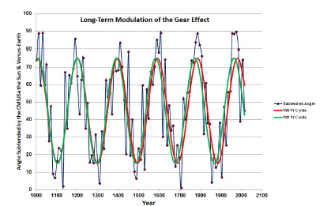
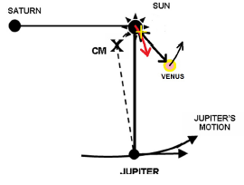
Modulating the gear effect
1784 1993
I.R.G. Wilson, Pattern Recogn Phys, 2013
Notes:
A possible explanation of a 190 year period: The Jupiter-Saturn gear effect (transfer of angular momentum when they are at quadrature with the sun every 19th yr - amplified by the gear effect from the Earth-Venus pair, which is largest when they also are near quadrature, which happened in 1784 and 1993 (209 yrs apart).

Slide 25
Is the Sun already on its way to a deep minimum? Time will show. if the double quadrature in 1993 is the precursor of a coming deep minimum: The following two cycles 23 and 24 are smaller than the previous 22 and earlier

Slide 26
Part 2 The length of the solar cycle as a predictor for local climate

Slide 27
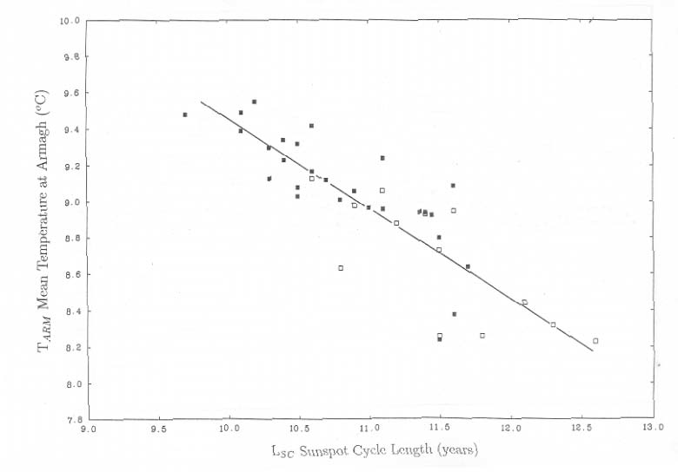
Armagh 1776-1992 SCL and T₊₁
Butler and Johnston 1996, JASTP, 58 ,1657-1672
Notes:
Here is shown the correlation between the length of a cycle and the temperature in the following cycle (T₊₁) - and the correlation coefficient with different smoothing.

Slide 28
Armagh 1776-1992 SCL and T₊₁
1°C
Butler and Johnston, 1996
Notes:
The difference in T₊₁ for a difference of 2.2 yrs as between solar cycle 22 and 23 is about 1C.

Slide 29
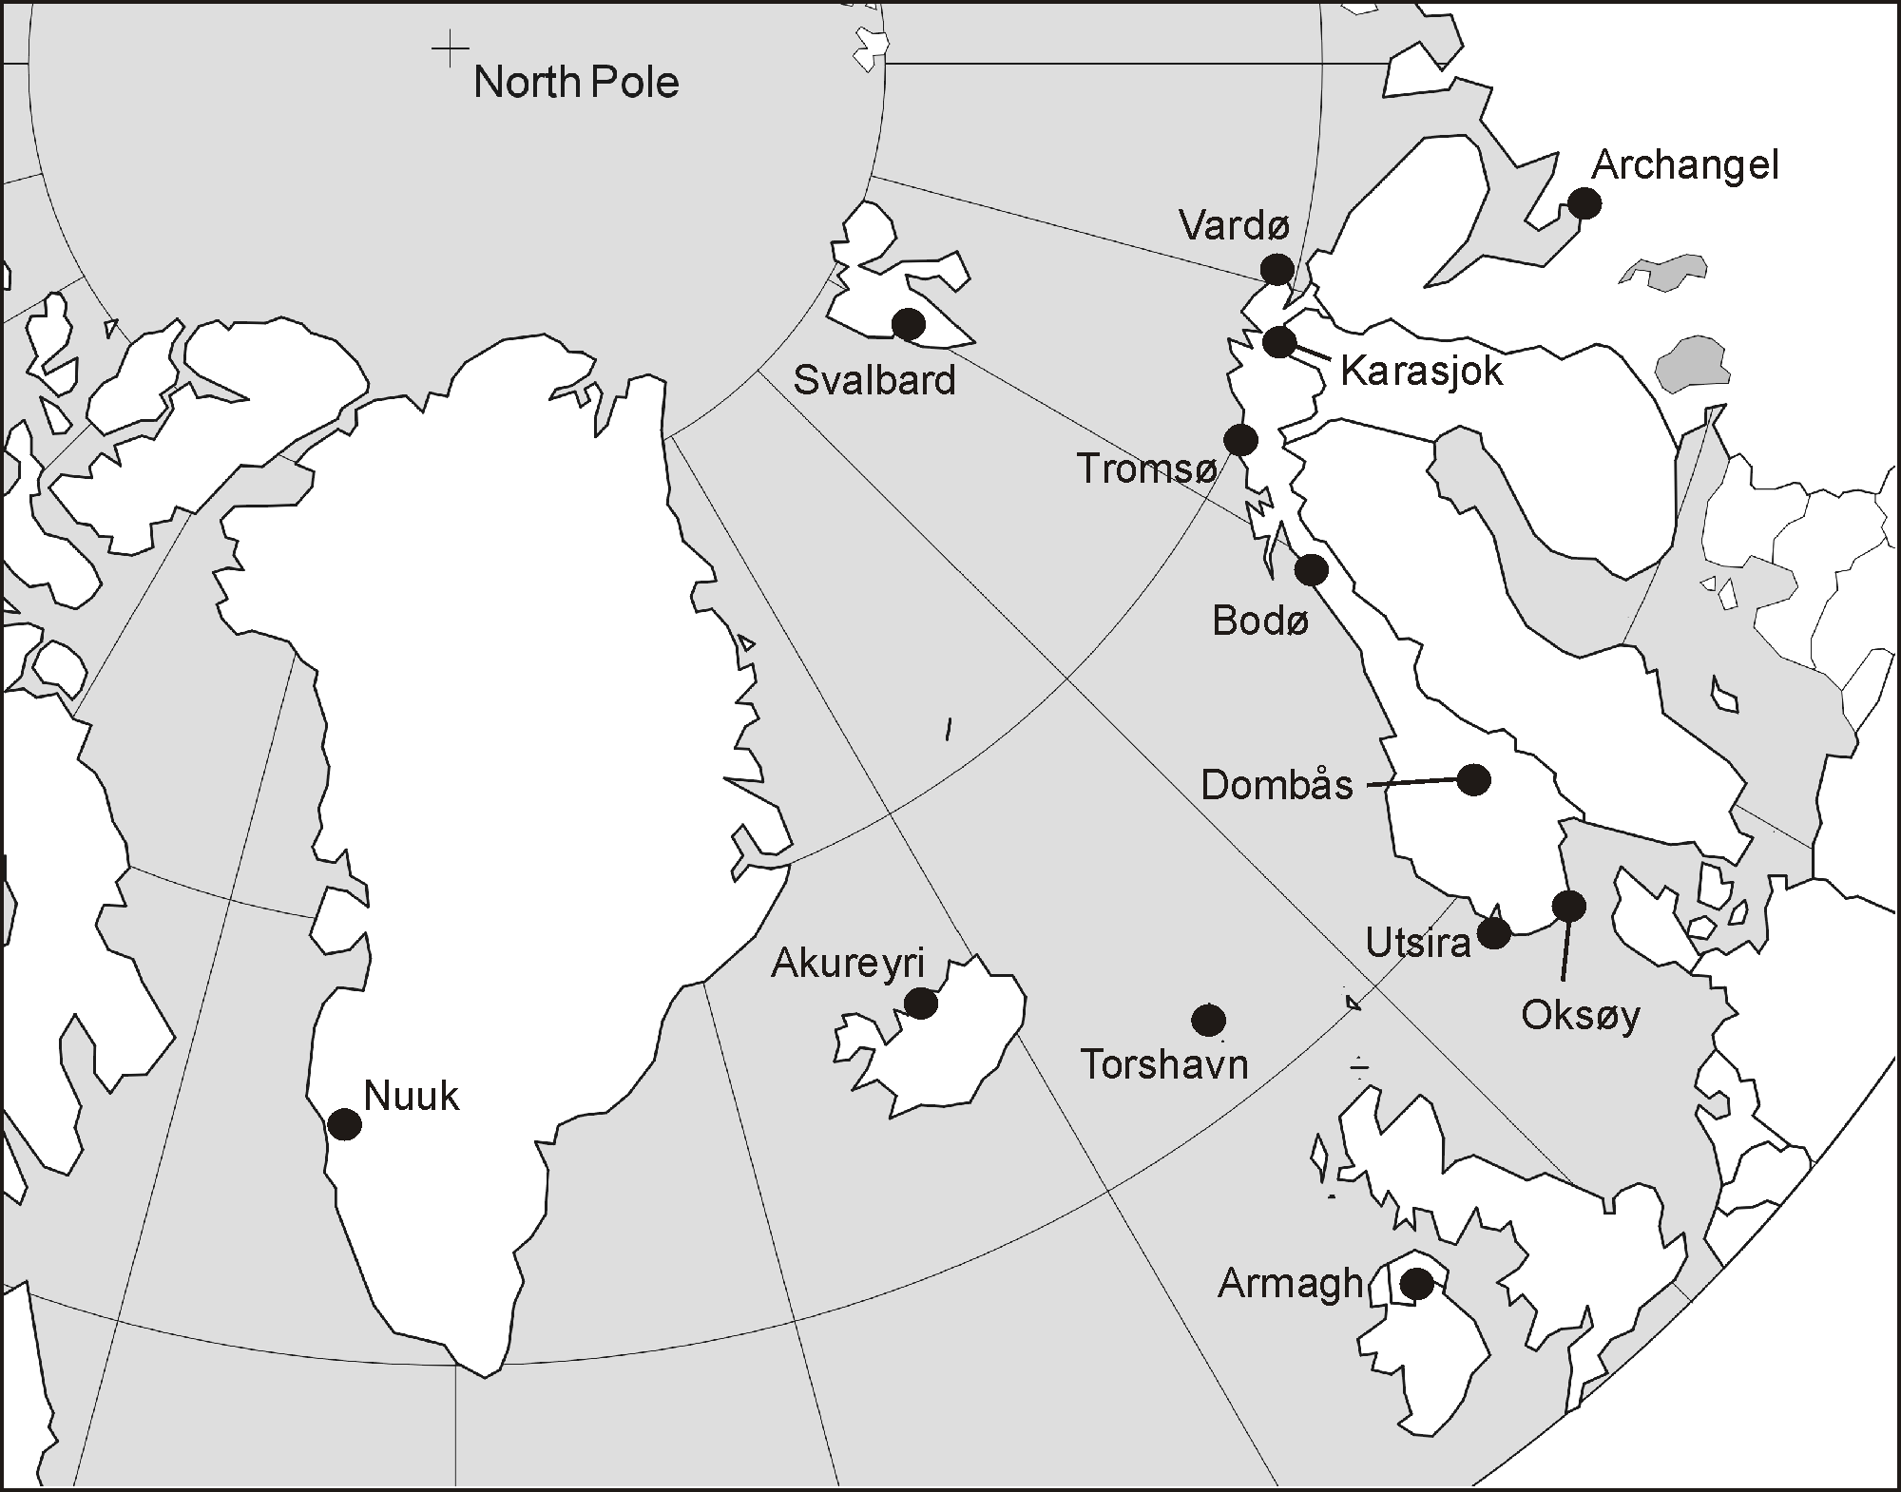
Solheim, Stordahl and Humlum, 2012
Notes:
The idea was to test the solar cycle length predicion in a sample of sites near the North Atlantic

Slide 30
Correlation between the length of a Solar Cycle (SCL) and the temperature in an 11 year period as function of delays in years
Solheim et al. 2012
Notes:
The correlation improves considerably with a time delay of 10-12 years for some specific stations in the lower left corner

Slide 31
Trend -62%
Solheim et al. 2012
Notes:
Example of one out of 14 series investigated. The lower panel show oberved temperatures and mean in solar cycles with the prediction in cycle 24 as the last mark (diamond). The central panel: the relation between SCL and temperature in the same cycle (left) and the following cycle (right). The top diagram shows the relation between temperature in solar cycles, corrected for the length of the previous cycle.

Slide 32
% of variance explained by PSCL-model
38
43
63
56
Vilnius
16
55
Asker 25
72
45
25
45
67
33
Notes:
Conclusion: the highest percentage of the variance for the Previous Solar Cycle Length model is found for stations in and near the North Atlantic > 50%
From this we can conclude that the Solar effect is related (strongest) to the Ocean currents. This explains the lag of 10-12 years.

Slide 33
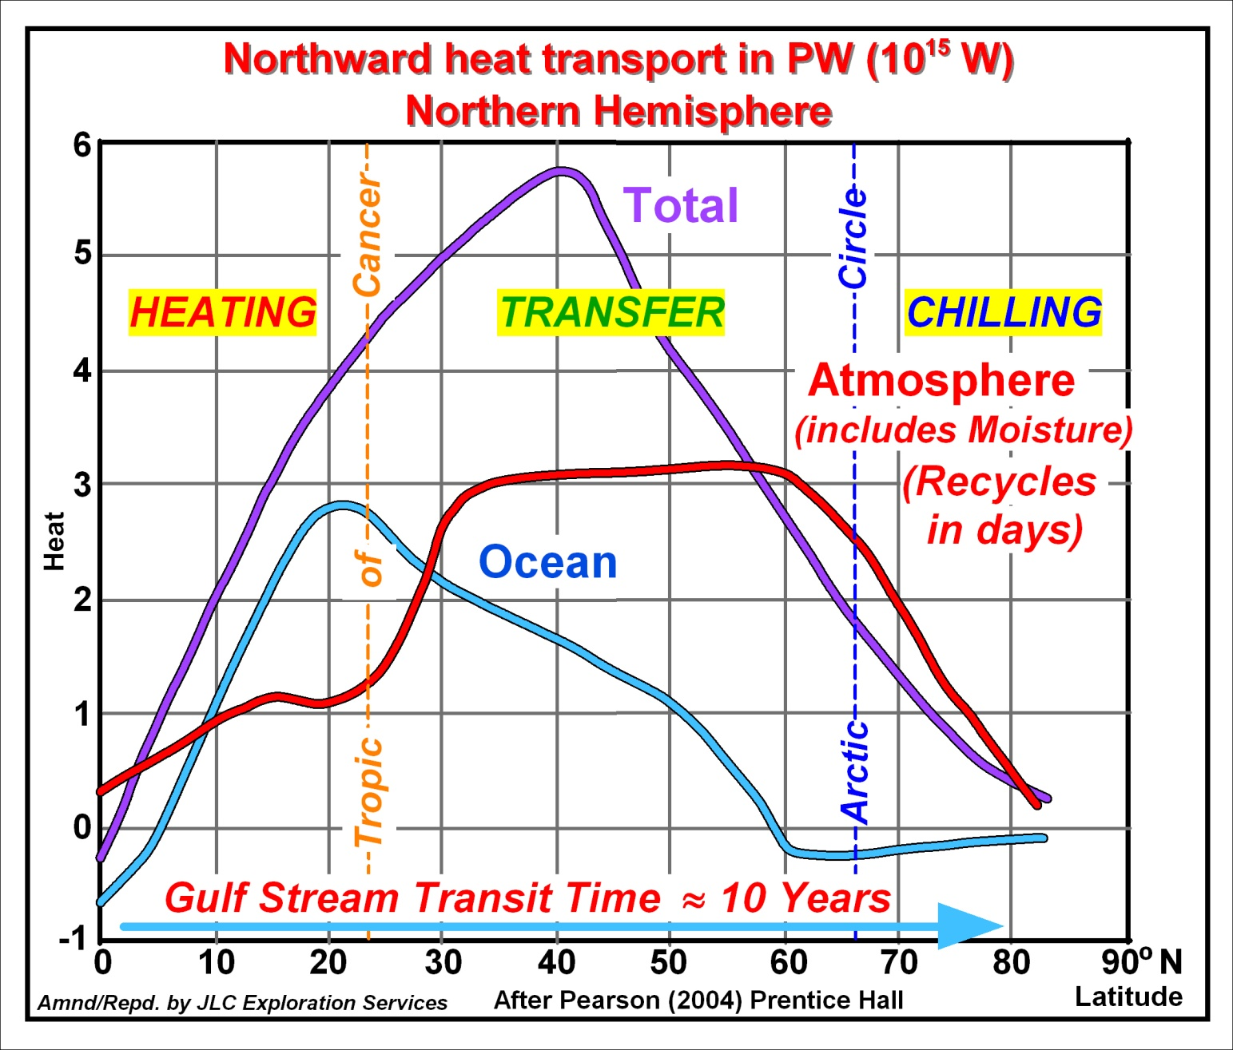
Marine and Atmospheric Thermal Transport –Northern Hemisphere
26
Notes:
Marine and Atmospheric Thermal Transport –Northern Hemisphere (Anthoni 2000)
Note The atmospheric heat transport is mainly energy involved in successive evaporation and precipitation.

Slide 34
Response to previous sunspot cycle length
Svalbard 78N
Tromsø 69.7 N
Norway 59-71N
Notes:
Examples of 3 of the series with predictions and observed temperatures so far (2010-17) in cycle 24. They show all higher temperatures than forecasted.

Slide 35
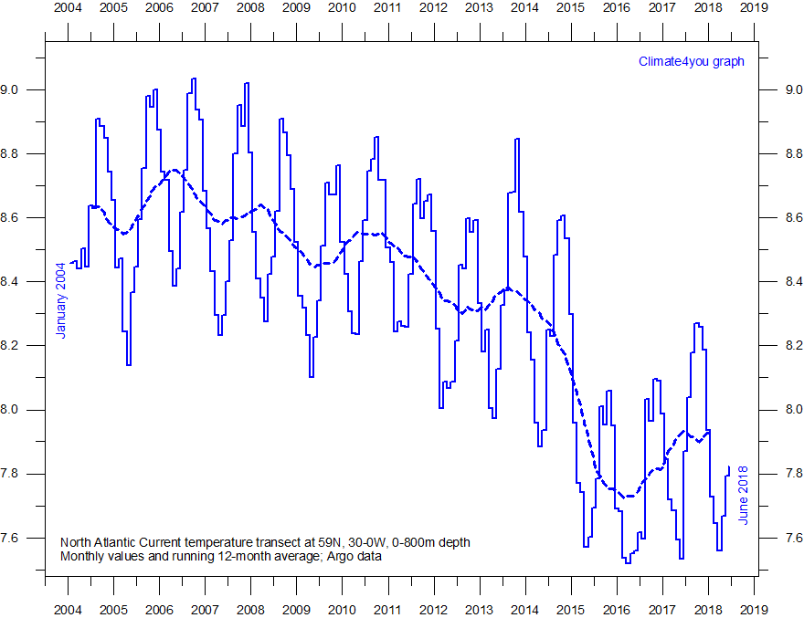
Ole Humlum, climate4you.com (Aug 13 update)
Notes:
The temperature in a cross-section of the North Atlantic ocean at 62N to a depth of 800m. The temperature has decreased almost one degree since the peak in 2006.

Slide 36
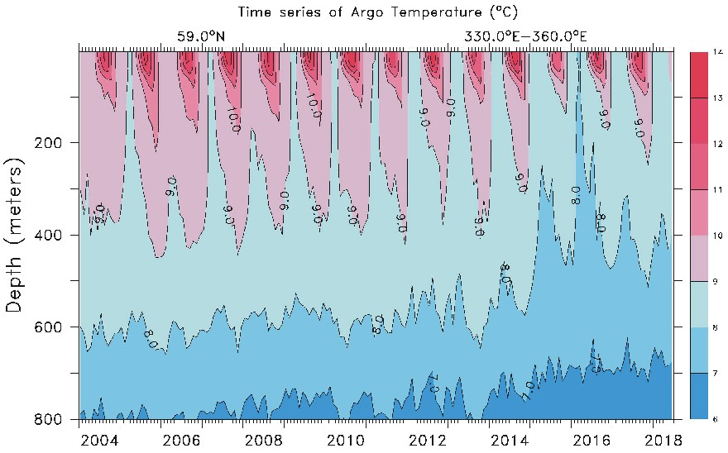
Temperature in a cross section of the Atlantic Current
Ole Humlum, climate4you.com
Notes:
Apparently the current is cooling from the bottom

Slide 37
Conclusions The sunspot cycle length as a predictor:
Previous Sunspot Period Length Predicted Temperature model (PSPL)
Well 1776-2009 (Armagh)
Acceptable 1850-2009 (North Atlantic)
PSPL failed 2010-17
What is uniqe with this period?
Temperature hiatus and heating events
Thermal resistance: Overshoot before cooling?
A turning point: change of gear in the Sun (210 yr period?)
Solution
Patience: Wait and see - maybe 2 cold years?
Breakdown of model because of deep minimum already started
-Cycle 24 normal or longer cycle indicate standstill or cooling
A stationary 210 yr period in solar activity (sunspots) and total solar irradion (TSI) - may also control the length of the solar cycle P=5/2 x P_{Uranus}
Yndestad & Solheim 2017

Slide 38
References
1. W. Soon, R. Connolly and M. Connolly, 2015, Re-evaluating the role of solar variability on Northern Hemisphere temperature trends since the 19th century, Earth-ScienceReviews, 150, 409-452
2. E. Friis-Christensen and K. Lassen, 1991, Length of the Solar Cycle: An indicator of Solar Activity Closely Associated with Climate, Science, New Series, 254, No. 5032, 698-700
3. J.-E. Solheim, K. Stordahl and O. Humlum, 2012, The long sunspot cycle 23 predicts a significant temperature decrease in cycle 24, Journal of Atmospheric and Solar-Terrestrial Physics, 80, 267-284
4. J.-E. Solheim, 2013, The sunspot cycle length – modulated by planets?, PatternRecognition in Physics, 1, 159-164

Slide 39
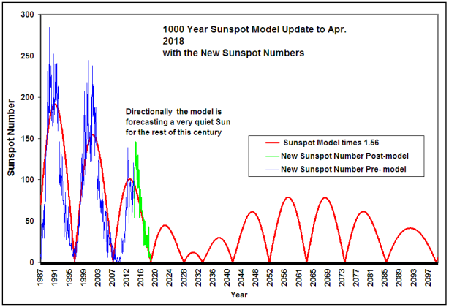
R. Salvadore mathematical model, PRP, 2013
Notes:
This model for the length of the solar cycle can be compared with my predictions in slide 21

Slide 40
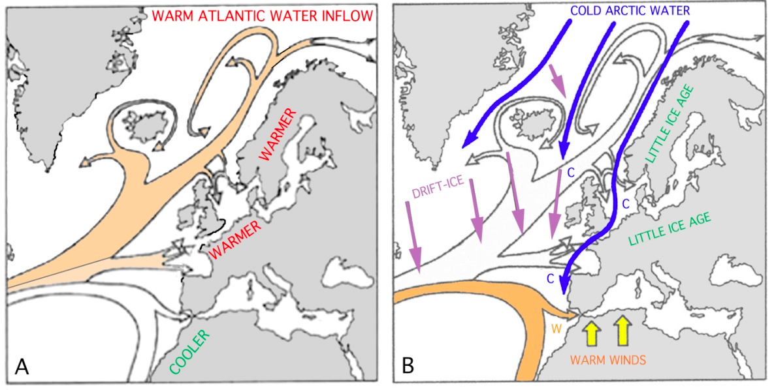
The Atlantic Current at high and low solar activity
N-A. Mörner
Notes:
The change of the Atlantic Current was discussed by N.A. Mörner yesterday.

Slide 41
