Slide 1
The Politics of Climate Change A I Adam Porto 2018 Basic Science of a Changing Climate Conference 7-8 September 2018

Slide 2
“It does not matter what is true, it only matters what people believe as true” - Paul Watson, Greenpeace co-founder, 1997 “The Models are convenient fictions that provide something very useful” - David Frame, Climate Modeller, 2008

Slide 3
“We are on the verge of a global transformation. All we need is a right major crisis” - David Rockefeller, speaking at the Business Council for the UN September 14, 1994 “The only way to get our society to truly change is to frighten people with the possibility of a catastrophe” - Emeritus Professor David Botkin, Opinion Journal, October 24, 2007

Slide 4
“…. the power of financial capitalism had another far-reaching aim, nothing less than to create a world system of financial control in private hands able to dominate the political system of each country and the economy of the world as a whole. This system was to be controlled in a feudalistic fashion by the central banks of the world acting in concert, by secret agreements arrived at in frequent private meetings and conferences.” - Carroll Quigley, Tragedy and Hope, p.324

Slide 5
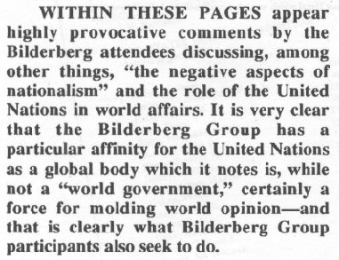

Slide 6
“This is the first time in the history of mankind that we are setting ourselves the task of intentionally, within a defined period of time, to change the economic development model that has been reigning for at least 150 years, since the Industrial Revolution….. This is probably the most difficult task we have given ourselves, which is to intentionally transform the economic development model for the first time in human history.” - Christiana Figueres, Executive Secretary, UNFCCC, January 2015

Slide 7
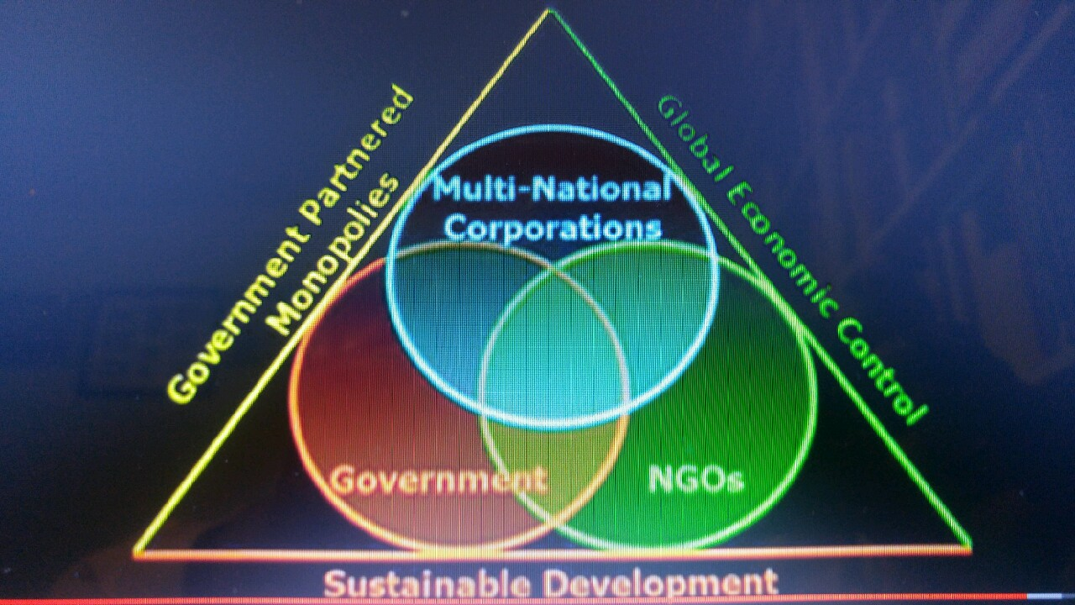

Slide 8
“Effective execution of Agenda 21 will require a profound reorientation of all human society, unlike anything the world has ever experienced a major shift in the priorities of both governments and individuals and an unprecedented redeployment of human and financial resources. This shift will demand that a concern for the environmental consequences for every human action be integrated into individual and collective decision-making at every level.” (Section IV)

Slide 9
“Isn’t the only hope for the planet that the industrialised civilisation collapse? Isn’t it our responsibility to bring that about?.... Current lifestyles and consumption patterns of the affluent middle class – involving high meat intake, use of fossil fuels, appliances, air-conditioning and suburban housing – are not sustainable.” . - Maurice Strong, Chair of Rio Earth Summit 1992

Slide 10
“Incompetent, dishonest, opportunistic, porch-climbing scientists will provide certainty where none exists, thereby driving out of circulation those scientists who can easily confess honest ignorance and uncertainty.” . Craig Bohren, 1996 Distinguished Professor Emeritus of Meteorology Pennsylvania State University

Slide 11
Greenhouse Gas Emissions or Global Warming do not change climate. Critical combination of the Astronomical Cycles changes the climate. These are: 1. Earth’s Orbital Eccentricity 2. Its Axial Tilt & 3. The Axial Wobble. Next critical combination is likely in 10-20 millennia from now which would likely be the end of current Interglacial Period & return of another Glacial Period. Don’t lose your sleep on it!

Slide 12
The tentacles of Global Governance have entrenched into every nook and cranny of the society – there is no escape! . SUSTAINABLE DEVELOPMENT GOALS ARE TOO GOOD TO BE TRUE! .. BUT THE GOGGLE-EYED MASSES HAVE NOT ONLY BEEN MISLED, THEY’RE LED TO DREAMING A FAIRYLAND TO LIVE HAPPILY EVER AFTER WILL NEVER EVENTUATE. Civilizing Capital is The Only Solution! But Who'll Bell The Cat ?????.....

