Slide 1
INCREASING COLD WEATHER EXTREMES SINCE 2000:
AN ASSESSMENT WITH A FOCUS ON WORLDWIDE ECONOMIC IMPACTS
E. Ray Garnett and Madhav L. Khandekar
Canada
PRESENTED AT THE BASIC SCIENCE OF CHANGING CLIMATE CONFERENCE
How Processes in the Sun, Atmosphere and Ocean affect Weather and Climate
September 7-8, 2018 Porto, Portugal

Slide 2
PREMISE:
• Increasing Cold Weather Extremes and diminishing solar activity in recent years suggest a possible change in large scale circulation patterns like the El Nino/Southern Oscillation (ENSO), the North Atlantic Oscillation(NAO) and Pacific Decadal Oscillation (PDO) which produce weather/climate anomalies worldwide.
•This talk analyzes recent cold weather extremes and increasing snow accumulation which are odds with the International Panel of Climate Change (IPCC).
• Economic impacts are analyzed and possible future impacts of such Cold extremes are considered as the Sun enters a grand minimum in the next 10 years.

Slide 3
The Global warming Debate: A Brief Overview
Hypothesis: Warming of earth’s climate is being caused by human-CO2 emissions: Increasing CO2 emissions in Future will warm the climate by 3°C or more by 2050.
--
Reality:
Climate warmed by 0.8°C or more between 1977-98 period.
NO additional warming since about 2000.
Cold Weather Extremes ( CWE) on the rise worldwide since the new millennium.
--
Europe: FIVE cold winters, 2002/03, 2005/06, 2007/08 2009/10 and 2012/13
North America : 2013/14 & 2014/15 longest and coldest , 2017/18 another long and cold winter

Slide 4
Cold Extremes in Northern Europe and Siberia
2000-2012
•In 2002/03, 2005/06, 2009/10 (11 ss/mo)and 2011/12 Europe bore the brunt of four
severe Northern Hemispheric winter winters.
• The winter of 2005/2006 exceptionally cold over western and northeastern Europe in which 23 people died Gdansk, Poland as a result of cold and heavy snow.
•In December 2010 Sweden reported its coldest winter in 100 years.
•In 2009/10 Scotland suffered the coldest winter months in almost 100 years.
•In December 2010 Britain recorded its coldest December in 120 years, the
second coldest December since records began in 1659.
•The winter of 2009/2010 Siberia witnessed one of coldest winters ever recorded
Sources: Khandekar, M.L. 2013., Petkhon, V. & V.A. Semenov, 2010., Casey, J.L. 2014.,
Cattiaux, J, et al 2010., Jung, T et al 2011., Seager, R. 2010., Idso et al 2013.

Slide 5
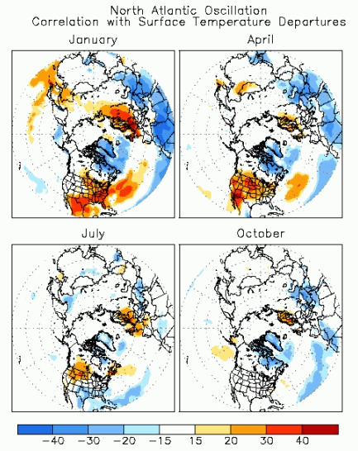
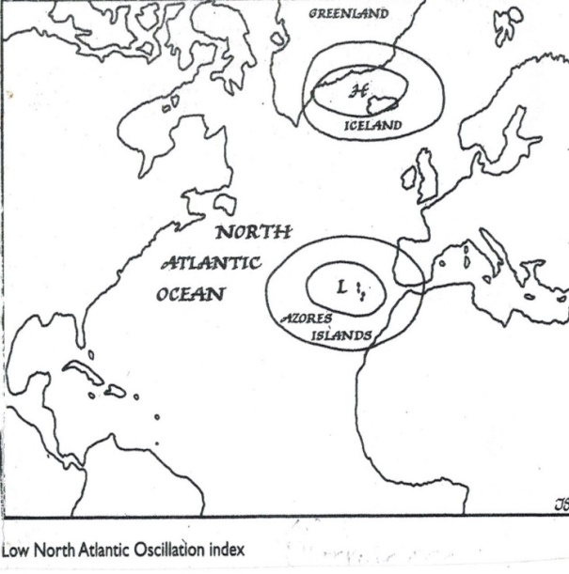
North Atlantic Oscillation(NAO) during SEVERE
EUROPEAN winters OF 2002/03, 2005/06, 2009/10 & 2011/12
a) average NAO in those winters b) Teleconnection patterns c) Schemata of negative NAO
• The NAO was discovered by Sir Gilbert Walker in the early part of the 20th Century
• Above winters mean sunspot activity 25 ss/mo. 2009/10 11 ss/mo Avg: 57 1985-2017
• NAO accumulation Nov-Mar -5.93 in 2009/10 and -2.77 in 2005/06. See next slide
• Solar influence on NAO originates from the Eurasian continent in early winter.

Slide 6
COLD EXTREMES IN ASIA IN THE NEW MILLENIUM
In January 2007 (11 ss/mo)Bangladesh experienced the coldest wave in 40 years.
In 2007/08 China (3 ss/mo)battled the coldest winter (December-February) in 100 years. January 2008 Hong Kong was the second coldest since 1885
• February 2008 in Vietnam cold weather destroyed 40% of the rice crop & 33,000 livestock.
• Winter of 2009/10 Beijing (11 ss/mo)had coldest day in 50 years; worst snowfall in decades.
In north India December-January of 2012/13 was significantly colder than normal leading to several hundred deaths as reported by media.
• The winter of 2013/14 was significantly colder than normal in northern India and Japan.
Northwest India reported snow accumulation of 75 cm (30 ft.) January-February of 2014.

Slide 7
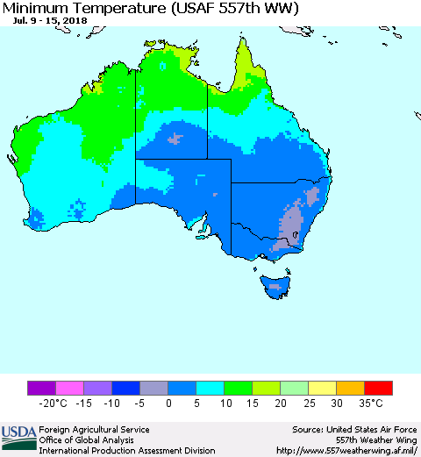
Cold/Wet EXTREMES In the Southern Hemisphere since 2000
May 2006 South Africa reported 54 cold weather records.
July 2007 Buenos Aires Argentina reported temperatures as low as -25⁰C. (11.ss/mo)
Snow was reported for the first time since 1918.
• January 2007 Brazil had heavy rain and flooding.
• January-February 2007 Bolivia had heavy rain and flooding affecting 200,000 people.
• May 2007 Uruguay experienced the worst flooding since 1959 affecting 100,000 people.
•Record minimums set in Australia July 14-15, 2018, 1.5 ss in July
-Qld: Toowoomba -6.6⁰ C., NSW: Dubbo -5.8⁰C. (coldest in 87 yrs)
Sources: Khandekar, M.L., 2013, Casey, J.L. 2014., Idso, C.D. et al. 2013

Slide 8
Cold Weather Europe and North America: 2012-2017
2012 February: Eastern Europe; low temperature -40°C, Danube River frozen till June 2013
2013: Heavy snows in Germany & northern France: 50-km long traffic jams on Auto-Bahns: March 2013 coldest in Germany & parts of Poland
2013/14: Coldest, longest and snowiest winter over US/Canada in 40 years. Low temp -40°C in parts of western Canada: Buffalo (US) received 100cm of snow November 18-19.
2015: Coldest February in Toronto; low temp at -35°C for several days: Boston USA recorded highest snow, 300cm: Snow avalanches killed 200 people in Afghanistan.
2016: Major snowstorm in Washington US: Also in Taiwan, heavy snow and extreme cold ( January) heavy snows in Canadian Prairies (October)
2017: Toronto & Vicinity, extreme cold at -20°C early January; extreme cold over eastern Europe, 55 deaths in Poland; Low temp at -30°C ; massive blizzard in Newfoundland December 15-16, with 30cm snow

Slide 9
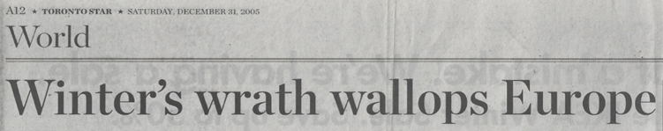
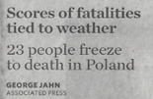
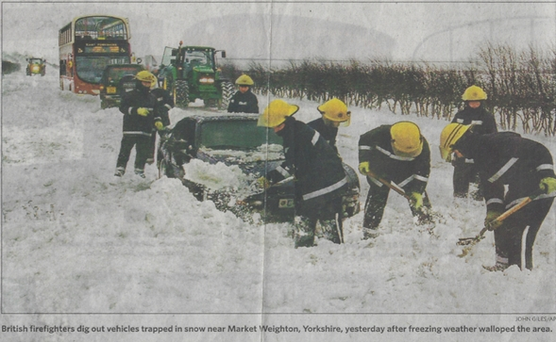

Slide 10
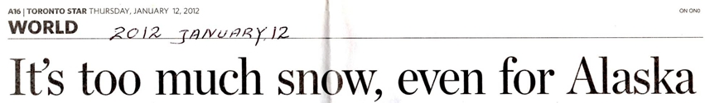

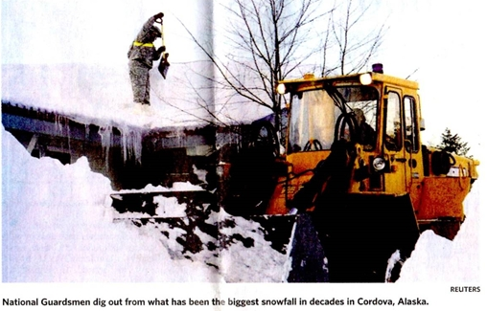

Slide 11
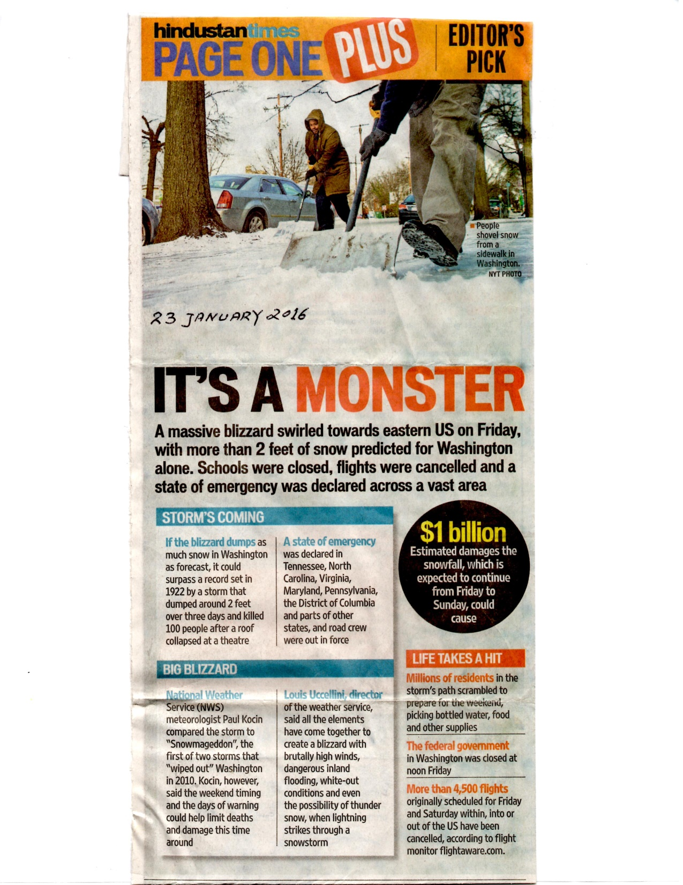
Snowstorm in the US January 2016

Slide 12

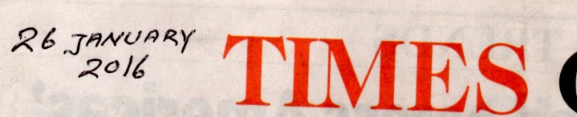
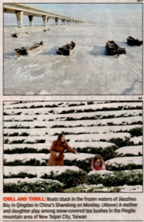



Slide 13


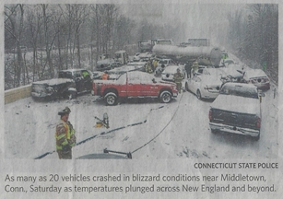


Slide 14
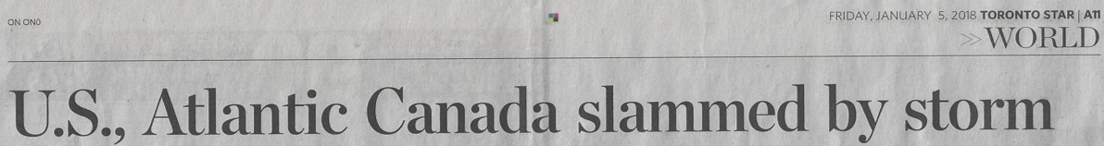
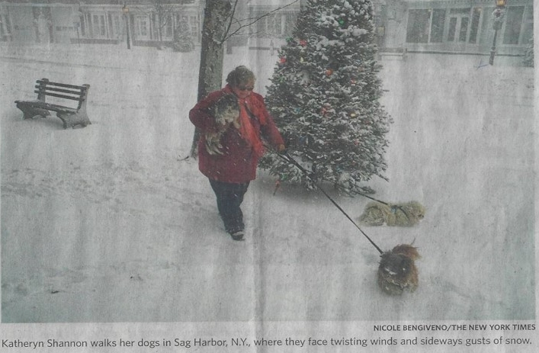

Slide 15
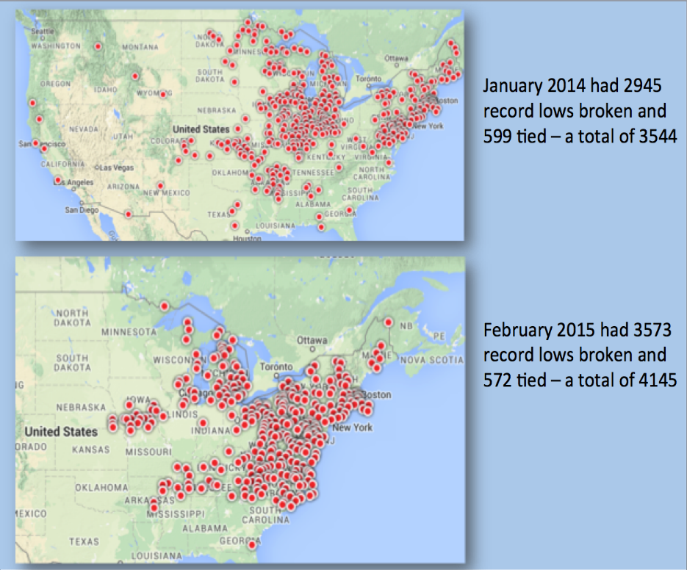
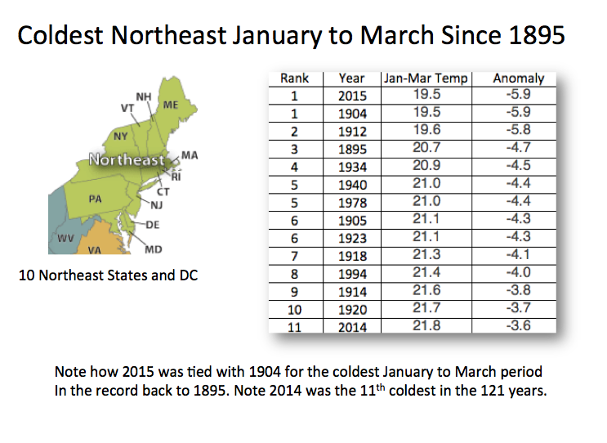
COLD NORTH AMERICAN WINTERS OF 2013/14 & 2014/15
•Winter of 2013/14 one of coldest, snowiest and longest North on the continent in 40 years.
• The mid March 2015 snow accumulation in Boston 300 cm (9.8 ft)
- Economic impact in Boston area estimated at $200 mln
•OECD estimated loss to Canada & U.S. at $20 bln & $50 bln for winter of 2013/14 (79ss/mo)
Sources: Organization for Economic Co-operation Development, Toronto Star, Mar.19, 2014

Slide 16
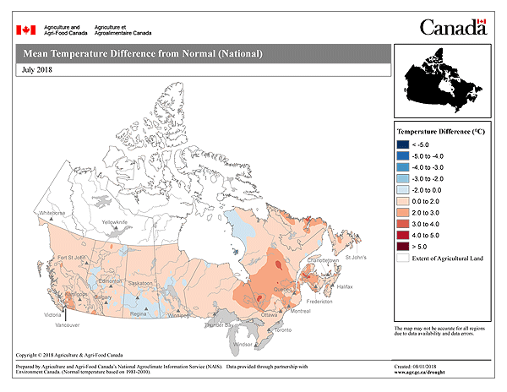
THE TEN PROVINCES AND TERRITORIES OF CANADA
• Most expensive Cold Weather Extremes •Slightly cooler Prairie winters since 2000.
since 2000 have occurred on the west •Prairie Winter 2013/14 2nd coldest in 36 years.
and east coasts.
Mean Monthly AP Index 2000-2017 (a proxy for solar activity)

Slide 17
Severe Winter of 2016/17 ON Canada’s West Coast
•December 4-January3 2017 British Columbia (B.C.) mainland coldest in 32 years.
•February 3, 2017 12 cm snowfall at Vancouver surpassed previous record.
•February 4, 2017 cm at Abbotsford B.C. broke 1957 record of 7.6 cm.
•Economic downturn to B.C. economy estimated at $2 bln.
Sources: CBC News Post Jan. 6, 2017 Environment Canada & Winnipeg Free Press Jan. 6 2017

Slide 18
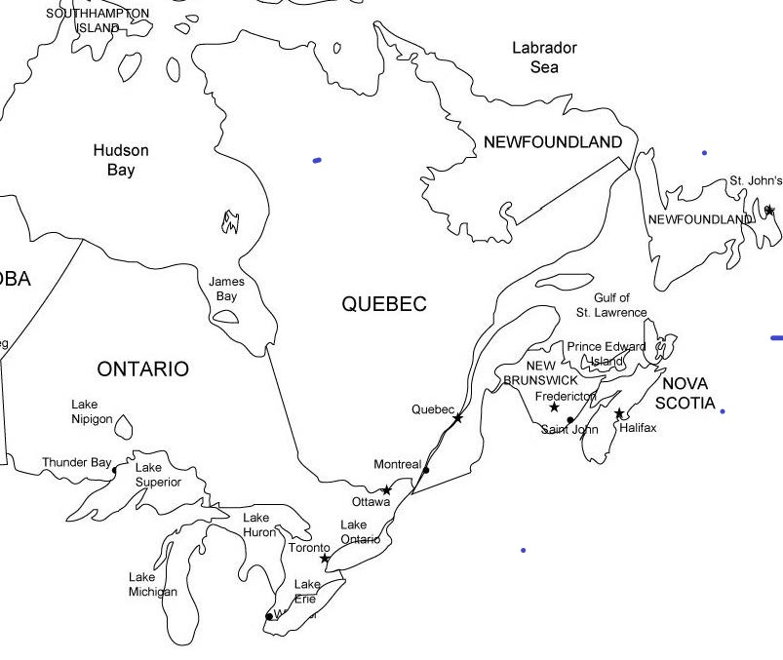
IMPACT OF HEAVY SNOWFALL in ATLANTIC CANADA
-Mar. 15, 2015 Fredericton, N.B. shut down 4 days with 75cm (2.5 ft) of snow
-Mar. 18, 2015 48 cm (1.5 ft) of snow shut Halifax, N.S. down for a week
-Dec.17, 2016 52 cm (1.7 ft) fell in Halifax, N.S. 13 times the average
-Feb. 16, 2017 Moncton, N.B. received
107 cm( 3.6 ft) 345% of normal
-Apr. 4, 2017 62 cm (2 ft) fell on Gander
Nfld. Economic impact $30-40 mln
ECONOMIC LOSSES IN ATLANTIC CANADA 2012-2017 ESTIMATED AT $5 Bln
Source: Environment Canada, Historical Climate Data Google Search

Slide 19
Economic Losses due to CWE:
Preliminary Estimates
2012/13: Europe: ~ US$ 50 billion
2013/14: US/Canada ~125 billion: Japan/China ~20 billion
2015: US:~25 Billion; Canada ~5-10 Billion
2016: US/Canada ~10 billion; Taiwan/China ~5 billion
2017: UK & Europe: ~2-5 Billion; US:~5-7 Billion; Canada: ~3-5 Billion
2018: Europe: ~ 10 Billion: US/Canada ~ 25 Billion

Slide 20
THE EDDY SOLAR MINIMUM (CYCLES #24 and #25) A Grande Minimum?
Top line average of nine 11-yr sunspot cycles 1902-2009, Second sunspot cycle #24 2009-?
Bottom line cycle # 5 1798-1810 during the Dalton Minimum
• Currently in year 9 of sunspot cycle 24 (12 ss/mo); how long will cycle #24 last?
• Solar activity expected to diminish lower in next few years. A colder climate awaits us.
Sources: Archibald 2014, Garnett and Khandekar 2018, NCAR

Slide 21
SUMMARY & CONCLUSIONS
Cold weather extremes have increased worldwide since the new millennium
Increasing cold extremes appear to be linked to large-scale flow patterns
Europe has witnessed five colder winters in last 15 years. North America has also witnessed colder recent winters
Weakening SUN plays its role via NAO patterns
Increasing Economic Impacts due to Cold Extremes
Cold Extremes may increase in next ten years.

Slide 22
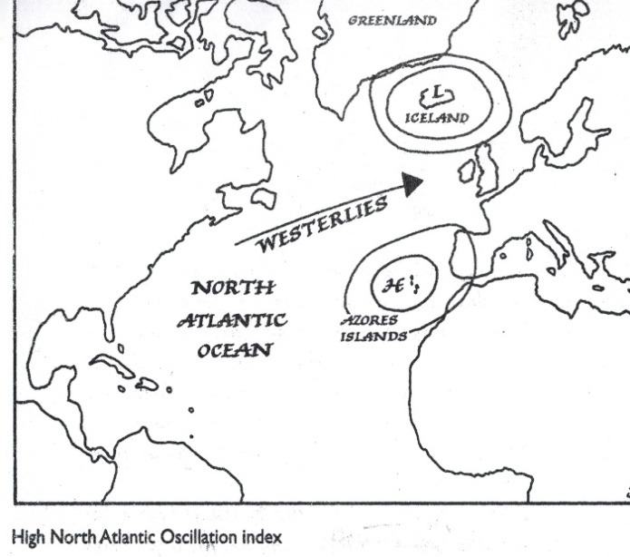
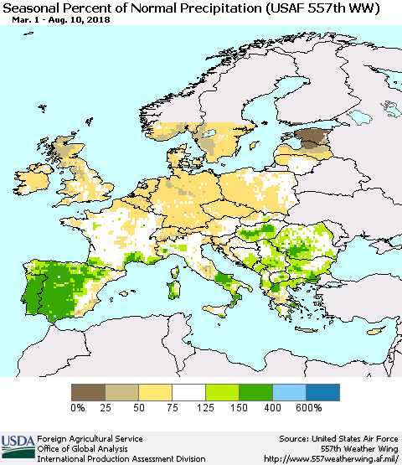
THE NAO AND THE EUROPEAN DROUGHT OF 2018
Orange line: NAO prior to & during German growing seasons of 1976, 2003, 2006, 2007 and 2011 when winter wheat yields reduced reduced.
• La Nina in spring a factor
• Germany’s 2018 winter wheat & barley yields less than 50% of normal.

Slide 24
REFERENCES (1)
Archibald, D.C 2009. Solar Cycle 24: Expectations and Implications. Energy &
Environment Vol.20, No 1 &2, 2009.
Archibald, D. 2014. Twilight of Abundance: Why Life in the 21st century will be Nasty,
Brutish and Short. Regency Publishing, Washington D.C. 208 pp
Allan, R. et al. 1996. El Nino/Southern Oscillation and Climate Variability. CSIRO Publishing
Browning I., E.M. 1981. Past and Future History. A Planners Guide. Fraser
Publishing, Burlington Vermont.
Casey, John L. 2014. Dark Winter- How the Sun Is Causing a 30-Year Cold Spell
Humane Books, Boca Raton, Fl. U.S.A.
Benestad, R.E. 2010. Low solar activity is blamed for winter chill over Europe.
Environmental Research Letters 5 1-2.
Canadian Broadcasting Corporation (CBC) News Post January 6, 2017, Environment
Canada and Climate Change Canada.
Christy, J.R. and R.T. McNider Satellite Bulk Tropospheric Temperatures as a Metric for
Climate Sensitivity Asia-Pac. J. of Atmos Sci 53(4), 511-518, 2017.
Cattiaux, J. et al 2010. Winter 2010 in Europe: a cold extreme in a warming climate.
Geophysical Research Letters 37 L20704 doi: 10.1029/201oGLO44613
Environment and Climate Change Canada. Top 10 stories for 2009. Enduring prairie
cold ends abruptly.
Environment Canada and Climate Change Canada 2013.Canada’s top 10 Weather stories of 2013. 1. Alberta’s Flood of Floods Google Search.

Slide 25
REFERENCES (2)
Fagan, B. The Little Ice Age. How Climate Made History 1300-1850 Basic Books
Idso, C.D. R.M. Carter and F. Singer Eds 2013: Climate Change Reconsidered II Physical Science. published by Heartland Institute Chicago, U.S.A. p.993
Garnett, E.R. and Khandekar, M.L.2018. Increasing Cold Weather Extremes since the New Millennium: An Assessment with a focus on worldwide Economic Impacts. Modern Environmental Science and Engineering. May 2018, Vol. 4. No 5, pp 427-438
Georgieva, K., [21] C. Bianci, and B. Kirov (2005), Once again about global warming and solar activity, Mem. S. A. It. (Società Astronomica Italiano), 76, 969.
Idso, C.D. R.M. Carter and F. Singer Eds 2013: Climate Change Reconsidered II Physical Science. published by Heartland Institute Chicago, U.S.A. p.993
IPCC 2013: Climate Change 2013; the scientific basis. Contribution to the working Group 1 to the Fifth Assessment Report of the Intergovernmental Panel on
Climate Change. Edited by T.F. Stocker at al Cambridge University Press.
Jung, T et al 2011. Origin and Predictability of the extreme negative NAO winter of 2009/10.Geophysical Research Letters 38 L007701 doi: 1029/2011GLO46786
Khandekar, M.L. 2003 Comments on WMO statement on extreme weather events. EOS, Transactions American Geophysical Union 84, 41, p.428
Kodera, K. 2003. Solar influence on the spatial structure of the NAO during the winter 1900- 1999. Geophysical Research Letters 30, 4 1175 doi:10.1029/2002GLO16584.
Plimer, I. 2007. Heaven and Earth: Global Warming the Missing Science
Connor Court Publishing Pty Ltd Ballan Victoria, Australia.
Seager R. et al 2010: Northern Hemisphere winter snow anomalies: ENSO, NAO and the winter of 2009/10. Geophysical Research Letters 37 L14703

Slide 26
REFERENCES (3)
Landsheid, T. 2000. Solar wind near the Earth: Indicator of variations in global temperature. In:
Vazquez, M. and Schmieder,B. ed.:The solar cycle and terrestrial climate. European Space Agency, Special Publications 463, 497-500.
Lockwood M. et al 2010. Are cold winters in Europe associated with low solar activity? Environment Research Letters 5 doi: 10.1088/1748-9326/5/2/024001
Petukhon V. and V.A. Semenov 2010. A link between reduced Barents-Kara sea and cold winter extremes over northern continents. Journal of Geophysical Research 115 D21111 doi: 10.1029/209JDO 13568.
Plimer, I. 2007. Heaven and Earth: Global Warming the Missing Science
Connor Court Publishing Pty Ltd Ballan Victoria, Australia.
Seager R. et al 2010: Northern Hemisphere winter snow anomalies: ENSO, NAO and the winter of 2009/10. Geophysical Research Letters 37 L14703
Soon Willie and David R Legates 2013: Solar irradiance modulation of equator-to-pole (Arctic) temperature gradients: Empirical evidence for climate variation on multi-decadal timescales. J of Atmospheric and Solar-terrestrial Physics 93 45-56
Svensmark et al. 2017. Increased ionization supports growth of aerosols into cloud condensation
nuclei. Nature Communication. DOI; 10.10.1038/S41467-017-02082-2 published online Dec. 19, 2017.
Svensmark, H. and Calder N. 2007. The Chilling Stars. A new Theory of Climate Change. Icon Books Ltd.
Toronto Star Newspaper, March 19, 2014.

Slide 27
REFERENCES (4)
Van Geel, B and P.A. Ziegler 2013 IPCC underestimates the sun’s role in climate change. Energy and Environment 24 431-451.
Winnipeg Free Press February 6, 2017.
The World Book Encyclopedia 1966. N-O Napoleon I, p.15.
Acknowlegement
This to acknowledge that the map of Canada was obtained from Agriculture and Agri-Food Canada (AAFC)

Slide 28
rences

