Slide 1
The Porto Climate Conference, September 7-8, 2018
Planetary beat and sea level changes
Nils-Axel Mörner
Paleogeophysics & Geodynamics, Stockholm, Sweden, morner@pog.nu
Independent Committee on Geoethics, https://geoethic.com/
Scientific advisor to the Porto Conference
Full paper posted on:
https://www.researchgate.net/publication/327427281_Planetary_beat_and_sea_level_changes

Slide 2
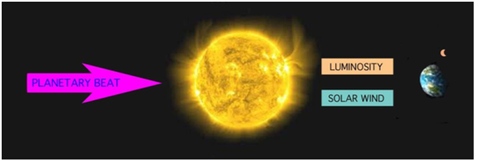
Easterbrook has an hour ago given an excellent account on the Solar-Terrestrial interaction. The planetary beat generating solar variability and changes in the emission of luminosity and solar wind (Fig. 1) was demonstrated in the special issue of Pattern Recognition in Physics 2013 [1] and Nova book on Planetary-Solar-Terrestrial Interaction 2015 [2].
Fig. 1. Planetary-Solar-Terrestrial interaction.
From: Mörner, Tattersall & Solheim, PRP, 2013 and Mörner, Nova book, 2015

Slide 3
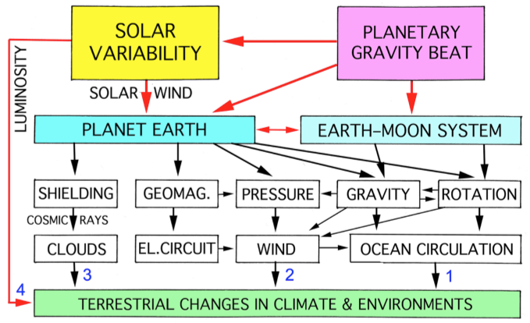
Fig. 2. Planetary beat processes and the spectrum of terrestrial variables affected:
1. Dominant factor according to Nils-Axel Mörner
2. Dominant factor according to Piers Corbyn
3. Dominant factor according to Henrik Svensmark
4. Dominant idea of solar luminosity forcing
Most probably all four lines are active in affecting Earth’s climate changes, sea level changes and other environmental variables.
From my paper at the London 2016 Climate Change Conference [5]
with the four (1-4) main lines of solar-terrestrial forcing.

Slide 4
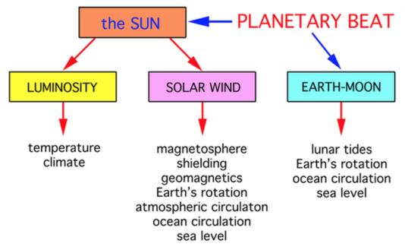
The 60-yr cycle is a fundamental cycle in Earth’s climate changes [17]. It is also a fundamental cycle in planetary beat [18] and solar variability [19]. The Gulf Stream beat is dominated by a 60-yr cycle over the last 200 years, driven by changes in the Earth’s rate of rotation [14, 13, 4]. The Earth’s geomagnetic field variations exhibit a strong 60-yr cyclicity [20, 21]. This implies at that the 60-year cycle must originate from the Solar Wind interaction with the magnetosphere generating changes in rotation, ocean circulation and sea level changes as given in Fig. 2 (line 1). Because lunar tidal components are identified [22], we can be sure that also the Earth/Moon system was affected [8]. This is illustrated in the above figure.

Slide 5
Sea level changes
The science of sea level changes is complicated and multi-disciplinary and always expands in view of knowledge & interpretation [6-12]. It must be solidly anchored in observational facts in the field – model shortcuts don’t pay off. Glacial eustasy and thermal heating are primarily driven by the Sun. Their contribution to sea level change is small [6]. Rotational eustasy has turned out to be the dominant factor over the last 500 years [11, even 8]. Rotational eustasy can only be understood in terms of planetary-solar-terrestrial interaction.
Rotational eustasy and planetary-solar-terrestrial interaction
The Spörer, Maunder and Dalton Grand Solar Minima with associated Little Ice Age climatic conditions were all found to correspond to periods of rotational speeding-ups [13, 3, 4]. The speeding-up at solar minima refers to a total speeding-up of the entire Earth system (not just the hydrosphere), and this must be the effect of the Solar Wind interaction with the magneto-sphere [14, 13, 3, 4, 8]. In response to the general speeding up, the equatorial bulge increases and the polar flattening deepens. The slowing down at solar minima, on the other hand, implies a lowering in the equatorial region and a rise in the polar region.

Slide 6
The Grand Solar Cycle Oscillation (GSCO)
The alternation between Grand Solar Maxima and Minima must be driven by Planetary-Solar forcing [1, 2, 3, 4, 5, 24]. The Gulf Steam beat and the periods of Little Ice Age climate conditions follow the Grand Solar Cycles oscillations in great details over the last 600 years [13, 25, 26].
The changes in sea level during the last 500 years in the Maldives [27], Bangladesh [28], Goa [10] and the Fiji Islands [12] all provide solid observational facts of high sea levels during Grand Solar Minima (i.e. periods Little Ice Ages) and low sea levels during Grand Solar Maxima [11, also 8]. This is quite opposite to glacial eustasy. Instead, it indicates that, during the last 500 years, rotational eustasy has been the dominant eustatic sea level factor [11].
Rotational eustasy implies horizontal interchanges of water masses; in this case changes between high and equatorial regions as illustrated in Fig. 3.

Slide 7
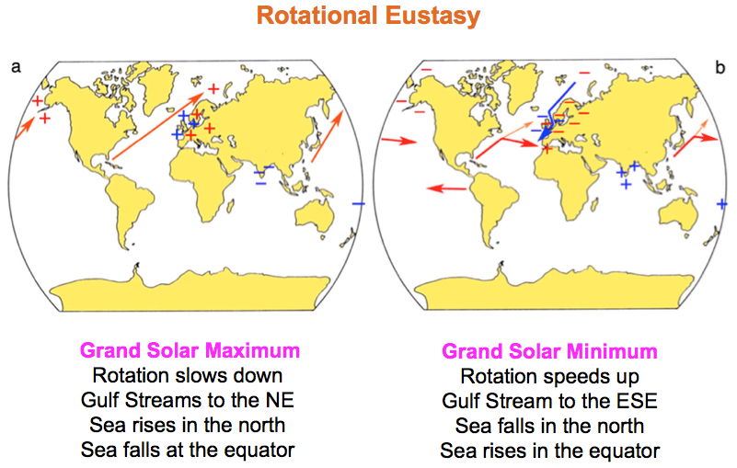
Rotational eustasy (horizontal eustasy) implies the lateral redistribution of ocean water masses.

Slide 8
The identification of the Grand Solar Cycles in ocean circulation [13] and predominant global eustatic sea level changes [8, 11] implies that all previous talk about an on-going rapid rise in global sea level (as driven by the IPCC project and its proponents) is nothing but a serious mistake* [29, 30, 31, 32]. *Not to say “bullshit”
This implies that sea level changes are natural phenomena [33, 34] – which humans cannot control or do anything about; just have to learn to live with and adapt for (as humans have done through millennia of the postglacial period).

Slide 9
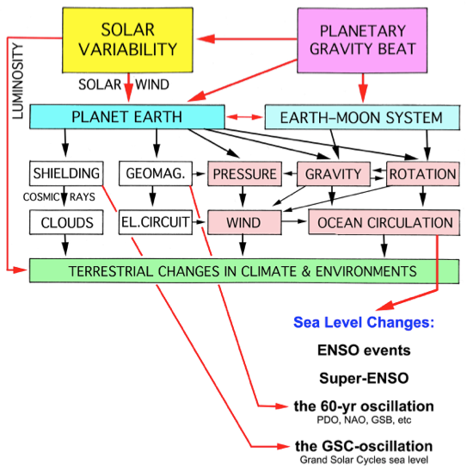
Generation of observed oceanic “oscillations” (EEO, 60yrCO, GSCO) in terms of planetary-solar forcing functions. Pressure, gravity and rotation affect wind and ocean circulation, and ocean circulation generates redistribution of ocean masses and sea level changes on the inter-annual basis (ENSO), on the 60-yr time scale and on the Grand Solar Cycle time scale. The 60yr geomagnetic cycle and the Grand Solar Cycle changes in shielding provide firm evidence of the simultaneous interaction of Solar Wind variations with the Earth’s magnetosphere.

Slide 10
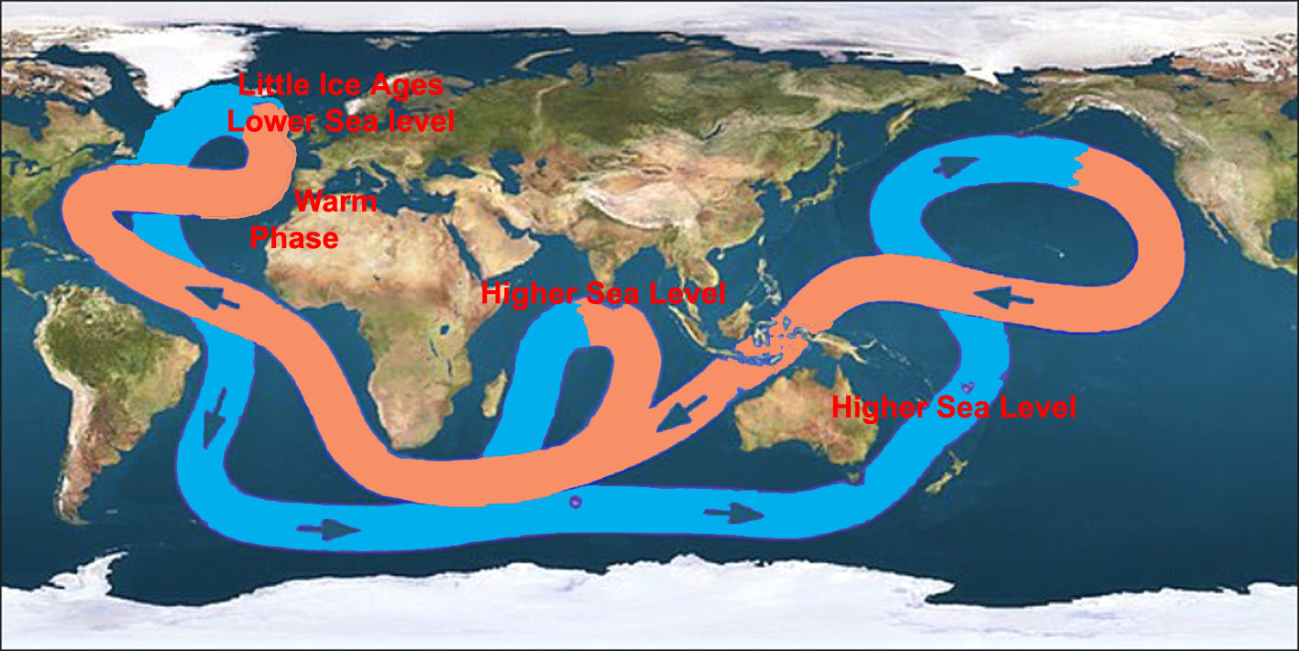
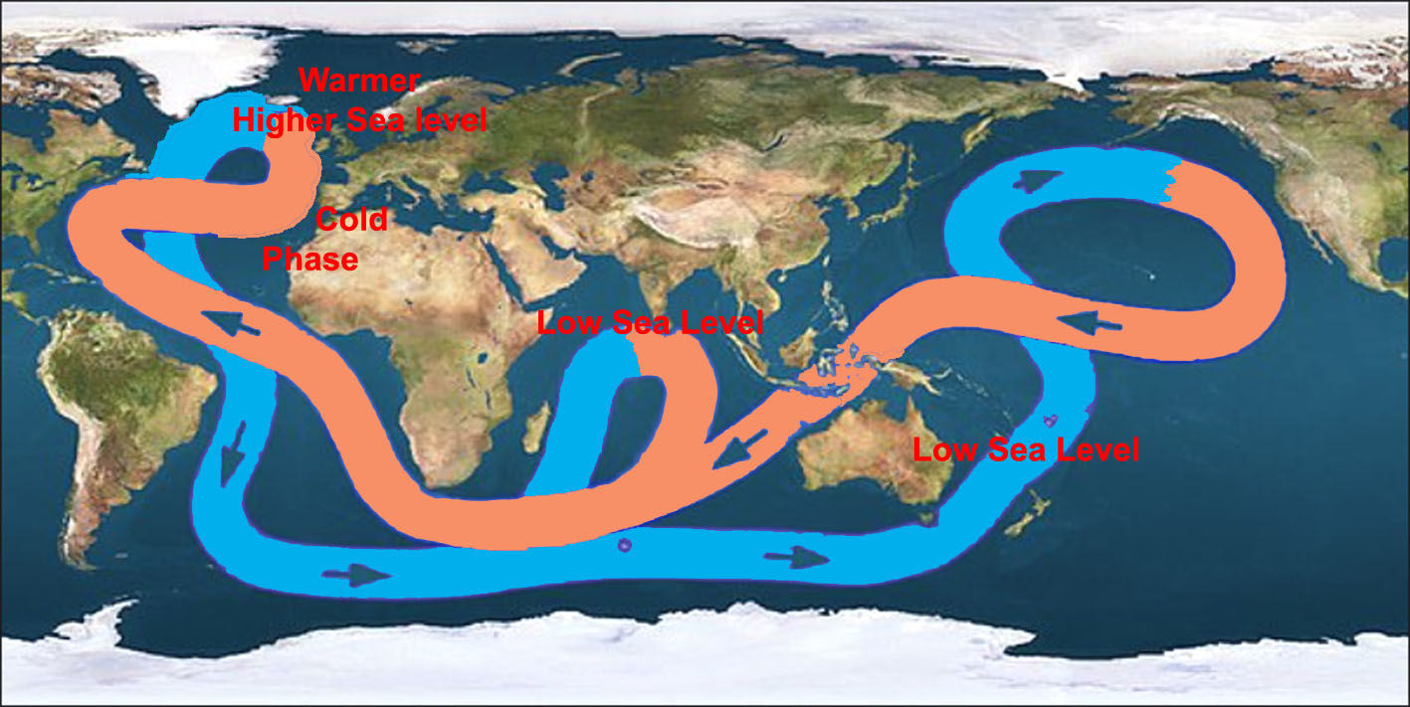
The thermohaline “pump”
at
Grand Solar Minima
and
Little Ice Ages
The thermohaline “pump”
at
Grand Solar Maxima
and
Warm phases

Slide 11
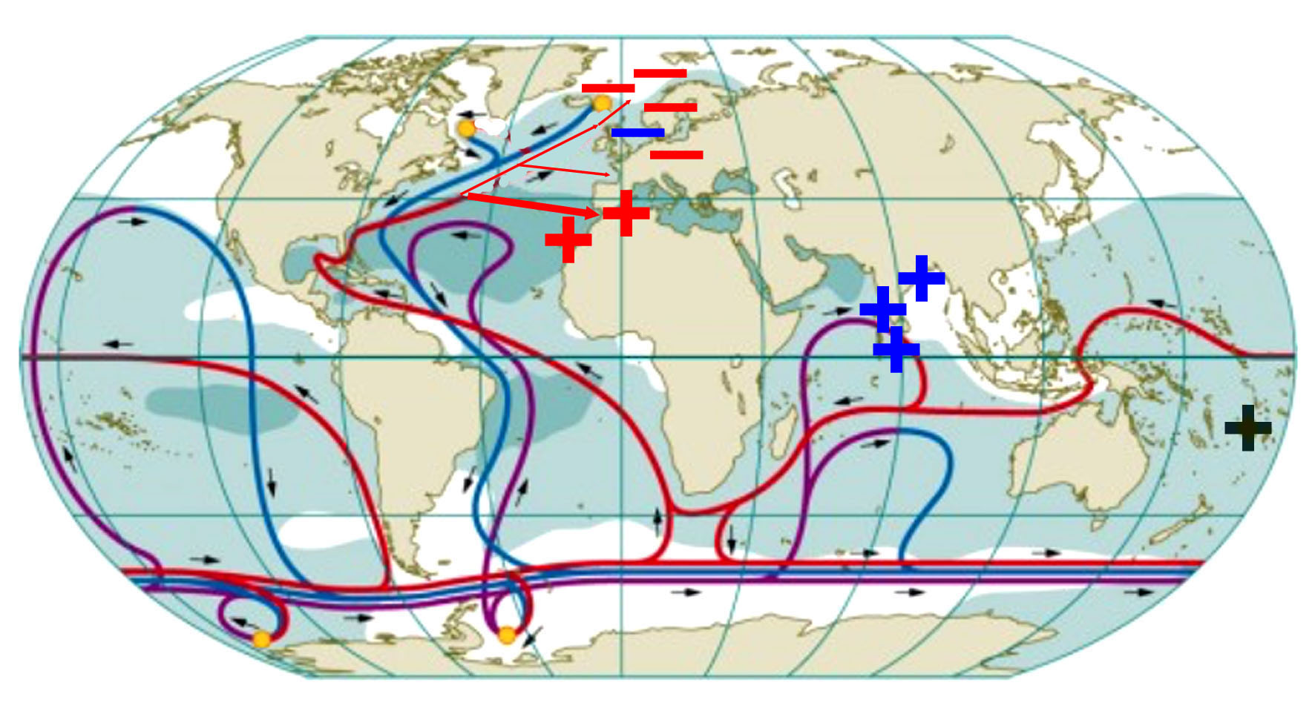
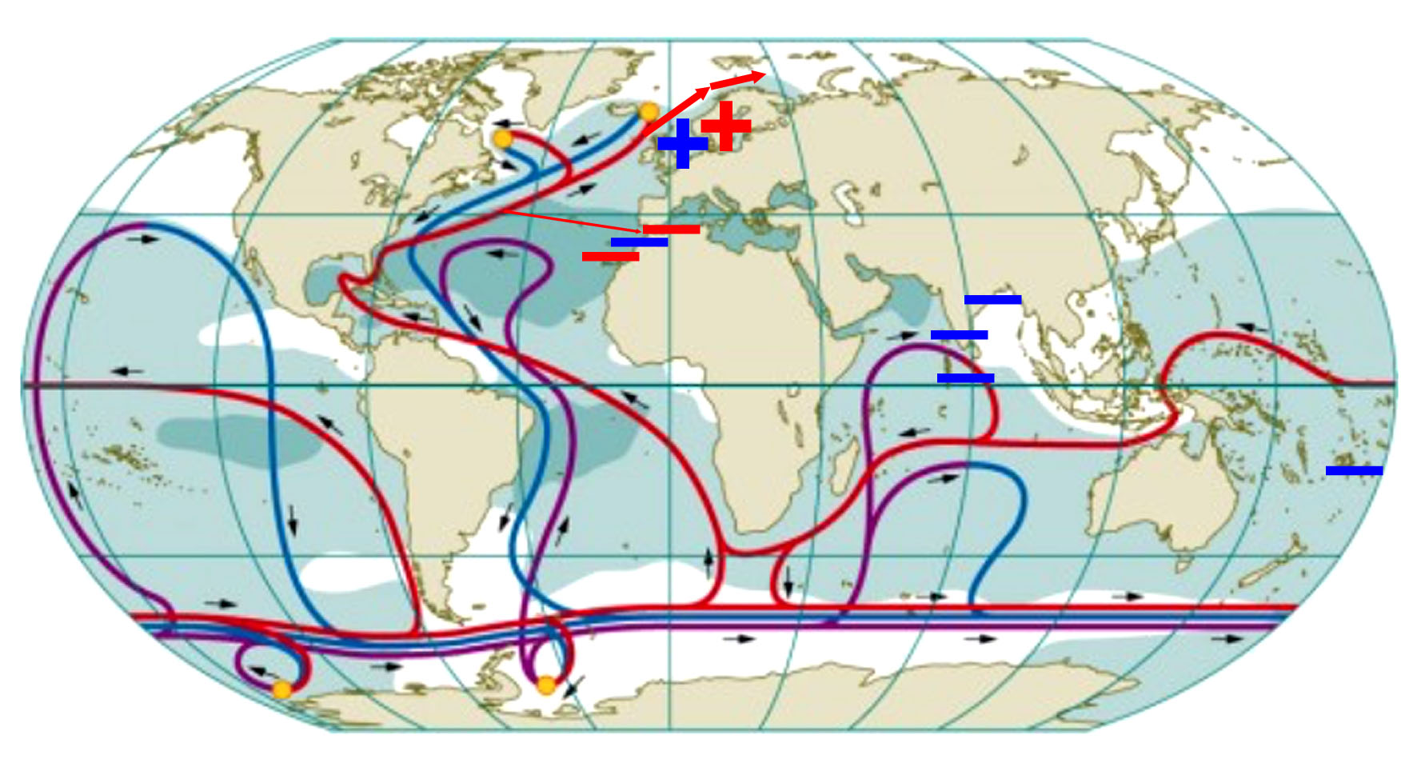
Grand Solar Minima:
Spörer Minimum 1440-1460
Maunder Minimum 1687-1703
Dalton Minimum 1809-1821
minimum 1880-1915
minimum 1940-1970
Next Minimum 20130-2050
Grand Solar Maxima:
Maximum around 970 AD
Medieval Warm Optimum ~1250
Maximum 1390
Maximum Late 1500
Maximum Late 1700
Maximum 1930-1950
Maximum 1970-2000

Slide 12
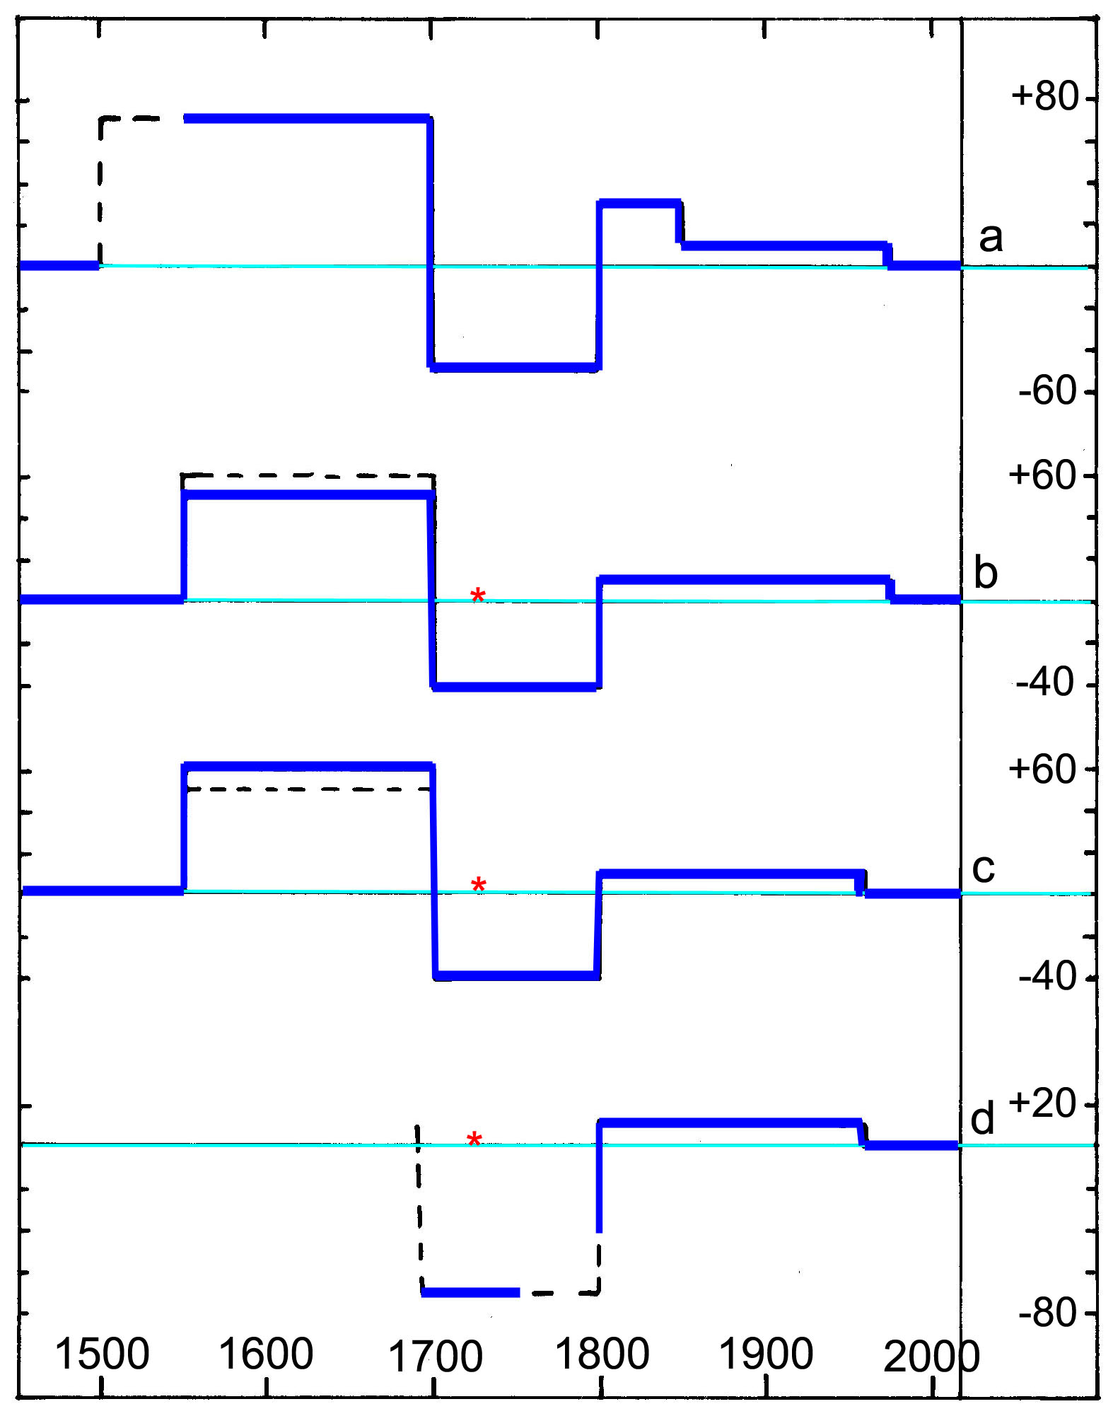
Sea level changes
in the Fiji Islands
in the Maldives
in Goa, India
in Bangladesh

Slide 13
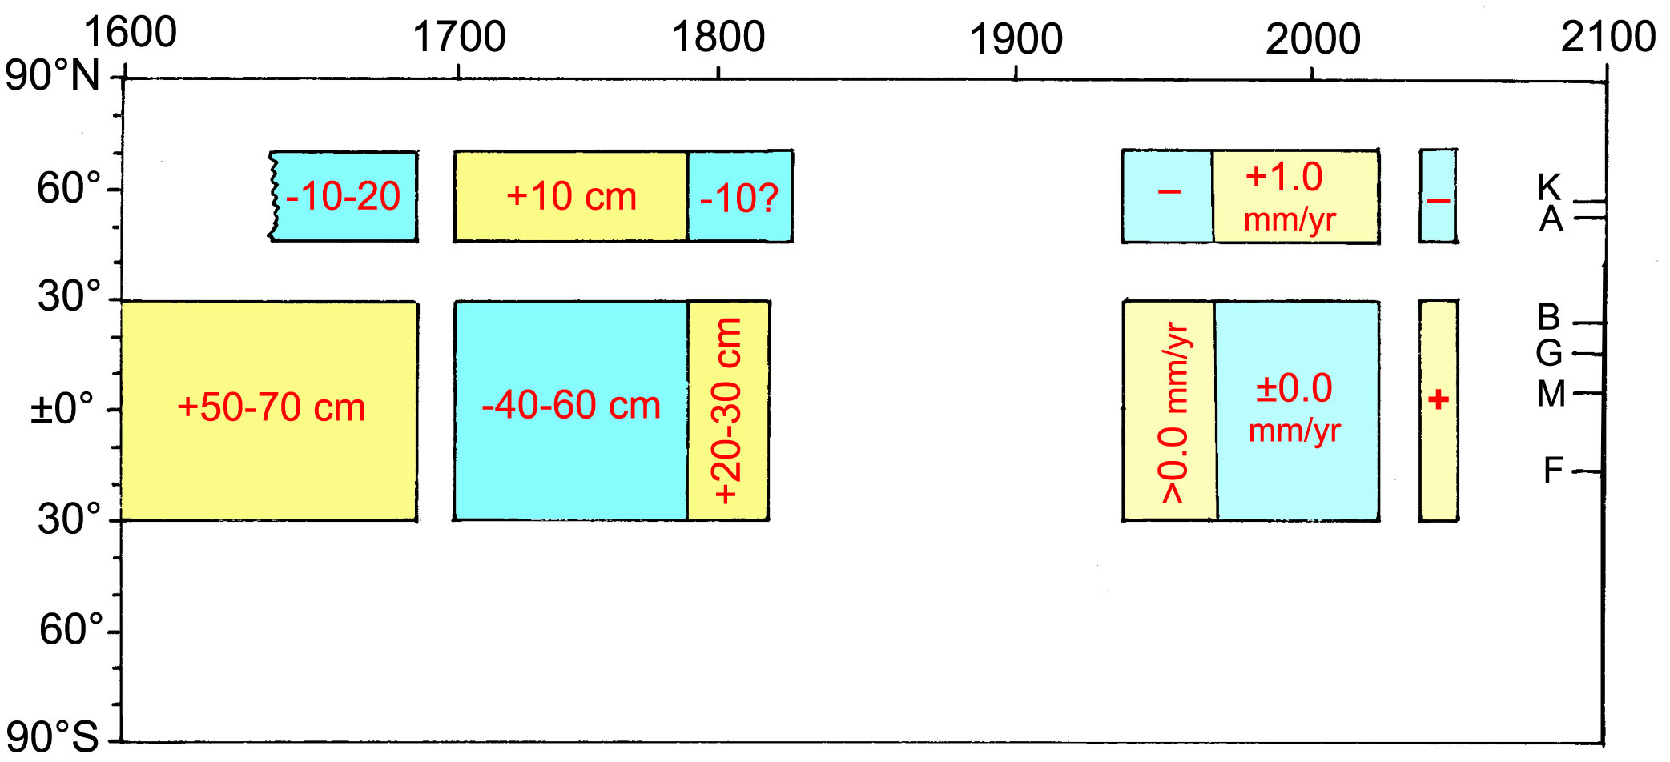
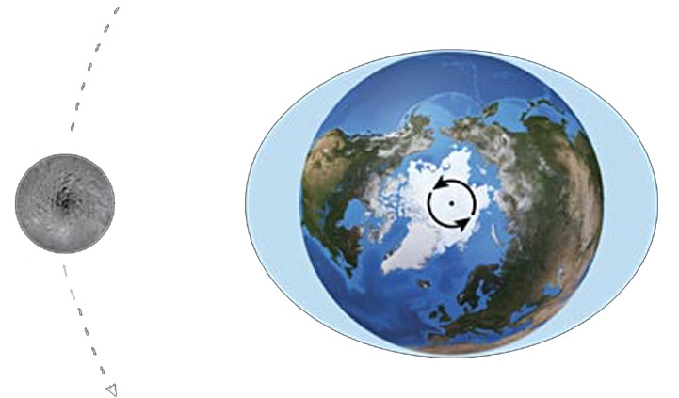
The North–South anti-correlations in sea level (rotational eustasy)
give evidence of Lunar-Tidal Super Cycles following the Grand Solar Cycles

Slide 14
Ocean level oscillations or horizontal eustasy (rotational eustasy) i.e. the ENSO events, Super-ENSO events, the 60-year cycle and the newly identified Grand Solar Cycle Oscillation must all lead their origin from the integrated changes in the brown boxes driven by Planetary-Solar forces (as further indicated by the geomagnetic factor in the 60-year cycle and the shielding factor in GSCO cycle.

Slide 15
Ocean Oscillations
Interpretation in terms of planetary-solar forcing
The previous figure illustrates the generation of observed oceanic “oscillations”
(EEO, 60yrCO, GSCO) in terms of planetary-solar forcing functions.
Pressure, gravity and rotation affect wind and ocean circulation.
Ocean circulation generates redistribution of ocean masses and sea level changes on the inter-annual basis (ENSO), on the 60-yr time scale and on the Grand Solar Cycle time scale.
The 60yr geomagnetic cycle and the Grand Solar Cycle changes in shielding provide firm evidence of the simultaneous interaction of Solar Wind variations with the Earth’s magnetosphere. The Grand Solar Cycle also generates Lunar-Tidal Super Cycles and changes in the Thermohaline “pump”.

Slide 16
Conclusions
The ENSO events may, at least partly, be driven by planetary effects on the Earth’s rotation (LOD) and ocean circulation (interchange of angular momentum).
The 60-yr cycle in climate, ocean circulation (GSB, PDO, NAO, etc) and sea level changes can be tied to corresponding changes in planetary beat, solar variability and geomagnetic field changes.
The Gulf Stream beat (GSB) and the rotational eustatic changes in sea level over the last 500-600 years can be directly linked observed solar variability (GSC), shielding variations and planetary beat.
With this, the theory of a planetary-solar-terrestrial interaction has taken an important step forward, also to be the prime forcing function for Earth’s rotation, ocean circulation and differential sea level changes over the globe (i.e. rotational eustasy).
By this the threat of a global sea level rise with disastrous effects (as claimed by the IPCC and its proponents) is revealed as deeply incorrect and The Greatest Lie Ever Told*
*to quote my booklet of 2007

Slide 17
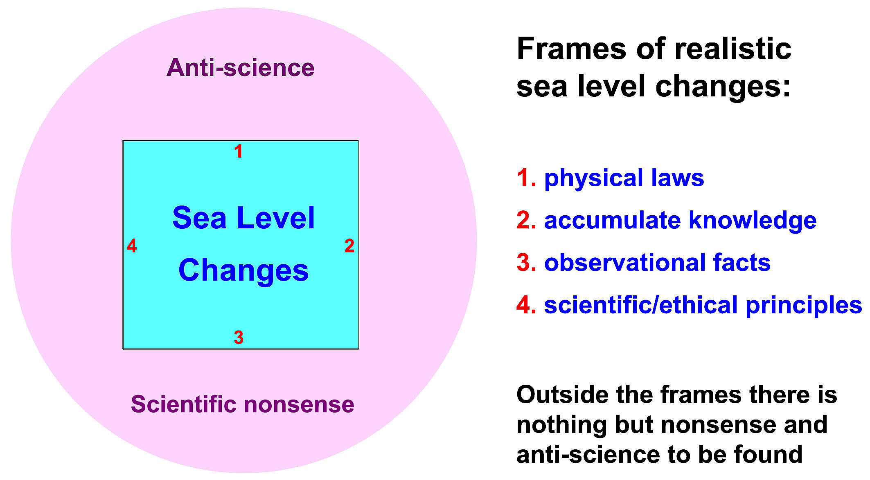
The frames changes with increased knowledge and observational facts.
All what is said, shown and claimed in this paper lie well within the frames of the blue box.
Very much of what IPCC and its proponents claim lie well out side the frames realistic sea level changes in the pink field of nonsense.

Slide 18
Finished (and grown up)

Slide 19
Supplementary data

Slide 20
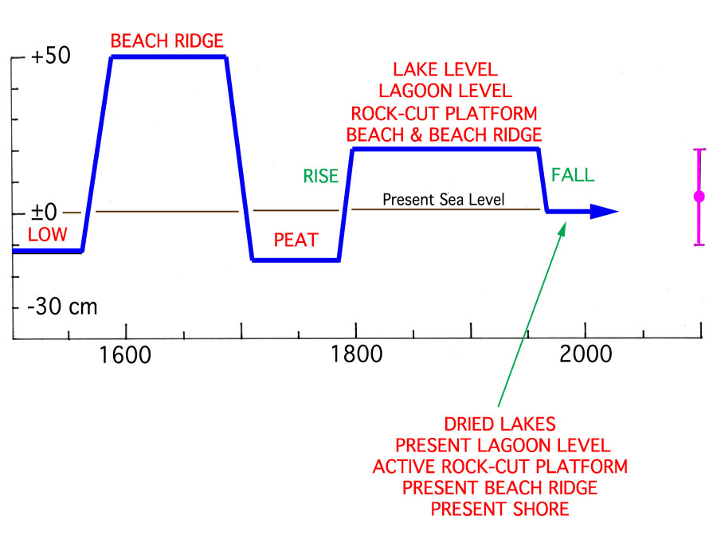
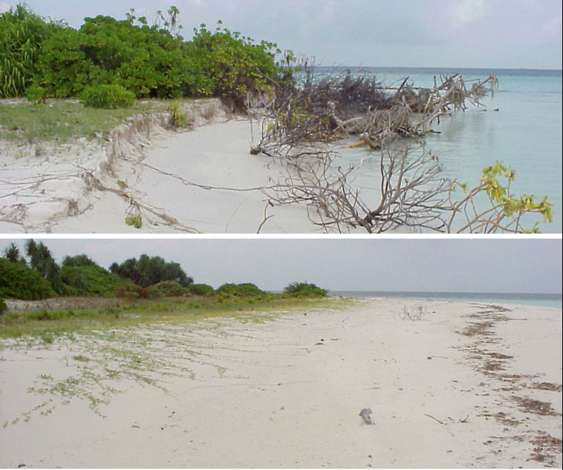
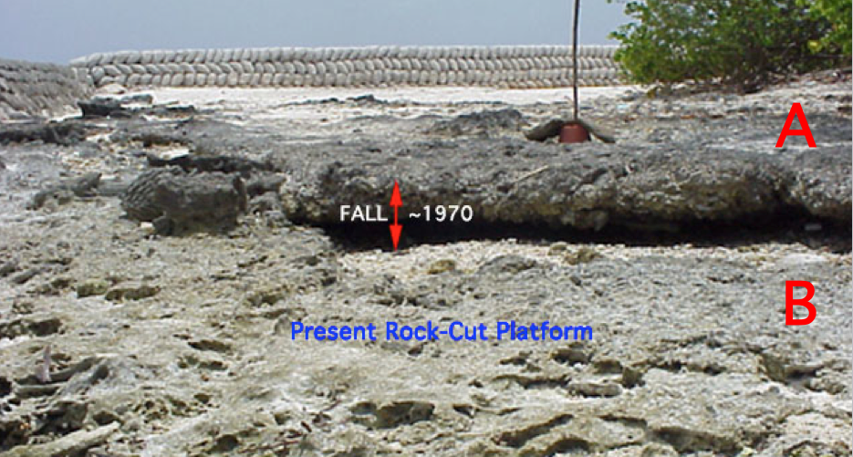
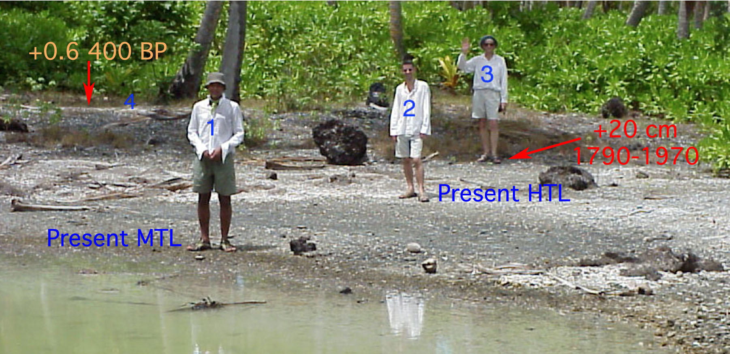
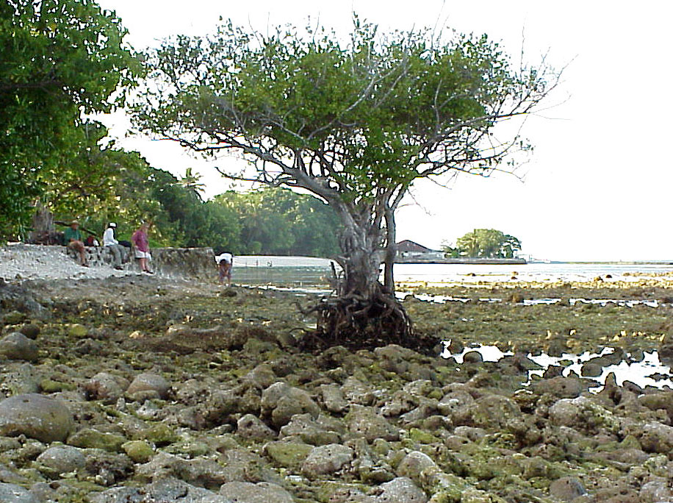
Coastal
morphology
in the
Maldives

Slide 21
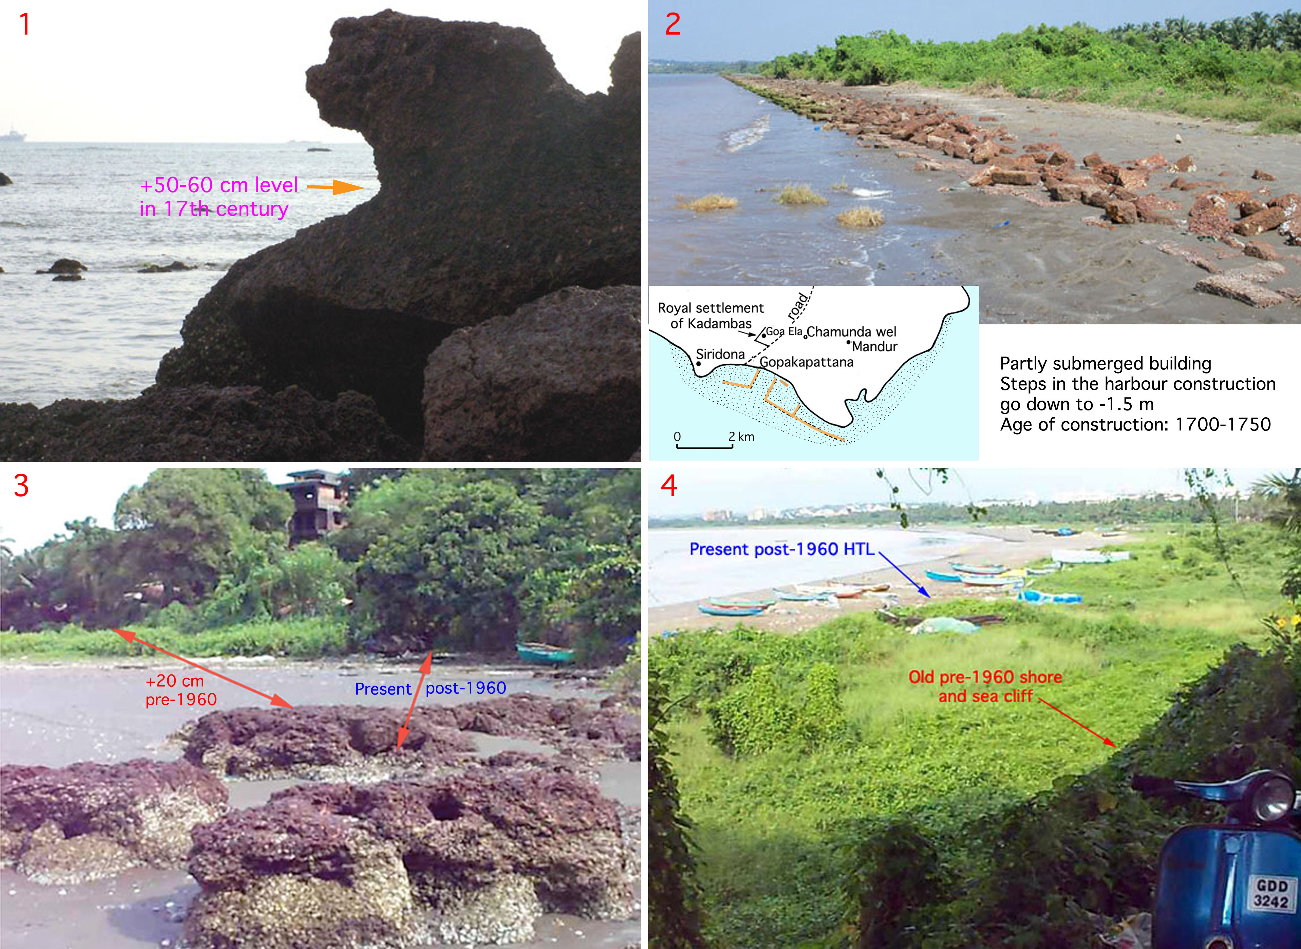

Slide 22
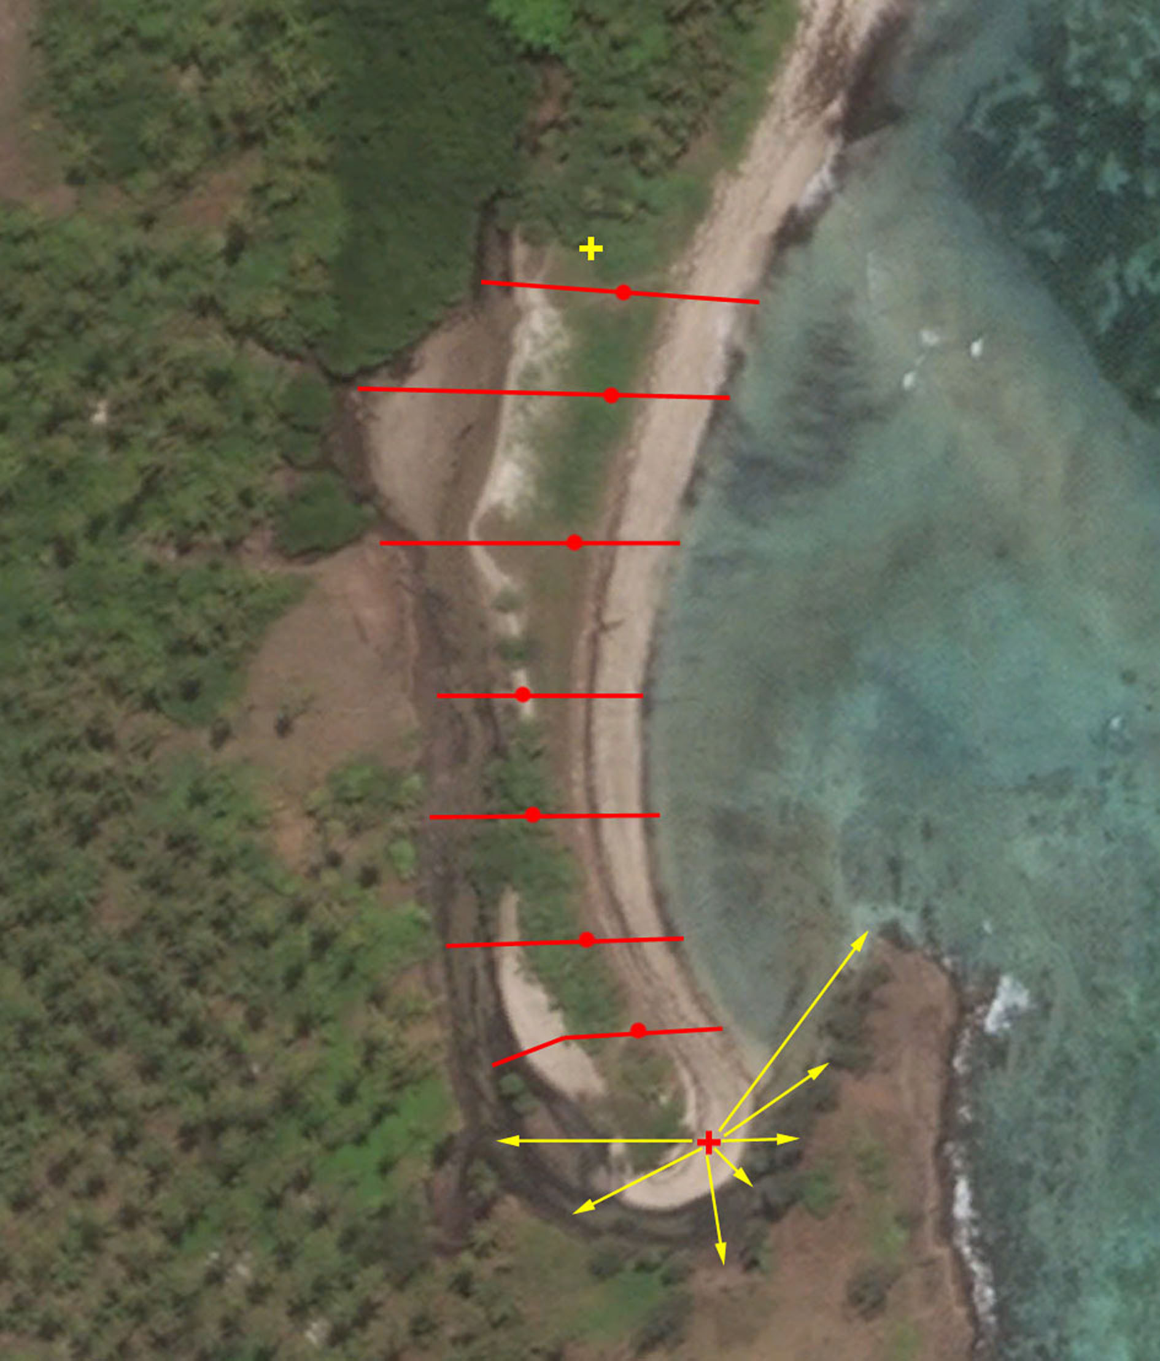
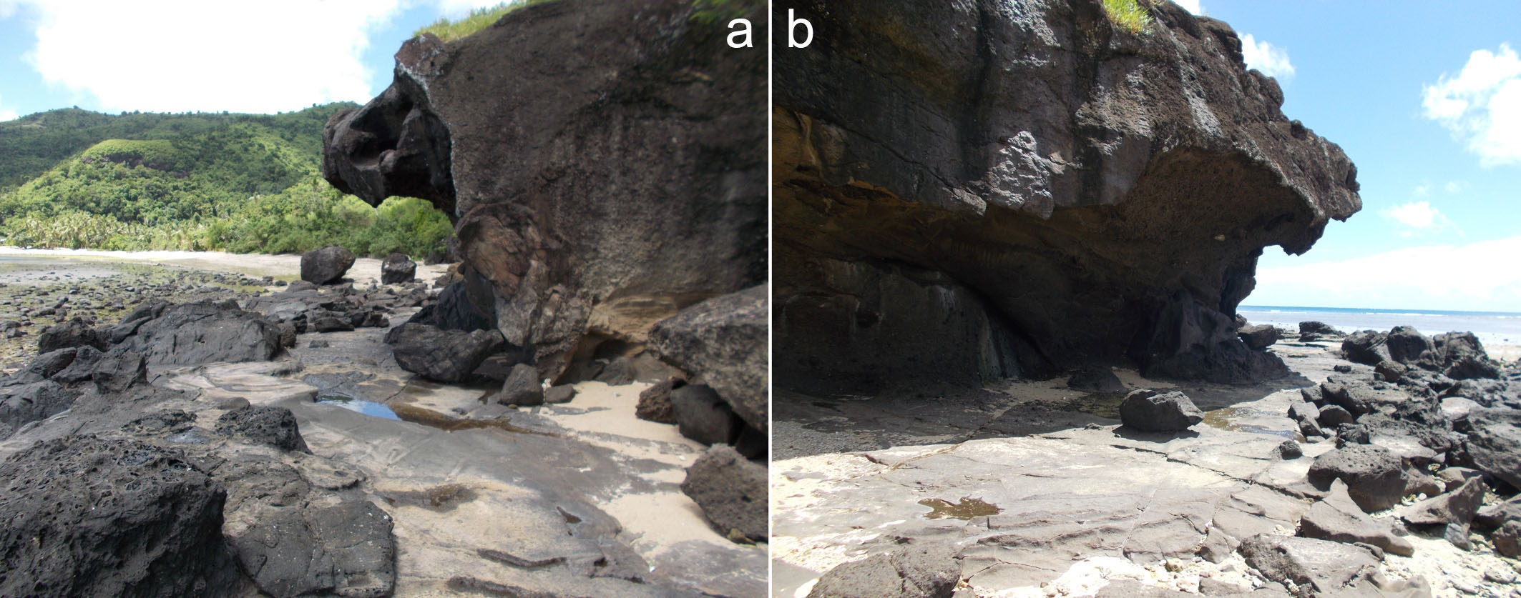
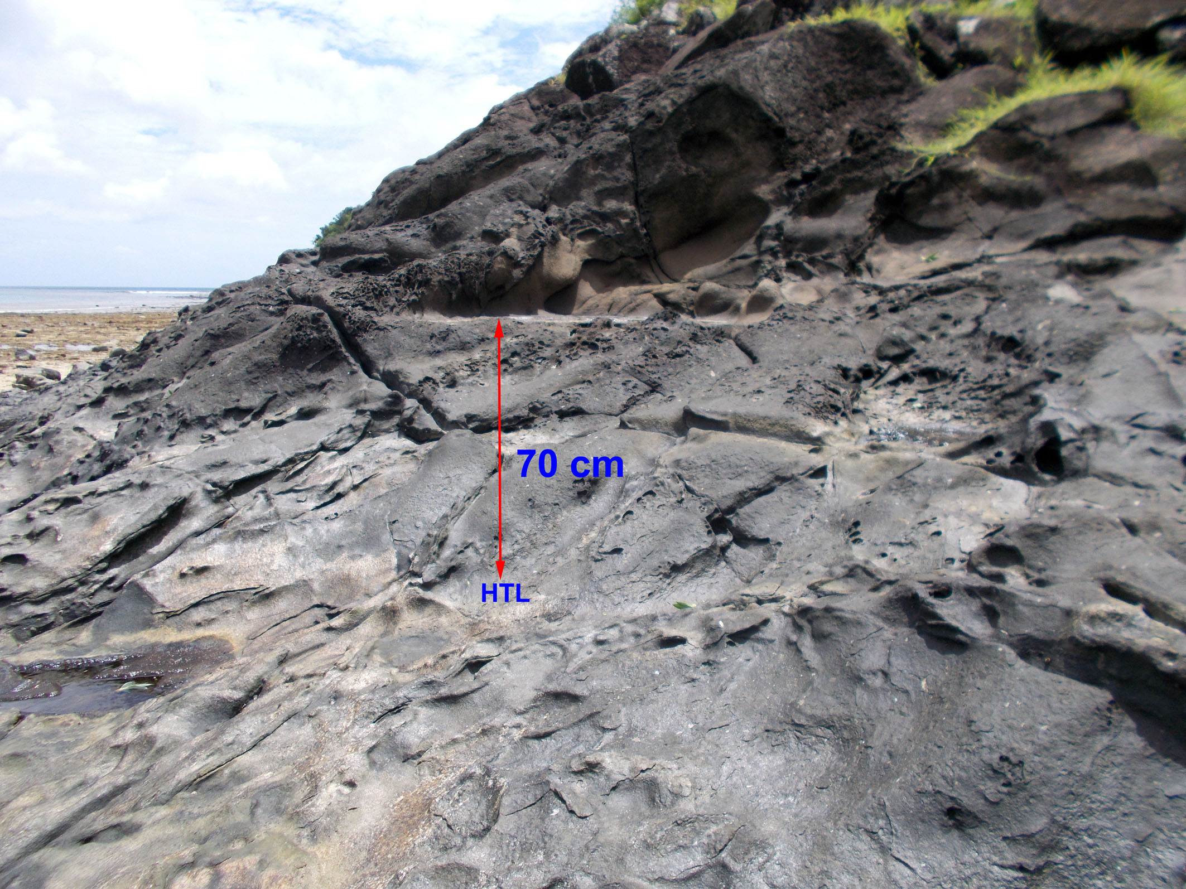
Strandlinjeförskjutningar i Fijiöarna under 500 år
med hjälp av strandmorfologi och C14-dateringar
Idag: högvattennivån är mycket klart utbildad som erosions hak med ”rock-cut platform”, även sand-stranden intill har väl utbildad högvattens nivå.
Senaste 200 åren: Strandsporren, 155 m lång, har byggts ut under 200 år. Nivån har avvägts med hög precision. ±0 m
På 1700-talet: bildades strand hak och rock-cut platform (från den tidens högvattennivå) där vi nu har dagens lågvattennivå. Ca –1,3 m
På 1600-talet: bildades ett strand hak 70 cm över dagens högvattennivå. +0,7 m

Slide 23
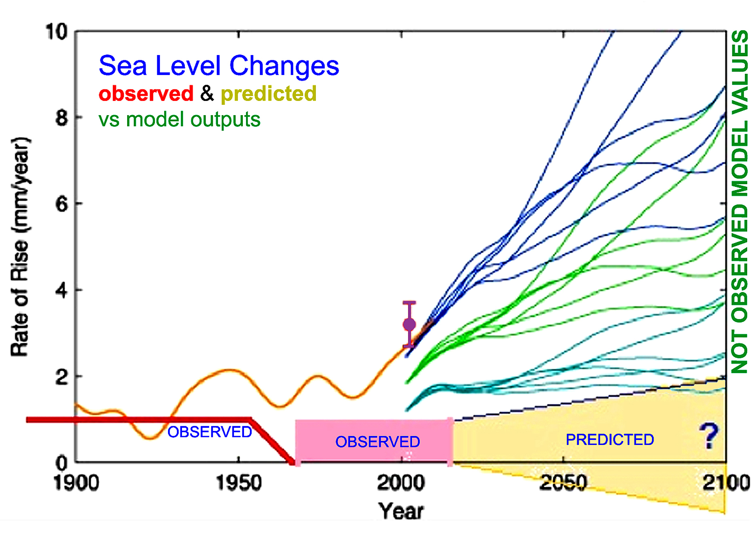
Observations vs models
In this figure (Mörner, 2015), we compare sea level data as observed in the field with model out-puts (i.e. not observed model values). The differences are striking with model values lying very far above actually observed values. By year 2100, the observational facts suggest a sea level position of +5 ±15 cm.
We, of course, insist that only actual facts from the field itself and documented by sea level specialists should provide meaningful forecasts of possible future changes in sea level.

Slide 24
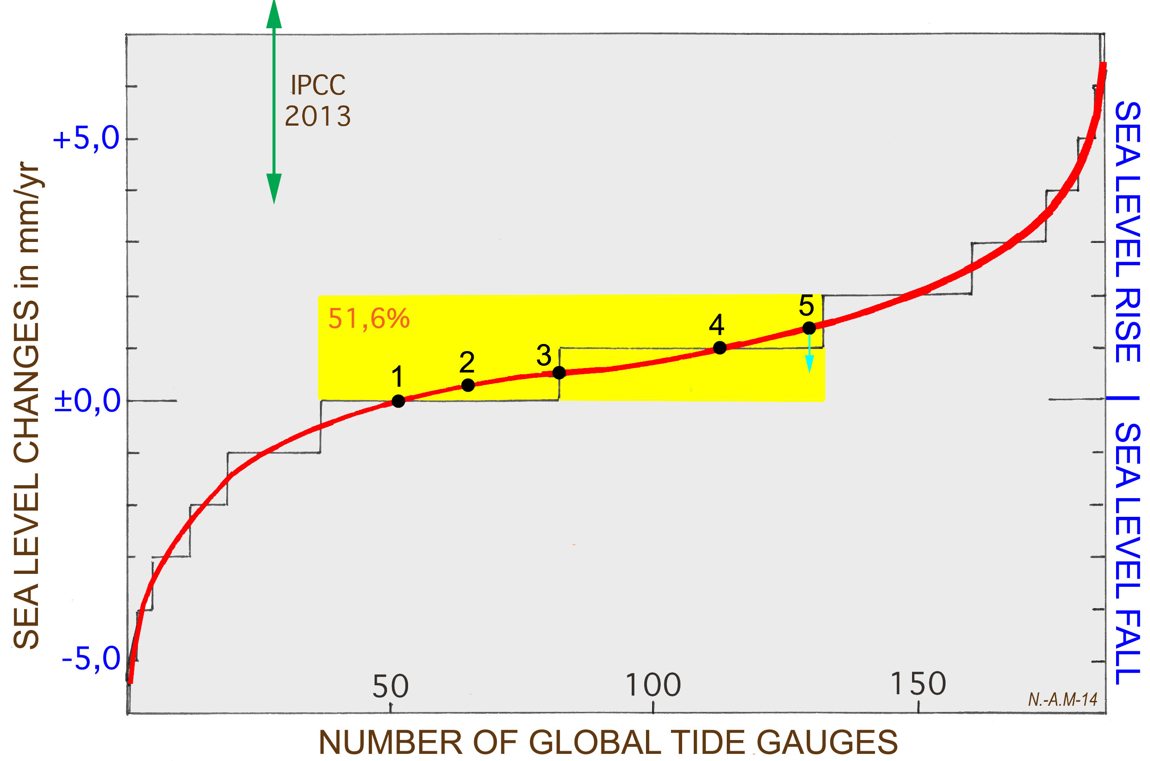
5 = less than +1.14 mm/ys, the mean of 184 tide gauges used by Univ. Colorado
4 = +1.0 ±0.1 mm/yr in the NW-European test sites
3 = +0.55 ±0.1 mm/yr from revised satellite altimetry records (NOAA & UC)
2 = +0.25 ±0.19 mm/yr, the mean of 170 PSMSL tide gauges of >60 years
1 = ±0.0 mm/yr from many global test sites; e.g. Maldives, Bangladesh, Goa (Indian Ocean), Fiji, Tuvalu, Vanuatu, Kiribati (Pacific), NE South America, Venice.
giving a congruent picture of ±0.0 to +1.0 mm/yr (+0.5 ±0.5 mm/yr) with
only the IPCC estimates hanging above “in the air”. (from Mörner, 2015).

