Slide 1
Climate change: solar-interplanetary forces not human activity
Roger Tattersall & Stuart Graham
Tallbloke.wordpress.com
rog@tallbloke.net

Slide 2
The laplace resonance in Galilean moons
The classical view compares orbital periods and observes an approximate 4:2:1 Mean Motion Resonance

Slide 3
The 1:2:3 synodic resonance in Galilean moons
Our new finding is that there is a more exact 1:2:3 ratio between the synodic conjunctions of the moon pairs.

Slide 4
Exoplanetary systems with 1:2:3 synodic resonance
Trappist-1 has a 1:1:2:3:6:9 synodic pair resonance series
After discussing orbital periods only in their original write up, the Trappist-1 investigators rushed out a paper describing the synodic resonance 3 months after it was published at Tallblokes Talkshop

Slide 5
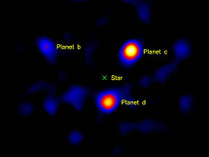
Exoplanetary systems with 1:2:3 synodic resonance
Gliese 876 c,b,e
HR 8799 b,c,d
Astrophysicists estimate 40% of exoplanetary systems contain syzygy pairs exhibiting orbital resonance. We think it will be more.

Slide 6
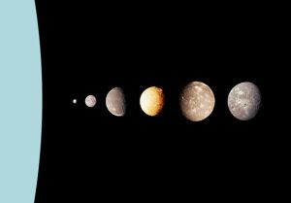
More resonant moon triplets now discovered
Styx, Nix and Hydra’s synodics exhibit a 2:3:5 resonance around Pluto.
Miranda-Ariel = 3.21845 d [* 18 = 57.9321 d] Ariel-Umbriel = 6.432386 d [* 9 = 57.891474 d] Miranda-Umbriel = 2.145132 d [* 27 = 57.918564 d]

Slide 7
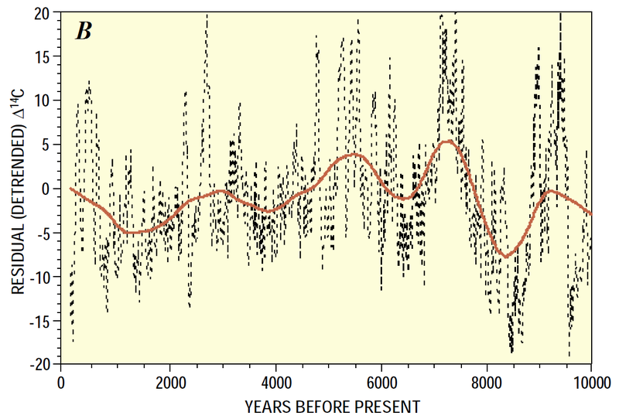
Major Synodic resonance in our solar system
5 Jupiter and 2 Saturn orbits form 3 synodic conjunctions every ~60 years
42 Kepler trigons precess through 360 degrees over a period of 2503 years which coincides with a paleoclimate periodicity called the Hallstatt Cycle.
Kepler’s Trigon - De Stella Nova 1606

Slide 8
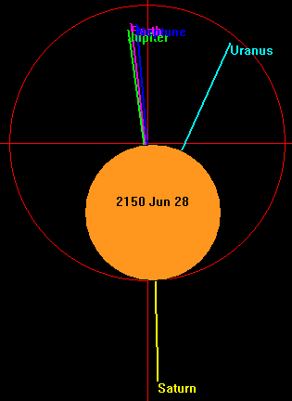
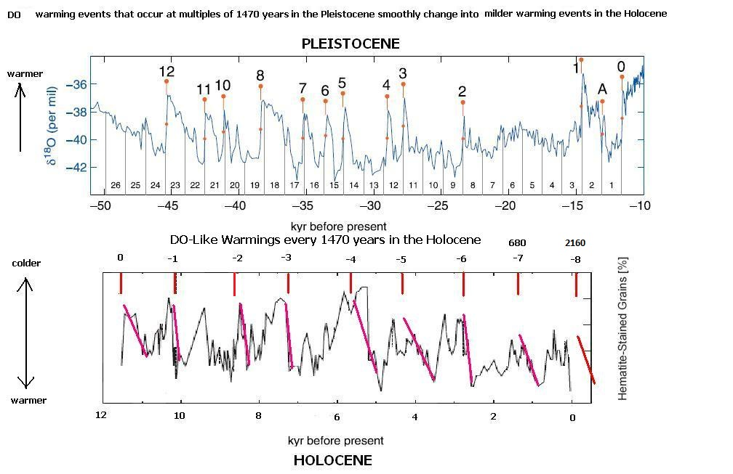
Multi-body resonances in our solar system
Bond Events occur every 1470 years coinciding with cyclic planetary alignments

Slide 9
Solar barycentric motion and activity cycles
60 year harmonious and 120 year chaotic periods form the ~180 year Jose Cycle of 3 Kepler trigons. These coincide with high and low solar activity periods varying over a 2403 year cycle.
Ivanka Charvatova: The solar motion and the variability of solar activity

Slide 10
Integrating the solar data to mimic ocean response
Integral of the 10Be solar reconstruction
correlates well with Michael Mann’s multiproxy global temperature reconstruction at the millennial timescale.

Slide 11
Integrating the solar data to mimic ocean response
9500 year Solar integral of 10Be data appears to match historical warm and cold epochs in Earth’s ever changing climate.

Slide 12
Modelling solar variation using planetary periodicities
Rick Salvador’s model replicates the 10Be TSI reconstruction over the last 4000 years to a Pearson R^2 value of 0.72.

Slide 13
Modelling solar variation using planetary periodicities
The same model replicates the Sunspot Number since 1749 to a Pearson R^2 value of 0.91

Slide 14
Solar-planetary Model Prediction to 2100
The model prediction made in 2013 now has 5 years of additional solar data to compare against. So far, so good.

Slide 15
Sea surface temperature prediction to 2050
Using Solar model integral, AMO cycle, LnCO2 0.4C per doubling and SOI to ‘curve fit’ a simple empirical model. Predictive power? Time will tell.

Slide 16
Thank You for your attention
Please Visit Tallbloke’s talkshop at
tallbloke.wordpress.com

