Slide 1
The Porto Climate Conference, September 7-8, 2018
Atlantic Ocean circulation and Gulf Steam beat
Nils-Axel Mörner
Paleogeophysics & Geodynamics, Stockholm, Sweden, morner@pog.nu
Independent Committee on Geoethics, https://geoethic.com/
Scientific advisor to the Porto Conference
Full paper posted on:
https://www.researchgate.net/publication/327427275_Atlantic_Ocean_circulation_and_Gulf_Stream_beat

Slide 2
Abstract
During all the Grand Solar Minima in the last 600 years – i.e. the Spörer Minimum 1440-1460, the Maunder Minimum 1687-1703 and the Dalton Minimum 1809-1821 – northwest Europe experienced Little Ice Age climate conditions. Cold Arctic water penetrated all the way down to middle Portugal. The Northern branches of the Gulf Stream severely weakened. At the same time, however, the southern branch of the Gulf Stream increased bringing hot equatorial water to the region of Gibraltar and the Canary Islands. This area experienced Little Inter-glacial climate conditions.
No doubt, we are now heading towards a new Grand Solar Minimum at about 2030-2050. Therefore, we are likely to experience similar climate conditions as were the case during the last Grand Solar Minima; i.e. Little Ice Age conditions in NW Europe.
This is a scenario in 100% opposition to the one proposed by the IPCC and agreed upon at the Paris Climate Conference, where global temperature is continually going to rise as a function of atmospheric increase in CO2.

Slide 3
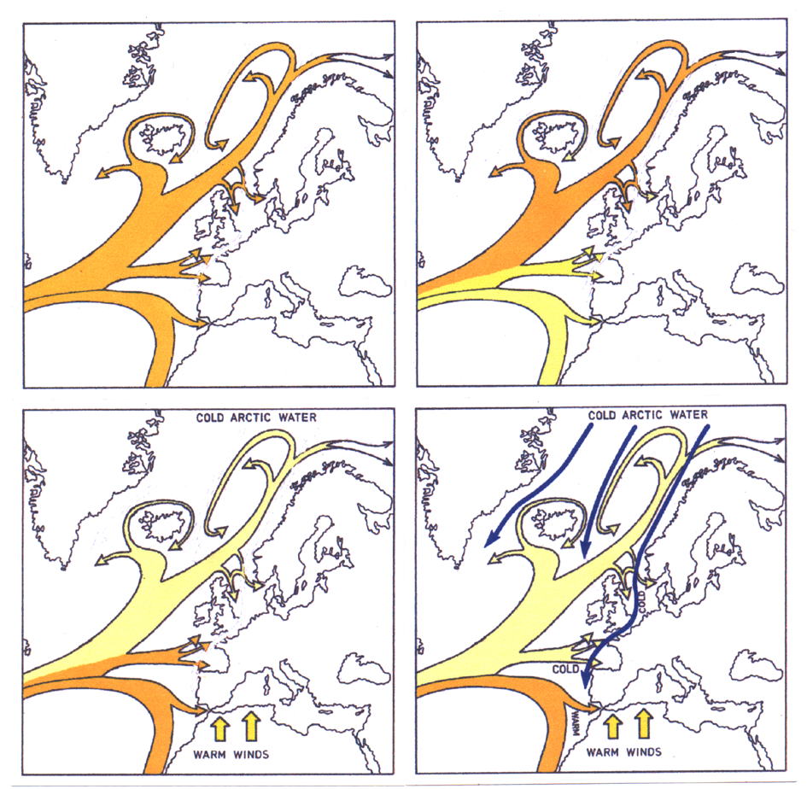
Gulf Stream
and its role in the transfer of rotational potential between the Earth and the Oceans
from upper right to lower right

Slide 4
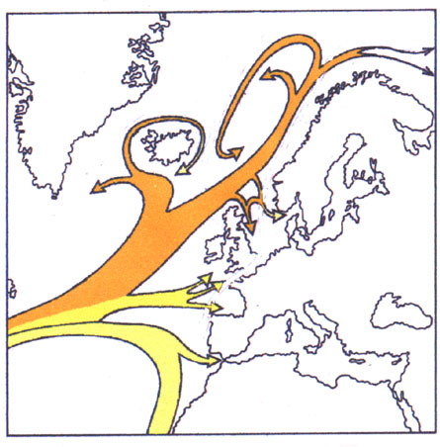
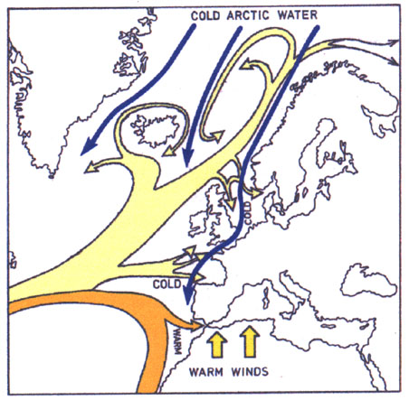
The Gulf Stream
at Solar Maxima (left)
with Earth deceleration
The Gulf Stream
at Solar Minima (right)
with Earth acceleration

Slide 5
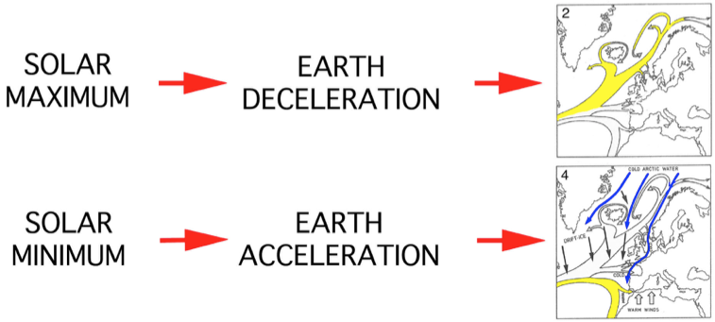
Gulf Stream beat as a function of solar variability and changes in Earth’s rotation

Slide 6
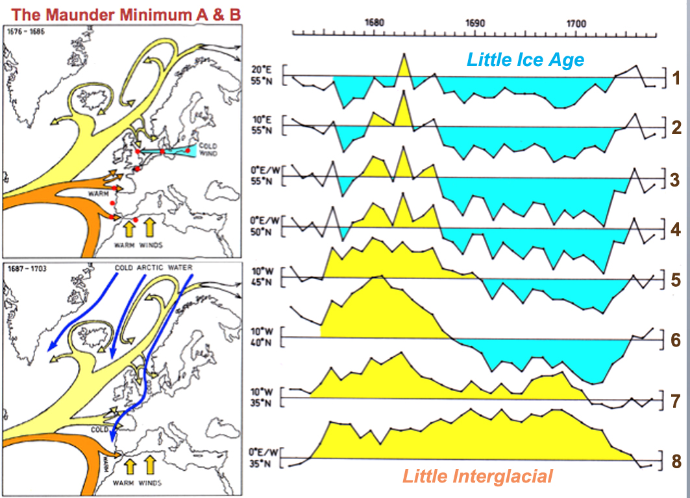

Slide 8
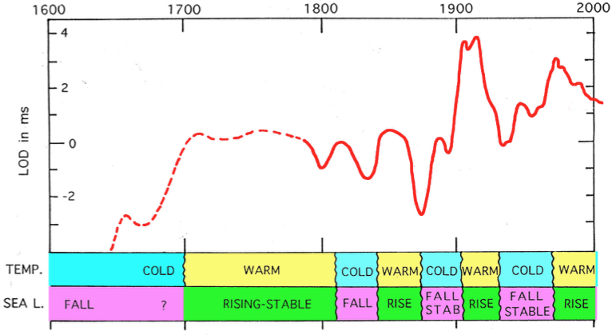
The changes in Earth’s rotation or LOD (down implies acceleration and up deceleration) and corresponding changes in temperature and sea level in the Northwest European region [4]. In southwest Europe, however, the changes in temperature and sea level were rather the opposite.

Slide 9
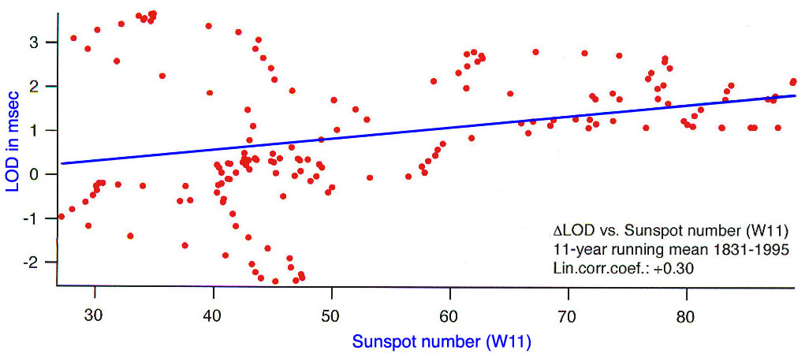
Correlation between variations in Earth’s rate of rotation and Solar activity
During the Spörer, Maunder and Dalton Sunspot Minima
the Earth experienced significant acceleration
due to the Solar Wind effect on Earth’s rotation.
This lead to strong effects in the ocean circulation
generating “Little Ice Ages” in northern and northwestern Europe

Slide 10
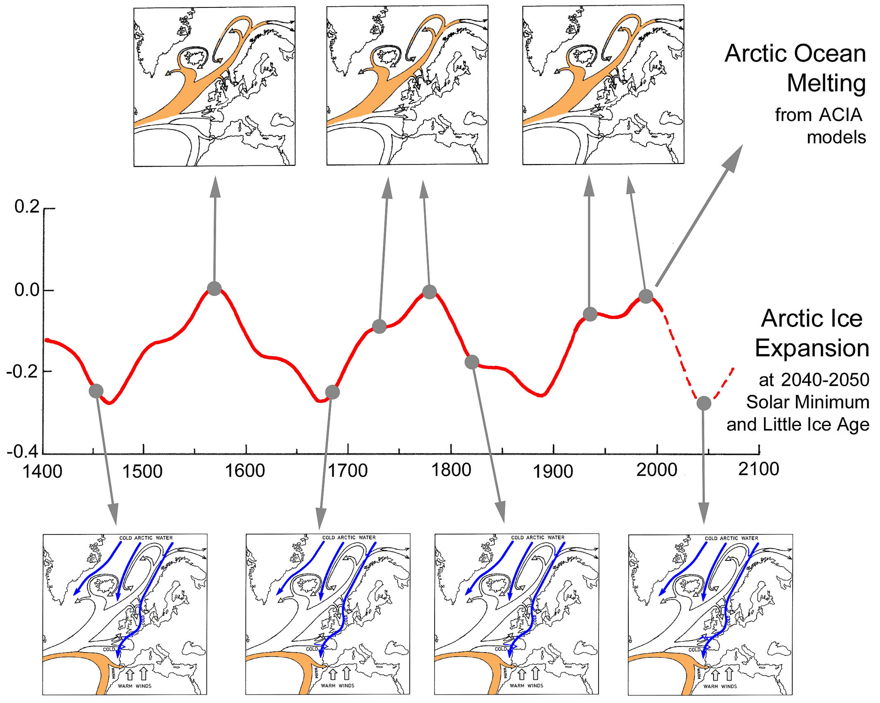

Slide 11
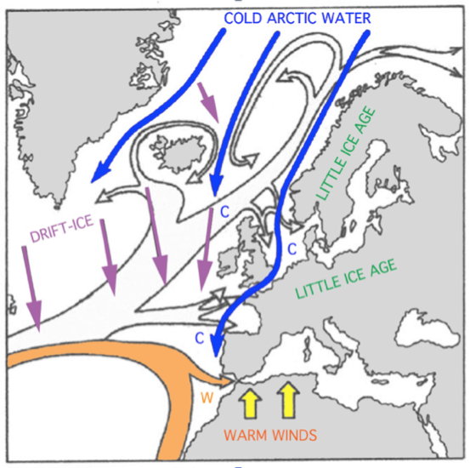
At the Spörer, Maunder and Dalton Grand Solar Minima
cold Arctic water reached all the way down to Lisbon.
This will be repeated at the Next Grand Solar Minimum in 2030-2050.

Slide 12
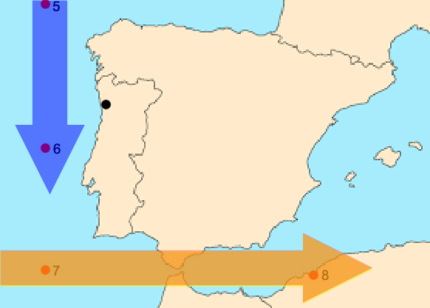
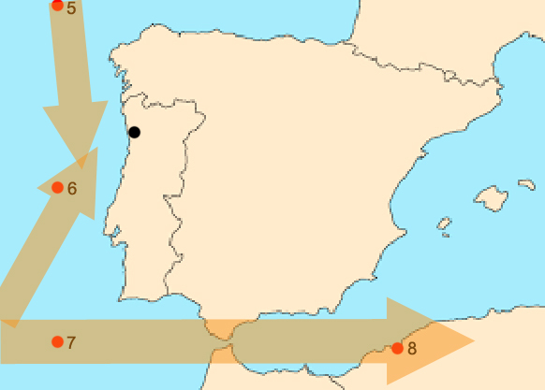
Implications for Portugal:
The Atlantic coasts of the Iberian Peninsula is, of course, strongly affected by the changes ocean circulation because of the changes in the intensity of the 3 branches of the Gulf Stream.
At periods of rotational speeding-up at Grand Solar Minima (and of the 60-years cycles), cold Arctic water penetrates all the way down to the Lisbon area, with Little Ice Age conditions in the north and Little Interglacial conditions in the south.
At normal conditions, the coast is heated by warm equatorial water via the Bay of Biscay branch and via the main Gibraltar branch of the Gulf Stream.
This makes the northern coast of Portugal ideal for integrated studies in changes of climate and sea level.

Slide 13
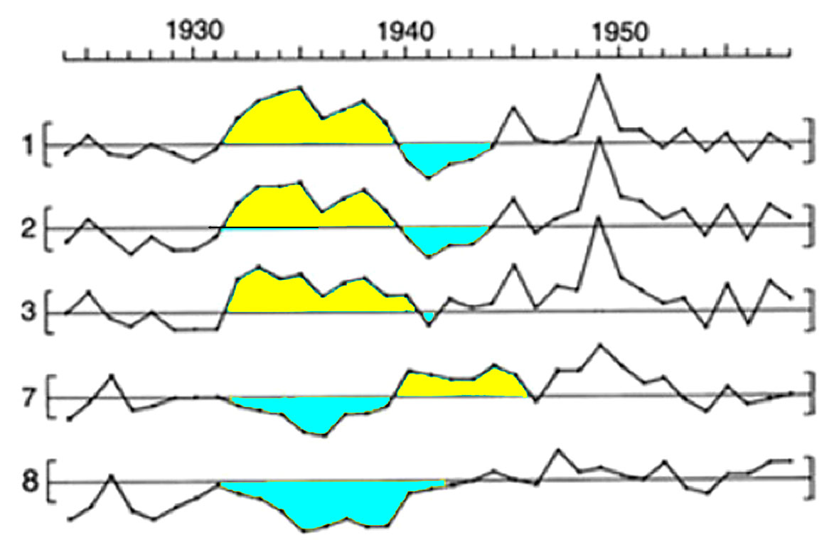
Even on the multi-annual to decadal time scale there is a N–S anti-correlation
Period 1924–1958 with temperature curves from the three northern stations (1-3) and the two southern stations (7-8). The warm peak in 1930-1940 in the north corresponds to cold period in the south. Similarly, the cold war-years in the north correspond to a warm period in the south.
The anti-correlation between the North and the South is striking.

Slide 14
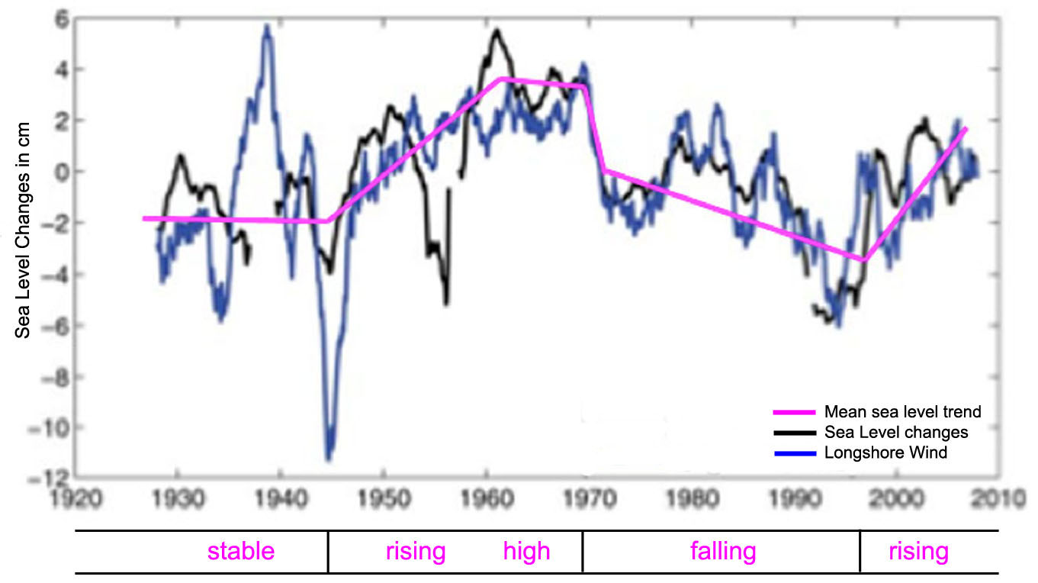
The sea level changes at Tenerife provides an interesting documentation
of the N–S anti-correlations due to the Gulf Stream beat
1945–1970 sea level rising and high (just when climate and sea level are held to be low)
1970–1996 sea level falling (just when climate and sea level are held to be rising rapidly)
This give evidence of ocean circulation dynamics
driven by rotational redistribution of water masses

Slide 15
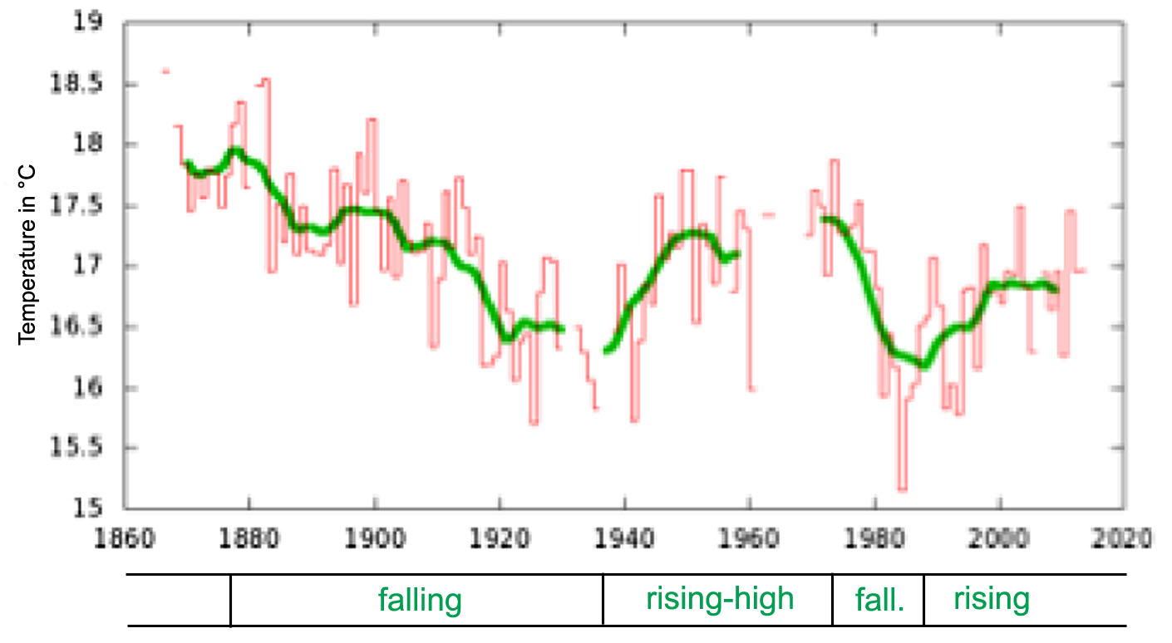
The temperature record from Mallorca provides an interesting documentation
of the N–S anti-correlations in temperature (due to the Gulf Stream beat)
1878–1938 general fall (just when climate is held to rise rapidly)
1938–1972 rising and high (just when climate is held to be falling and low)
1972–1988 falling (just when climate is held to rise rapidly)
1988–2016 rising (just when climate is held to experience a pause)
This give evidence of opposed changes in temperature

Slide 16
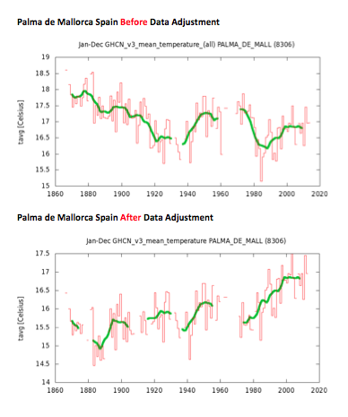
Also in Mallorca
Temperature
is “up-side-down”
compared to
northwest Europa
and the Arctic
So what did the IPCC proponents do?
They handled it
by ”data adjustment”
And by that they
killed the dynamics
of climate change
and ocean circulation

Slide 17
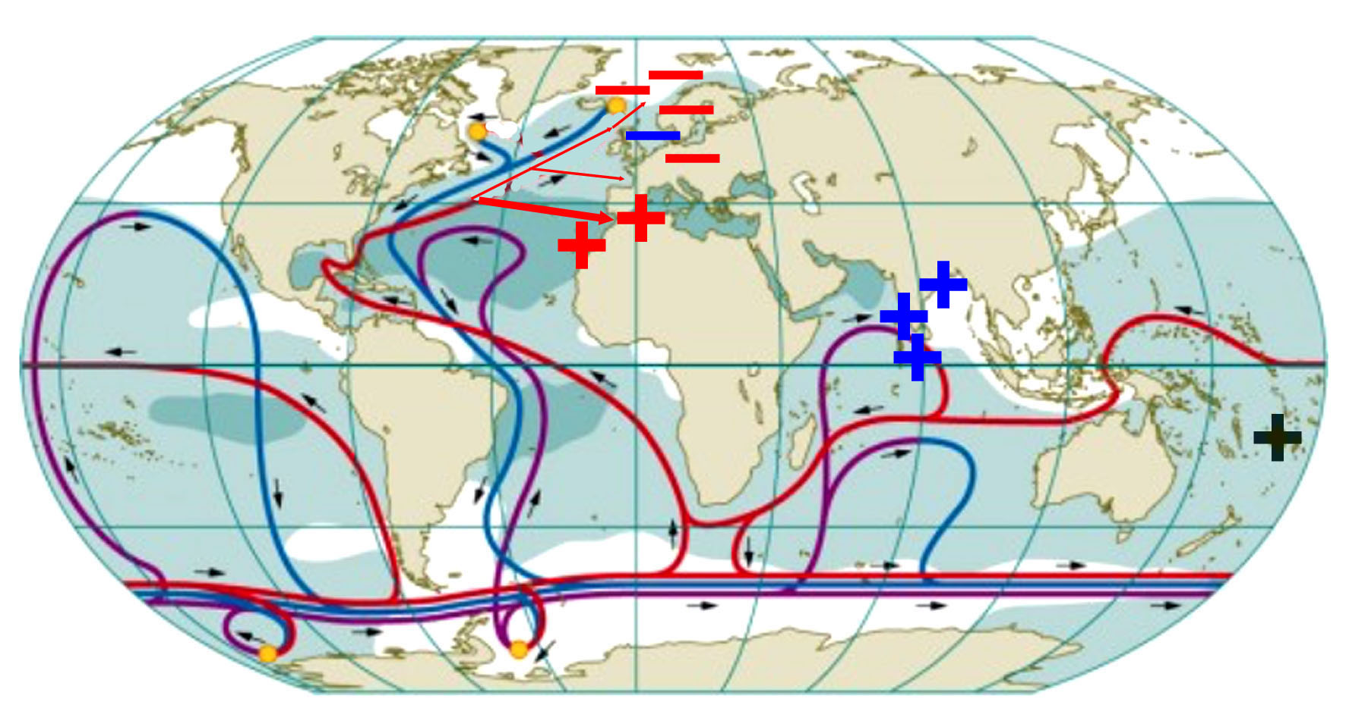
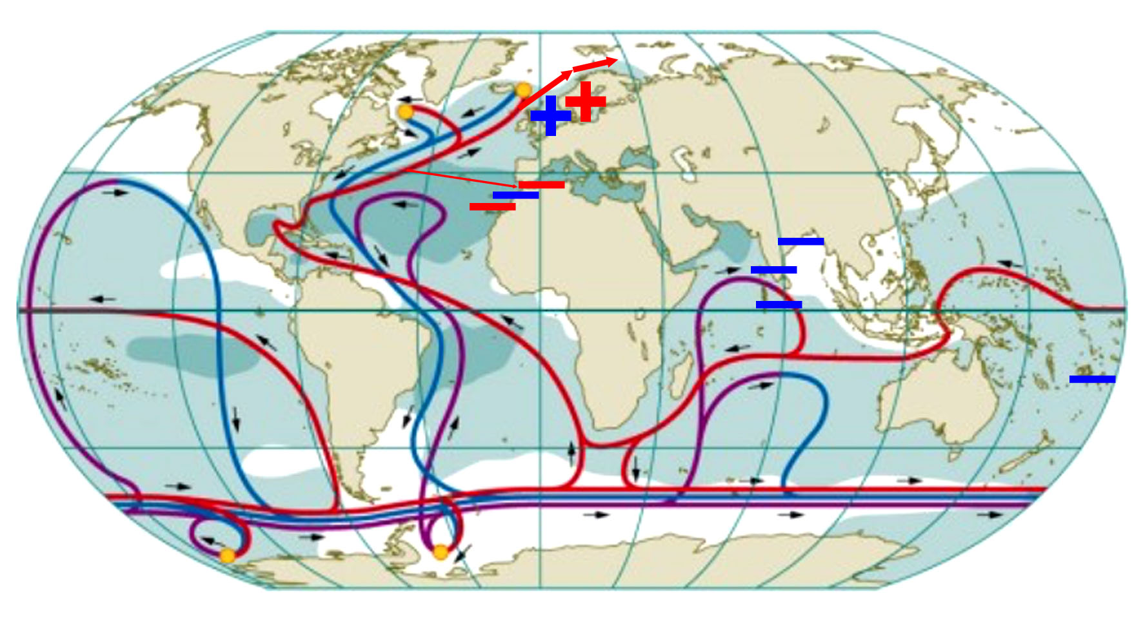
Grand Solar Minima:
Spörer Minimum 1440-1460
Maunder Minimum 1687-1703
Dalton Minimum 1809-1821
minimum 1880-1915
minimum 1940-1970
Next Minimum 20130-2050
Grand Solar Maxima:
Maximum around 970 AD
Medieval Warm Optimum ~1250
Maximum 1390
Maximum Late 1500
Maximum Late 1700
Maximum 1930-1950
Maximum 1970-2000

Slide 18
CONCLUSIONS
The changes in climate and sea level presented by the IPCC and its proponents do not agree with observations.
Ocean water masses are dislocated laterally, which gives sea level changes that differ over the globe. The driving forces are changes in Earth’s rotation as a function of planetary–solar variations. The Gulf Stream beat plays a central role in Europe. It is a part of the thermohaline global “pump”.
This is also true for observed changes in temperature. In Europe, this is primarily caused by changes in the Gulf Stream beat.
When data “do not fit”, there is a reason for this. We call for dynamic differentiation, where the IPCC-group falls to quite subjective “data adjustment”, which we consider a shameful disgrace to science.
All talk about “global mean temperature” and “global mean sea level” becomes misleading.

Slide 19
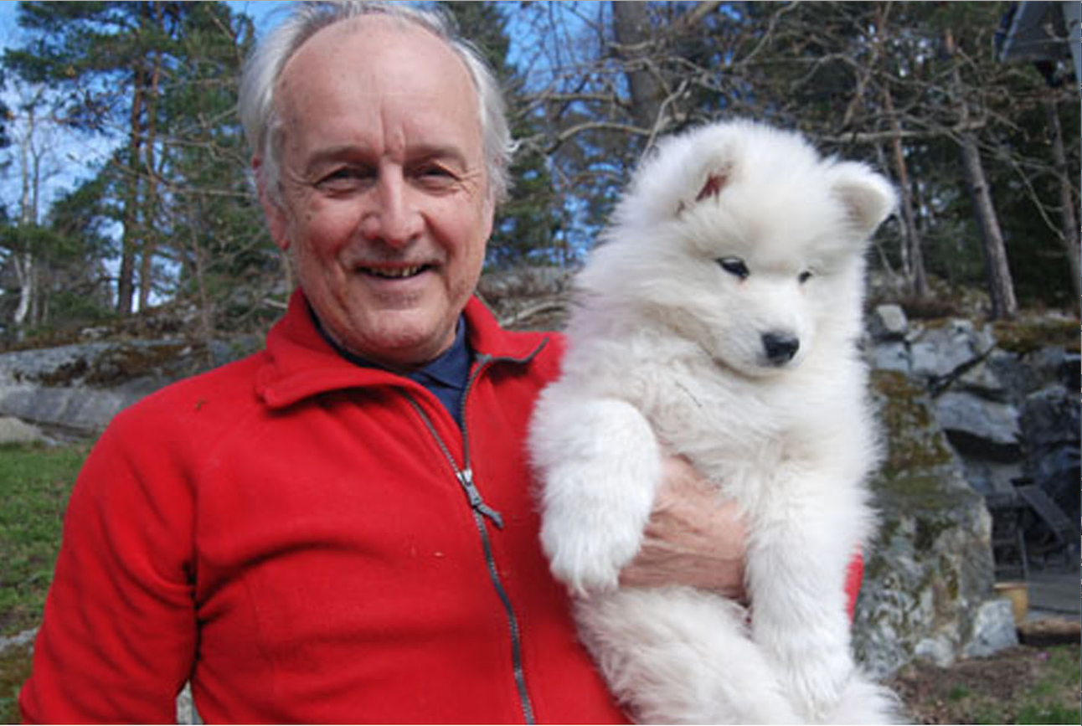
Finished for today – welcome back tomorrow

Slide 22
