Slide 1
Renewable subsidies: destroyers of low cost electricity supplies
Alan Moran, Regulation Economics

Slide 3
Energy Consumption by Source

Slide 5
Global new investment in renewable energy 2004-2017

Slide 6
Renewables share of new investment and of total supply

Slide 7
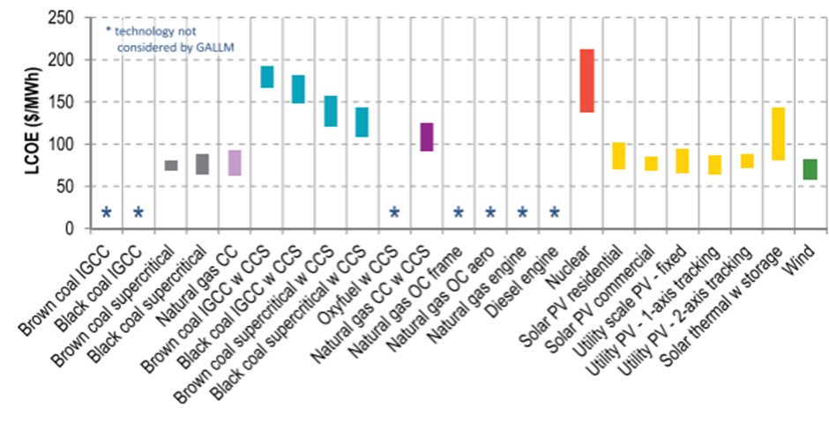
Estimated levelised cost of electricity by source (Australia)

Slide 8
UK £ estimated cost of power sources

Slide 9
US Subsidies by energy source

Slide 11
EU Electricity costs

Slide 12
Australian subsidies for renewables

Slide 13
Australian economic modelling of electricity prices

Slide 15
Household electricity prices 1998

Slide 16
Household electricity prices 2017

Slide 18
UK wind generation May-June 2018

