Slide 1

Eleven facts
you MUST know
to avoid being deceived by
the AGW “science”
camille.veyres@polytechnique.org
Basic Science of a Changing Climate:
How Processes in the Sun, Atmosphere and Ocean Affect Weather and Climate
(facts 1 to 7 on the carbon cycle)
The amount of CO₂ in the air is a consequence of the temperatures d[CO2]/dt = a AT(t) +b
and cannot be their cause
(facts 8 to 11 debunk the greenhouse effect)
The greenhouse effect exists ONLY in VACUUM.
It CANNOT exist on Earth: water vapor is a heat pipe & is opaque in thermal IR
The polytropic T~Pª relation describes the tropospheric temperatures on Earth & on Venus
The AMOUNT of water vapor near 300 mbar controls the global OLR
Frauds and obfuscations are explained
Notes:
Thank you Mr. Chairman
Eleven facts prove that the global warming pseudo-science started in the 1960s has been fabricated to deceive.
*** One: the amount of carbon dioxide in the air is the integral over time of past temperatures; it cannot cause the temperatures. It is a consequence of them
*** Two: The greenhouse effect exists ONLY in VACUUM. It CANNOT exist on Earth because water vapor is a heat pipe between the surface and the top of the troposphere, and because water vapor makes the air very opaque to thermal Infrared radiation; no heat can be carried by radiation across an opaque body.
The polytropic relation, T equals P to the power a, rules the temperatures of the troposphere both on Earth & on Venus.
The AMOUNT of water vapor near 300 millibar controls the global Outgoing Longwave Radiation.

Slide 2
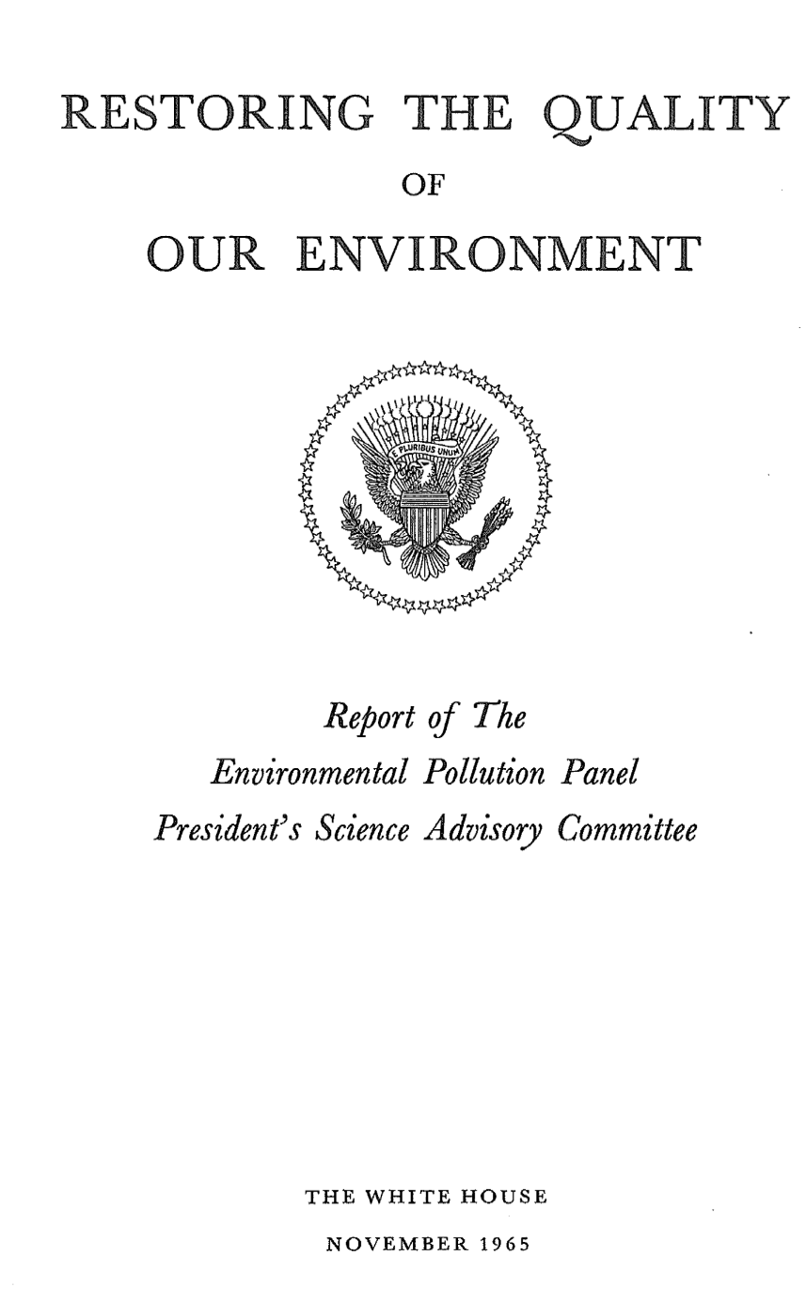
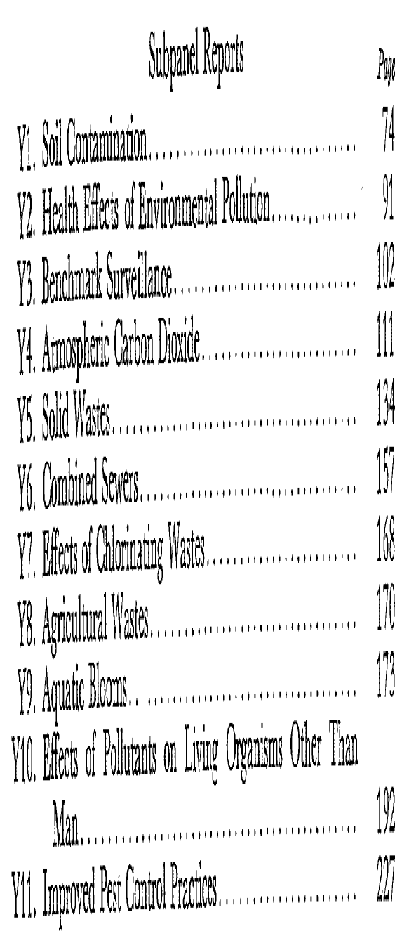


First display of bogus « climate science » designed
to incriminate fossil fuels
November 1965
http://climateandcapitalism.com/wp-content/uploads/sites/2/2014/06/Presidents-Advisory-Report-on-warming-1965.pdf
Claims :
50% of fossil fuel CO₂ remains forever in the air
CO₂… like the glass in a greenhouse raises the temperature of the lower air
Notes:
The first time carbon dioxide was named a pollutant is by Roger Revelle in his 1965 report to the White House.
Al Gore calls Roger Revelle his mentor.
The two claims on the carbon cycle and on the greenhouse effect are still today the twin pillars of the scam.

Slide 3
Cumulative anthropogenic emissions (fuels and cement) since 1751 = 430 Gt-C =
one per cent of the carbon circulating in oceans, soils, vegetation, air
IPCC (figure 6-1, page 471)
(80 + 90) = 850 / 5
ocean absorbs 80 Gt-C/year
vegetation ( 24 hours respiration discounted) absorbs (3/4)123 = 90 Gt-C/year
ocean 39 000 Gt-C
soils 2 000 Gt-C
vegetation 550 Gt-C
air 860 Gt-C (2017)
Reality: 95 + 28 because +31% over the XXth Century
Reality: 3 times more
J. E. Campbell, J. A. Berry, U. Seibt, S. J. Smith, S. A. Montzka, T. Launois, S. Belviso, L. Bopp & M. Laine Large historical growth in global terrestrial gross primary production http://www.nature.com/ +31% over 1900 - 1999
Notes:
Carbon cycle from the last IPCC report: oceans 39000, vegetation and soils 2500, air 860, OK
*** Cumulative fossil fuels emissions are about one percent of the carbon circulating in oceans, air, vegetation and soils; one percent, where is the problem?
*** oceans and vegetation absorb, every year a fifth of the CO2 of the atmosphere. OK!
*** Now two important corrections:
- more CO2 in the air means a larger vegetation and an increased absorption: +31% over the twentieth century!
- the amount of carbon exchanged between deep ocean and surface ocean is under-estimated by a factor three! This fraud is to keep the deep ocean out of the carbon cycle.

Slide 4
In the ocean: Dissolved Inorganic Carbon DIC = CO₂ (1%), HCO₃⁻ (90%), CO₃⁻ ⁻ (9%) with Ca CO₃
Sea water p_{CO2} increases 3,6 times when temperature goes from -1,5°C to 30°C
Dissolved Inorganic Carbon DIC µmole/kg | 2000 | 2100 | 2000 | 2100 | 2000 | 2100
Temperature °C | 0°C | 0°C | 15°C | 15°C | 30°C | 30°C
p_{CO2 sea water} µatm | 129 | 217 | 251 | 419 | 464 | 763
CO₂ aq µmol/kg | 8,1 | 13,7 | 9,4 | 15,7 | 11,6 | 19,2
HCO₃⁻ µmol/kg | 1789 | 1938 | 1775 | 1931 | 1967 | 1921
CO₃⁻⁻ µmol/kg | 211 | 148 | 217 | 154 | 222 | 160
pH | 8,46 | 8,27 | 8,22 | 8,03 | 7,99 | 7,81
Fact 1
400 µatm =
1972 µmole/kg @30°C
&
µmole/kg @0°C
Outgassing: sea water → air ≈ α (p_{CO2 sea water} - p_{CO2 air})
Example : p_{CO2 sea water} = 500; p_{CO2 air} = 400 +1°C → +4% on p_{CO2 sea water}
Outgassing grows by 20% from α (500 – 400) = 100 α to α (500 x1,04 – 400) = 120 α
Frauds and obfuscation: (Bert Bolin, 1960; Roger Revelle, 1965)
(1) Revelle’s relation dp_{CO2} / p_{CO2} = {8 to 12} d DIC/ DIC
[applies in a bottle with sea water and air, NOT globally … unless oceans do not move!]
(2) the surface ocean does NOT exchange carbon with the deep ocean
Notes:
Fact One: the partial pressure of the carbon dioxide in sea water increases by almost four times between the border of the ice pack and the intertropical oceans:
*** outgassing is proportional to the difference of the partial pressures in water and in air; plus one degree in sea water means +4% for the partial pressure and +20% for the sea to air flux.
*** Frauds: To exclude oceans from the carbon cycle two tricks still used today:
First trick: Revelle’s relation between dissolved inorganic carbon and partial pressure; it applies in a closed bottle with sea water and air; it is sheer nonsense at the global scale: oceans move and there is no equilibrium but a constant renewal of the carbon of the surface oceans!
Second trick: a stratified ocean with no carbon exchanged between surface ocean and deep ocean

Slide 5
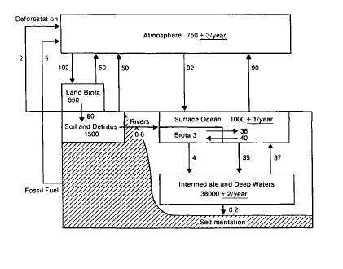
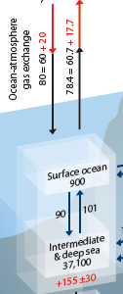
Fact 2: Marina Levy et al. (2013) … climatological physical fluxes of dissolved inorganic carbon (DIC) are two orders of magnitude larger than the other carbon fluxes …
At temperate latitudes, the subduction of DIC and to a much lesser extent (<10%) the sinking of particles maintain CO₂ undersaturation, whereas DIC is obducted back to the surface in the tropical band (75%) and Southern Ocean (25%).
At the global scale, these two large counter-balancing fluxes of DIC amount to +275.5 Gt-C /yr for the supply by obduction and –264.5 Gt-C/ yr for the removal by subduction which is 3 to 5 times larger than previous estimates.“ M. Levy, L. Bopp, P. Karleskind, L. Resplandy, C. Ethe, and F. Pinsard (2013), Physical pathways for carbon transfers between the surface mixed layer and the ocean interior, Global Biogeochem. Cycles, 27, 1001–1012, doi:10.1002/gbc.20092
Fact 2: Gt-C/yr
Surface ocean
265
276
deep sea
Deceptions & frauds: Roger Revelle (1965) and IPCC
IPCC FAR-AR1 1990
IPCC AR5 2013 figure 6-1 page 471
Notes:
Fact 2: the carbon of the surface ocean is renewed continuously
I quote: “at temperate latitudes the subduction of dissolved inorganic carbon and to a lesser extent the sinking particles maintain CO2 under-saturation”, and hence absorption of carbon dioxide from the air.
”In the tropical band and in the Southern Ocean Dissolved Inorganic Carbon is obducted back to the surface.
The 275 gigaton per year supply by obduction and the 265 gigaton per year removal by subduction are 3 to 5 times larger than previous estimates.”
*** Now, incriminating evidence: Revelle says zero between deep and surface oceans,
*** first IPCC report says 35 and 37 gigaton per year, the fifth report says 90 and 101

Slide 6
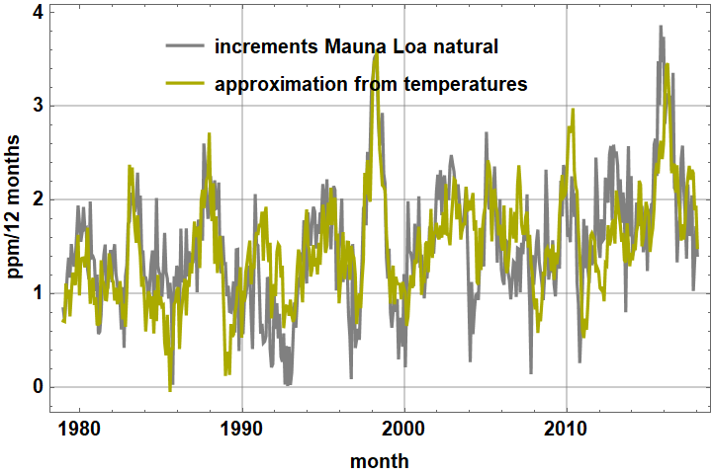
∫_{t0}^{t} df(x)/dx dx = f(t) - f(t₀)
d[CO₂](t)/dt Mauna Loa, natural, for dt=12 months (gray) = 1,7 (AT(t) – (-0,8°C) )
Fact 3
Statistical Unit root tests for time series say that it is the derivative dCO₂ /dt that can be correlated with the intertropical temperature d [CO₂](t) /dt = a AT(t) + b , [CO₂](t) - [CO₂](t₀) = ∫_{t0} ^{t} (a AT(t) + b) dt
Mauna Loa ppm MUST be derived once w.r.t. time to get a weakly stationary process
SARIMAProcess[0.003, {-0.36, -0.19, -0.16, -0.086, 0.005}, 1, {} , {12, {}, 1, {-0.8}},0.10]
+ Dickey Fuller tests
AT(t) from UAH MSU intertropical lower troposphere series is
a weakly stationary ARProcess[0.0028 , {0.89}, 0.022]
The carbon dioxide content of the air is the integral over time of past temperatures. It cannot cause temperatures !
Notes:
Fact 3: The integral over time of the time-derivative of a function f is the function itself
*** in grey the time derivative of the ppm, in yellow-green the temperature anomaly; the derivative of the carbon content of the air is a linear function of the temperatures; the Mauna Loa ppm are the integral over time of past temperatures
*** Statistical tests on time series, called unit root tests, prove mathematically that the Mauna Loa ppm time series MUST be derived once before attempting a correlation with the stationary time series of the temperatures. The carbon content of the air is a consequence of past temperatures. It cannot cause the temperatures!
*** autocorrelation function of emissions in black; autocorrelation of Mauna Loa ppm increments and of temperatures in colors: emissions cannot be related to the increases of the ppm, but temperatures are related,

Slide 7


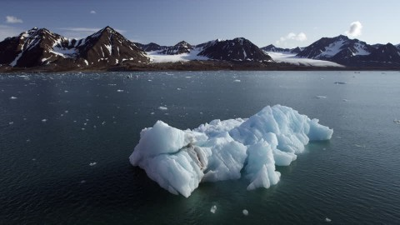
Fact 4
Gt = billion tons = Giga ton 1 ppmv CO₂ in the atmosphere is 2,1 Gt-Carbon
The more CO₂ in the air, the more the plants eat, the more the oceans absorb!
Every year 1/5 th of the CO₂ of the atmosphere is absorbed!
Atmosphere
860 Gt-C
90 Gt-C/yr (*)
Vegetation & soils
2500 Gt-C
(*) respiration over 24 hours discounted as not seen from Mauna Loa
Anthropogenic
CO₂
10 Gt-C/yr
known exactly
400 µatm
400 µatm
80 Gt-C/yr
1/5 = (90 + 80) / 850
Transit time: 1 or 2 years ?
Ocean
39 000 Gt-C
Ions bicarbonate, carbonate & CO₂
A fifth of the atmospheric CO₂ is absorbed every year
change of CO₂ in the air =
input - output
dy/dt = f(t) - y(t)/5
y(t) = 5 f(t) – 5 dy/dt
600 µatm
200 µatm
270 Gt-C/an
270 Gt-C/an
Transit time: 140 years ?
Anthropogenic y_{anth.}(t) = 5 yr x 10 Gt-C/yr – 5 yr x 0,4 Gt-C/yr = 48 Gt-C = 23 ppm or 6%
hence Natural CO₂ from natural outgassing = 812 Gt-C = 383 ppm
Notes:
Fact 4: The oceans at the border of the ice pack with a CO2 partial pressure of 200 micro-atmosphere sucks CO2 from the air at 400
The intertropical ocean at 600 belches out CO2 to the atmosphere at 400
*** One fifth of the carbon dioxide of the air is absorbed every year, hence this elementary linear differential equation that applies separately to anthropogenic emissions and to natural outgassing
*** The fossil fuel time series is known exactly; its contribution is today 23 ppm or 6% of the carbon dioxide of the air. All the rest is from natural outgassing!
*** The transit time inside the deep ocean may be a century. Discussion on the net flux air to ocean of some 2 Giga ton-Carbon per year is a nonsense due to that delay

Slide 8
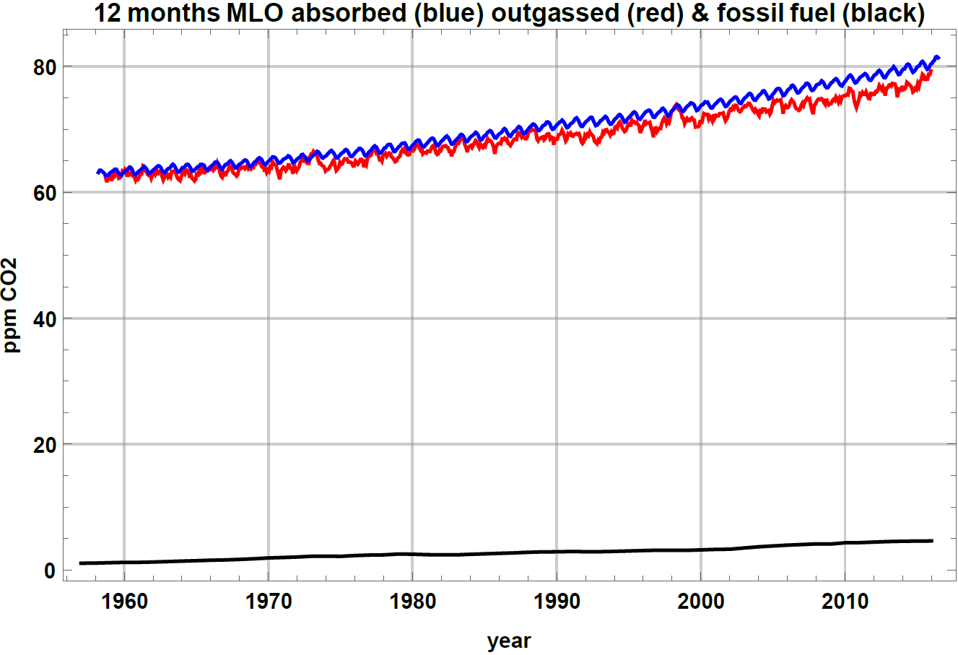
Fact 4
Natural climate cycles → Temperatures → Natural outgassing →
CO₂ in the air → Absorption = 1/5th per year
80 ppm/yr
absorbed natural 57 ppm/yr→ 74 ppm/yr during the XXth century
63 ppm/yr
Outgassed natural
anthropogenic emissions
4,5 ppm/yr
1 ppm/yr
Notes:
Natural climate cycles drive the temperatures that drive the natural outgassing in red that went from 62 to 78 ppm per year and provides 94% of the CO2 of today’s air.
The CO2 of the air drives the yearly absorption which was and is about a fifth of the carbon content of the air.
The sole effect of fossil fuels is that absorption, in blue, is a few years ahead of natural outgassing in red.

Slide 9
Fact 5
ẟ¹³C = 1000 ( (¹³C/¹²C) /0,0112372 – 1 ) proves that:
there is no more than 6% of fossil fuel carbon in the air
(-30 pm) (6%) + (-7.14 pm) (94% ) = (-8.4 pm) observed in 2014
ẟ¹³C of fossil fuels
Observed ẟ¹³C @Mauna Loa & ẟ¹³C of natural outgassing
Deceptions and frauds: IPCC FAR (1990) page 14 of Chapter 1 § 1.2.5: "Evidence that contemporary carbon dioxide increase is anthropogenic....The observed isotopic trends of ¹³C and ¹⁴C agree qualitatively with those expected due to CO₂ emissions from fossil fuels and the biosphere and they are quantitatively consistent with the results from carbon cycle modeling.
IPCC AR4 p 139: “Data presented in Figure 2.3 for the ¹³C/¹²C ratio of atmospheric CO2 at Mauna Loa show a decreasing ratio, consistent with trends in both fossil fuel CO2 emissions and atmospheric CO2 mixing ratios (Andres et al., 2000; Keeling et al., 2005).”
Notes:
Fact 5: delta thirteen C, in per mil is this function of the numbers of atoms carbon 13 and carbon 12
minus 30 times 6% for fossil fuels + minus 7.1 times 94% for natural outgassing is what is observed: measurements are shown by the blue curve
*** Fossil fuels ppm in the air went from 5 ppm in 1960 to 23 ppm
*** the delta13C of fossil fuels reflects the shares of coal, oil and gas
The computed delta13C of the naturally outgassed carbon is the green curve; it is that of the ambient air (blue curve) some sixty years before
*** deceptions from IPCC reports: “agree qualitatively”, “quantitatively consistent“ “is consistent”. Bullshit! delta thirteen C is consistent with 6%!

Slide 10
Deceptions & frauds: impulse response or transfer functions manufactured in the 1980s
A PRIORI assumption: all the change of ppm is from fossil fuels !
Input = fossil fuels & cements ; output = Mauna Loa ppm
ppmCO₂ [t] – ppmCO₂[t₀] = ∫_{t0}^{t} F(t-t’) fossil_fuels(t’) dt’ F(t) with 8 coefficients tuned at will !
Bern & Hamburg & Berne rev. transfer functions and “airborne fraction”
Gone are the 160 Gt-C /year naturally outgassed !
Remaining in the air
A half remains forever in the air
F(t) = 0,5 δ(t) (Revelle 1965, IPCC)
Those Bern & Hamburg functions failed miserably: coal production doubled (2000-2010) while the ppm 12-months change did not increase!
1/e =37%
F(t) = exp(-t/5)
dy(t) / dt + y(t)/5 = f(t)
Years after the impulse of CO₂ into the atmosphere
Life time (at 1/e =1 / 2,718 = 0,37= 37%) : from 90 to 100 years
Notes:
Another Deception: the A PRIORI hypothesis is that all increase of ppm is from fossil fuels! Input: fossil fuels, F transfer function, Output: Mauna Loa ppm.
The temperature driven natural outgassing has disappeared!
A compartment model is a set of linear differential equations solved by Laplace transform; its impulse response F is a weighted sum of exponential time decays; here, eight free parameters are tunable at will
*** The impulse-responses F fabricated in the 1980s, Bern and Hamburg formulas are in black, blue and red. The green line, half a Dirac says that an airborne fraction of half the fossil fuels emissions remains forever in the air. The Bern transfer function has a hundred years decay time
*** All that pseudo-science has been falsified by observations: the doubling of the production of coal between 2000 and 2010, +40% on anthropogenic emissions, had no effect on the time derivative of the Mauna-Loa ppm!

Slide 11
Fact 6
J. E. Campbell, J. A. Berry, … Large historical growth in global terrestrial gross primary production (+31% over 1900-1999) http://www.nature.com/nature/journal/v544/n7648/full/nature22030.htm
Pretzsch, H., Biber, P., Schütze, G., Uhl, E., Rötzer, Th., Forest stand growth dynamics in Central Europe have accelerated since 1870, (2014) Nat. Commun. 5:4967, 552 DOI:10.1038/ncomms5967
Fossil fuels
(- 420)
Atmosphere
860 Gt-C (+ 220)
Vegetation & soils
2500 Gt-C (+ 700)
Ocean
39 000 Gt-C (- 500)
Transit time 140 years?
Both ocean and fossil fuels have, during the XXth century, delivered carbon to the “vegetation & soils” compartment, more than to air, because of the nonlinear effect of vegetation growth with more CO₂ : dy_{veg & soils} /dt = (y_{atm}(t) /10) (y_{veg & soils}(t)/y_{veg & soils}(t₀))^{u} - y_{veg & soils}(t-30)/ 30
E. Eriksson, P. Welander On a mathematical model of the carbon cycle in nature Tellus, 1956, VIII, 2, pp. 155-175
Notes:
Fact 6: The large increase of primary plant production +31% between 1900 and 1999 is confirmed by reports on forest patches of central Europe kept pristine since the nineteenth century
*** during the twentieth century, fossil fuels and oceans almost equally contributed to the+700 Gigaton increase in the vegetation and soil compartment and to the +220 Gigaton in the atmosphere.
*** The transfer of carbon dioxide from deep ocean to vegetation was described in 1956 by Eriksson and Welander as an exercise in nonlinear mathematics; this proves that the transfer of carbon was properly understood a decade before Revelle’s obfuscations and lies

Slide 12
ocean carbon turnover time from subduction to upwelling is possibly a century
(60 m ice) / ( 5 mm/year = precipitation over the central Antarctic) = 10 000 years
Fact 7
The moving-average time smoothing over millennia made by the slow closing of pores between ice crystals in the firn, between surface and a given layer, removes all trace of the oceanic century-long carbon cycles between
middle latitude absorption & subduction
and
intertropical obduction & outgassing
Snow
Firn
final closing of pores
Ice
Deceptive claim: ice cores show that the ppm were always below 300 ppm
Comment: the information that could show significant changes of CO₂ w.r.t. time (e.g. 300 ppm to 400 ppm) has been erased in ice cores!
See Jaworowski 2007 (EIR) and 1997 (21st Century , spring 1997) http://21sci-tech.com/Articles%202007/20_1-2_CO2_Scandal.pdf
E.G. Beck’s critical compilation of historical measurements of CO₂ 1812-1962
Notes:
Fact 7: The ocean carbon turnover time may be one or two centuries.
60 meters of ice divided by Antarctic precipitations of 5 mm per year is ten thousand years.
Putting on the same graph ice core data time averaged over millennia and instantaneous spectroscopic measurements is a fraud.
In a slice of an ice core, different bubbles had different and random closure times of the air paths to the surface, some 80 meters above
The moving-time-average over millennia done by the physics of the closing of the paths between ice crystals removes all and any trace of the oceanic century-long carbon cycles in the deep ocean
*** Hence ice core records always below 300 ppm are an artefact of the physics of the closing of the ice pores in the firn.

Slide 13
Fact 8
The diabatic polytropic relation between temperature and pressure
T(p) / T₀ = (p / p₀)^{R/(Cp - Ch)} models the tropospheric temperature of Earth and of Venus; the lapse rate is g/(C_{p} - C_{h})
g = 9,81 m/s², C_{h} = -509 J/K/kg, C_{p}= 1005 J/K/kg, R = (8,314/molar mass) J/K
(V. A. Bielinski 1948, O. G. Sorokhtin 2005, 2007)
Proof: dH = T dS + V dp ; T dS = d'Q = C_{h} dT = C_{p} dT –R T dp/p dp = - ρ g dz or dp/p = - g/(R T_{v}) dz
T(p) / T₀ = (p / p₀)^{R/(Cp - Ch)} where (p₀, T₀) is some point in the troposphere
Venus: 230 K + 63 km x 8 K/km = 735 K = 230 K (92 atm /0,1 atm)^{0,17} ;
almost 0 insolation on the surface (30 W/m² on the lit face) ; 160 W/m² radiated to the cosmos
Earth: 223 K + 10 km x 6,5 K/km = 288 K = 223 K (1 atm /0,26 atm)^{0,19}
Referred to the dynamic layer of water vapor radiating thermal infrared to cosmos, below the tropopause
Notes:
Fact 8: atmospheric physics
The diabatic, not adiabatic, polytropic relation between pressure and temperature has an exponent R over Cp minus Ch which is .19 on Earth, .17 on Venus
The proof is simple: d prime Q is Ch d T and the barometric relation deliver the polytropic relation between T and P, and the strictly equivalent gravitational lapse rate.
*** Its works well on Venus and on Earth This dispels two nonsenses:
Radiative heat trapping? No! The tropospheric temperature is an effect of the pressure!
A runaway greenhouse effect on Venus? No! It’s a straight consequence of the mass of the air, one thousand tons per square meter

Slide 14
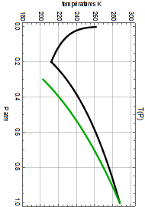
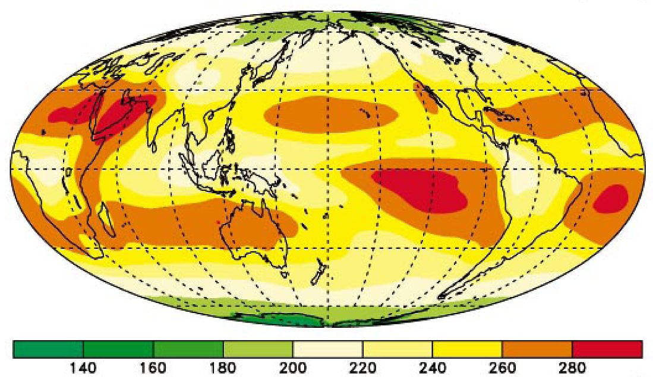
The “cooling” of the troposphere on Earth : H₂O and clouds
Overview
22 W/m²
200 W/m²
max: 18 W/m²
Temperatures K
thermal infrared
from CO₂ & O₃
(50 km)
stratosphere
Solar UV
(12 km)
tropopause
dynamic
troposphere
Solar infrared absorption by water vapor
Troposphere:
Higher & cooler !
Lower & warmer!
“pellicle” of water vapor
condensation
Pressure P(atm)
Evaporation 2,5 MJ /kg
Convection
surface : oceans: 71%
of the globe
(0 km)
Deceptive claims:
Kiehl and Trenberth schemes: thermal IR from the surface is over-estimated by about 10% (some 30 W/m² !)
See: Feldman, Daniel R. et al. Far-infrared surface emissivity and Climate PNAS 2014 vol. 111 nº. 46
Water, water vapor & clouds equalize OLR in the 220 W/m² to 280 W/m² range
Instead of 2 W/m² to 1300 W/m² on the Moon
Notes:
The diabatic curve in black is warmer than the green adiabatic: why ?
*** because water vapor absorbs solar infrared and releases heat by condensation; it radiates some 200 Watt per square meter to the cosmos.
Stratospheric CO2 and ozone are independent.
Due to clouds, surface-to-cosmos flux is measured at 22 Watt per square meter in global average
*** another deception: the thermal infrared emissivity of sea water was revisited four years ago to minus 10% with respect to a black body. Kiehl and Trenberth schemes display a 60 Watt per square meter unbalance between upwelling and downwelling thermal infrared radiation. This is a willful fraud as microwave properties of sea water are known since World War II.

Slide 15
Greenhouse effect: a glass pane on the Moon under a zenithal sun in VACUUM increases surface temperature by 75°C
Fact 9
intersideral vacuum
Intersideral vacuum
100
Glass pane opaque to thermal infrared
Back radiation
100
100
vacuum
100
vacuum
200
100
surface
surface
On the Moon
T_{surface} = 393 K = 120°C
Sun at its zenith (1360 W/m²)
On the Moon
T_{surface} = 393 K 2^{1/4} = 468 K = 195°C
Sun at its zenith (1360 W/m²)
Nota : the flows 100 or 200 are not W/m² but simple numbers to help the understanding of what happens
Notes:
Fact 9: Yes! There exists a greenhouse effect, … but only in vacuum!
On the Moon, a glass pane under zenithal sun would increase the surface temperature by some 75°C.
This trick works only in vacuum and under the sun!

Slide 16
Imaginary Greenhouse effect and real Earth: conceptual frameworks
Fact 9
intersideral vacuum
100
100
H₂O skin radiating
to the cosmos
Glass pane
Air filled with water vapor
OPAQUE
to thermal infrared
100
100
100
100
H₂O an excellent heat-pipe
vacuum
200
200
200
H₂O Evaporation & convection
surface
soils
oceans
A glass pane in vacuum, the wall of a thermos bottle, a good insulator, is by no way a model for a turbulent and water-vapor laden air, which is an excellent
heat-pipe, carrying latent and sensible heat!
No heat transfer by thermal infrared from the surface
as 200 - 200 = 0
No radiative carriage of heat through the air made opaque
by the water vapor
(T surface) / (T radiating pellicle) = ( (P surface)/ (P pellicle) )^{0,19}
Nota : the flows 100 or 200 are not W/m² but simple numbers to help the understanding of what happens
Notes:
Fact 9: A water vapor laden atmosphere is an excellent heat pipe, thanks to evaporation, turbulent convection and condensation.
*** The solar heat is taken away from the surface by this heat pipe, the big blue arrow, and transferred to the skin of water vapor that radiates thermal infrared to the cosmos.
An opaque, I repeat OPAQUE, atmosphere cannot, can NOT, carry heat by infrared thermal radiation.
The heat pipe and the opaque atmosphere make the greenhouse effect disappear completely.
*** The bottom layer of the air absorbs the thermal infrared from the surface and radiates roughly as much thermal infrared to the surface: the net balance, or radiative transfer of heat, is zero between air and surface!
Heating by back-radiation is a nonsense.

Slide 17
The optical thickness τ of the atmosphere is the parameter to use to compute the diffuse radiation in an absorbing and radiating medium like the atmosphere (Chandrasekhar 1948, K. Ya. Kondratiev 1969)
Fact 10
Water vapor makes the air very, very opaque to thermal infrared
τ | transmission
1,07 | 20%
4,3 | 0,0016
10 | 7 10⁻⁶
τ =10
80% of the thermal radiation from a body is produced in its skin or “pellicle” of optical thickness τ = 1,07
f_{down} (ν, z) = π ∫₀^{τ(ν,z)} B(ν, T(t')) 2 E₂(τ(ν, z) - t') dt' f_{up}(ν, z) = π ∫_{τ(ν,z)}^{τmax} B(ν, T(t')) 2 E₂(t' - τ(ν, z)) dt'
f_{surface} (ν, z) = π B(ν, T_{surface} ) 2 E₃(t_{max} – τ(ν, z)) B Planck’s function, E₂ and E₃ exponential integral functions
Notes:
Fact 10: The Optical thickness of a body is minus the logarithm of the transmission of light across that body.
To compute thermal radiation, one must use the optical thickness: the simple formulas at the bottom of the slide are in the books of Chandrasekhar 1948 and of Kondratiev
*** A pellicle or skin of optical thickness 1.07 transmits 20% and absorbs 80% of the incoming thermal infrared; hence it produces about 80% of the thermal infrared radiated by the body.
*** The optical thickness of the air, in blue for the average water vapor of 25 kilograms per square meter is in the tens and hundreds. CO2 is that little red spike; it radiates from the stratosphere wherever its optical thickness is more than six. The horizontal dashed line slightly above zero marks a thickness of ten and a transmission of seven millionths.
The water vapor window from 27 to 39 Tera Hz may be closed by clouds.

Slide 18
CO₂
O₃
stratosphere
troposphere
mK/day /cm⁻¹
http://airs.jpl.nasa.gov/Science/ResearcherResources/MeetingArchives/TeamMeeting20060307/2006_03_07/Gettelman_airs_climate.pdf
Notes:
This is a line by line computation of the cooling of the air by thermal infrared radiation lost to the cosmos. Cooling is about 2°C per day in the troposphere

Slide 19
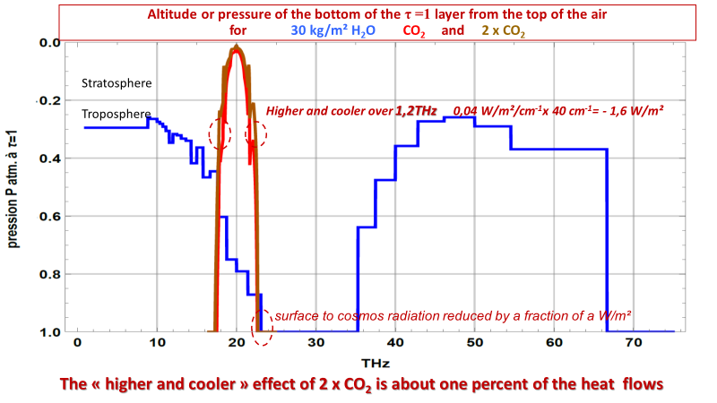
Fact 10
Level of τ=1,07 computed with τ(P)_{H2O}=P^{4,5} τ(1)_{H2Omax} τ(P)_{CO2}=P^{1,45} τ(1)_{CO2max}
Water vapor content of the air near 300 mbar is dynamic and controls OLR
Higher and colder with more CO2 over 1.2 THz : OK
IPCC insists that ONLY a warmer 300 mbar layer will restore the OLR
This is a sleight of hand , a deception !
Slightly less water vapor between 200 mbar and 400 mbar restores OLR because water vapor radiates over 40 THz from a lower and warmer layer
The worst deception ever seen!
Notes:
Same picture simplified
The lower limit of the radiating skin is in blue for water vapor, in red for today’s CO2, in brown for doubled CO2.
CO2 radiates from the stratosphere except near 18 Tera Hertz and near 22 Tera Hertz. Doubling CO2 shifts the radiating skin from red to brown, to a “higher and colder” place near the tropopause : that reduces the OLR by some 2 Watt per square meter.
The blue curve shows that between 200 and 400 millibar water vapor radiates over about 40 Tera Hertz, CO2 over 1 Tera Hertz.
*** Now the big and quite efficient deception: IPCC says that the only way to restore OLR is by a warming of the layers below the tropopause; no other option, only warming can do!
*** the alternative option is: Slightly less water vapor near 300 mbar and OLR is restored, because water vapor radiates from a lower and warmer level over 40 THz!
Near 300 millibar it is not the temperature but the water vapor content of the air that controls the OLR

Slide 20
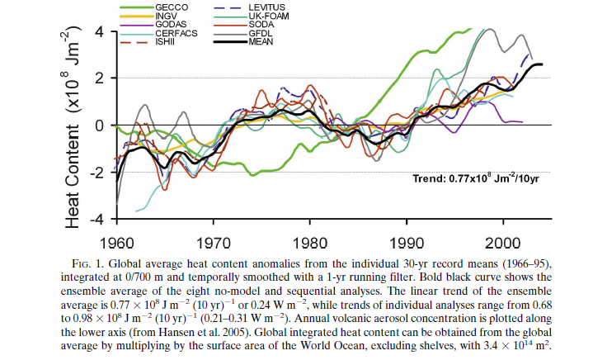
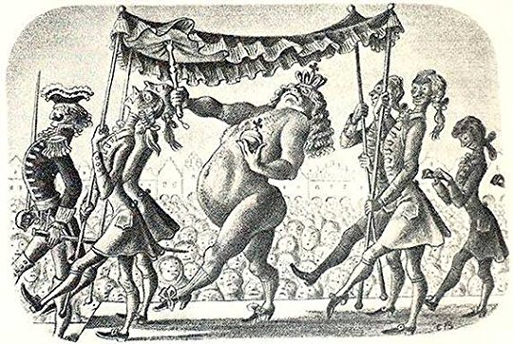

Frauds and deceptions
More CO₂ means less Outgoing Longwave Radiation (OLR) [yes, for the tropospheric CO₂ !]
This reduction of the OLR is a "radiative forcing" per GIEC AR5 WG1 2013 figure 8.1
Deceptive claims: (1) There exist a radiative forcing from more CO₂ : 2,3 W/m² in 2011;
(2) 93% of this radiative forcing ends in the oceans (IPCC); (3) Oceans will be boiling (James Hansen https://www.youtube.com/watch?v=ACHLayfA6_4)
Radiative Forcing from greenhouse gases does not exist! It is a myth!
And a miracle: energy produced from nothing! No chemical or nuclear reaction!
OLR: +1,1 W/m² / decade
Ocean Heat Content
Ocean Heat Content since 1960 0,25 W/m²
Notes:
IPCC claims that increasing CO2 has reduced the Outgoing infrared radiation by two and a half Watt per square meter and that 93% of this heat is gone into the oceans, which, as said by James Hansen, will be boiling.
Check the facts:
*** the OLR has, for the last 40 years, increased by about 1.1 Watt per square meter per decade: is radiative forcing a myth?
*** The ocean heat content increases by zero-point twenty-five Watt per square meter, ten times less than the forcing said by IPCC
*** Radiative forcing is like the new clothes of the Emperor. It is invisible and made from nothing, no chemical reaction, no nuclear reaction, only by the mind of some quacks.
And there is a second MIRACLE: according to IPCC, that heat descends from the cold upper troposphere down to the much warmer surface!

Slide 21
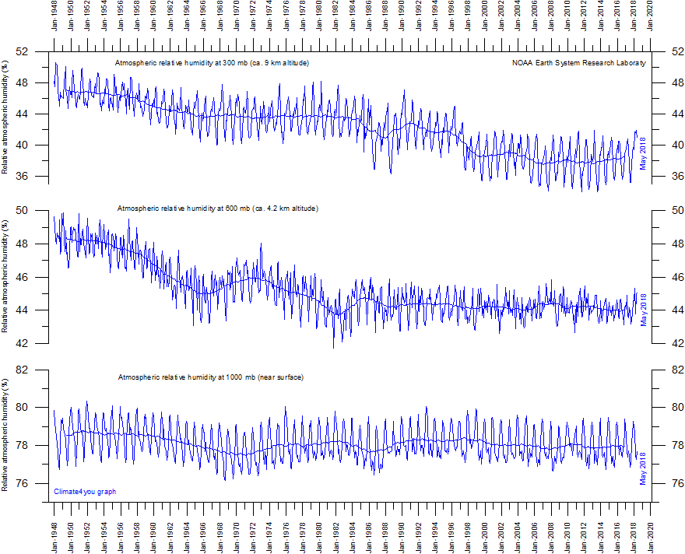
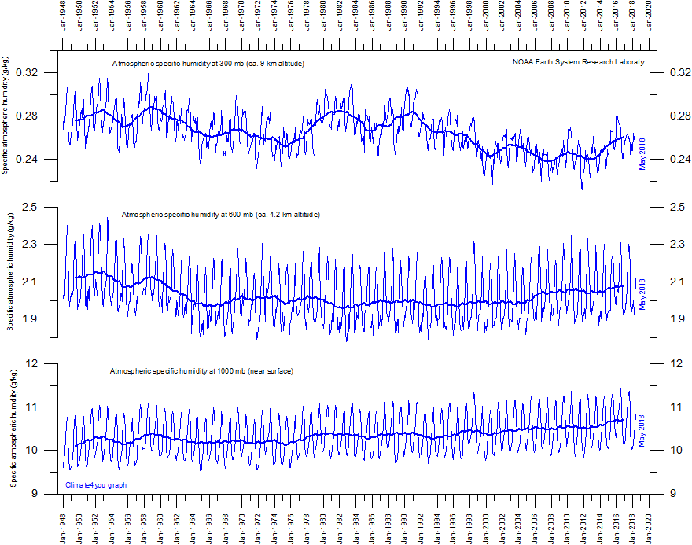
The water vapor content of the air of the upper troposphere controls the OLR and the surface temperatures.
Fact 11
OLR is controlled here
at 300 mbar
300 grams/ton
10 kg /ton
Relative humidity: percent of saturated content @T(P)
Specific humidity: kg/ton of air (kg/100 mbar)
Notes:
Fact 11 : Water vapor profiles since 1948. Measurements are, for the last 40 years, reliable. The relative humidity in percent, has been declining in both the middle and the upper troposphere:
hence the tales of positive water vapor feedbacks with constant relative humidity are willful deceptions.
*** Here is the water vapor content per ton of air : 10 kilograms near the surface, 300 grams at 300 millibar and 9 kilometers. The specific humidity at 9 kilometers has decreased between 1980 and 2010.
*** the radiation of water vapor from a lower and warmer layer may explain the observed increasing OLR reminded in the top right corner

Slide 22
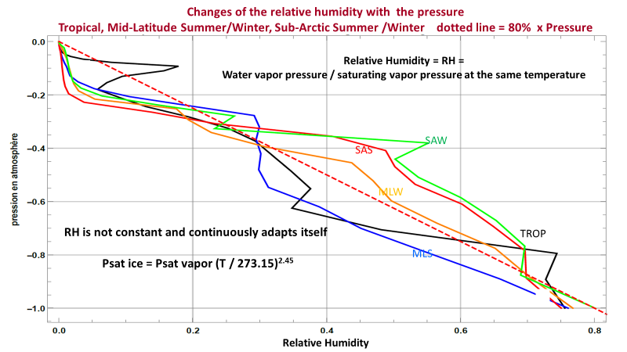
The water vapor content of the air of the upper troposphere controls the OLR and the surface temperatures.
This upper troposphere water content is a consequence of the vertical and horizontal motions of the air.
It might be -someday- computed from a "Maximum Entropy Production Principle"
Richard Lindzen, Stefan Buehler, Garth Paltridge.
Fact 11
OLR is controlled here
http://eodg.atm.ox.ac.uk/RFM/atm/saw.atm and likes
Notes:
Relative humidity on the horizontal axis, pressure on the vertical axis
Five standard relative humidity profiles from tropics in black to subarctic winter in green:
between 400 millibar and 200 millibar, the relative humidity is between 20% and 50%; the controller of the OLR is the freely floating water vapor content near the tropopause.

Slide 23
Please, focus on the two major deceptions and frauds used continuously since Roger Revelle’s 1965 report: “Anthropogenic CO₂ accumulates in the atmosphere”, “Greenhouse effect traps heat, etc.”
Main facts:
1- Only 6% of the CO₂ of the air is, in 2018, from fossil fuels due to the 5 years lifetime of CO₂ in the air; the carbon of the high latitude surface oceans is subducted, every year, into the deep ocean, that of the intertropical ocean is obducted by upwelling from the deep ocean and renewed every year! 94% is the time integral of past temperatures !
2- The air is very OPAQUE (optical thickness in the 10s and 100s) to thermal infrared; surface releases solar heat by evaporation and convection.
3- There is both on Earth and on Venus a temperature-pressure relation (on Earth, C_{h} related to water vapor) which determines the surface temperature; the dynamic water vapor “top of the troposphere skin” radiates almost all of the “troposphere & surface thermal infrared lost to the cosmos”.
4- The quantity of water vapor per ton of air near 300 mbar (about 300 grams) dynamically controls and regulates Earth’s OLR (Outgoing Longwave Radiation).
Notes:
Conclusion: One: only 6% of the carbon dioxide in the air is from fossil fuels! The tales on a surface ocean isolated from deep ocean have been debunked. The Bern impulse responses and the so called “airborne fraction” have been falsified by the Chinese coal surge. 94% of the carbon dioxide in the air is the time integral of past temperatures; it is a consequence of the temperatures
Two: water vapor makes the air very opaque. Surface cools mostly by evaporation and convection.
Three: The polytropic temperature versus pressure relation rules the troposphere with Ch related to water vapor
Four: The quantity of water vapor per ton of air near 300 mbar , about 300 grams, dynamically controls and regulates Earth’s thermal emission, lower and warmer or higher and colder; it wipes out in hours, any radiative effect of more or less carbon dioxide in the air.
You may have been duped into believing nonsenses. I hope those eleven facts will help restore sanity.
Thank you!

Slide 25
Mauna Loa approximation = 1.78 intertropical temp - 0,166 southern ocean temp + 1.424
South pole approximation = 0.85 intertropical temp + 1.088 southern ocean temp + 1.416

Slide 26
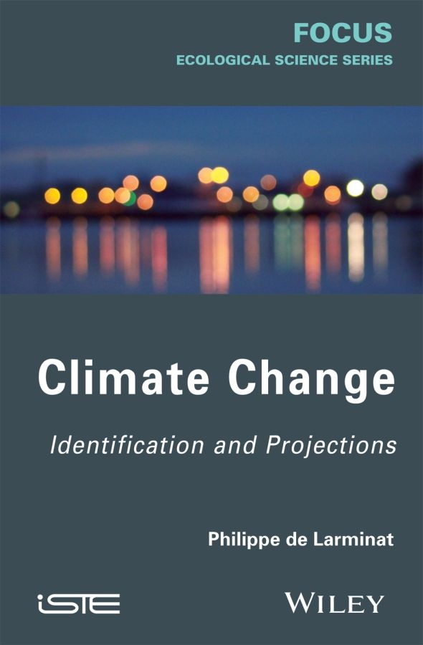
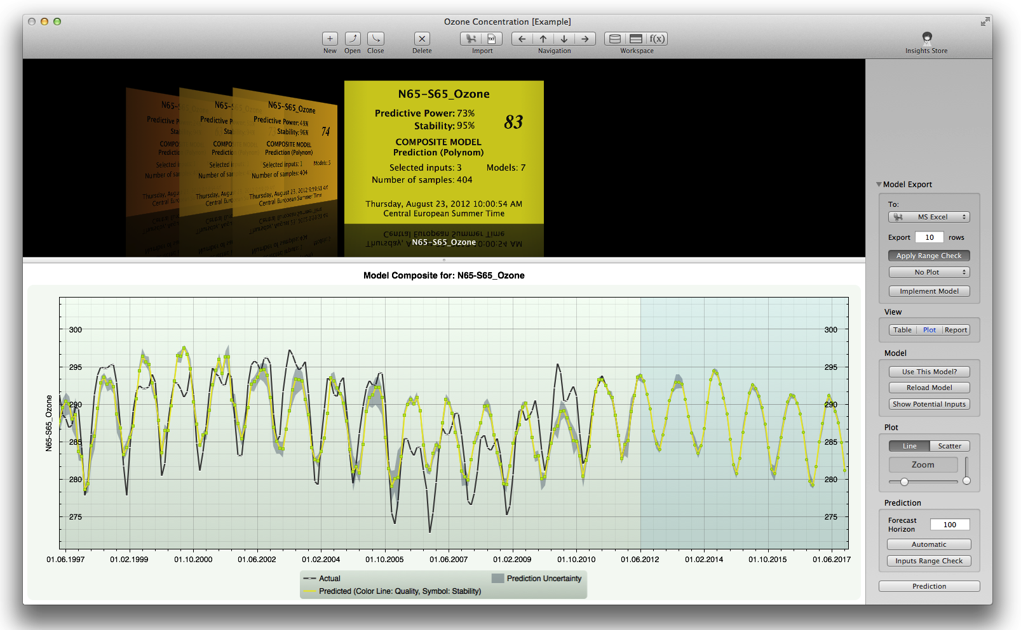
Fact 12
The correct identification framework as practiced in engineering, control & automation
Deceptive claims: (4) water vapor feedback (5) attribution studies with “models”
IPCC
linear G₀
Prof. de Larminat’s TOA radiative balance model
Knowledgeminer.eu

Slide 27
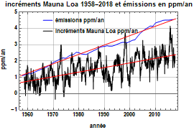
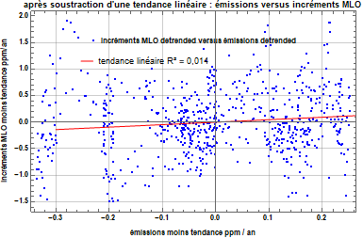

Slide 31
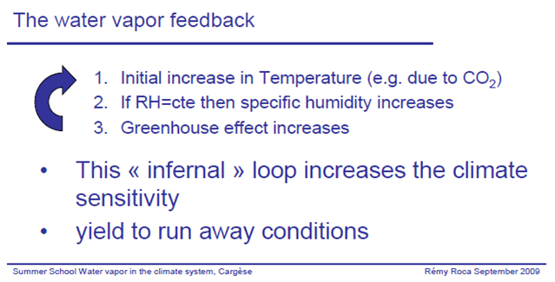

Slide 32
Absorption coefficients calculated using a line-by-line radiative transfer model (Francis and Edwards, 2007) with the HITRAN2004 spectral database for water vapour (black curve) and carbon dioxide (red curve) as function of wavenumber/wavelength.

Slide 33
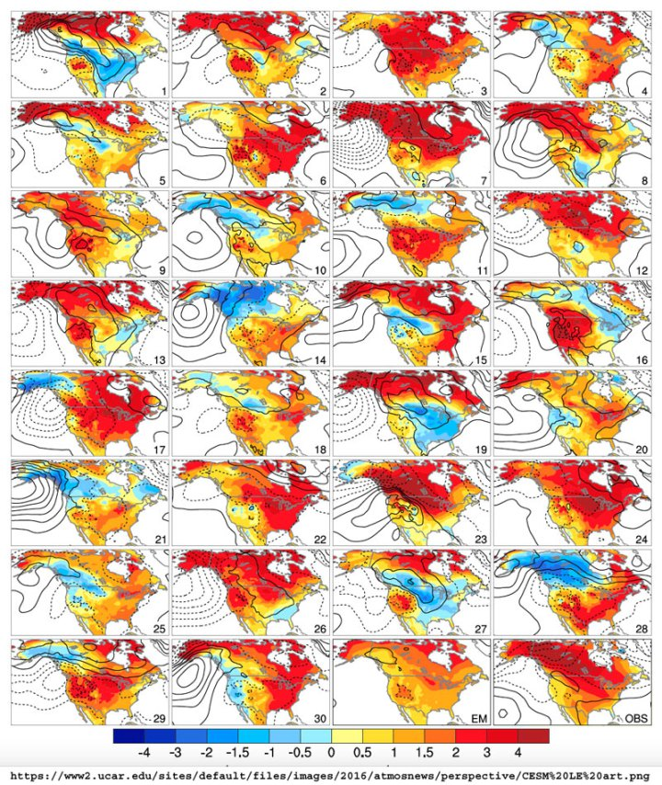

30 essais avec une différence d’un milliardième de degré sur les températures initiales = effet Lorenz
Winter temperature trends (in degrees Celsius) for North America between 1963 and 2012 for each of 30 members of the CESM Large Ensemble.
The variations in warming and cooling in the 30 members illustrate the far-reaching effects of natural variability [???] superimposed on human-induced climate change.
The ensemble mean (EM; bottom, second image from right) averages out the natural variability, leaving only the warming trend attributed to human-caused climate change.
The image at bottom right (OBS) shows actual observations from the same time period. By comparing the ensemble mean to the observations, the science [??] team was able to parse how much of the warming over North America was due to natural variability and how much was due to human-caused climate change.
Read the full study in the American Meteorological Society’s Journal of Climate. (© 2016 AMS.)”

Slide 34
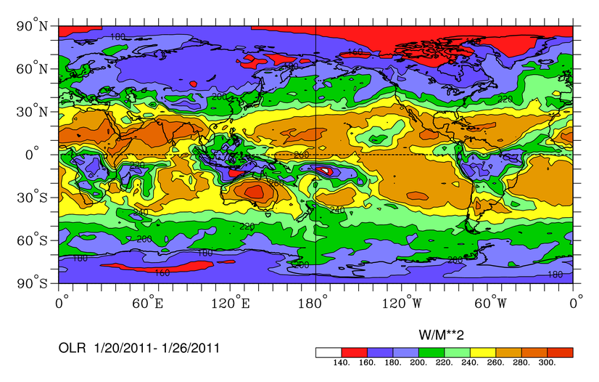
Répartition des émissions infrarouge thermique du globe en moyenne du 20 au 26 janvier 2011
http://www.esrl.noaa.gov/psd/map/images/olr/olr.png
Teneur de l’air en vapeur d’eau
1 g/cm² = 10 kg/m²
Ce qui repart
Les « moyennes » des « climatologues » sur l’année ou le trimestre ou sur tout le globe dissimulent les mécanismes réellement à l’œuvre

Slide 35
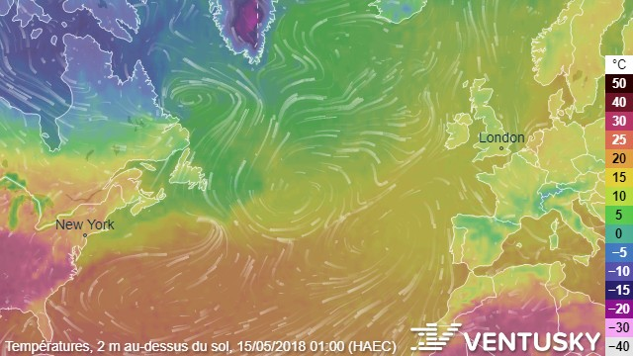
https://www.ventusky.com/?p=48;62;2&l=temperature-2m&t=20180514/23
https://youtu.be/T4LVXCCmIKA
https://www.iceagenow.info/page/2/

